Slide 1
Follow Up on AMP Link Budgets
Date: 2024-01-15
Authors:
Name | Affiliations | Address | Phone | Email
Wei Lin | Huawei | Huawei, Shenzhen, China |  | lin.linwei@huawei.com
Lei Huang |  | Huawei, Singapore
Bin Qian |  | Huawei, Shenzhen, China
Zhi Mao |  | Huawei, Shenzhen, China
Ying Li |  | Huawei, Shenzhen, China
Rojan Chitrakar |  | Huawei, Singapore
Shuqiao Chen |  | Huawei, Singapore
David Xun Yang |  | Huawei, Shenzhen, China

Slide 2

Recap of AMP Link Budget Computations [1] [2]
The consideration of link budget computations were extensively discussed in [1] [2] [3]
  AMP-only device are assumed since AMP-assisted IoT device has similar coverage as the current Wi-Fi device
In [1], three types of backscatter AMP IoT devices and one type of AMP IoT devices with active transmitters are assumed:
  Case 1: AMP IoT devices without power storage → IoT Rx activation threshold of -20dBm
  Case 2: AMP IoT devices with power storage → IoT Rx activation threshold of -30dBm
  Case 3: AMP IoT devices with power storage (Tx LNA Supported) → IoT Rx activation threshold of -45dBm
  Case 4: AMP IoT devices with active transmitters → IoT Rx activation threshold of -45dBm
In [2], a category of close-range (~10cm) AMP backscattering use case is proposed for 2.4GHz
  AMP tag activation power: -20dBm, and reader dynamic range can be 30~50dB (assume 20dB antenna isolation)
It should be noted that Friis equation is applied in both link budget evaluations [1], [2]

Slide 3

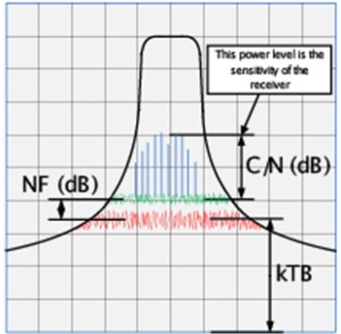
Recap of AMP Link Budget Computations [3]
[3] extended the results of [1] from simple Friis equation to the 11n/ah defined channel models
  According to the defined channel models [2]-[4], shadowing fading shall be considered on either S1G (2~4 dB decreasing) or 2.4GHz (3~5 dB decreasing) channels
  Furthermore, breaking point at 10 meter distance shall be considered [2]-[4]
Assume the sensitivities of the receivers have taken into account kTB, NF, and minimum SNR
Sensitivity = 10xlog10(kTB) + 30 + NF + C/N
  Noise figure: the amount of noise power added by the electronic circuitry in the receiver to the thermal noise power from the input of the receiver.
  kTB: The total thermal noise power is a function of three quantities, 1) Boltzmann’s constant “k” in Joules/˚K, 2) temperature in ˚Kelvin, and 3) the overall bandwidth of the channel selective filtering in the receiver.
https://www.highfrequencyelectronics.com/index.php?option=com_content&view=article&id=553:receiver-sensitivity-and-equivalent-noise-bandwidth&catid=94:2014-06-june-articles&Itemid=189

Slide 4
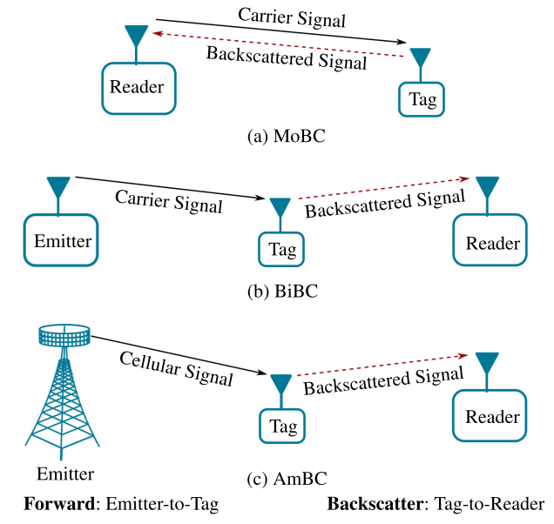
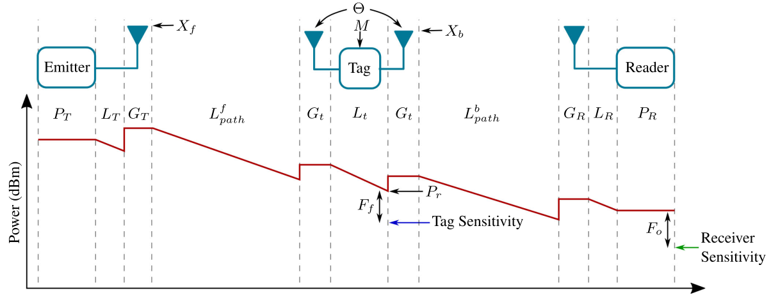
Overview of Backscatter Link Budget Calculation (1/2)
In [7], link budgets of Backscatter IoT were extensively studied, and BackCom systems were categorized into three configurations
-
  (a) MoBC (Monostatic BackCom): a reader and a tag
  (b) BiBC (Bistatic BackCom): a separate dedicated RF emitter and reader
  (c) AmBC (Ambient BackCom): utilize existing ambient RF emitters
L_{T} denotes the total losses in dB at the emitter, i.e., feeder loss, circuit loss (or any other loss)
X_{f} denotes the polarization mismatches of the forward link in dB.
[7] D. Galappaththige, F. Rezaei, C. Tellambura, S. P. Herath, ‘‘Link Budget Analysis for Backscatter-Based Passive IoT,’’ IEEE Access, vol. 10, pp. 128890-128922, 2022.

Slide 5




Overview of Backscatter Link Budget Calculation (2/2)
In [7], link budgets of Backscatter IoT were extensively studied, and BackCom systems were categorized into three configurations
-
  (a) MoBC (Monostatic BackCom): a reader and a tag
  (b) BiBC (Bistatic BackCom): a separate dedicated RF emitter and reader
  (c) AmBC (Ambient BackCom): utilize existing ambient RF emitters
[1] [3]
where P⁰_{tag} and P⁰_{r} are, respectively, the tag activation threshold and the reader sensitivity in dBm.
L_{T} denotes the total losses in dB at the emitter, i.e., feeder loss, circuit loss (or any other loss)
X_{f} denotes the polarization mismatches of the forward link in dB.
Θ represents the on-object penalty gain of the antenna of tag, discounting any loss factors internal to tag circuit
M is the modulation factor in dB, and F₀ denotes the overall fade margin in dB.
[7] D. Galappaththige, F. Rezaei, C. Tellambura, S. P. Herath, ‘‘Link Budget Analysis for Backscatter-Based Passive IoT,’’ IEEE Access, vol. 10, pp. 128890-128922, 2022.

Slide 6
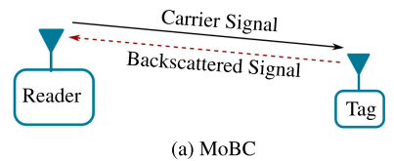
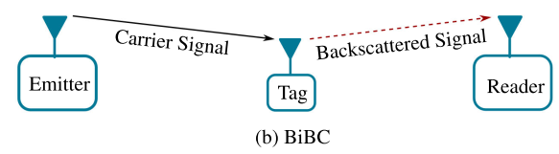
Further Discussion on Link Budgets of AMP Devices
Based on the discussion, to accurately calculate the link budgets of AMP devices, types or configurations of AMP devices should be clarified
  Type A: AMP-assisted IoT devices has similar capability as current Wi-Fi devices → Similar Coverage
  Type B: AMP IoT devices with active transmitters → power & signal transmitting coverages are de-coupled
  Type C: Backscatter AMP IoT devices with configuration MoBC and BiBC
Downlink link budget computations of Type-B and Type C-1 / C-2 are similar
For uplink link budget computations, the above mentioned three types are different
  Type B: AMP IoT devices with active transmitters → Tx LNA Supported
  Type C (MoBC): DL & UL coverages are coupled, Tag shall be activated in the first place, and reader shall have enough dynamic range (Tx and Rx signal isolation, 30~50dB in [2]) to operate transmitting and receiving simultaneously
  Type C (BiBC): DL & UL coverages are de-coupled, no full duplex operation required at the reader
[7] D. Galappaththige, F. Rezaei, C. Tellambura, S. P. Herath, “Link Budget Analysis for Backscatter-Based Passive IoT,” IEEE Access, vol. 10, pp. 128890-128922, 2022.

Slide 7
Downlink Link Budgets of AMP Devices
Downlink link budget computations of Type B and Type C are similar
  Type B: AMP IoT devices with active transmitters → power & signal transmitting coverages are de-coupled
  Type C: Backscatter AMP IoT devices with configuration MoBC and BiBC
Pr = Pt + Gt + Gr + 20log₁₀(λ) – 20log₁₀(4πd) (with Friis Equation)
 | Type B |  | Type C MoBC / BiBC
Antenna gain of IoT device (dBi) | 2 |  | 2
Minimum receiving power for IoT device (dBm) | -45 |  | -20
Frequency | 2.4 GHz |  | 2.4 GHz
EIRP of AP (dBm) | 27 | 20 | 27 | 20
Max. commun. distance from AP to IoT device (m) (Friis) | 49.85 | 22.27 | 2.80 | 1.25
Max. commun. distance from AP to IoT device (m) (11n Channel D) | 17.8 | 11.32 | 2 | 0.88
Frequency | 920 MHz |  | 920 MHz
EIRP of AP (dBm) | 30 |  | 30
Max. commun. distance from AP to IoT device (m) (Friis) | 183.70 |  | 10.33
Max. commun. distance from AP to IoT device (m) (11ah Channel D Indoor) | 40.2 |  | 8

Slide 8
Uplink Link Budgets of AMP Devices
For uplink link budget computations, the above mentioned three types are different
  Type B: AMP IoT devices with active transmitters → power & signal transmitting coverages are de-coupled
  Type C (BiBC): Backscatter AMP IoT devices with configuration BiBC → consider worst case (Just Activated)
Pr = Pt + Gt + Gr + 20log₁₀(λ) – 20log₁₀(4πd) (with Friis Equation)
 | Type B | Type C (BiBC) (Worst Case)
Antenna gains of IoT device / AP (dBi) | 0 | 0
Receiver sensitivity of AP (dBm) | -95 | -95
Maximum transmission power of IoT device (dBm) | -15 | -20
Backscattering loss at IoT device (dB) | / | 5
Frequency | 2.4 GHz | 2.4 GHz
Max. commun. distance from IoT device to AP (m) (Friis) | 99.47 | 31.45
Max. commun. distance from IoT device to AP (m) (11n Channel D) | 27 | 13.8
Frequency | 920 MHz | 920 MHz
Max. commun. distance from IoT device to AP (m) (Friis) | 259.49 | 82.05
Max. commun. distance from IoT device to AP (m) (11ah Channel D Indoor) | 48.7 | 25.48

Slide 9
Uplink Link Budgets of AMP Devices
For uplink link budget computations, the above mentioned three types are different
  Type C (MoBC): DL & UL coverages are coupled, Tag shall be activated in the first place, and reader shall have enough dynamic range (Tx and Rx signal isolation, 30~50dB in [2]) to operate both transmitting and receiving
  Therefore, the UL coverage of Type C (MoBC) can’t larger than that of maximum DL coverage
  Furthermore, the requirement on Tx and Rx signal isolation at the reader may further limit the UL coverage
    If the EIRP of AP is 30dBm as we assumed before, with 50dB dynamic range (optimistic case) [2], the Rx sensitivity of AP shall be around -20dBm
    If we decrease the Rx sensitivity of AP to better receive the backscatter signal from Tag, the EIRP of AP shall be decreased as well due to limited dynamic range of AP, which reduces the DL coverage.
DL: Pr = Pt + Gt(AP) + Gr(STA) + 20log₁₀(λ) – 20log₁₀(4πd) (with Friis Equation)
UL: Pr = Pt + Gt(AP) + Gr(STA) + Gt(STA) + Gr(AP) + 2 ∙ (20log₁₀(λ) – 20log₁₀(4πd)) (with Friis Equation)
The UL equation of MoBC doesn’t take the tag activation power into account, thus has to be adjusted to consider both tag activation power and AP dynamic range

Slide 10
Uplink Link Budgets of AMP Devices
For uplink link budget computations, the above mentioned three types are different
  Type C (MoBC): DL & UL coverages are coupled, Tag shall be activated in the first place, and reader shall have enough dynamic range (Tx and Rx signal isolation, 30~50dB in [2]) to operate both transmitting and receiving
Adjusted Equations
DL: Pr(STA) = Pt(AP) + Gt(AP) + Gr(STA) + 20log₁₀(λ) – 20log₁₀(4πd) (with Friis Equation)
UL: Pr(AP) = Pt(STA) + Gr(STA) + Gr(AP) + 20log₁₀(λ) – 20log₁₀(4πd) – L_{BC} (with Friis Equation)
D L | Type C (MoBC)
Antenna gains of IoT device / AP (dBi) | 2
Pt(AP) | 0
Maximum transmission power of IoT device (dBm) | -20
Backscattering loss at IoT device (dB) | /
Frequency | 2.4 GHz
Max. DL distance (m) (Friis) | 0.157
Max. DL distance (m) (11n Channel D) | 0.111
Frequency | 920 MHz
Max. DL distance (m) (Friis) | 0.411
Max. DL distance (m) (11ah Channel D Indoor) | 0.324
U L | Type C (MoBC)
Antenna gains of IoT device / AP (dBi) | 2
Receiver sensitivity of AP (dBm) | -50
Pt(STA) (dBm) | -20
Backscattering loss at IoT device (dB) | 6
Frequency | 2.4 GHz
Max. UL distance (m) (Friis) | 0.250
Max. UL distance (m) (11n Channel D) | 0.175
Frequency | 920 MHz
Max. UL distance (m) (Friis) | 0.651
Max. UL distance (m) (11ah Channel D Indoor) | 0.514
DL:
Pt = 0 dBm
Pr(STA) = -20 dBm
Gr = Gt = 2 dBi
UL:
Pr = -50 dBm
Pt(STA) = -20 dBm
L_{BC} = 6 dB
Gt = Gr = 2 dBi

Slide 11
Summary
To accurately calculate the link budgets of AMP devices, types or configurations of AMP devices should be clarified
  Type A: AMP-assisted IoT devices has similar capability as current Wi-Fi devices → Similar Coverage
  Type B: AMP IoT devices with active transmitters → power & signal transmitting coverages are de-coupled
  Type C: Backscatter AMP IoT devices with configuration MoBC and BiBC
It can be observed that, there are significant DL and UL coverage imbalances
  Uplink coverages are larger than downlink coverages for Type-B, Type C devices under BiBC configurations
For Type C devices under MoBC configuration, the UL coverage is at the level of tens of centimeters
  Uplink coverages are smaller than downlink coverages for Type C devices under MoBC configuration mainly due to the limited dynamic range (isolation) of AP/Reader

Slide 12
Thank You

Slide 13
References
[1] IEEE 802.11-23/1562r8, Draft Technical Report on support of AMP IoT devices in WLAN
[2] IEEE 802.11-23/2038r1, Close-range AMP Backscattering in 2.4GHz
[3] IEEE 802.11-23/2013r0, Discussions on AMP Link Budgets
[4] IEEE 802.11-03/940r4, TGn Channel Models
[5] IEEE 802.11-11/0968r3, TGah Channel Model – Proposed Text
[6] IEEE 802.11-15/0425r1, Corrections to TGah Channel Model
[7] D. Galappaththige, F. Rezaei, C. Tellambura, S. P. Herath, ‘‘Link Budget Analysis for Backscatter-Based Passive IoT,’’ IEEE Access, vol. 10, pp. 128890-128922, 2022.

Slide 14
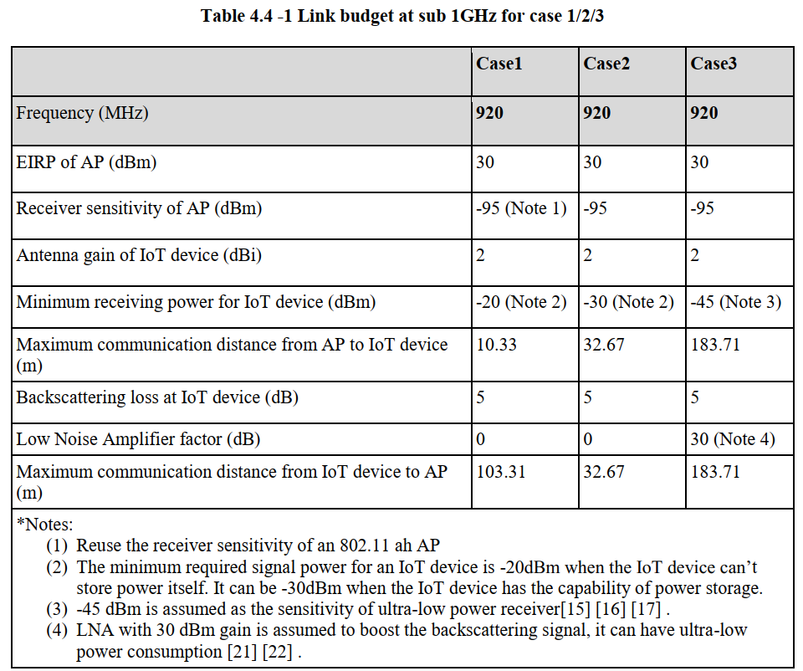
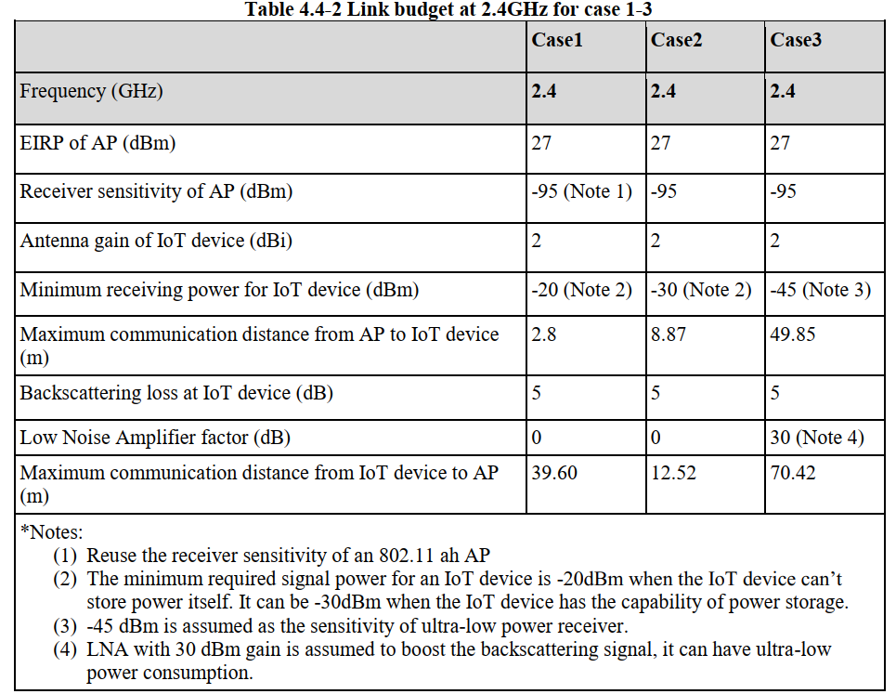
Recap of AMP Link Budget Computations in [1]
The Link Budget Evaluations for Case1/2/3 at both Sub 1 GHz and 2.4GHz → Backscatter Transmitters

Slide 15
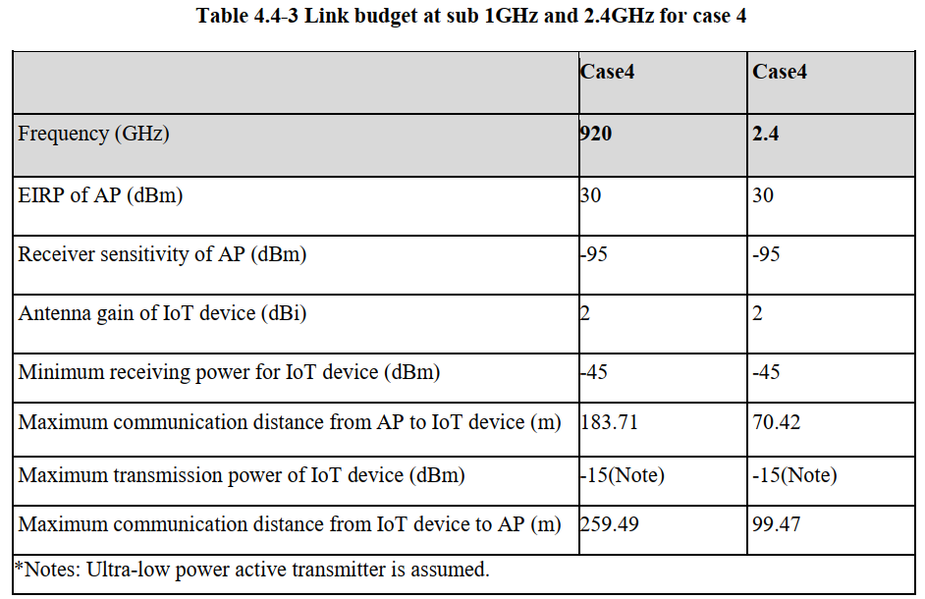
Recap of AMP Link Budget Computations in [1]
The Link Budget Evaluations for Case 4 at both Sub 1 GHz and 2.4GHz → Active Transmitters

Slide 16
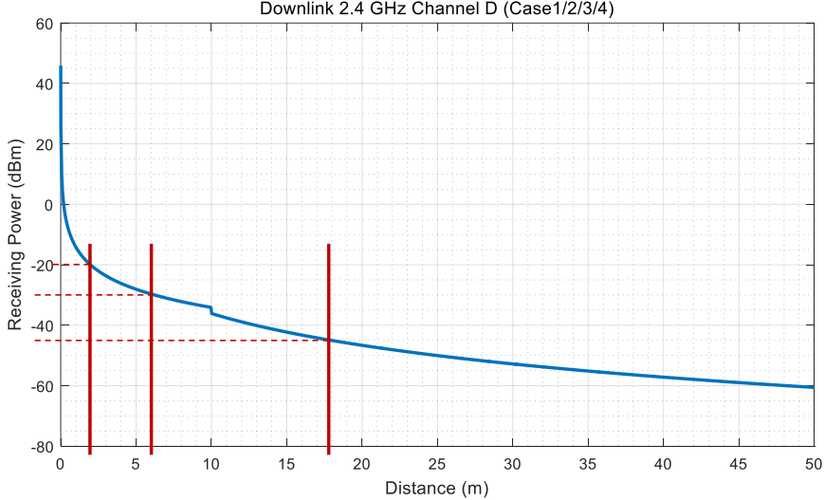
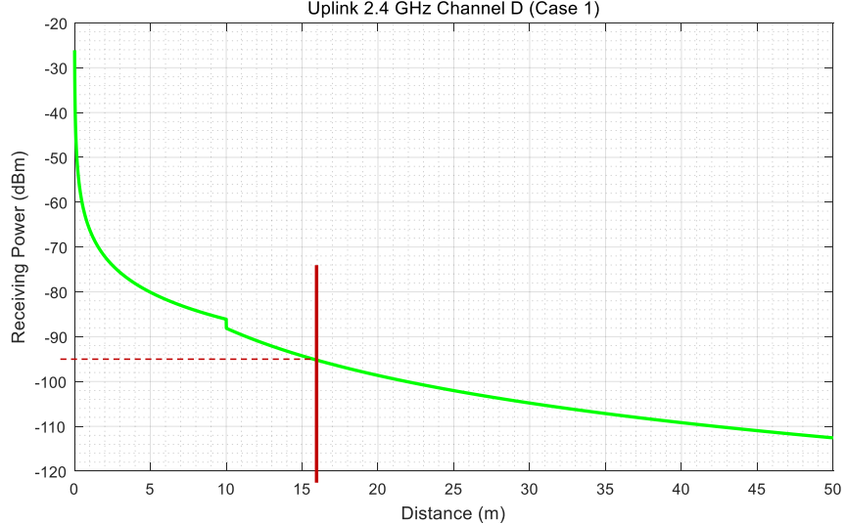
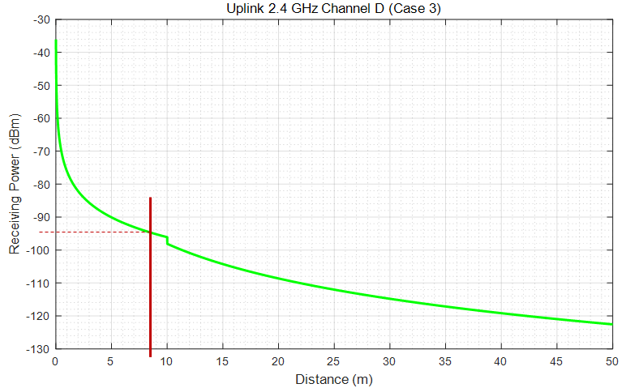
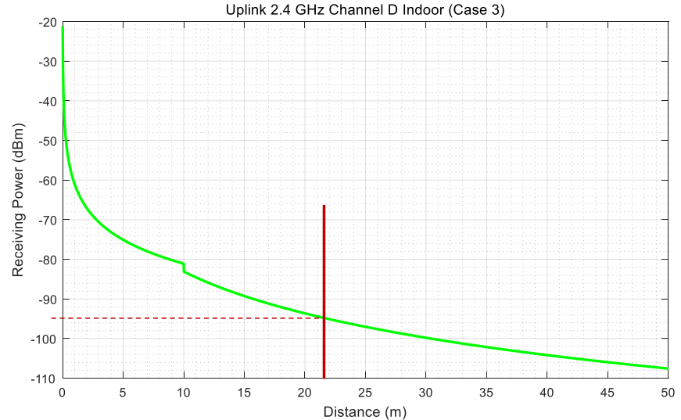
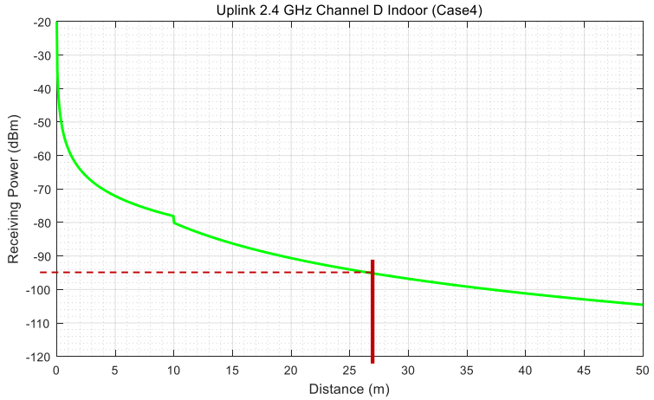
Recap of AMP Link Budget Computations in [3]
Adjusted Link budgets with 11n channel D at 2.4 GHz
Case 1
Case 2
Case 1
Case 3/4
Case 2
Case 4
Case 3

Slide 17
Recap of AMP Link Budget Computations in [3]
Adjusted Link budgets with 11n channel model at 2.4GHz
 | Case 1 | Case 2 | Case 3 | Case 4
Frequency (GHz) | 2.4 | 2.4 | 2.4 | 2.4
EIRP of AP (dBm) | 27 | 27 | 27 | 30
Receiver sensitivity of AP (dBm) | -95 (Note 1) | -95 (Note 1) | -95 | -95
Antenna gain of IoT device (dBi) | 2 | 2 | 2 | 2
Minimum receiving power for IoT device (dBm) | -20 (Note 2) | -30 (Note 2) | -45 (Note 3) | -45 (Note 3)
Max. commun. distance from AP to IoT device (m) (Friis [1]) (Note 6) | 2.8 | 8.87 | 49.85 | 49.85
Max. commun. distance from AP to IoT device (m) (11n Channel D) | 2 | 6 | 17.8 | 17.8
Backscattering loss at IoT device (dB) | 5 | 5 | 5 | /
Maximum transmission power of IoT device (dBm) | / | / | / | -15 (Note 5)
Low Noise Amplifier factor (dB) | 0 | 0 | 30 (Note 4) | /
Max. commun. distance from IoT device to AP (m) (Friis [1]) (Note 6) | 39.60 | 12.52 | 70.42 | 99.47
Max. commun. distance from IoT device to AP (m) (11n Channel D) | 16 | 8.8 | 21.9 | 27
*Notes: Reuse the receiver sensitivity of an 802.11 ah AP The minimum required signal power for an IoT device is -20dBm when the IoT device can’t store power itself. It can be -30dBm when the IoT device has the capability of power storage. -45 dBm is assumed as the sensitivity of ultra-low power receiver. LNA with 30 dBm gain is assumed to boost the backscattering signal, it can have ultra-low power consumption. Ultra-low power active transmitter is assumed. Distances calculated with Friis Equation in [1]

Slide 18
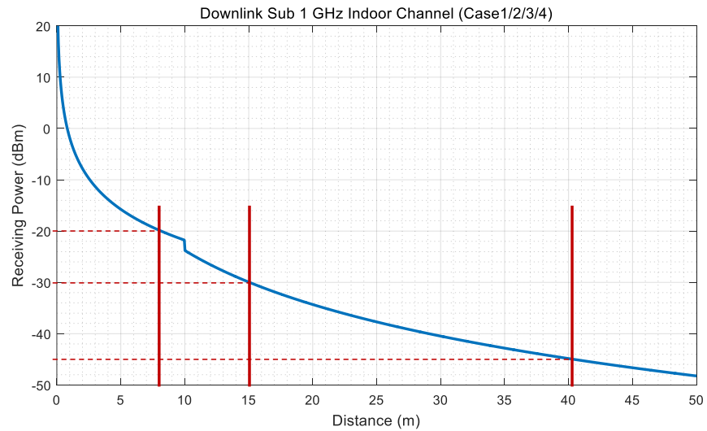
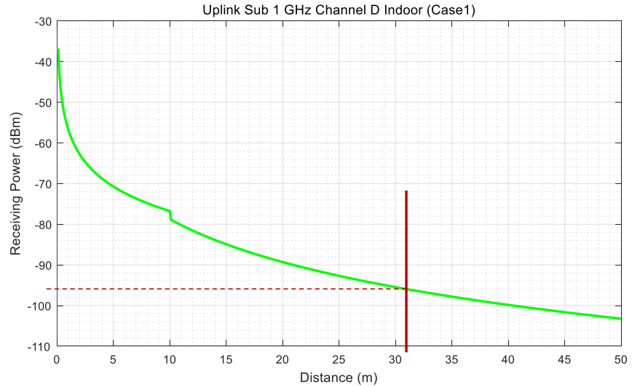
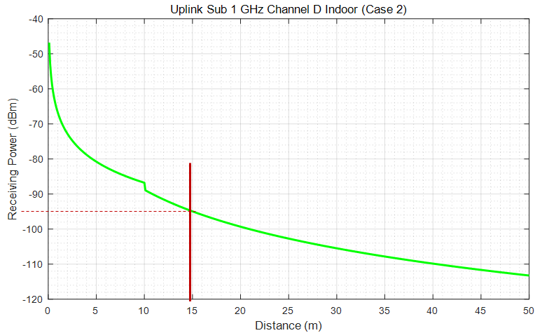
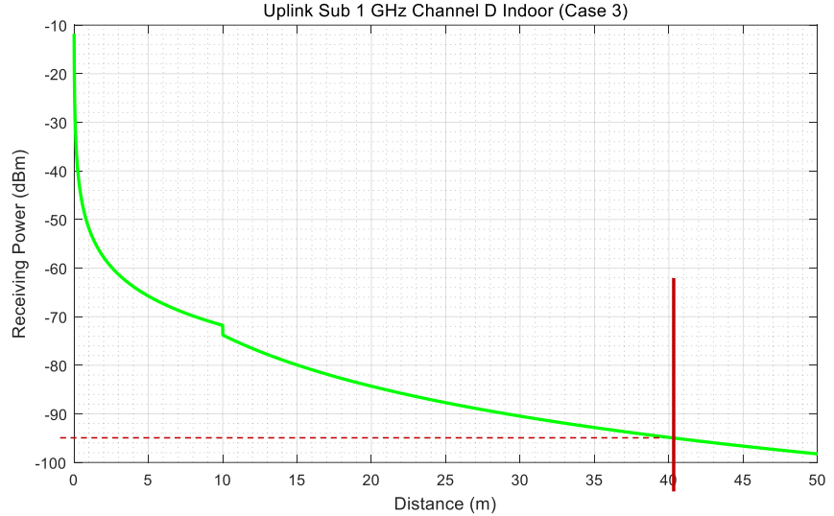
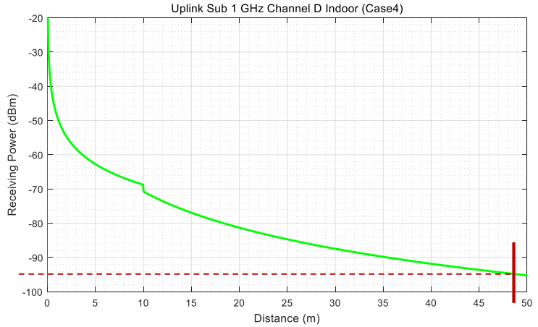
Recap of AMP Link Budget Computations in [3]
Adjusted Link budgets with 11ah (indoor) channel D at sub 1GHz
Case 1
Case 2
Case 3/4
Case 1
Case 2
Case 3
Case 4

Slide 19
Recap of AMP Link Budget Computations in [3]
Adjusted Link budgets with 11ah channel model at Sub-1GHz
 | Case 1 | Case 2 | Case 3 | Case 4
Frequency (MHz) | 920 | 920 | 920 | 920
EIRP of AP (dBm) | 30 | 30 | 30 | 30
Receiver sensitivity of AP (dBm) | -95 (Note 1) | -95 (Note 1) | -95 | -95
Antenna gain of IoT device (dBi) | 2 | 2 | 2 | 2
Minimum receiving power for IoT device (dBm) | -20 (Note 2) | -30 (Note 2) | -45 (Note 3) | -45 (Note 3)
Max. commun. distance from AP to IoT device (m) (Friis [1]) (Note 6) | 10.33 | 32.67 | 183.71 | 183.71
Max. commun. distance from AP to IoT device (m) (11ah Channel D Indoor) | 8 | 15 | 40.2 | 40.2
Backscattering loss at IoT device (dB) | 5 | 5 | 5 | /
Maximum transmission power of IoT device (dBm) | / | / | / | -15 (Note 5)
Low Noise Amplifier factor (dB) | 0 | 0 | 30 (Note 4) | /
Max. commun. distance from IoT device to AP (m) (Friis [1]) (Note 6) | 103.31 | 32.67 | 183.71 | 259.49
Max. commun. distance from IoT device to AP (m) (11ah Channel D Indoor) | 31 | 15 | 40.1 | 48.7
*Notes: Reuse the receiver sensitivity of an 802.11 ah AP The minimum required signal power for an IoT device is -20dBm when the IoT device can’t store power itself. It can be -30dBm when the IoT device has the capability of power storage. -45 dBm is assumed as the sensitivity of ultra-low power receiver. LNA with 30 dBm gain is assumed to boost the backscattering signal, it can have ultra-low power consumption. Ultra-low power active transmitter is assumed. Distances calculated with Friis Equation in [1]

