Slide 1
MIMO Analysis for IMMW
Jan. 2024
Date: 2024-01-12
Authors:
Name | Affiliations | Address | Phone | Email
Bo Gong | Huawei |  |  | gongbo8@huawei.com
Ming Gan
Xiaofei Bai
Mengshi Hu

Slide 2
Background and Motivation
Jan. 2024
IMMW SG has been setup for discussion of integrated baseband of sub-7G and super-45G, which is intended to support millimeter wave transmission at the lowest cost.
Taking account for the applications which have special requirements for throughput, such as AR/VR, MIMO can be taken as an optional feature to improve the throughput.
This proposal analyzes the possible number of spatial streams of SU MIMO, which provides reference for the determination of the throughput in IMMW PAR.

Slide 3
Jan. 2024
Possible Number of Spatial Streams for Typical Scenarios
For APs and non-AP STAs under typical scenarios, such as routers and mobile phones, the analysis should be based on far-field antenna model;
As analyzed in Appendix and proved by product test, the rank of the channel with LOS path is usually 1. The reason is that the strength of the reflection path is much lower than the LOS path due to the large reflection loss.
In addition, the rank of the channel without LOS path will not exceed 2~5. The channel quality is usually worse due to the large reflection loss.

Slide 4
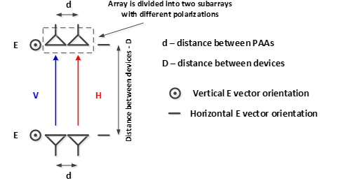
Recommended MIMO Scheme for Typical Scenarios
Jan. 2024
(1) For the rank 1 LOS path channel, dual-polarization can be adopted to support 2 spatial streams.
For the channel without LOS path, on the one hand, it doesn’t come up very often; On the other hand, the channel quality is usually unsatisfactory. Thus, 2 spatial streams are regarded as enough.

Slide 5
Jan. 2024
Possible Number of Spatial Streams for Some Other Scenarios
For some other scenarios with larger devices and closer distances, the analysis can also be based on near-field antenna model;
Dual-polarization can be adopted to support 2 spatial streams.
Spatial Separation supports 2 spatial streams with antenna distance 30cm and transmitter-receiver distance 2m [2]. Note that the Half Power Beamwidth (HPBW) is equal to 14.0⁰. It is challenging for implementation to some degree.
Simultaneous dual-polarization and Spatial Separation can be adopted to support 4 spatial streams.

Slide 6
Summary
Jan. 2024
In this proposal, we analyze the possible number of spatial streams and recommend two spatial streams for typical scenarios.

Slide 7
Jan. 2024
Appendix

Slide 8
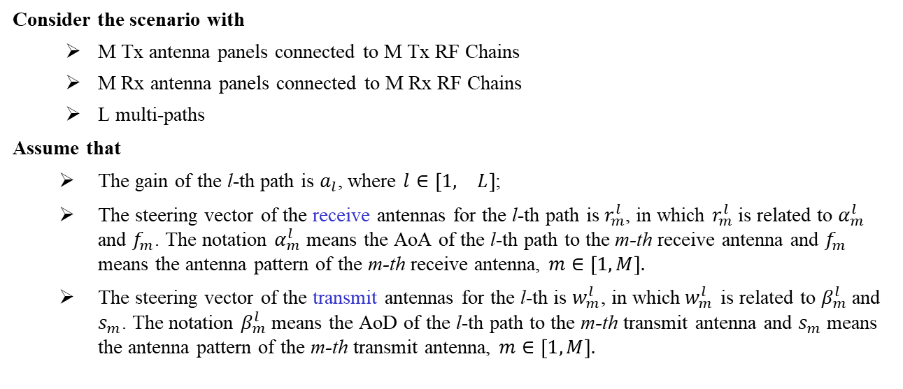
Part I : Relationship between Multi-path and Channel Rank (1)
Jan. 2024
Consider the scenario with
M Tx antenna panels connected to M Tx RF Chains
M Rx antenna panels connected to M Rx RF Chains
L multi-paths
Assume that
The gain of the l-th path is $a_{l}$, where $l∈\left[\begin{matrix}1, & L\end{matrix}\right]$;
The steering vector of the receive antennas for the l-th path is $r_{m}^{l}$, in which $r_{m}^{l}$ is related to $α_{m}^{l}$ and $f_{m}$. The notation $α_{m}^{l}$ means the AoA of the l-th path to the m-th receive antenna and $f_{m}$ means the antenna pattern of the m-th receive antenna, $m∈\left[1, M\right].$
The steering vector of the transmit antennas for the l-th is $w_{m}^{l}$, in which${ w}_{m}^{l}$ is related to $β_{m}^{l}$ and $s_{m}$. The notation $β_{m}^{l}$ means the AoD of the l-th path to the m-th transmit antenna and $s_{m}$ means the antenna pattern of the m-th transmit antenna, $m∈\left[1, M\right].$

Slide 9
Part I : Relationship between Multi-path and Channel Rank (2)
Jan. 2024
Assume that
$g_{l}=a_{l}∙{\left[\begin{matrix}r_{1}^{l}, & r_{2}^{l}, & \begin{matrix}…, & r_{M}^{l}\end{matrix}\end{matrix}\right]}^{T}$,
we have
$\left[\begin{matrix}\begin{matrix}y_{1} \\ y_{2}\end{matrix} \\ ⋮ \\ y_{M}\end{matrix}\right]=\left[\begin{matrix}\sum_{l=1}^{L}{w_{1}^{l}∙g_{l}}, & \sum_{l=1}^{L}{w_{2}^{l}∙g_{l}}, & \begin{matrix}…, & \sum_{l=1}^{L}{w_{M}^{l}∙g_{l}}\end{matrix}\end{matrix}\right]\left[\begin{matrix}\begin{matrix}x_{1} \\ x_{2}\end{matrix} \\ ⋮ \\ x_{M}\end{matrix}\right]+n$,
in which,
${\left[\begin{matrix}x_{1}, & x_{2}, & \begin{matrix}…, & x_{M}\end{matrix}\end{matrix}\right]}^{T}$denotes the transmit data for M spatial streams,
${\left[\begin{matrix}y_{1}, & y_{2}, & \begin{matrix}…, & y_{M}\end{matrix}\end{matrix}\right]}^{T}$denotes the receive data for M receive antennas.
It can be found that $\sum_{l=1}^{L}{w_{m}^{l}∙g_{l}}$ can be regarded as a linear combination of $g_{1}, g_{2}, …,g_{L}$.
It means that the rank of the channel matrix won’t exceed the number of multi-paths.
Note that if a beam doesn’t pass partial multi-paths, the corresponding coefficients of the steering vector are 0, which doesn’t affect the conclusion.
The proof process comes from reference [3].

Slide 10
Part II : Rank Analysis for Channel with LOS Path (1)
For IEEE Channel Models for 60GHz WLAN Systems, there exists 3 channel modes, including conference room channel model, cubicle environment channel model and living room channel model.
The multi-path component can be summarized as follows [1].
Table 1 Multipath of conference room
Table 2 Multipath of cubicle environment
Table 3 Multipath of living room
Type of paths | Number of paths for STA-AP sub-scenario
LOS path | 1
First order reflections from walls | 4
Second order reflections from two walls | 8
First order reflection from ceiling | -
Second order reflections from the walls and ceiling* | -
Type of Path | Cubicle #1 | Cubicle #2 | Cubicle #5
LOS path | 1 | 1 | 1
Reflection from OW#1 (office wall) | 1 | 1 | 1
Reflection from OW#2 | 1 | 1 | 0
Reflection from CW#1 (cubicle wall) | 1 | 0 | 0
Reflection from CW#2 | 1 | 1 | 0
Reflection from CW#3 | 0 | 1 | 0
Reflection from CW#4 | 0 | 0 | 1
Reflection from table | 1 | 1 | 1
Reflection from table and then ceiling | 0 | 0 | 1
Type of Paths | Number of Paths
LOS path | 1
First order reflections from walls | 3
First order reflections from ceiling and floor | 2
Second order reflections from two walls | 5
Second order reflections from ceiling and floor | 2
Second order reflections from the wall and ceiling, from the wall and floor | 6

Slide 11
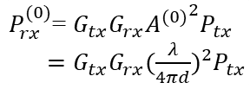
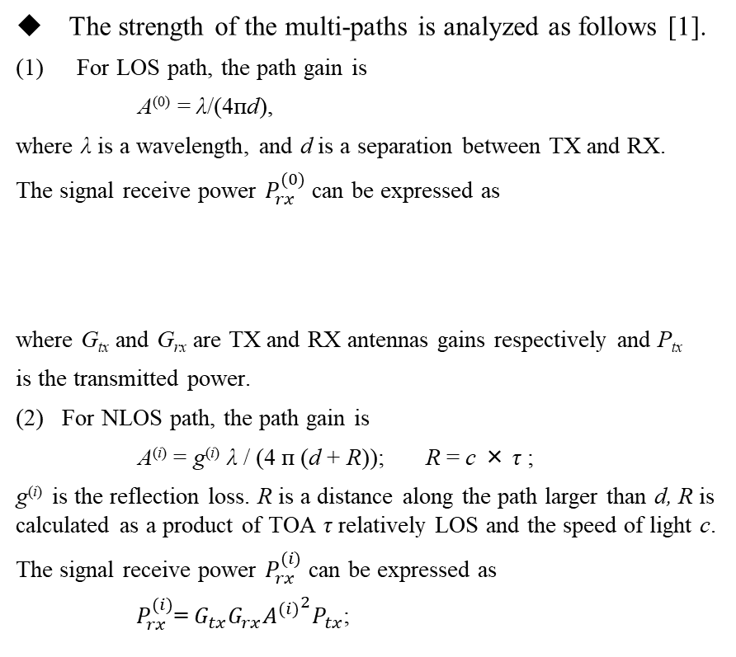
Part II : Rank Analysis for Channel with LOS Path (2)
Jan. 2024
The strength of the multi-paths is analyzed as follows [1].
(1) For LOS path, the path gain is
A⁽⁰⁾ = λ/(4пd),
where λ is a wavelength, and d is a separation between TX and RX.
The signal receive power $P_{rx}^{(0)}$ can be expressed as
where G_{tx} and G_{rx} are TX and RX antennas gains respectively and P_{tx}
is the transmitted power.
For NLOS path, the path gain is
A^{(i)} = g^{(i)} λ / (4 п (d + R)); R = c × τ ;
$\text{g}\text{(}\text{i}\text{)}$ is the reflection loss. R is a distance along the path larger than d, R is calculated as a product of TOA τ relatively LOS and the speed of light c.
The signal receive power $P_{rx}^{(i)}$ can be expressed as
$P_{rx}^{(i)}$= $G_{tx}G_{rx}{A^{(i)}}^{2}P_{tx}$;
Considering that
A^{(i)} = $\frac{\text{g}\text{(}\text{i}\text{)} \text{λ}}{\text{4}\text{п}d}∙\frac{1}{(1+\frac{R}{d})}$,
beside $1/{\left(1+R/d\right)}<1$, $\text{g}\text{(}\text{i}\text{)}$ is about -10dB for the first order reflection path and about -16dB for the second order reflection path.
(4) It means that compared with $P_{rx}^{(0)}$, $P_{rx}^{(i)}$ is about -20dB to -32dB lower. The obvious strength gap results in that the NLOS path can be ignored. Thus, for channel with LOS path, the rank of the channel matrix is approximately 1.
$P_{rx}^{(0)}$= $G_{tx}G_{rx}{A^{(0)}}^{2}P_{tx}$
$=G_{tx}G_{rx}{(\frac{λ}{4πd})}^{2}P_{tx}$

Slide 12
Part III :Rank Analysis for Channel without LOS Path (1)
For the channel without LOS path,
For conference room and living room model, the mean value of the reflection loss $\text{g}\text{(}\text{i}\text{)}$ for the first order reflection path is about -10dB. The mean value of the reflection loss $\text{g}\text{(}\text{i}\text{)}$ for the second order reflection path is about -16dB. The receive power gap between the first and the second order reflection path is about -12dB. Thus, we can ignore the second order reflection path and mainly focus on the first order reflection path to simplify the analysis.
For the cubicle environment, the mean values of the reflection loss $\text{g}\text{(}\text{i}\text{)}$ are almost the same for the first order reflections and the second order reflections. Thus, we consider the first and the second order reflection paths together.

Slide 13
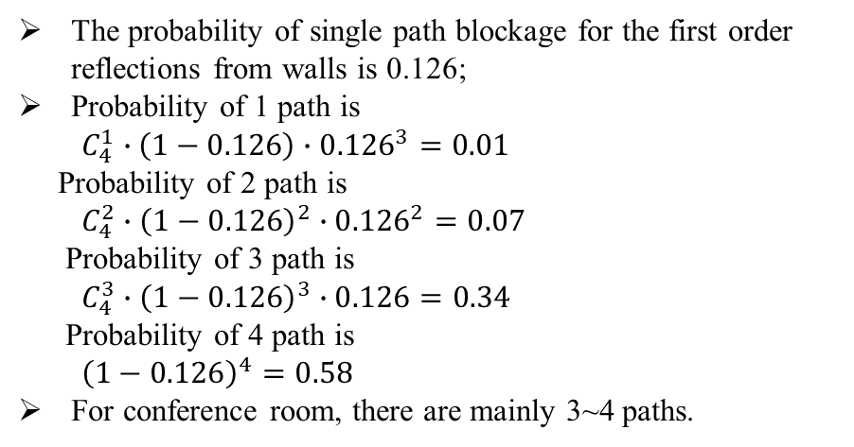
Jan. 2024
Part III : Rank Analysis for Channel without LOS Path (2)
Probabilities of path blockage
Table 1 Multipath of conference room
The probability of single path blockage for the first order reflections from walls is 0.126;
Probability of 1 path is
$C_{4}^{1}∙\left(1−0.126\right)∙{0.126}^{3}=0.01$
Probability of 2 path is
$C_{4}^{2}∙{\left(1−0.126\right)}^{2}∙{0.126}^{2}=0.07$
Probability of 3 path is
$C_{4}^{3}∙{\left(1−0.126\right)}^{3}∙0.126=0.34$
Probability of 4 path is
${\left(1−0.126\right)}^{4}=0.58$
For conference room, there are mainly 3~4 paths.
Type of paths | Number of paths for STA-AP sub-scenario
LOS path | 1
First order reflections from walls | 4
Second order reflections from two walls | 8
First order reflection from ceiling | -
Second order reflections from the walls and ceiling* | -

Slide 14
Jan. 2024
Part III : Rank Analysis for Channel without LOS Path (3)
Probabilities of path blockage
Table 2 Multipath of cubicle environment
Type of Path | Cubicle #1 | Cubicle #2 | Cubicle #5
LOS path | 1 | 1 | 1
Reflection from OW#1 (office wall) | 1 | 1 | 1
Reflection from OW#2 | 1 | 1 | 0
Reflection from CW#1 (cubicle wall) | 1 | 0 | 0
Reflection from CW#2 | 1 | 1 | 0
Reflection from CW#3 | 0 | 1 | 0
Reflection from CW#4 | 0 | 0 | 1
Reflection from table | 1 | 1 | 1
Reflection from table and then ceiling | 0 | 0 | 1
For Cubicle #5, LOS path is always existing.
For Cubicle #1 and #2, there exists 3, 4, or 5 NLOS paths with probabilities 0.5, 0.2, and 0.3 accordingly.
There are mainly 3~5 paths.

Slide 15
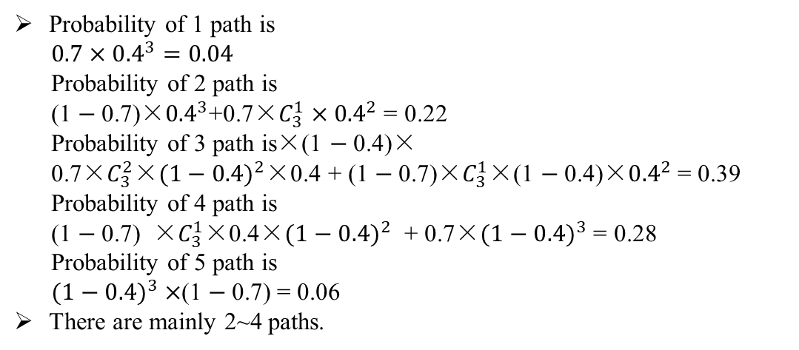
Jan. 2024
Part III : Rank Analysis for Channel without LOS Path (4)
Probabilities of path blockage
Table 3 Multipath of living room
Probability of 1 path is
$0.7×{0.4}^{3}=0.04$
Probability of 2 path is
(1 $−$0.7)×${0.4}^{3}$+0.7×$C_{3}^{1}{×0.4}^{2}$ = 0.22
Probability of 3 path is×(1 $−$0.4)×
0.7×$C_{3}^{2}$×${(1−0.4)}^{2}$×0.4 + (1 $−$0.7)×$C_{3}^{1}$×(1 $−$0.4)×${0.4}^{2}$ = 0.39
Probability of 4 path is
(1 $−$0.7) ×$C_{3}^{1}$×0.4×$({1−0.4)}^{2}$ + 0.7×$({1−0.4)}^{3}$ = 0.28
Probability of 5 path is
$({1−0.4)}^{3}×$(1 $−$0.7) = 0.06
There are mainly 2~4 paths.
Type of Paths | Number of Paths
LOS path | 1
First order reflections from walls | 3
First order reflections from ceiling and floor | 2
Second order reflections from two walls | 5
Second order reflections from ceiling and floor | 2
Second order reflections from the wall and ceiling, from the wall and floor | 6
Table 4 Probabilities of paths blockage for the living room model
Path type | Probability of Path blockage
First order reflections from walls (3) | 0.4
First order reflections from ceiling (1) | 0
First order reflections from floor (1) | 0.7
For the channel without LOS paths, there are mainly 2~5 paths, which means the rank of the channel won’t exceed 2~5.

Slide 16
References
Jan. 2024
[1] IEEE doc. 802.11-09/0334r8. Channel models for 60 GHz WLAN systems, A. Maltsev et al, Mar. 2010.
[2] 11-15-0632-01-00ay-experimental-measurements-for-short-range-los-su-mimo.
[3] X. Li, J. Fang, H. Li, and P. Wang, “Millimeter wave channel estimation via exploiting joint sparse and low-rank structures,” IEEE Transactions on Wireless Communications, vol. 17, no. 2, pp. 1123–1133, 2017

