Slide 1
Range Expansion via Repeated Transmission
Date: 2024-05-12
Authors:
Revision 0: initial submission
Revision 1: added slides 5-7 + updated references
Revision 2: editoral

Slide 2
Introduction
Enhanced Long Range (ELR) was previously explored by the UHR study group as a means to augment uplink coverage and rectify the disparity between downlink and uplink signal strengths [1-5].
The objective of incorporating ELR into the 11bn standard is to facilitate long-distance reception PPDUs, even under conditions of severely diminished signal strength.
In this document, we propose a combined approach of repeated transmissions across time and frequency domains, coupled with coherent combining, to enhance the 11bn range in both downlink (DL) and uplink (UL) directions. Importantly, our proposed solution requires only minimal modifications to the existing standard, preserving the established methods of detection, modulation, and coding.

Slide 3
Repeated Transmission
The concept of repeated transmission offers a straightforward yet immensely effective approach to improved the SNR and range.
  A simple version of repeated transmission was introduced in 802.11ax (DCM and ER PPDU).
Leveraging Signal Repetition for Range Expansion:
    This strategy entails the deliberate transmission of identical or slightly modified copies of the same signal across the wireless medium.
    The aim is to counteract the adverse impact of channel impairments – such as path loss, fading, noise, and interference – that often curtail the coverage distance and reliability of wireless links.
    The repetition can be employed over time, frequency, and space dimensions or any combination thereof (e.g., time and freq.).
    The receiver must employ coherent combination of the received replicas to improve the observed SNR.

Slide 4
Signal Processing at the receiver
The receiver should be aware of the repetition scheme employed by the transmitter.
  The required signaling for this purpose is discussed in the following slides.
Utilizing Coherent Combining for improved SNR
  Different Coherent Combining methods can be implemented.
  In particular, MRC yields the maximum possible SNR gain.
  For instance, when the AP employs MRC and N independent signal replicas are dispatched through the channel, the resultant increase in received SNR in dB can be approximated by 10*log(N).
Illustrative example:
  Transmitting 2 signal replicas in the UL could yield an anticipated 3dB enhancement in received SNR. As another example, the receiver can observe 9.53 dB gain in SNR when N=9, i.e., replicating the original signal over 8 other branches.

Slide 5

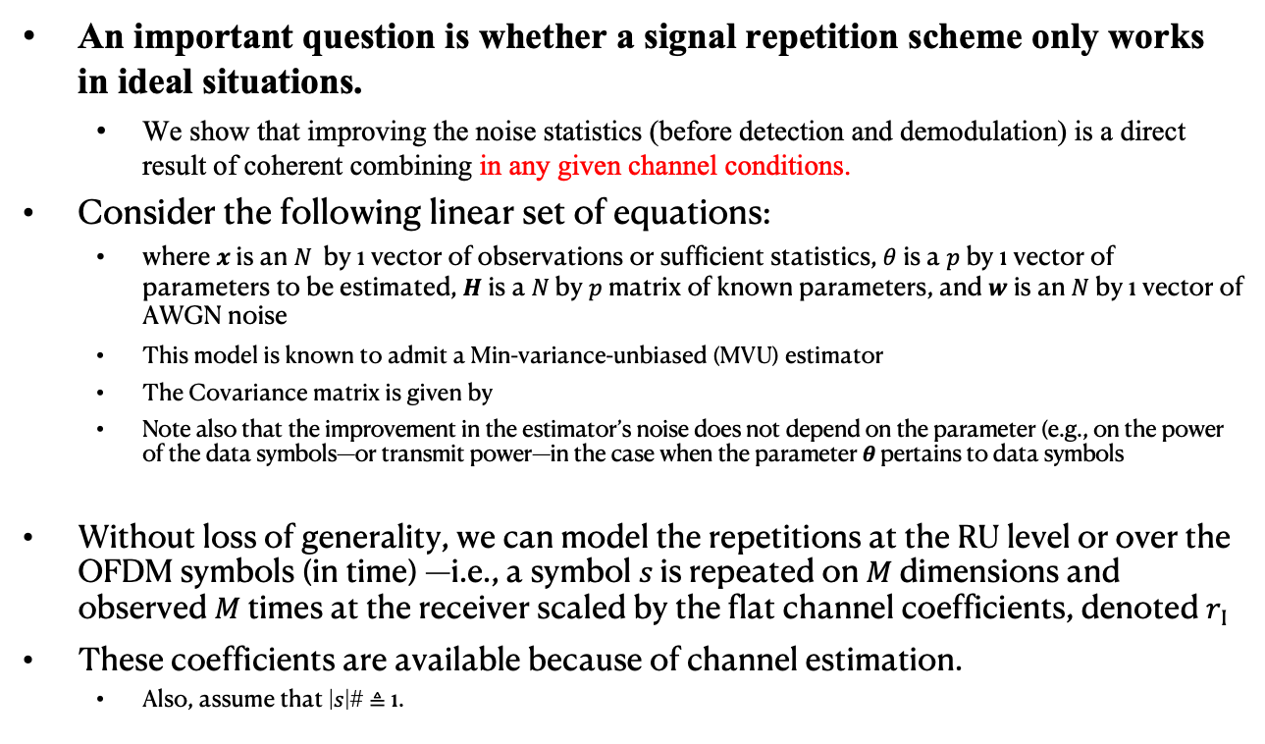
Coherent Combining Improves the Noise Statistics (1/3)
An important question is whether a signal repetition scheme only works in ideal situations.
  We show that improving the noise statistics (before detection and demodulation) is a direct result of coherent combining in any given channel conditions.
Consider the following linear set of equations:
  where 𝒙 is an 𝑁 by 1 vector of observations or sufficient statistics, $θ$ is a 𝑝 by 1 vector of parameters to be estimated, 𝑯 is a 𝑁 by 𝑝 matrix of known parameters, and 𝒘 is an 𝑁 by 1 vector of AWGN noise
  This model is known to admit a Min-variance-unbiased (MVU) estimator
  The Covariance matrix is given by
  Note also that the improvement in the estimator’s noise does not depend on the parameter (e.g., on the power of the data symbols—or transmit power—in the case when the parameter 𝜽 pertains to data symbols
Without loss of generality, we can model the repetitions at the RU level or over the OFDM symbols (in time) —i.e., a symbol 𝑠 is repeated on 𝑀 dimensions and observed 𝑀 times at the receiver scaled by the flat channel coefficients, denoted 𝑟_{I}
These coefficients are available because of channel estimation.
  Also, assume that |𝑠|# ≜ 1.

Slide 6

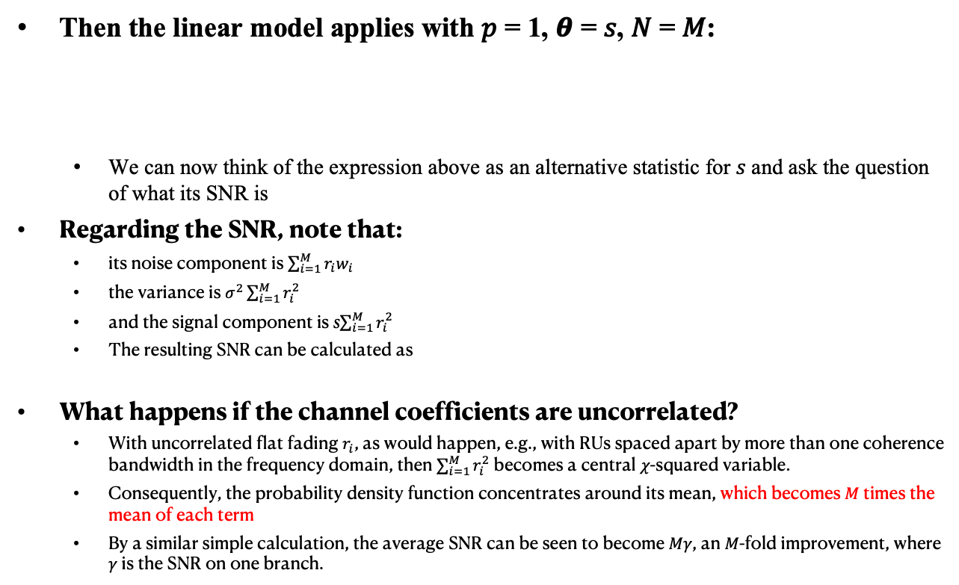
Coherent Combining Improves the Noise Statistics (2/3)
Then the linear model applies with 𝑝 = 1, 𝜽 = 𝑠, 𝑁 = 𝑀:
  We can now think of the expression above as an alternative statistic for 𝑠 and ask the question of what its SNR is
Regarding the SNR, note that:
  its noise component is $\sum_{i=1}^{M}{r_{i}w_{i}}$
  the variance is $σ^{2}\sum_{i=1}^{M}{r_{i}^{2}}$
  and the signal component is s$\sum_{i=1}^{M}{r_{i}^{2}}$
  The resulting SNR can be calculated as
What happens if the channel coefficients are uncorrelated?
  With uncorrelated flat fading $r_{i}$, as would happen, e.g., with RUs spaced apart by more than one coherence bandwidth in the frequency domain, then $\sum_{i=1}^{M}{r_{i}^{2}}$ becomes a central 𝜒-squared variable.
  Consequently, the probability density function concentrates around its mean, which becomes 𝑀 times the mean of each term
  By a similar simple calculation, the average SNR can be seen to become 𝑀𝛾, an 𝑀-fold improvement, where 𝛾 is the SNR on one branch.

Slide 7
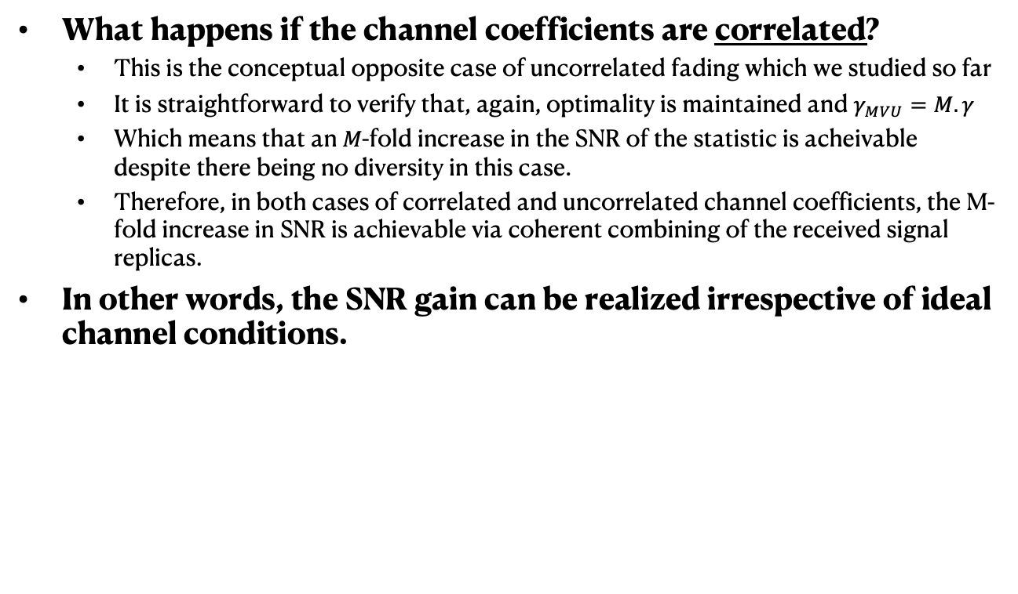
Coherent Combining Improves the Noise Statistics (3/3)
What happens if the channel coefficients are correlated?
  This is the conceptual opposite case of uncorrelated fading which we studied so far
  It is straightforward to verify that, again, optimality is maintained and $γ_{MVU}=M.γ$
  Which means that an 𝑀-fold increase in the SNR of the statistic is acheivable despite there being no diversity in this case.
  Therefore, in both cases of correlated and uncorrelated channel coefficients, the M-fold increase in SNR is achievable via coherent combining of the received signal replicas.
In other words, the SNR gain can be realized irrespective of ideal channel conditions.

Slide 8
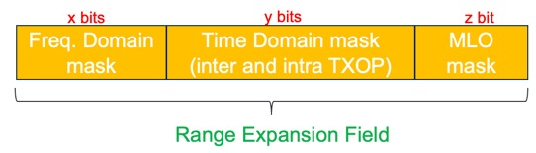
Proposed Mechanism
As pointed out, the transmitter needs to inform the receiver about the repetition scheme it is employing to enable coherent combining upon the reception of signal replicas.
We propose a new "Range Expansion" Field to be included in the U-SIG
  The new Repetition Field carries all the necessary information about the time/freq./link domain repetition that is employed by the transmitter.
The proposed " Range Expansion " Field is composed of 3 subfields:
  Freq.-domain Mask (x bits): carries information about the repetition scheme over RUs
  Time-domain Mask (y bits): carries information about inter and intra TXOP repetition schemes
  MLO Activation (z bits): carries information about repetition over multiple links in MLO-capable device

Slide 9
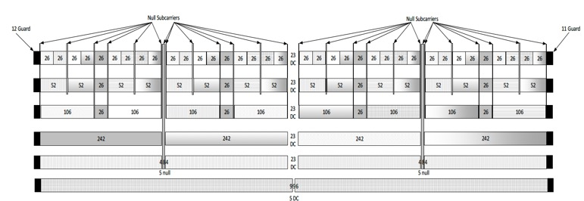
Freq. Domain Mask
Proposed structure:
  Consecutive RU treatment
  Duplication happens in RUs following original data
  4-bit value to indicate the desired duplication
Illustrative Example assuming 4-bit freq. domain mask:
80 MHz RU106 {1,2,3,4,5,6,7}
  0001 = duplicate once {1,2,3} {4,5,6}
  0010 = duplicate twice {1,2} {3,4} and {5,6}
  0011 = duplicate thrice {1} {2,3,4}
  0100 = duplicate 4 times {1} {2,3,4,5}
  0110 = duplicate 6 times {1} {2,3,4,5,6,7}

Slide 10
Time Domain Mask
Proposed structure:
  It is composed of two subfields corresponding to intra-TXOP and inter-TXOP repetitions, respectively.
  Intra-TXOP subfield indicates PPDU repetition across consecutive OFDMA symbols within a single TXOP
  Inter-TXOP subfield indicates PPDU repetition over consecutive TXOPs
Illustrative Example assuming 8-bit time domain mask:
  0000 0000: no time domain repetition
  0011 0000: three times repetition over the OFDMA symbols
  within a single TXOP.
  0000 0001: one repetition over the immediately next available TXOP

Slide 11
Usage example for “Range Expansion” Field
We consider two illustrative examples to show how the proposed repetition field in the U-SIG carries the necessary information about the transmitter's adopted repetition scheme.
Example 1:
  If only freq. domain is active, and repetition occurs across 3 RU sets
Example 2:
  If freq. domain is active and 2 intra-TXOP repetitions on all the available links

Slide 12
References
[1] Design Targets and Considerations for Enhanced Long Range, IEEE 802.11-24/0873r2
[2] “An Enhanced Long Range PPDU”, IEEE 802.11-24/0921r0
[3] Thought for Range Extension in UHR, IEEE 802.11-23/0042r0
[4] Low Power and Long Range Preamble, IEEE 802.11-23/1100r0
[5] UHR Rate vs Range Enhancement with Relay, IEEE 802.11-23/1908r1
[6] David Tse and Pramod Viswanath. Fundamentals of wireless communication. Cambridge university press, 2005.

Slide 13
SP1
Do you support to define a “range expansion” mode for the AP and non-AP STA where the transmitter may invoke a repetition scheme over time/freq. to improve the SNR at the receiver when the coverage is poor?

Slide 14
SP2
Do you agree to define a new “range expansion” field in the U-SIG to determine/signal the employed repetition scheme across time/freq.?

