Slide 1
DPWiFi MATLAB Validation
Date: 2024-01-13
Authors:

Slide 2
Abstract
During last November’s Doteleven plenary TWI proposed “Dynamic Polarization MIMO Multiplexing and Beamforming” as a candidate PHY for the nascent TGbn standard. TWI has since MATLAB-modelled “DPMXBF” (henceforth “DPWiFi”) for Fixed Wireless Access applications (salient test results presented herein) and conclusively simulation-validated its functionality and performance as posited in Honolulu.

Slide 3
Proposed DPWiFi PHY
32 IEEE802.11be concurrent, cochannel RF streams
  32x32 MIMO Dynamic Polarization Multiplexing (“DP-32”)
  32x32 MIMO Tx/Rx DLOS/ nLOS/ NLOS Beamforming/Beamsteering
  AP MU-MIMO Tx Multi-beaming
  Client MU-MIMO Rx Interference Cancellation
  Client MU-MIMO Rx NLOS Multipath Recombination
  5-7 GHz UNII Operation
  4096 QAM 5/6
  320 MHz BW
  92.2 Gbps Peak Data Rate
  80 GbE P2P Throughput over a 28 km Free-Space Range
  27 GbE PMP Throughput across a 79 km² Foliage-obstructed Area

Slide 4
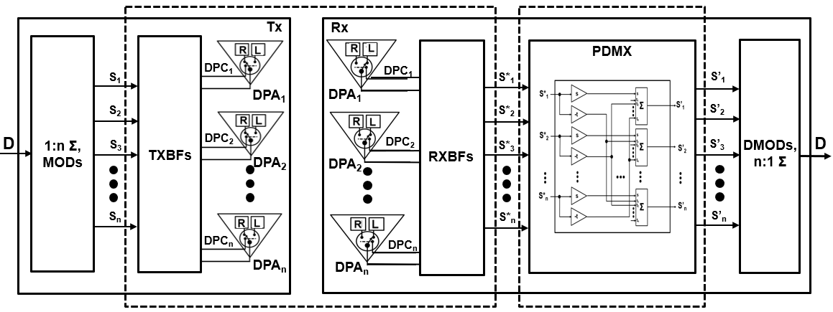



Proposed DPWiFi TRX Architecture
stevenlee131
[H_{DP}] DPWiFi Propagation Channel
[H_{DP}⁻¹] DPWiFi Rx PDMX
Post-Honolulu enhancements

Slide 5
DPWiFi for FWA
DPWiFi Fixed WiFi Access Requirements
  FWA propagation channel transfer function [H_{DP}]: n-dimensional “Polarization Space”, n upper bound > 32
  32 x 32 DPWiFi (“DPWiFi-32”) posits unrivaled 80 GbE P2P/ 27 GbE PMP Throughput for FWA
  [H_{DP}] is non-singular, deterministic and scalar (i.e., h_{ij} = 1, i = j; h_{ij} = r, i ≠ j), r varying with [H_{DP}] impairments
  FWA comprises DLOS, nLOS and NLOS links, all susceptible to propagation channel “depolarization” losses
  Channel Depolarization (“ChDp”, in º) = Rx DPA-incident DPWiFi polarization rotation from the Tx DPA-impressed baseline
    Direct Line of Sight TRXs hampered by atmospheric fog, rain, etc. depolarize by up to 5º
    near Line of Sight TRXs hindered by incompletely-obstructing foliage/ landscape/ structures depolarize by up to 15º
    Non Line of Sight (i.e., reflected/diffracted) TRX due to fully obstructing landscape/ structures/ vehicles depolarize by up to 45º
  Increasing ChDp severely impacts DPWiFi MIMO Demux, rapidly and fatally boosting S’_{i} residual CCI
  DPWiFi must incorporate comprehensive ChDp compensation to support its otherwise incomparably compelling FWA solution
DPWiFi Fixed Wireless Access (2-Stage) Operation
  DPWiFi (Open Loop) Channel Sounding
    AP broadcasts “Training Packet (T)” to all associated STAs at 1mS intervals
    Each STA processes T, estimates ChDp, determines its actual [H_{DP}], computes [H_{DP}⁻¹] and reconfigures its Rx PDMux to match
  FWA Traffic DPWiFi TRX
  Normal Data traffic DPWiFi TRX, but with each STA fully compensating for its particular channel impairments

Slide 6
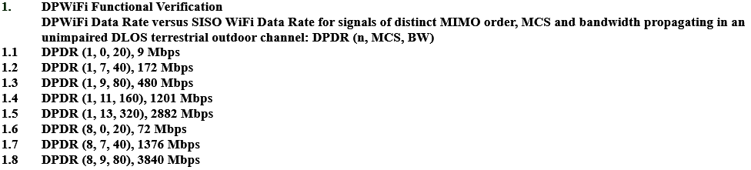
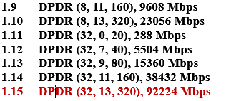
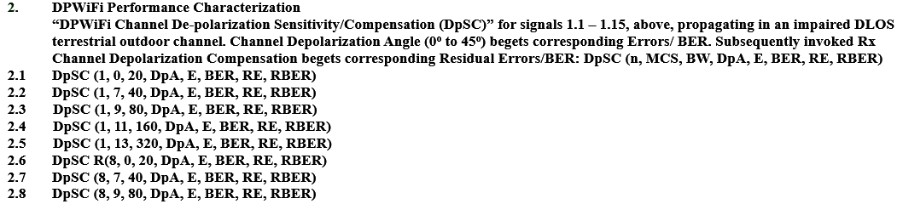
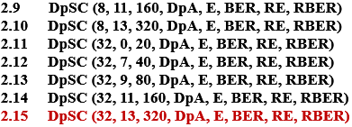
DPWiFi TRX Validation Plan
Note: See corresponding Validation Test results following

Slide 7
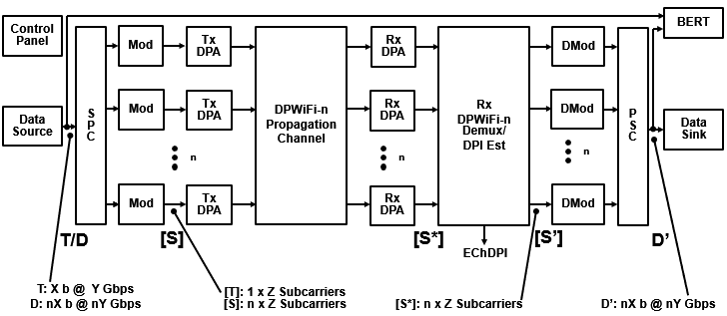
DPWiFi TRX MATLAB Model
Data Source
Generates
1x Training Packet/
1x Data Packet
SPC/Modulators
Synthesize
1x Training Stream/
32x Symbol Streams
Tx DPAs
Walsh-Polarize
1x Training Stream/
32x Symbol Streams
DPWiFi Channel
MIMO-Multiplexes
1x Training Stream/
32x Symbol Streams
Rx DPAs
De-correlate
32x M-M Training Streams/
32x M-M Symbol Streams
Rx DPDMux
Estimates Channel DPI/
Recovers 32x
Symbol Streams
Demodulators/PSC
Recover 1x
Data Packet
Data Sink
Accepts 1x
Data Packet

Slide 8
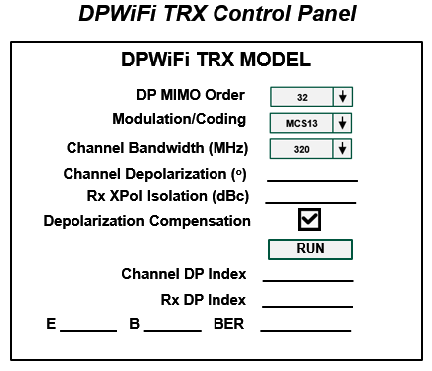
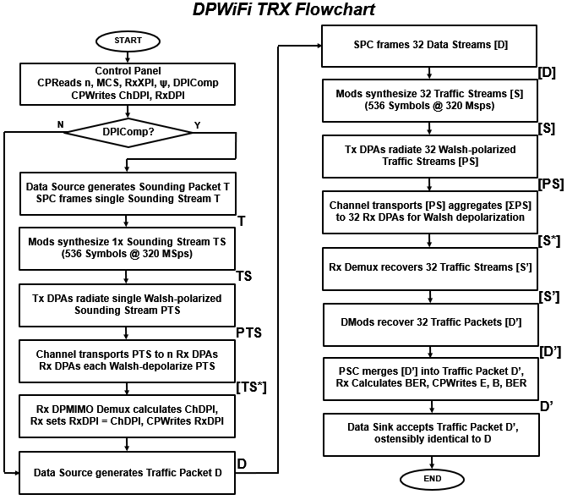
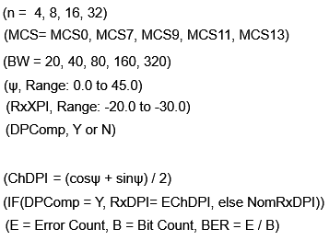
DPWiFi TRX Model Detail

Slide 9
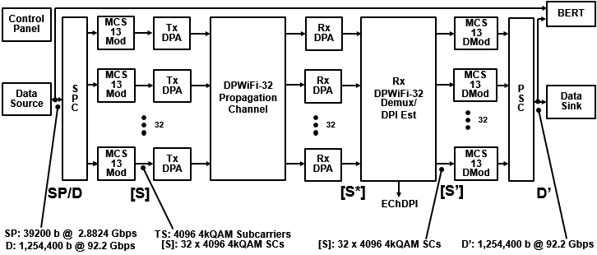
DPWiFi TRX Validation
TWI is currently executing the full DPWiFi TRX Validation Plan of Slide 6
However, the key “Will DPWiFi work for FWA?” question has already been settled:
  Validation Plan items 1.15 and 2.15 comprise the most extreme DPWiFi-for-FWA corner case
    I.e., if 320 MHz MCS13 DPWiFi-32 operation under prescribed test conditions functions/performs to spec, then ALL OTHER BW/MCS/MIMO order DPWiFi combinations will ALSO perform to spec
    Ergo, following find
DPWiFi Validation: DPWiFi-32 320MHz MCS13 vs Channel Depolarization

Slide 10
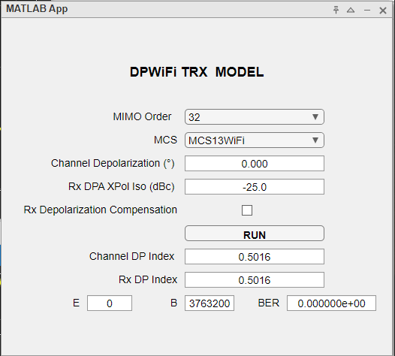
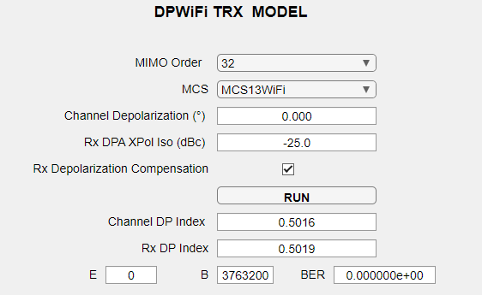
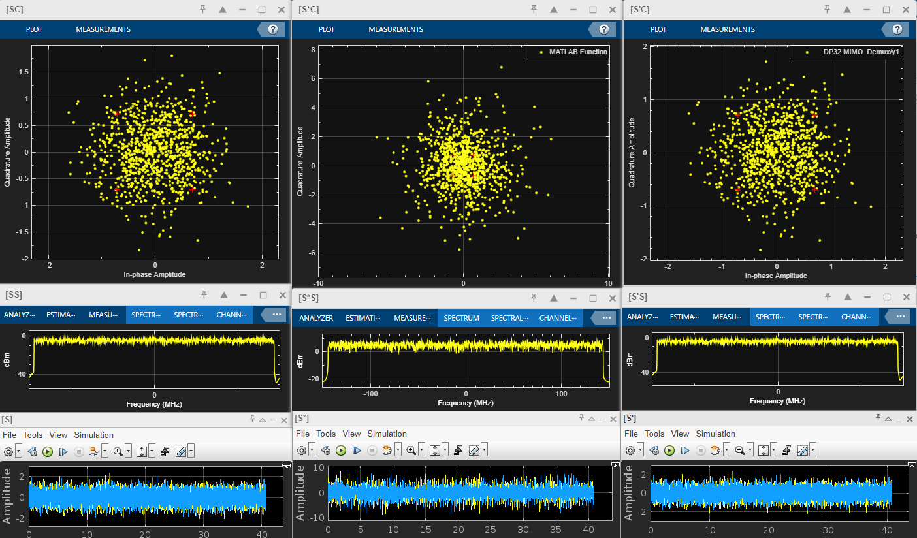
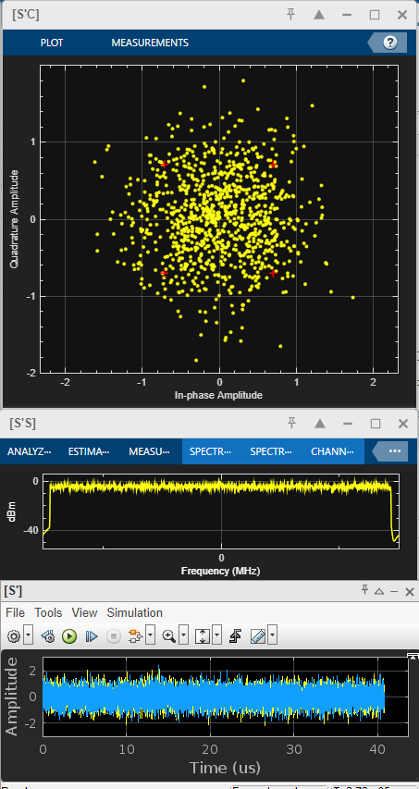
DPWiFi-32 320 MHz MCS13 TRX Validation- Data
DPWiFi Validation Data
1.1 DPWiFi-32 320MHz MCS13
ChDp = 0.0º

Slide 11
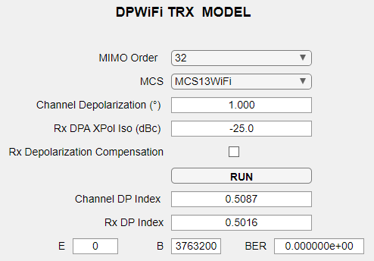
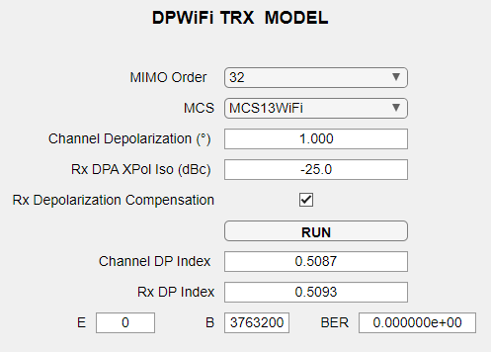
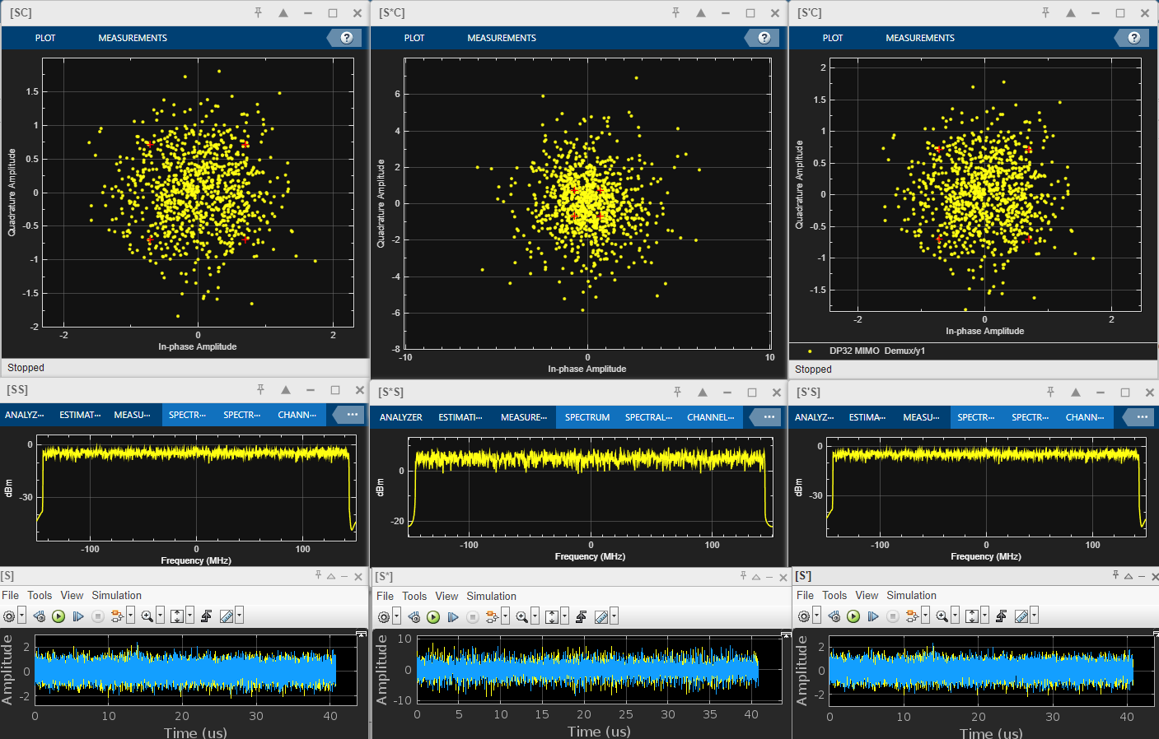
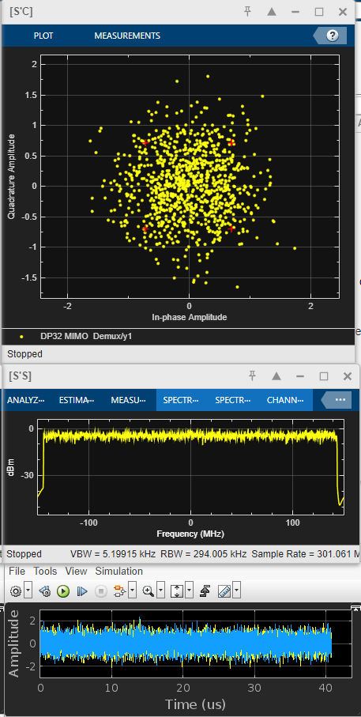
DPWiFi-32 320 MHz MCS13 TRX Validation- Data
DPWiFi Validation Data
1.2 DPWiFi-32 320MHz MCS13
ChDp = 1.0º

Slide 12
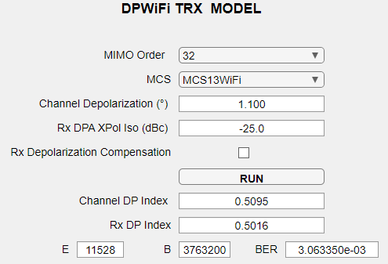
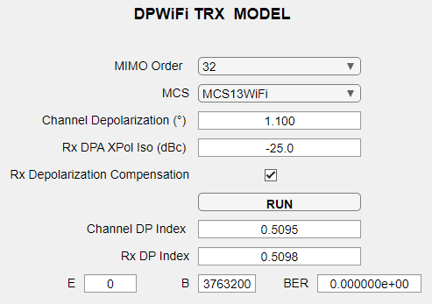
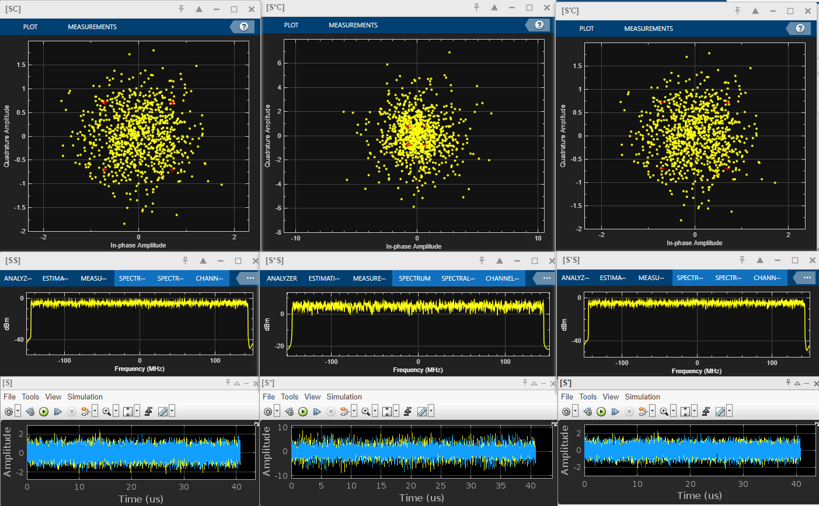
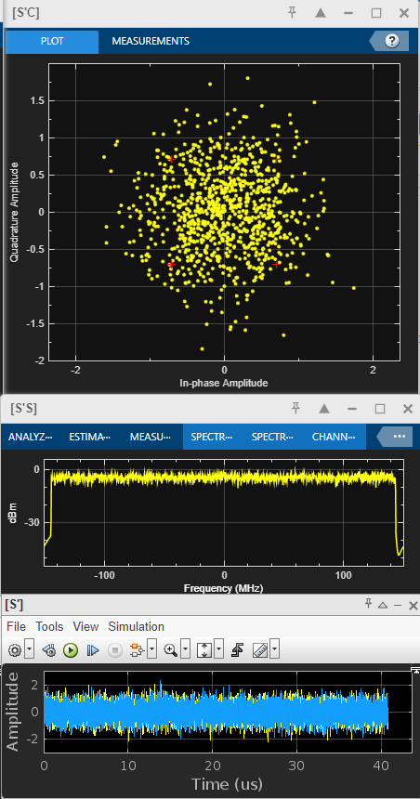
DPWiFi-32 320 MHz MCS13 TRX Validation- Data
DPWiFi Validation Data
1.3 DPWiFi-32 320MHz MCS13
ChDp = 1.1º

Slide 13
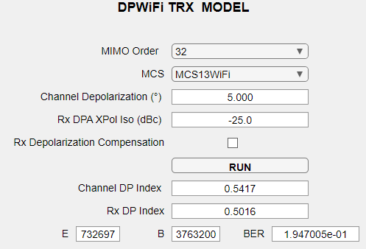
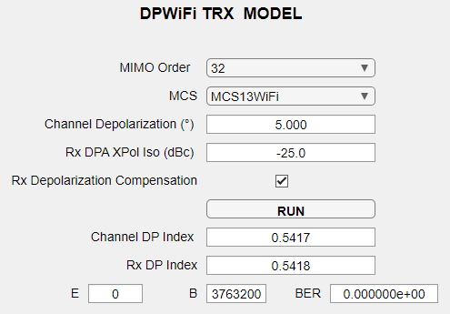
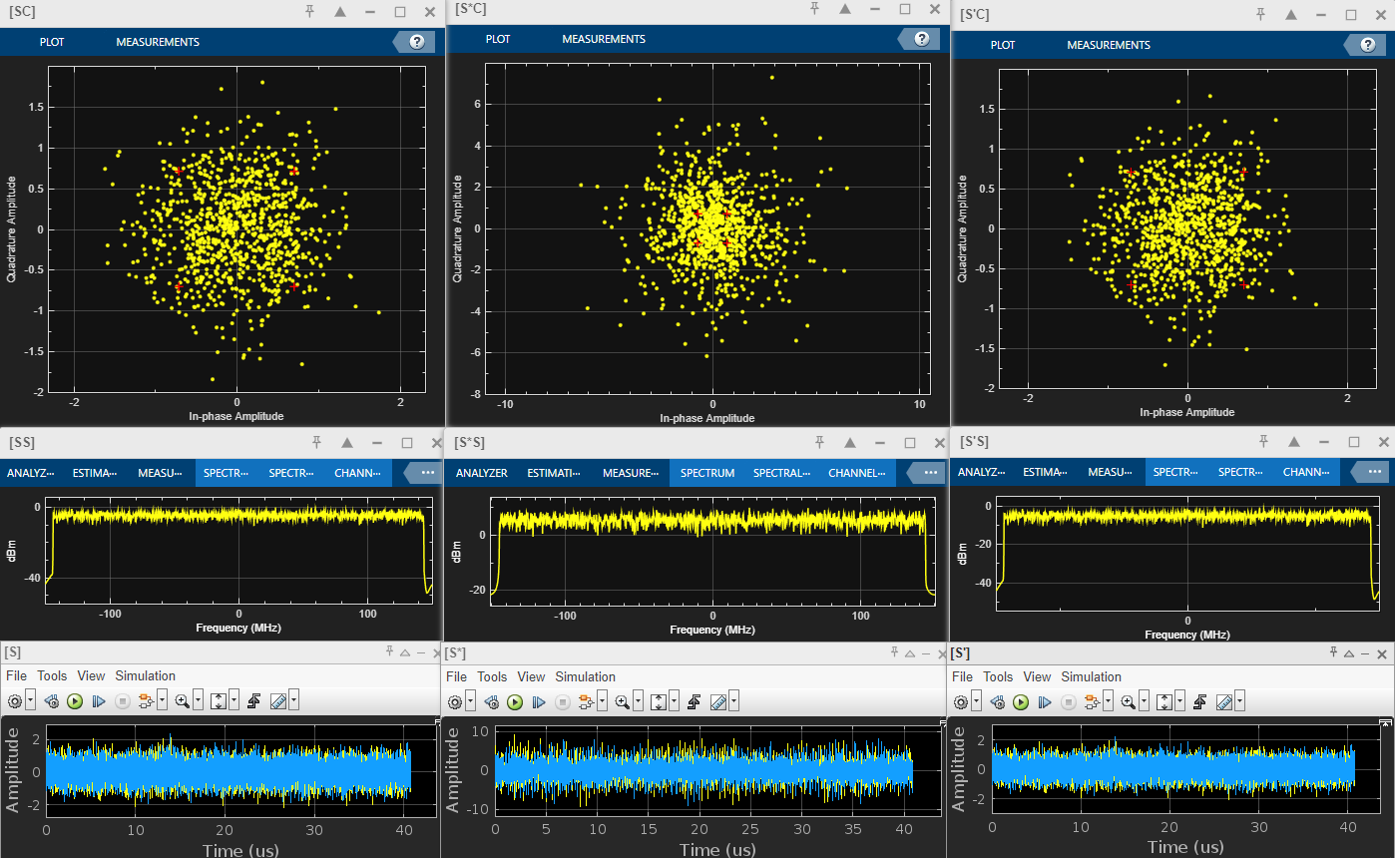
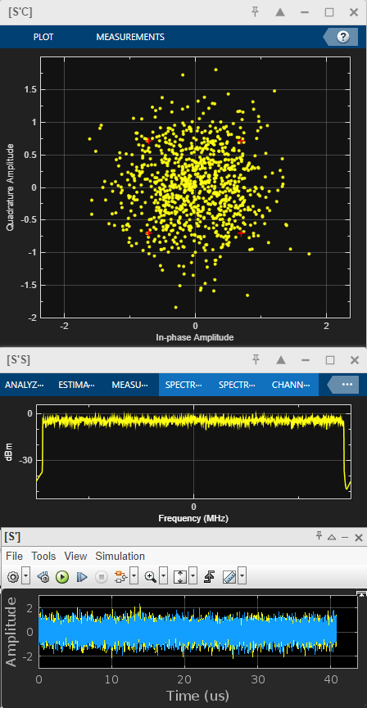
DPWiFi-32 320 MHz MCS13 TRX Validation-Data
DPWiFi Validation Data
1.4 DPWiFi-32 320MHz MCS13
ChDp = 5.0º

Slide 14
DPWiFi-32 320 MHz MCS13 TRX Validation-Data
DPWiFi Validation Data
1.5 DPWiFi-32 320MHz MCS13
ChDp = 15.0º

Slide 15
DPWiFi-32 320 MHz MCS13 TRX Validation-Data
DPWiFi Validation Data
1.5 DPWiFi-32 320MHz MCS13
ChDp = 15.0º

Slide 16
DPWiFi-32 320 MHz MCS13 TRX Validation-Data
DPWiFi Validation Data
1.6 DPWiFi-32 320MHz MCS13
ChDp = 45.0º

Slide 17
DPWiFi-32 320 MHz MCS13 TRX Validation- A & C
DPWiFi Validation Analysis
DPWiFi Validation Conclusions

Slide 18
DPWiFi MATLAB Validation Summary

