Slide 1
Thoughts on Accommodating High-Mobility STAs
Date: 2024-01-12
Authors:

Slide 2


Abstract
Seamless mobility, outlined in UHR PAR [1], requires, among others, a mechanism to ensure reliable connectivity and quality of experience for mobile users
In this presentation, we discuss the growing need for Wi-Fi support of (non-AP) STAs in high mobility
We propose a modification to PHY to improve rCFO estimation for high-mobility (non-AP) STAs
We propose reuse of location track notification
mechanism to inform AP of the speed of (non-AP) STAs

Slide 3
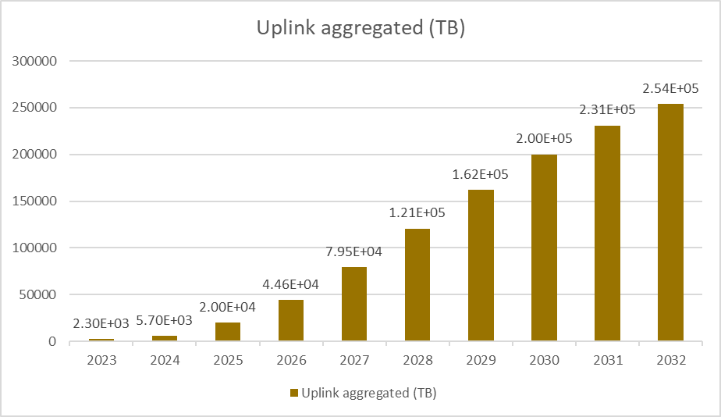
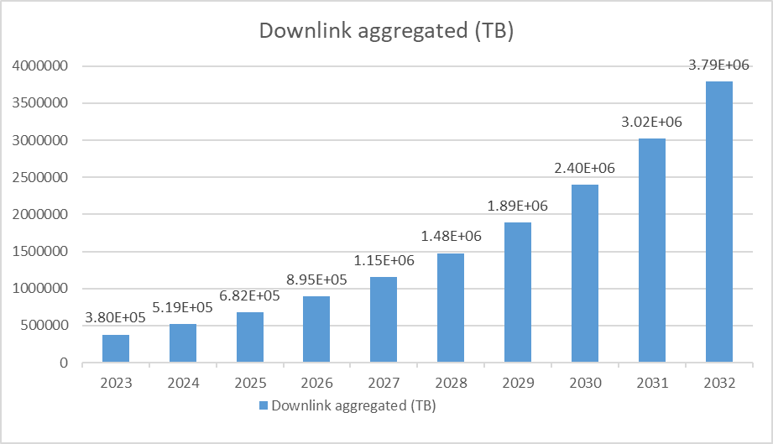

Motivation
The Connected Vehicle Market size is estimated at USD 63.39 billion in 2023, and is expected to reach USD 141.06 billion by 2028, growing at a Compound Annual Growth Rate of 17.35% during the forecast period (2023-2028). (Modor Intelligence)
Currently internet connectivity for connected vehicles while in motion is via cellular:
  Increasingly costly
  Too taxing for current cellular capacity given the enormous projected data volume
If only Wi-Fi could also help as backhaul link for vehicle connectivity during motion…
~94% of DL data is infotainment94%

Slide 4
Motivation
Currently available externally accessible Wi-Fi APs can provide coverage in downtown and even suburb environments if other challenges addressed
Several PHY, MAC & higher layer issues need to be addressed to make this possible, but:
  In this presentation, we only focus on (1) improving rCFO estimation, and (2) high-mobility STAs identification
Mid-amble included in 802.11ax to improve channel estimation for outdoor environments with moving scatterers [2-3], but:
  Implementation support by vendors very limited
  Lacks in data in proving efficacy for addressing channel estimation accuracy at high-mobility (non-AP) STA with speed > 3 km/h with currently possible configurations
  Options for mid-amble update interval (No. of data symbols between two mid-ambles): currently 10 and 20 → might need to be revisited for STAs of high-mobility
  Need to use Mid-amble for both CFO & channel estimation
In high Doppler, rCFO estimation based on current pilot tones within RUs allocated for STAs with < 3 km/h speed may perform poorly for high-mobility STAs

Slide 5
Ultra-Robust Resource Units
Proposing an Ultra-Robust RU type for high-mobility STAs:
  Ultra-Robust RUs have higher number of pilot subcarriers to better track rCFO
  Number of pilot subcarriers can be selected from a few options based on the (non-AP) STA’s velocity and change of direction
  The set of options could correspond to low (3 km/h < v < 20 km/h), medium (20 km/h < v <50 km/h), and high speed (50 km/h < v < 180 km/h)
Ultra-Robust RUs may be rRUs (regular RUs) or dRUs (distributed RUs [4]):
  For rRUs, this requires new additional pilot tone assignments for RUs of different sizes
  For dRUs, building on [5] with dRUs with one set of shared pilot tones for all RU sizes:
    Define a single set of pilot tones to sample the entire frequency band wherein:
      Non-high mobility STAs could use RUs wherein once every M >1 tones of the superset of possible pilot tones are included in the dRU as pilot tones
      High-mobility STAs assign Ultra-Robust dRUs wherein once every K tones (K=1, 2, … < M) are included in the dRU as pilot tones

Slide 6
Thoughts on identifying high-mobility STAs and their speed
Use Location Configuration Request/Response and Location Track Notification frames as specified in [6] → No new change to 802.11 standard
  APs serving high-mobility users could send Location Configuration Request
  High Mobility (non-AP) STAs could respond to the request thereby activating location tracking (which also includes speed data)
  PHY parameters decided based on motion/speed values received from STA’s periodic (at configurable target data rate) location track notification data received by AP
  STA being tracked sends Location Track Notification frames to the AP which had sent it the Location Configuration Request and potentially all APs in the same ESS
  The (non-AP) STA will stop sending Location Track Notification frames if it does not hear any beacons from ESS it was configured to send Location Track Notification in
Alternative option: Create a new field in Extended Capabilities to indicate AP’s capability for handling high-mobility (non-AP) STAs→ Needs new field and modification to the association process for AP and high-mobility STA

Slide 7
Future Studies
Assess rCFO for high-mobility (non-AP) STAs
Assess rCFO improvement gained by proposed Ultra-Robust RUs
Assess rCFO improvement gained by proposed Ultra-Robust RUs + Midamble-enhanced CFO estimation
Location Track Notification frames are currently Multicast, creating privacy concerns: revisit this?

Slide 8
References
[1] 11-23/480r3 UHR draft proposed PAR
[2] 11-17/0773r2 Thoughts on Doppler Design in 802.11ax
[3] 11-17/0960r0 Follow Up on Doppler Design in 802.11ax
[4] 11-23/0037 UHR Feature to Overcome PSD Limitations Distributed-Tone Resource Units
[5] 11-23/1516r0 Use case for distributed RUs in Downlink
[6] 80211-2020

Slide 9
BACK-UP SLIDES

Slide 10
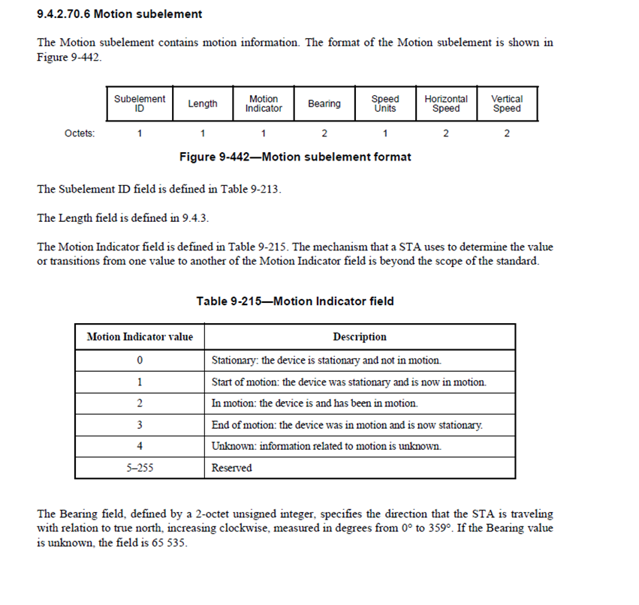
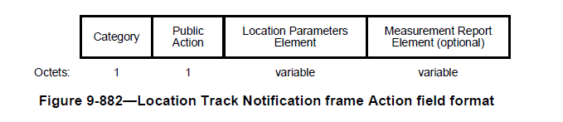
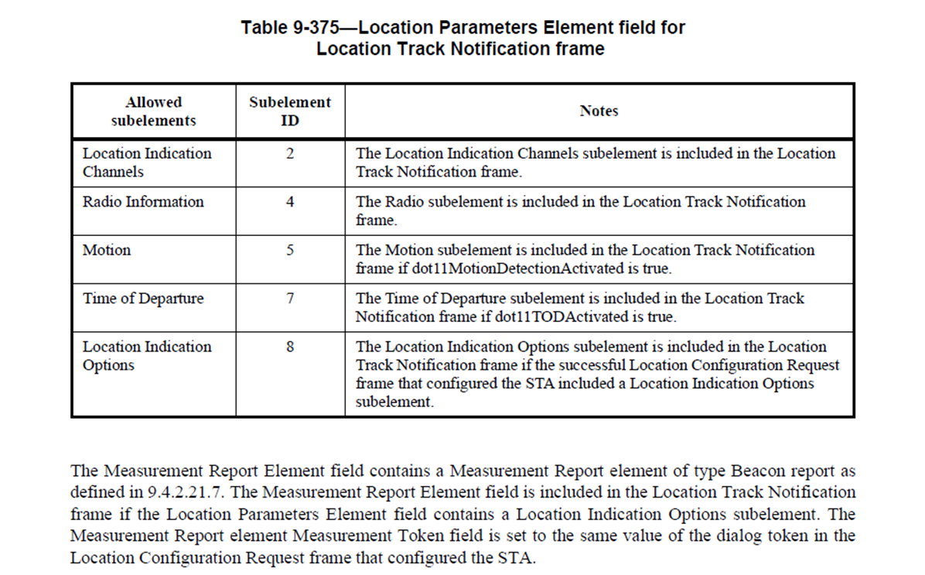
Backup- Location Tracking Details from 802.11-2020
“The Broadcast Target Data Rate field specifies the target data rate at which the STA transmits Location
Track Notification frames. The Broadcast Target Data Rate field format is specified by the Rate
Identification field defined in 9.4.1.32. A Broadcast Target Data Rate field set to 0 indicates the STA
transmits Location Track Notification frames at a rate chosen by the STA transmitting the Location Track
Notification frames.”

Slide 11
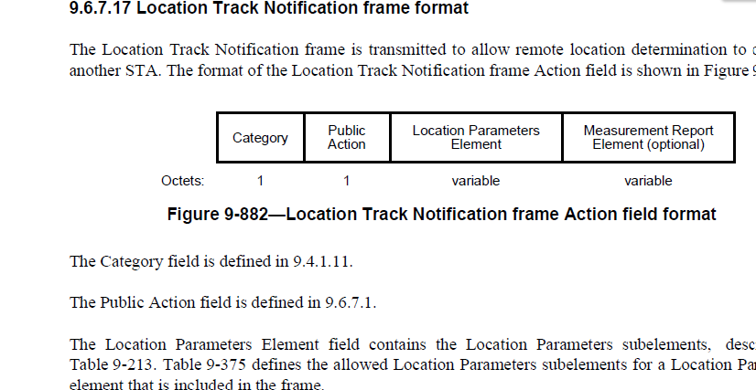
Backup
The Motion subelement field values are valid at the time of transmission of the Location Track Notification frame containing the subelement.
11.21.4.2 – d)4) If the Tracking Duration is 0 the STA shall continuously transmit Location Track Notification
frames as defined by Normal and In-Motion Report Interval field values until configured to
terminate transmission as described 11.21.4.1.

