Slide 1
Coordinated Spatial Nulling (C-SN) Concept
Date: 2024-01-03

Slide 2
Introduction
Previous submissions presented Multi-AP joint transmission [1, 2] and Coordinated Spatial Re-Use [3]
  While JT achieves significant gains under ideal conditions, synchronization and backhaul capacity requirements are demanding
  Coordinated spatial re-use (C-SR) results for a residential scenario are shown in [3]. There is a limited rate increase in dense environments, but latency can be improved.
This contribution further investigates:
  A framework for coordinated spatial nulling (C-SN) using the same feedback method as presented in [3]
  Miscellaneous technical aspects of C-SN (time alignment, sounding options, precoding options, overhead, …)
  Accompanying simulation results included in [10]

Slide 3
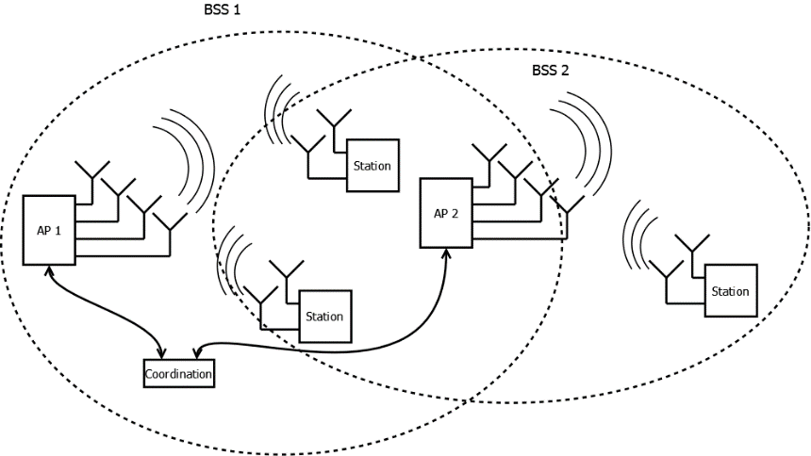
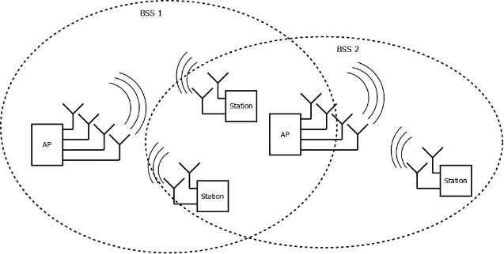
OBSS Cooperation Scenarios
OBSS (Half coordinated)
No central coordination
AP-STA association is fixed
Primary AP gains channel, triggers the spatial nulling transmission, but doesn’t do a power back-off (it has no information about secondary AP)
Secondary AP(s) limit interference into primary transmission (through nulling and/or power backoff)
OBSS (Fully coordinated)
Central/joint coordination
AP-STA association is fixed
Primary AP triggers transmission
APs do joint throughput/latency optimization (e.g., by precoder computation at a central point)

Slide 4
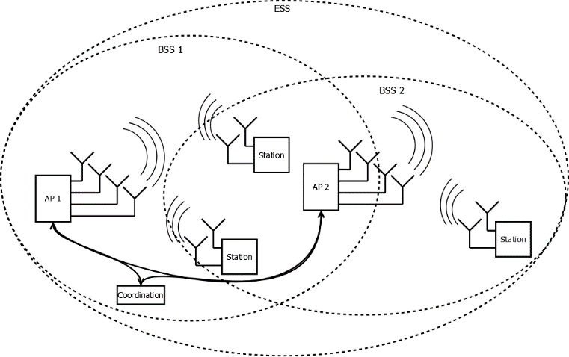
ESS Cooperation Scenarios
ESS (fully coordinated)
  Central/joint coordination (can be part of one of the APs)
  Unlike OBSS cases, AP-STA association can be optimized
  throughput/latency optimization is done for primary and secondary APs jointly

Slide 5
Need for Trigger in C-SN
Need for Time Alignment
  Symbol alignment is needed for precoding to be effective
  Start-time alignment is needed because otherwise the (non-precoded) preamble (before the EHT-LTF) will cause full crosstalk from the secondary APs into the primary AP transmission
To avoid interference, C-SN transmissions shall start simultaneously, triggered by the primary AP (for both half coordinated and fully coordinated)
Trigger Frame Contents
  To simplify the C-SN operation, the trigger frame may include necessary information, e.g., the STAs served and the acceptable interference per STA (e.g., when a higher level of interference than indicated by the STA feedback is acceptable, due to the selected MCS)

Slide 6
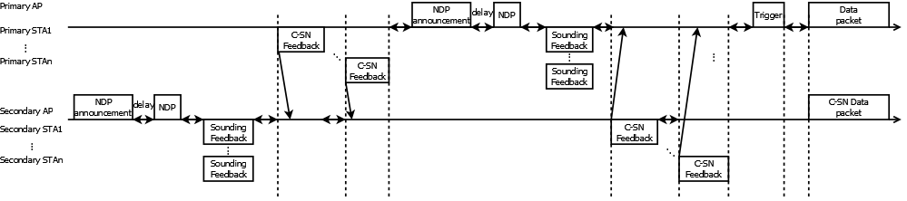
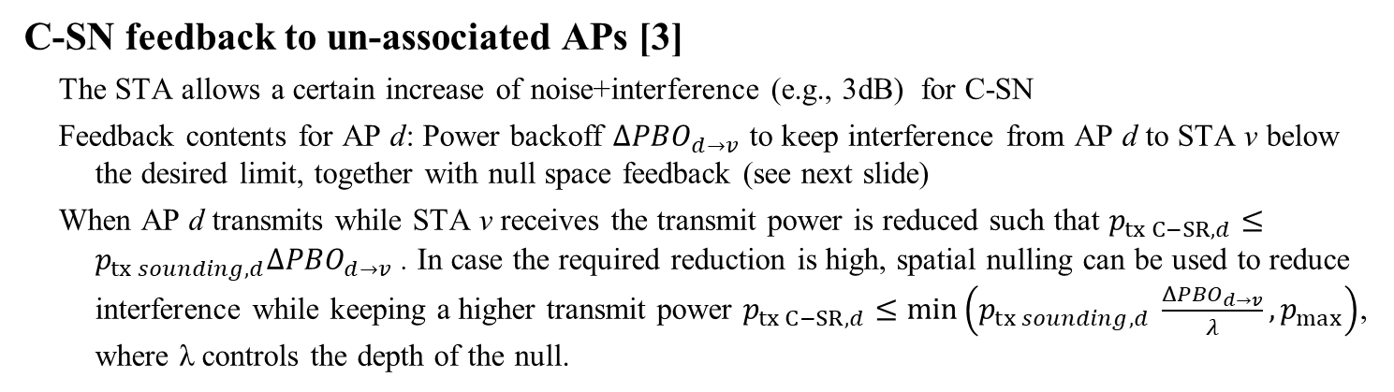
Sounding Feedback for C-SN
C-SN feedback to un-associated APs [3]
  The STA allows a certain increase of noise+interference (e.g., 3dB) for C-SN
  Feedback contents for AP d: Power backoff ${ΔPBO}_{d→v}$ to keep interference from AP d to STA v below the desired limit, together with null space feedback (see next slide)
  When AP d transmits while STA v receives the transmit power is reduced such that $p_{tx C−SR,d}≤p_{tx sounding,d}{ΔPBO}_{d→v}$ . In case the required reduction is high, spatial nulling can be used to reduce interference while keeping a higher transmit power $p_{tx C−SR,d}≤min\left(p_{tx sounding,d} \frac{{ΔPBO}_{d→v}}{λ},p_{max}\right)$, where λ controls the depth of the null.

Slide 7


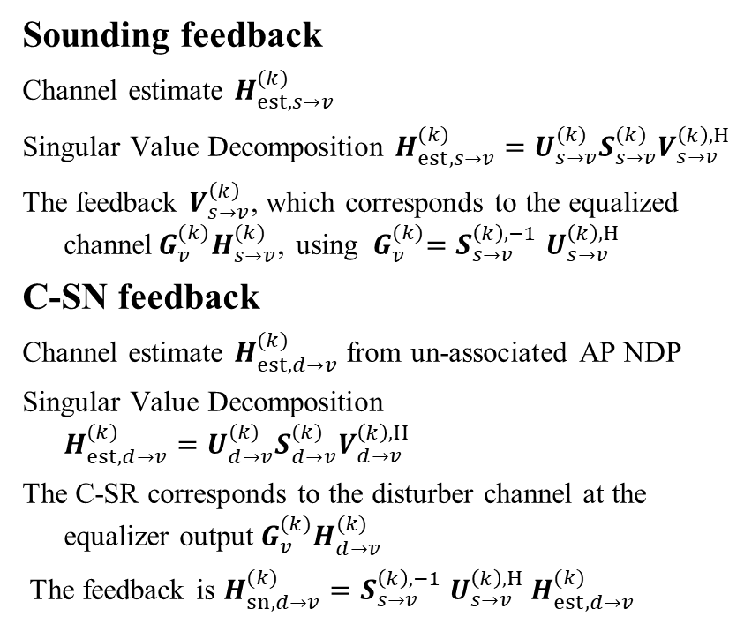
Null Space Feedback
Sounding feedback
  Channel estimate $H_{est,s→v}^{(k)}$
  Singular Value Decomposition ${H_{est,s→v}^{(k)}=U_{s→v}^{(k)}S}_{s→v}^{(k)}V_{s→v}^{\left(k\right),H}$
  The feedback $V_{s→v}^{\left(k\right)}$, which corresponds to the equalized channel${ G}_{v}^{(k)}H_{s→v}^{(k)}$, using ${ G}_{v}^{(k)}=S_{s→v}^{\left(k\right),−1}$ $U_{s→v}^{\left(k\right),H}$
C-SN feedback
  Channel estimate $H_{est,d→v}^{(k)}$ from un-associated AP NDP
  Singular Value Decomposition ${H_{est,d→v}^{(k)}=U_{d→v}^{(k)}S}_{d→v}^{(k)}V_{d→v}^{\left(k\right),H}$
  The C-SR corresponds to the disturber channel at the equalizer output${ G}_{v}^{(k)}H_{d→v}^{(k)}$
  The feedback is ${H_{sn,d→v}^{(k)}=S}_{s→v}^{\left(k\right),−1}$ $U_{s→v}^{\left(k\right),H} H_{est,d→v}^{(k)}$
Associated AP s
Un-associated AP d
Sounding feedback v➔s
C-SR/C-SN feedback v➔d
Sounding NDP s➔v
Sounding NDP d➔v
STA v

Slide 8
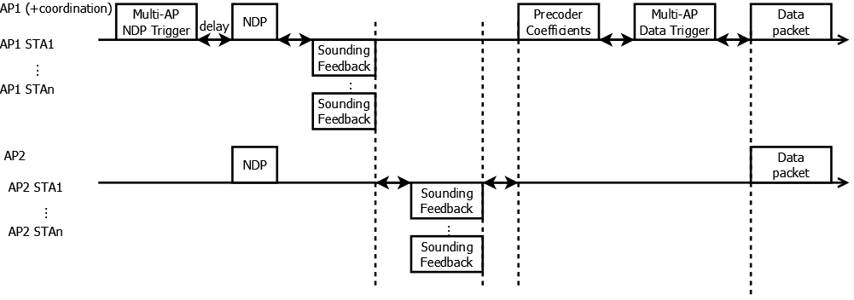
Multi-AP Joint Sounding
Joint Sounding for Joint Precoder Optimization
  Multi-AP sounding can be done jointly to increase efficiency
  Different APs act like a single AP and send the LTFs jointly (each AP uses a different spatial mapping on the LTFs)
  For joint precoder optimization, the sounding feedback is collected at the central coordination (e.g., AP1) to calculate precoders
  The precoders are distributed to other APs with a precoder message

Slide 9
C-SN Optimal Partial Nulling
AP 1
AP 2
C-SR with only power back-off (no nulling) and C-SN with perfect nulling are extreme cases
Interference can be reduced by reducing transmit power or using spatial nulling or a combination of both
A perfect null (zero-forcing) often leads to an ill-conditioned precoder matrix. To avoid that, partial nulling with the nulling depth λ can be used (see appendix slide).
  Perfect nulling can be worse than no nulling
null
null
data
data
STA 1
STA 2
Partial nulling
Perfect nulling
No nulling

Slide 10
Sounding Overhead (Approximation)
Assumptions
  Baseline is MU-MIMO TDMA
  TXOP duration: 6ms
  Desired sounding interval around 10ms (or 2 TXOPs)
  All management frames sent with MCS 0, full bandwidth
  C-SN feedback is 2 byte per carrier group
MU-MIMO Sounding (2 OBSS)
  Sounding overhead is approx. 7% of airtime
MU-MIMO Sounding+C-SN feedback
  Overhead increase 7%➔10% (for C-SN feedback)
Joint Sounding
  Reduced overhead 7%➔6%

Slide 11
Conclusion and Next Steps
We analyzed requirements for C-SN
  Start-time alignment and symbol alignment are needed
  Sounding feedback needs to be enhanced
    Either separate or joint sounding
    Joint sounding enhances efficiency
  Nulling depth of C-SN has to be optimized
    Perfect nulling is not needed and sometimes disadvantageous
Simulations will be presented in [10]

Slide 12
References
[1] “Multi-AP Simulations: framework and Joint Transmission results”, IEEE 802.11-23/1176r1
[2] “Multi-AP Simulations: follow-up”, IEEE 802.11-23/1843r0
[3] “Coordinated spatial re-use for UHR”, IEEE 802.11-23/1975r0
[3] “Spatial Reuse in Coordinated M-AP for UHR”, IEEE 802.11-23-0058r0
[4] Sigurd Schelstraete (Maxlinear), “SINR-aware Spatial Reuse”, IEEE 802.11-22/1970r0, November 2022
[5] “Performance of C-BF and C-SR”, IEEE 802.11-22/0776r1
[6] Gary Anwyl et. al“Coordinated Spatial Reuse in a 4 AP Topology”, IEEE 802.11-23-1023r2
[7] Kanke Wu et. al“Performance of Coordinated Spatial Reuse”, IEEE 802.11-23-1037r0
[8] “TGax Simulation Scenarios”, IEEE 802.11-14/0621r3, Simone Merlin, etc.
[9] Sigurd Schelstraete et.al.,“Nulling and coordinated beamforming” IEEE 802.11-19/0638
[10] Rainer Strobel et.al.,“Coordinated Spatial Nulling (C-SN) Simulations” IEEE 802.11-24/0012

Slide 13
APPENDIX

Slide 14
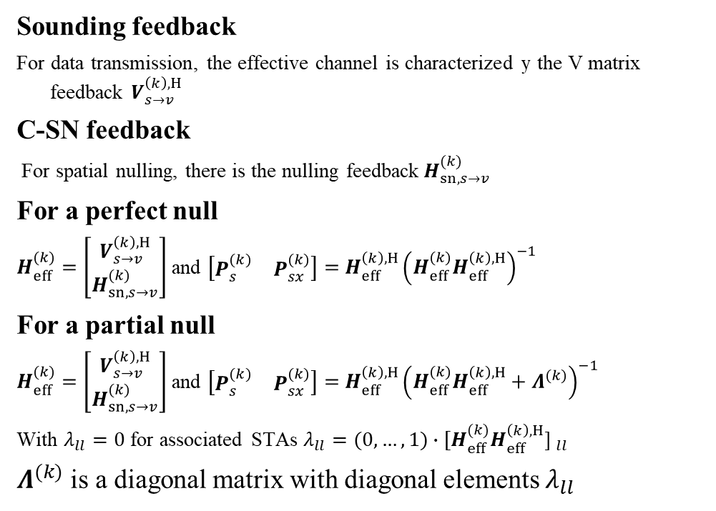
Partial Null vs. Perfect Null
Sounding feedback
  For data transmission, the effective channel is characterized y the V matrix feedback $V_{s→v}^{\left(k\right),H}$
C-SN feedback
  For spatial nulling, there is the nulling feedback$H_{sn,s→v}^{(k)}$
For a perfect null
  $H_{eff}^{(k)}=\left[\begin{matrix}V_{s→v}^{\left(k\right),H} \\ H_{sn,s→v}^{(k)}\end{matrix}\right]$ and $\left[\begin{matrix}P_{s}^{(k)} & P_{sx}^{(k)}\end{matrix}\right]=$ $H_{eff}^{\left(k\right),H}{\left({H_{eff}^{(k)}H}_{eff}^{\left(k\right),H}\right)}^{−1}$
For a partial null
  $H_{eff}^{(k)}=\left[\begin{matrix}V_{s→v}^{\left(k\right),H} \\ H_{sn,s→v}^{(k)}\end{matrix}\right]$ and $\left[\begin{matrix}P_{s}^{(k)} & P_{sx}^{(k)}\end{matrix}\right]=$ $H_{eff}^{\left(k\right),H}{\left({H_{eff}^{(k)}H}_{eff}^{\left(k\right),H}+Λ^{(k)}\right)}^{−1}$
  With $λ_{ll}=0$ for associated STAs $λ_{ll}=(0,…,1)∙{[{H_{eff}^{(k)}H}_{eff}^{\left(k\right),H}\text{] }}_{ll}$
  $Λ^{(k)}$ is a diagonal matrix with diagonal elements $λ_{ll}$
AP 1
AP 2
null
null
data
data
STA 1
STA 2

Slide 15
Nulling Accuracy – contributing factors
ZF Nulling is not perfect in practice
  Channel estimation accuracy (feedback format, grouping and interpolation)
  Channel aging
  Clock differences between APs
Example
  STA1 and STA 3 associated with AP1, AP2 serves STA2 and 4 and creates a spatial null to STA 1 and 3.
  Interference and noise contributions are shown for STA 1.
  The sounding interval is 10ms with 1.2km/h movement speed, clock offset is ±0.07ppm.
  Aging is the main contributor limiting the null depth.

