Slide 1
Existing Technologies Consideration
Date: 2024-01-02
Authors:

Slide 2
Abstract
IMMW SG can be viewed as a renewed purpose for 60 GHz spectrum.
There’s a strong desire to leverage existing MAC/PHY from sub-7 GHz.
Renewed interest in 60 GHz is greatly appreciated!
From November’s Plenary, there was much discussion of what we think was wrong with 11ad/11ay. However, there is a growing number of devices deployed around the world.
  This is evidence we got at least some things right.
In defining a new TG we should consider what does work with mmWave.
Our roadmap here should include both interoperability and lessons learned.

Slide 3
“The reports of my death are greatly exaggerated.” – Mark Twain

Slide 4
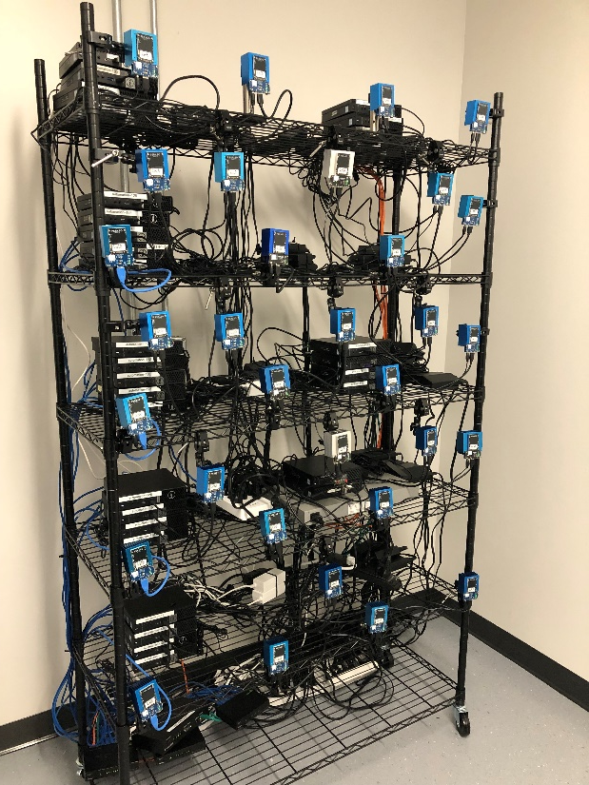
Existing Applications: Point-to-Point (PtP) and Point-to-Multipoint (PtMP) Networking
Largest application space for products based on IEEE 802.11ad
  Many deployments around the world.
Multi-gigabit last mile connectivity at a much lower cost than copper or fiber
Requires both:
  Extremely high throughput (AP, PtP backhaul)
  Low throughput (dense networks, low-cost CPEs)
Long range is critical: fewer APs, larger coverage, lower costs

Slide 5
PtP, PtMP Networking: Things We Got Right
Directivity at 60 GHz. Benefits of channels 5, 6.
  Deployments exist for ranges from 30 km (backhaul, repeater) down to less than 100 m (last mile and CPE applications).
  Higher directivity increases spatial reuse. Adaptive features maximize parallel transmission between multiple BSSs in dense networks.
  Directivity is the balance to pathloss. Channels 5, 6 are awesome at longer distances even with relatively small antennas.
Beamforming
  Higher directivity means training beams. Trading off coverage for gain also means training beams.
  Bi-directional BRP lets us resolve beams quickly. Very useful for changing conditions, where “conditions” also includes interference, multipath, and many other factors.

Slide 6
PtP, PtMP Networking: Things We Got Right, Things to Consider
More and Less throughput
  APs, being an aggregation point, generally need to use as much bandwidth as the medium will allow.
  In general, bigger pipes mean smaller bursts of traffic will count more. This is especially useful in dense networks. It’s one way we avoid contention.
  ½ and ¼ bandwidth modes are very useful for dense networks. (Not part of .11ad/.11ay but worthy of future consideration).
  North America: Market demand is for >1 Gb links.
  The rest of the world: Market demand is for lower throughput links. Density and deployment cost (simplicity) are key factors.
    Number of clients and spatial diversity are critical.

Slide 7
PtP, PtMP Networking: Things We Got Right, Things to Consider
Simplicity of 11ad Single Carrier PHY
  Leads directly to cost savings.
  < MCS 9 can employ transmitters in the non-linear region. (More EIRP, no predistortion required)
  Higher efficiency versus OFDM.
  Great for maintaining connectivity, good throughput, and link reliability.
Reverse direction data transfer. Helps to reduce contention in networks with many STAs.

Slide 8
Indoor Applications That Work
The “Directive” part of DMG is crucial to indoor applications, even at short distances.
The balance is coverage (how wide we can make a beam) versus range.
In almost all indoor applications, and especially dynamic scenarios, rapid beamforming is critical to maintaining a good link.
These applications often require high continuous throughput or bursty traffic.
An attractive feature for all these applications is the lack of interference from sub-7 GHz devices, and cooperation between existing devices in this band.

Slide 9
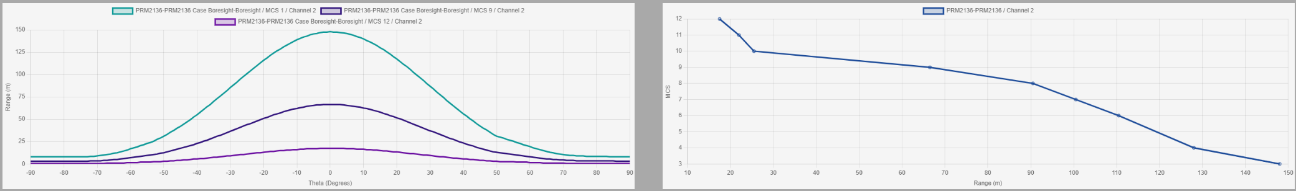
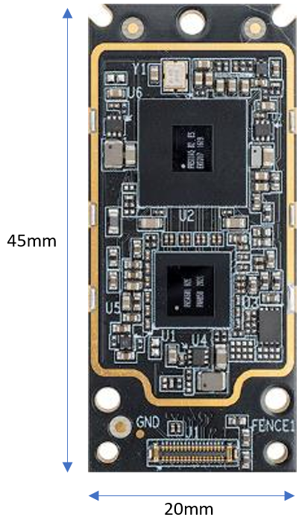
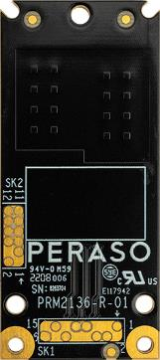
Indoor Applications That Work [1]
29 dBm EIRP
Polarization diversity with Horizontal and Vertically polarized arrays.
  Beamforming done across both arrays individually to find best link.
22 – 47°HPBW
Up to 120˚steering range

Slide 10
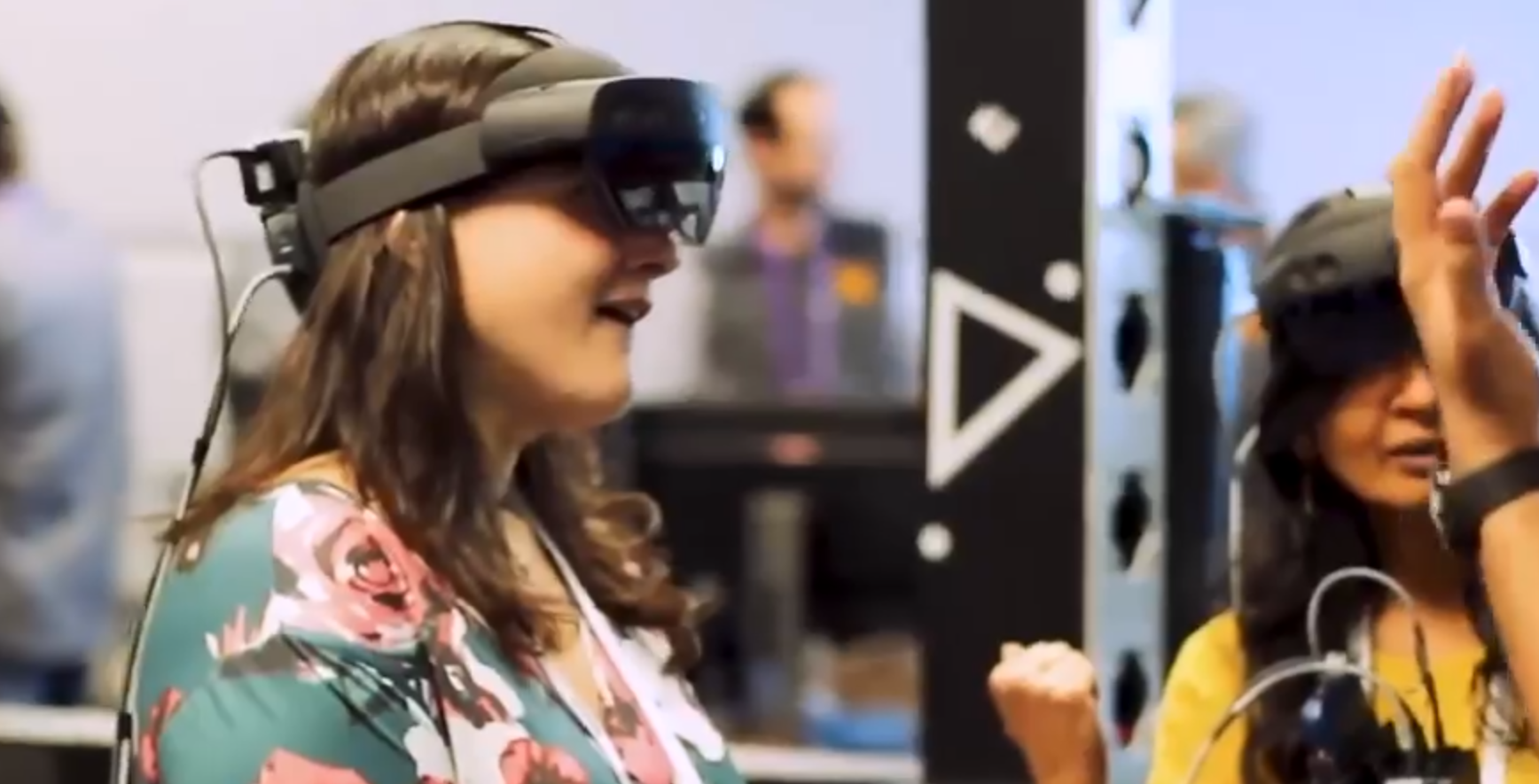
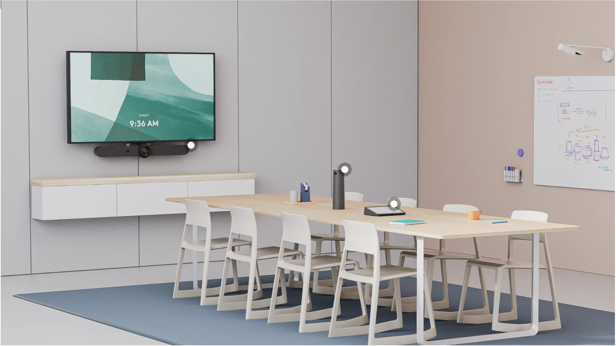
Indoor Applications That Work
Classroom/lecture hall projection.
  Bursty traffic. Longer ranges (to 20 m). Partially occluded STAs. Fast beamforming to adapt for STA movement. Power savings critical.
Fast sync for users entering/exiting vehicles.
  Huge bursts up and downlink for short periods. Short range. Quick connect/disconnect. Dynamic beamforming.
Wireless conference room.
  Multiple devices with steady stream of low- to high-throughput. Medium ranges (10-15m).
VR/XR [2].
  Extremely high beamforming rate. Constant medium to high downlink throughput. Ranges up to 20 m.

Slide 11
Things to Keep: Preamble, PHY Header Compatibility
The current 11ad/11ay preamble is the primary method of detection and interference mitigation.
Coherent detection (as opposed to just Energy Detection (ED)) is used because
  Correlation based methods are more sensitive than ED when pulling packets out of the noise. This helps with hidden node issues.
  Coherent detection allows us to gain knowledge of other BSSs, improve interference mitigation, and improve spatial reuse.
  PHY header gives us packet length, destination (useful for medium efficiency, power saving, spatial reuse)
We view this as an important requirement for backward compatibility, not to only rely on ED.

Slide 12
Conclusions
When creating a PAR, we should consider what does currently work in mmWave.
  Beamforming is important to get the right gain/coverage tradeoff for reliable communications. This is especially true for indoor applications.
  Backward compatibility is important. Relying on ED alone will lead to poor user experience.
  Single Carrier has many benefits over OFDM and should be considered.

Slide 13
References
[1] https://shop.richardsonrfpd.com/docs/rfpd/PRM2136X_brief.pdf
[2] https://xcom-labs.com/xcom-labs-demonstrates-wireless-xr-iitsec2022/

