Slide 1
Draft Response to ITU-T SG20 LS on the draft Technical Report ITU-T YSTR.Ambient IoT
January 2024
Doc.: IEEE 802.11-23/2202r2
Date: 2024-01-16
Authors:
Name | Affiliation | Address | Phone | Email
Yinan Qi | OPPO |  |  | v-qiyinan@oppo.com
Weijie Xu

Slide 2
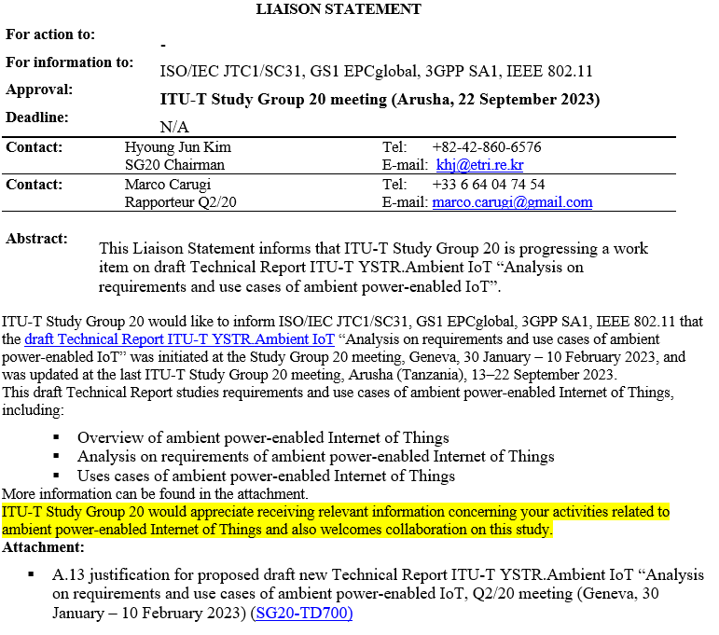
Background
January 2024
Doc.: IEEE 802.11-22/2202r2

Slide 3
Proposed Response (1)
January 2024
Doc.: IEEE 802.11-22/2202r2
Dear ITU-T Study Group 20 Members,
Thank you for notifying IEEE 802.11 about the commencement of the Ambient power-enabled (AMP) IoT study and the initiation of drafting the Technical Report titled "Analysis on requirements and use cases of ambient power-enabled IoT" within ITU-T Study Group 20. We acknowledge your inquiry regarding our relevant activities.
In response, we would like to update you on the progress of the study on AMP IoT in IEEE 802.11, which has undergone the following phases:
Technical Interest Group (TIG) for AMP: A TIG focused on AMP was established during the IEEE 802.11 meeting in May 2022. The primary outcome of this research is a technical report [1] that encompasses use cases, requirements, prototypes, technical and economic feasibility analysis, and more. The TIG concluded its work during the IEEE 802.11 meeting in March 2023.
Following the TIG, a study group (SG) was formed in IEEE 802.11 meeting in March 2023. Discussions within this group covered aspects such as Tx/Rx architectures, deployment topologies, operation frequency bands, etc. The objective of the SG is to develop Project Authorization Request (PAR) and Criteria for Standards Development (CSD) for AMP IoT study. Following the discussion in the SG, the technical report is further updated [2].

Slide 4
Proposed Response (2)
January 2024
Doc.: IEEE 802.11-22/2202r2
Future meeting dates:
See: http://www.ieee802.org/11/Meetings/Meeting_Plan.html for Future meeting dates of the IEEE 802.11 Working Group
References
[1] “Technical Report on support of AMP IoT devices in WLAN”, Weijie Xu, Yinan Qi, etc., 15 Mar. 2023, https://mentor.ieee.org/802.11/dcn/23/11-23-0436-00-0amp-technical-report-on-support-of-amp-iot-devices-in-wlan.docx
[2] “Technical Report on support of AMP IoT devices in WLAN”, Weijie Xu, Yinan Qi, etc., 15 Nov. 2023, https://mentor.ieee.org/802.11/dcn/23/11-23-2203-00-0amp-updated-technical-report-on-support-of-amp-iot-devices-in-wlan.docx

Slide 5
Summary
January 2024
Doc.: IEEE 802.11-22/2202r2
This submission provides a response to ITU-T SG20 Liaison regarding activities on AMP IoT within 802.11 group.

