Slide 1
Draft Response to ITU-T SG20 LS on the draft Technical Report ITU-T YSTR.Ambient IoT
December 2022
Doc.: IEEE 802.11-23/2202r0
Date: 2023-12-19
Authors:
Name | Affiliation | Address | Phone | Email
Yinan Qi | OPPO |  |  | v-qiyinan@oppo.com
Weijie Xu

Slide 2
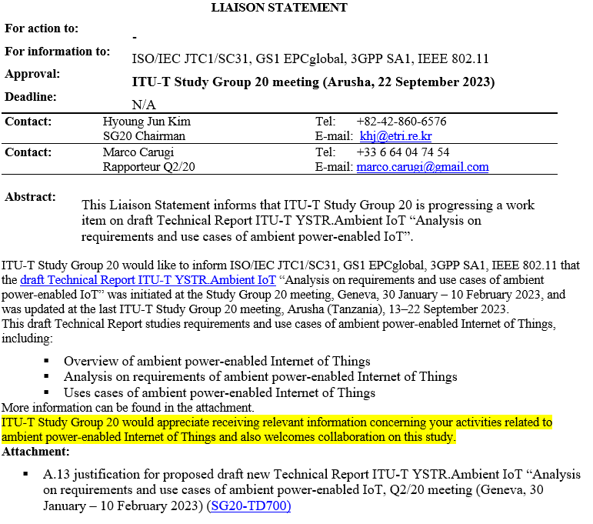
Background
December 2022
Doc.: IEEE 802.11-22/2202r0

Slide 3
Proposed Response (1)
December 2022
Doc.: IEEE 802.11-22/2202r0
Dear ITU-T Study Group 20 Members,
Thank you for notifying IEEE 802.11 about the commencement of the Ambient power-enabled (AMP) IoT study and the initiation of drafting the Technical Report titled "Analysis on requirements and use cases of ambient power-enabled IoT" within ITU-T Study Group 20. We acknowledge your inquiry regarding our relevant activities.
In response, we would like to update you on the progress of the study on AMP IoT in IEEE 802.11, which has undergone the following phases:
Technical Interest Group (TIG) for AMP: A TIG focused on AMP was established during the IEEE meeting in May 2022. The primary outcome of this research is a technical report [1] that encompasses use cases, requirements, prototypes, technical and economic feasibility analysis, and more. The TIG concluded its work during the IEEE meeting in March 2023.
Following the TIG, a study group (SG) was formed in IEEE meeting in March 2023. Discussions within this group covered aspects such as Tx/Rx architectures, deployment topologies, operation frequency bands, etc. With valuable contributions from involved IEEE 802.11 members, the objectives of the AMP IoT study were incorporated into the agreed Project Authorization Request (PAR) and Criteria for Standards Development (CSD) [2]-[3]. In the IEEE plenary meeting in November 2023, consensus was reached to establish a Task Group (TG) for specification purposes.

Slide 4
Proposed Response (2)
December 2022
Doc.: IEEE 802.11-22/2202r0
Future meeting dates:
See: http://www.ieee802.org/11/Meetings/Meeting_Plan.html for Future meeting dates of the IEEE 802.11 Working Group
References
[1] “Technical Report on support of AMP IoT devices in WLAN”, Weijie Xu, Yinan Qi, etc., 15 Mar. 2023, https://mentor.ieee.org/802.11/dcn/23/11-23-0436-00-0amp-technical-report-on-support-of-amp-iot-devices-in-wlan.docx
[2] “IEEE 802.11 AMP PAR Proposal”, Bo Sun, Weijie Xu, and Yinan Qi, 16 Nov. 2023, https://mentor.ieee.org/802.11/dcn/23/11-23-1006-04-0amp-ieee-802-11-amp-sg-proposed-par.docx
[3] “IEEE 802.11 AMP SG Proposed CSD”, Bo Sun, Weijie Xu, and Yinan Qi, 16 Nov. 2023, https://mentor.ieee.org/802.11/dcn/23/11-23-1212-02-0amp-ieee-802-11-amp-sg-proposed-csd.docx

Slide 5
Summary
December 2022
Doc.: IEEE 802.11-22/2202r0
This submission provides a response to ITU-T SG20 Liaison regarding activities on AMP IoT within 802.11 group.

