Slide 1
TXOP Adjustment for inter-BSS R-TWT Schedule Protection
Date: 2024-01-10
Authors:
Name | Affiliations | Address | Phone | email
Dana Ciochina | Sony Group Corporation |  |  | Dana.Ciochina@sony.com
Thomas Handte |  |  |  | Thomas.Handte@sony.com
Daniel Verenzuela
Salvatore Talarico
Qing Xia
Yusuke Tanaka |  |  |  | Yusuke.YT.Tanaka@sony.com
Kosuke Aio
Ryuichi Hirata
Ken Tanaka

Slide 2
Introduction
R-TWT has been proposed as mechanism to prioritize low latency traffic [1] and is envisioned to assist in multi-AP coordination [2], [3]
Current protection mechanisms are only applicable to intra-BSS scenarios
  Extensions for inter-BSS scenarios need to be defined
Initial solutions to protect R-TWT schedules from oBSS STAs have been discussed in [4]-[7]
  Schedule coordination [4]
  Selective consideration of oBSS schedules [5]- [7]
  STAs reporting neighboring AP’s R-TWT [5]

Slide 3
Challenges regarding inter-BSS Protection
Defining the right action to be taken based on scheduling information from multiple BSSs may depend on many factors
    Some STAs within a BSS may impact or be impacted by transmissions from a neighboring BSS, whereas others may not
      How much schedule information should be propagated
      How much should the quiet element protection be extended?
    Some schedules may be full or have critical start time requirements whereas others may be more flexible regarding the start time
    Various levels of coordination between the APs may be possible
    An EHT or UHR STA may have urgent low latency traffic to transmit even though it is not a member of the upcoming R-TWT
Requiring non-AP STAs to respect quiet elements or large amount of schedule information from neighboring BSSs can be complex and inefficient

Slide 4
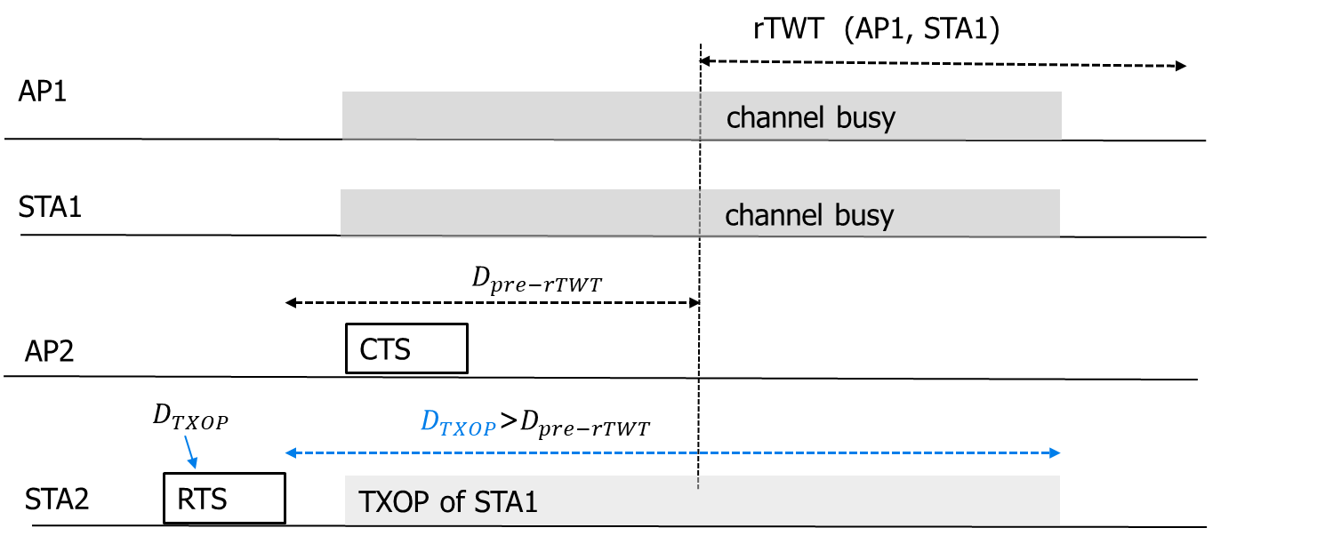
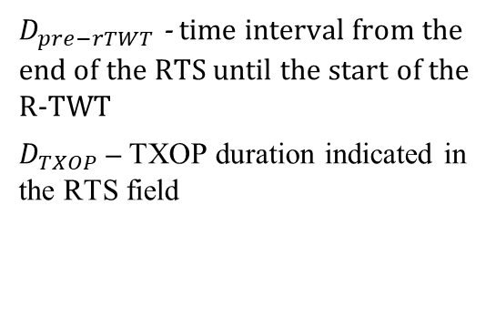
Proposed Approach Idea
Consider the original problem
  a STA from one BSS requests a TXOP overlapping with the R-TWT set up by an AP in another BSS
$D_{pre−rTWT}$ - time interval from the end of the RTS until the start of the R-TWT
$D_{TXOP}$– TXOP duration indicated in the RTS field
Prerequisite
  the APs know the schedule information of neighboring APs
Proposed approach
  allow an AP to handle such cases individually, depending on available scheduling information and requests from neighboring APs, as well as traffic requirements of the requesting STA

Slide 5
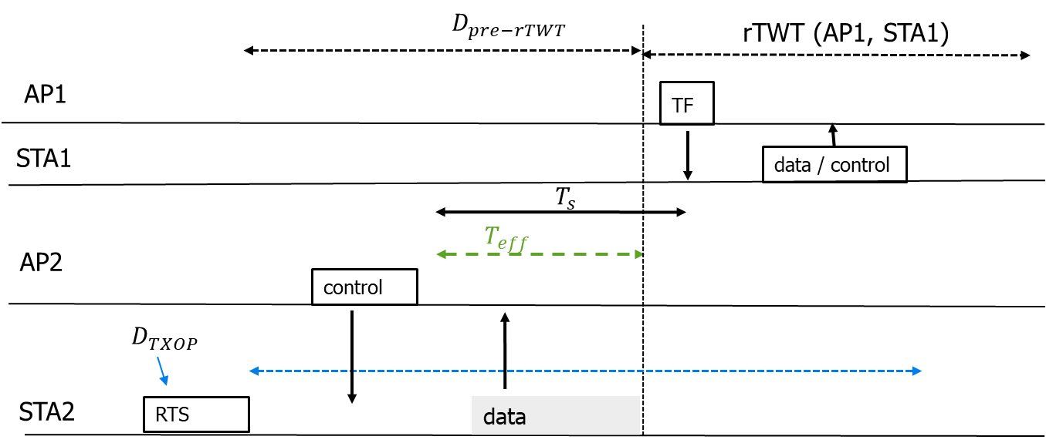
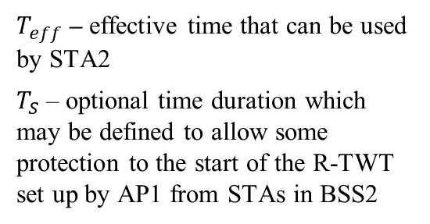
Initial Solution for inter-BSS Protection
Assumptions:
  no information available at AP2 regarding potential urgent traffic at STA2 (e.g., based on an SCS stream)
  not possible to accommodate STA2 traffic after the R-TWT boundary (due to e.g., interference levels, full schedule, or no multi-AP coordination scheme active)
Solution: AP2 adjusts the parameters of an overlapping requested TXOP to indicate
  to stop the TXOP at the boundary of the incoming R-TWT or
  defer transmission, if the remaining time until the start of the R-TWT is too short
$T_{eff}$– effective time that can be used by STA2
$T_{S}$– optional time duration which may be defined to allow some protection to the start of the R-TWT set up by AP1 from STAs in BSS2
Adjusts the effective duration the TXOP can be used for, via $T_{S}$, and $T_{eff}$ parameters

Slide 6
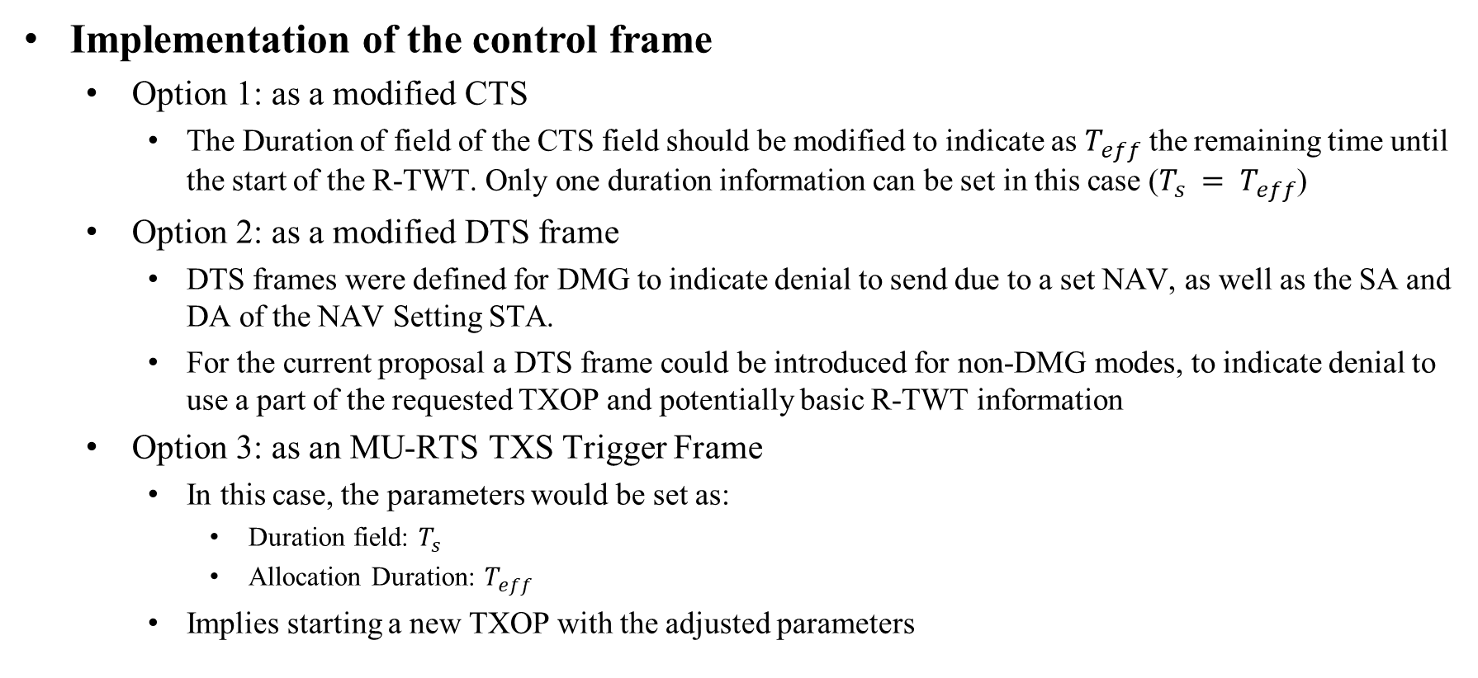
Initial Solution for inter-BSS Protection
Implementation of the control frame
  Option 1: as a modified CTS
    The Duration of field of the CTS field should be modified to indicate as $T_{eff}$ the remaining time until the start of the R-TWT. Only one duration information can be set in this case ($T_{s} = T_{eff}$)
  Option 2: as a modified DTS frame
    DTS frames were defined for DMG to indicate denial to send due to a set NAV, as well as the SA and DA of the NAV Setting STA.
    For the current proposal a DTS frame could be introduced for non-DMG modes, to indicate denial to use a part of the requested TXOP and potentially basic R-TWT information
  Option 3: as an MU-RTS TXS Trigger Frame
    In this case, the parameters would be set as:
      Duration field: $T_{s}$
      Allocation Duration: $T_{eff}$
    Implies starting a new TXOP with the adjusted parameters

Slide 7
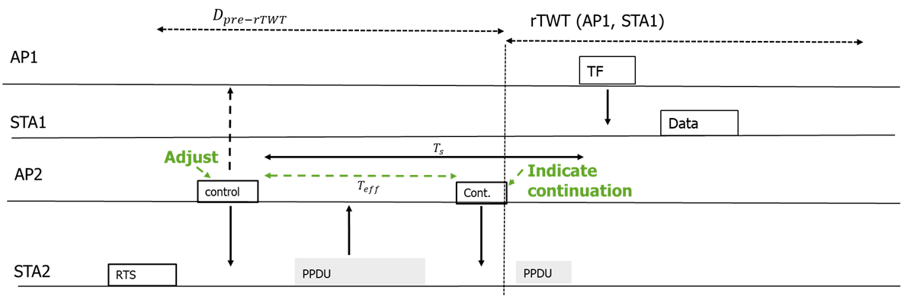
Extended Solution - Protection with Fairness Constraints (1/3)
Goal: balance both traffic requirements of STA2 and the schedule information
Solution: AP2 adjusts the TXOP or initiates a new TXOP such that:
  a first part of the TXOP until the schedule could be used by STA2
  the continuation is decided at R-TWT border depending on the traffic type, schedule parameters, coordination information and prior negotiation between the two APs
Figure: Example with one type of continuation

Slide 8
Extended Solution - Protection with Fairness Constraints (2/3)
A continuation can be:
  allowed if STA2 traffic has similar TID as the one in the R-TWT or urgent transmission requirement
  allowed in C-TDMA fashion, if previously negotiated between APs e.g., hand over remaining TXOP to AP1
  allowed with adjusted transmit power, if CSR is possible e.g., overlap UL transmissions with adjusted power
  not allowed if none of the conditions above satisfied
    E.g., continuation is a CF-End with the PPDU ending at the border of the R-TWT start

Slide 9
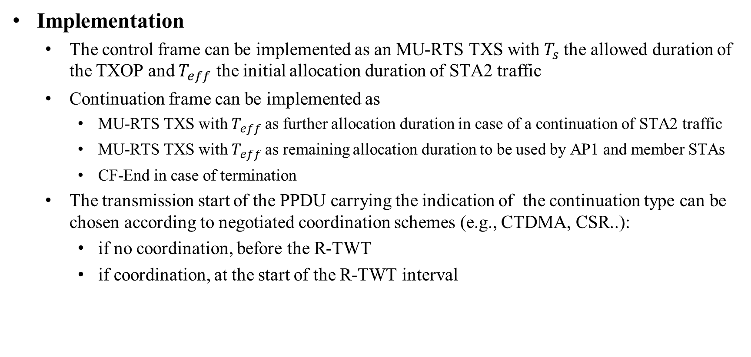
Extended Solution - Protection with Fairness Constraints (3/3)
Implementation
  The control frame can be implemented as an MU-RTS TXS with $T_{s}$the allowed duration of the TXOP and $T_{eff}$ the initial allocation duration of STA2 traffic
  Continuation frame can be implemented as
    MU-RTS TXS with $T_{eff}$as further allocation duration in case of a continuation of STA2 traffic
    MU-RTS TXS with $T_{eff}$as remaining allocation duration to be used by AP1 and member STAs
    CF-End in case of termination
  The transmission start of the PPDU carrying the indication of the continuation type can be chosen according to negotiated coordination schemes (e.g., CTDMA, CSR..):
    if no coordination, before the R-TWT
    if coordination, at the start of the R-TWT interval

Slide 10
Pros and Cons
Advantages of the proposed solutions:
  Low implementation complexity at non-AP STA
    The proposed solutions can improve the protection mechanisms from oBSS STAs, without requiring the oBSS STAs to determine, save or respect a large amount of schedule information
  Existing frameworks can be adapted to implement the proposed methods
  The proposed techniques can be further enhanced to consider different coordination techniques
Disadvantages
  Allowing an AP to change the TXOP parameters that a STA requested should be done with care to avoid overuse and to guarantee fairness
  A STA may need to reparse the packets to fit the adjusted TXOP duration

Slide 11
Summary
Protection mechanisms for scheduling intervals from oBSS STAs still need to be defined
  Schedule information exchange and negotiation may be heavy on the non-AP STAs
We have introduced a mechanism to increase the protection of an R-TWT from oBSS STAs with two flavors
  Both aim at limiting the amount of schedule information and rules that a non-AP STA needs to follow
  The initial solution assumes an AP adjusting a requested TXOP based on R-TWT information
  An enhanced solution assumes an AP adjusting a requested TXOP based on, in addition to the R-TWT information, the traffic requirements of the oBSS STA

Slide 12
References
[1] 11-20/1046r12 Protected TWT Enhancement for Latency Sensitive Traffic
[2] 11-23/226r2 Considerations for AP coordination in UHR: Coordinated Medium Access
[3] 11-23/rTWT for Multi-AP
[4] 11-23/291 R-TWT Multi-AP Coordination
[5] 11-23/250r0 AP Coordination
[6] 11-23/0771r0 Coordinated R-TWT Protection in Multi-BSS
[7] 11-23/1087r0 Announcement for R-TWT Coordination

