Slide 1
802.11 WG January 2024 Closing Reports
Date: 2024-01-18
Authors:

Slide 2
Attendance Data

Slide 5
Attendees by affiliation
(attended at least one meeting November to January)

Slide 6
Attendance by subgroup (November to January)

Slide 7
Attendance by affiliation (January interim session)

Slide 8
Attendance by breakout (January interim session)

Slide 9
Closing Reports

Slide 10
Abstract
This document is a digest of the closing reports of all 802.11 sub-groups for presentation at the January 2024 closing plenary meeting. Liaison reports (including liaison reports from the opening plenary) are also included.

Slide 11
802.11 WG Editor’s Meeting (January 2024)
Date: 2024-01-18
Authors:

Slide 12
Abstract
Closing report for editors meeting January 2024

Slide 13
Agenda and Report for 2024-01-16 meeting
Roll Call / Contacts / Reflector
Brief status report
Draft and Amendment alignments
  11bc publication and 11be, 11bf, 11bh, 11bk ordering
11bf and 11bh MDR/MEC Planning
  11bf and 11bh MDR/MEC starts in January and will complete in the March meeting
Review updated WG Style Guide (to be covered in the next meeting)
ANA number spaces

Slide 14
January 16 roundtable status report
11bc – In publication editing
11be – 1045 pages for D5.0. Expect to align the draft with the baseline when REVme 5.0 is published with 11az, 11bd, 11bb, and 11bc amendments.
11bf – LB281 just finished. 308 comments. Working on comment resolution. Expect to complete and go to recirc out of the March meeting. Plan to start MDR.
11bh – LB282 just finished, 284 comments, Working through comment resolution. Expect to complete and go to recirc out of the January meeting. Plan to start MDR.
11bi – Plan to have D0.1 out of January meeting session, and check with the group and see whether the draft is ready for CC or not.
11bk –Current draft is D 1.0. completed LB 279, 401 comments. Expect to complete and go to recirc out of the March or May meeting.
REVme – 606 comments on initial SA Ballot. Plan to go SA recirc out of the January meeting. 4 new amendments will be included in recirc.

Slide 15
Editor Amendment Ordering
Data as of November 2023
See http://grouper.ieee.org/groups/802/11/Reports/802.11_Timelines.htm
Changes are usually based on MDR readiness.
Amendment Number | Task Group | Page Count | Projected RevCom Date
802.11-2020 Amendment 7 | TGbc | 121 | Jan or Feb 2024
REVme | TGm | 6119 | Sep 2024
802.11-2024 Amendment 1 | TGbh | 34 | Sep 2024
802.11-2024 Amendment 2 | TGbe | 1031 | Dec 2024
802.11-2024 Amendment 3 | TGbk | 94 | Dec 2024
802.11-2024 Amendment 4 | TGbf | 220 | Mar 2025

Slide 16
11bf and 11bh MDR/MEC Planning
Timeline: Start in Jan 2024 and complete in March 2024.
11bh will be based on D3.0, around Feb 2nd; 11bh review volunteers:
    Robert; Emily ; Edward ; Joseph Levy; Ross; Po-kai; Roy; Carol Ansley; Mark H ... ...
11bf will be based on D3.0, 11bf review volunteers:
    Robert; Emily ; Edward ; Joseph Levy; Ross; Po-kai; Roy; Carol Ansley; Mark H ... ...

Slide 17
Review updated style guide
See: https://mentor.ieee.org/802.11/dcn/09/11-09-1034-21-0000-802-11-editorial-style-guide.docx
No time to cover it. Will be reviewed in the next meeting

Slide 18
Draft Development Snapshot
Changes from last report shown in red.
January 2024
TG | Published or Draft Baseline Document |  |  |  |  |  | Source | MDR | Editor | Snapshot Date
 | Published | me | bh | be | bf | bk
bc | Y |  |  |  |  |  | FrameMaker 2020 | Yes | Carol Ansley | 14-Mar
me | Y | 4.2 |  |  |  |  | FrameMaker 2020 | Yes | Emily Qi, Edward Au | 11-Jan
bh | Y | 4.1 | 2.0 |  |  |  | FrameMaker | No | Carol Ansley | 16-Jan
be | Y | 3.0 |  | 5.0 |  |  | FrameMaker (old) | Yes | Edward Au | 16-Jan
bf | Y | 3.0 |  | 3.2 | 2.1 |  | FrameMaker 2020 | No | Claudio da Silva | 16-Jan
bk | Y | 3.0 | 1.0 | 3.0 | 1.0 | 1.0 | Word | No | Roy Want | 16-Jan

Slide 19
ARC Closing Report
Date: 2024-01-18
Authors:

Slide 20
Abstract
This document is the closing report for ARC SC,
January 2024 Session

Slide 21
Work Completed - 1
Agenda is here: 11-23/2182r6
IEEE Std 802 revision:
  Currently under WG LB (802.1 “hosting”). Not aware of any new comments or issues to discuss here.
  The last significant open issue is what to do to better describe EPD/LPD. Reviewed a a proposal for replacement text, which will remove the EPD and LPD terminology, and instead refer to/describe how the HLPDE does protocol discrimination with a protocol identifier (PI) and how it carries the PI in “LLC protocol” between peer HLPDEs (EtherType, LSAP addresses/SNAP, etc.). Made some edits of suggestions for improvement of the draft.

Slide 22
Work Completed - 2
“Non-infrastructure BSS” and Channel Usage
  Reviewed a proposal for 802.11 language to clarity “non-infrastructure”, and propose that Channel Usage really needs a new concept that focuses on an ESS that provides channel hints to other devices. Gave the author feedback.
WBA E2E QoS presentation
  With invited guest SME, Ganesh Venkatesan. Reviewed a presentation (PPT) describing how L4S can fit with/over 802.11, and also a bit about 802.1Q-QCN. This could likely become a project kicking-off soon.
Annex G:
  The author of an updated proposal progressing the Annex G replacement, was not available. This item is deferred to March.

Slide 23
Monitoring/future activities
    Other items being tracked (but not actively worked unless/until contributions):
    Related to IEEE Std 802 updates (slide 20):
      802.1AC mapping from ISS to 802.11 MAC SAP interface
      Consider any changes to remove 802.2/LLC terms?
      802.11’s “Portal”, and mapping to/usage of IEEE Std 802 terminology
      Access Domains: “802 Access Domains”? In 802.11, an ESS? TGbe implications?
      Is the DS a bridge (small ‘b’)?
      Clarify EPD/LPD within 802.11: 11-20/0174r0
        Follow the lead from 802REVc?
    MLME-RESET, versus MLME-JOIN, MLME-START, MLME-SCAN and MLME-END
      One aspect is how MAC address is set/controlled – related to IEEE 1609/TGbd activities

Slide 24
Plans
Ongoing work:
Monitor results of IEEE P802REVc recirculation ballot
Annex G replacement phase 2, continued
WBA E2E QoS coordination, continued
Monitoring/future activities, or other relevant topics, if any contributions
Teleconferences – Probably will need one, to review P802REVc ballot results/output. Will schedule with 10-days notice.
Two meeting slots requested in March

Slide 25
Coex SC Closing Report
Date: 2024-01-18
Authors:

Slide 26
Abstract
Closing report for IEEE 802.11 Coex SC (Coexistence Standing Committee) for January 2024.

Slide 27
Coex SC’s week at a glance
Met three times
Two Coex SC (only) slots
One Joint session with 15.4.ab
10 Coex Submissions & Discussions with 15.4ab
Made use of every minute of our meeting time
Straw poll on an opening statement of Coex for the joint session

Slide 28
ETSI BRAN Update to 802.11 (1/2)
EN 301 893 (5 GHz)
Work completed
Version 2.2.0 published on 2023-11-16
EN Approval Procedure (ENAP) in progress
EN 303 753 (60 GHz)
waiting for approval by European Commission to enter next stage
Re-circulation at national voting level

Slide 29
ETSI BRAN Update to 802.11 (2/2)
EN 303 687 (6 GHz)
Work on revision EN 303 687 continued
Version 1.1.2 published (Early draft)
Spectrum mask requirements for 320 MHz included
New test regarding deferral for narrowband signals included
Further interest in medium access requirements for narrowband frequency hopping equipment and client-to-client communication

Slide 30
Update from Bluetooth SIG Work
Addressed FCC23-68
Second Report and Order
VLP Power Levels and Protection of Incumbents
Bluetooth SIG:
  Support Wi-Fi conclusions on VLP power and PSD limits (14 dBm and 1 dBm/MHz); narrowband less likely to cause harmful interference.
  CBP for protection of BAS and CARS not a concern for U-NII-5
  Second Further Notice of Proposed Rulemaking
  Power Limits for Geofenced VLP Devices in the U-NII-5 through U-NII-8 Bands
  Bluetooth SIG:
  Currently, Bluetooth does not natively have geolocation capability, but can share in multi-radio devices via coordination with GPS
  Narrowband operation may not pose harmful interference threat without geofencing

Slide 31
Technical Submissions & Discussion Items (1/3)
Preparation for joint .15.4ab session
Review / comparison of previously discussed NB simulation results
Identified discussion items for joint session
Straw poll as initial discussion statement of Coex towards .15.4ab for joint session:
  802.11 Coex SC recommends that 802.15.4ab considers adopting a mandatory coexistence mechanism to enable shared use of the spectrum and adequate performance between 802.11 and 802.15.4ab. This mandatory coex mechanism should consist of one or more of LBT or other techniques
  Coex SC results: Y-N-A: 44 – 13 - 0

Slide 32
Technical Submissions & Discussion Items (2/3)
Joint Session Coex SC with 802.15.4ab
Joint session as a place for discussions welcomed
Straw poll as opening statement for discussion well received
Discussion and feedback:
  802.15.4ab build on .15.4 (baseline) which has mandatory coexistence mechanisms in place
  Not all implementations follow strictly what is specified
  Potential need to improve on the wording in the standard to emphasize this mandatory feature
  802.15.4 SA Ballot pool was open. Chairs encouraged members to join the ballot pool to file comments. Future joint sessions could be scheduled to discuss and potentially resolve those
Next Step: continue with joint session in March; intermediate telco

Slide 33
Technical Submissions & Discussion Items (3/3)
Additional technical submissions addressed
Performance evaluation of Bluetooth isochronous audio in the presence of a Wi-Fi XR link (23/122)
Revisit of presentation on “In-Device Coexistence (IDC)” previously given to 11bn and 15.4 (23/126)
Comparison of an optimal and a “easy, simple-to-implement” puncturing scheme for coexistence (24/0055)
Discussed framework for Wi-Fi and Bluetooth coexistence in the 5 and 6 GHz bands, viewed from the perspective of Bluetooth (24/0007)
Continued discussion of simulation results of non-LBT BT on 802.11 (11-24/0130)

Slide 34
Announcement: DSA Tutorial in March
Request for giving a tutorial on Dynamic Spectrum Access (DSA)
If you would kindly be willing to give
a tutorial on Dynamic Spectrum Access (DSA) to ETSI BRAN
Please contact Guido Hiertz (hiertz@ieee.org).
Mark Gibson (Comsearch) volunteered.
He will give the tutorial to ETSI BRAN as well as to 802
Plans for scheduling the tutorial Monday EVE of the March meeting
Confirmed slot:
Tutorial "Automated Frequency Coordination (AFC)”
assigned to
Tutorial #2 Monday 7:45-9:05 PM.

Slide 35
Plans for March
Two Coex slots:
One joint 802.11 Coex SC – 802.15.4ab – Tuesday EVE
Two dot11 Coex (only) slot (one before and one after the joint session with .15.4ab)
Joint dot11 dot15.4ab slot:
Agenda tbd.
Dot11 Coex (only):
Update on ETSI BRAN
Update on Bluetooth SIG
DSA Tutorial (Monday 802 tutorial slots)
Technical submissions (tba)
Note: coexistence-related topics are welcome. Please contact the Coex Chair or respond to the call for submissions

Slide 36
Telcos
One telco to continue discussion with 802.15.4ab
Coex SC members will join 802.15.4ab telco bridge.
Tuesday, Feb 27, 2024
6AM PT / 9AM ET

Slide 37
References for this week
Agenda for this week: 11-23/2130
Snapshot Slide: 11-23/2131
Meeting / Chair’s Slide Deck: 11-23/2132
Closing report: 11-23/2133
Meeting minutes: 11-24/0157

Slide 38
Coex Submissions
ETSI TC BRAN update, January 2024 | 11-24/127
Bluetooth SIG January 2024 Update | 11-24/0006
NB Simulation Results Comparison | 11-24/0148
Bluetooth isochronous audio with LBT | 11-24/0122
Discussion items 11 Coex SC / 15.4ab | 11-24/0146
Balanced Wireless In-Device Coexistence | 11-23/2026
Revising ETSI EN 303 687 | 11-24/0019
Evaluation of Puncturing for Coexistence of IEEE 802.11 and Bluetooth in 6 GHz | 11-24/0055
Proposal for Bluetooth and Wi-Fi Coexistence in 5 and 6GHz | 11-24/007
Effect of no-LBT NB on 802.11 devices: Part 2 | 11-24/0130

Slide 39
IEEE 802 JTC1 Standing Committee
January 2024 (mixed-mode) closing report
Date: 2024-01-19
Author:

Slide 40
The IEEE 802 JTC1 SC reviewed the PSDO process status, including IPR issues holding up 802.11ax/ay/ba/az
Agenda - 11-23/2168r01; Minutes – 11-24/0174
WG | Completed | In-process
802.1 | 50 | 13
802.3 | 32 | 8
802.11 | 13 | 14
802.15 | 3 | 14
802.16 | 0 | 0
802.19 | 0 | 0
802.21 | 3 | 0
802.22 | 4 | 0
All | 105 | 49
802.11ax/ay/ba/az IPR issue
Situation: IPR holding up PSDO process
  Multiple 802.11 submissions into PSDO process are “on hold” due to negative LoAs (in IEEE)
  802.3’s situation is improving.
Next steps: keep waiting!
  Resolution possible but progress is unclear
  This really is an issue for ISO to sort out, which they have started to do in the case of 802.3.

Slide 41
The IEEE 802 JTC1 SC will undertake its usual work at its mixed-mode meeting in Denver in March 2024
IEEE 802 JTC1 SC plans for March 2024 …
  Execute PSDO process, to the extent possible
    There are no current ballots open, but some IEEE 802.1and 802.15 amendments have been submitted for adoption
    But this doesn’t include IEEE 802.11 or (yet) IEEE 802.3 ☹
  Monitor ISO/IEC JTC 1/SC 6 activities
    And remain hopeful the ISO/CS and IEEE have a breakthrough on the IPR issues

Slide 42
REVme Closing Report – January 2024
Date: 2024-01-18
Authors:

Slide 43
Work Completed
Completed comment resolution for initial SA Ballot on D4.0
Recirculation will begin once P802.11bc has been published and rolled in along with comment resolutions.

Slide 44
Plans for March
Teleconferences scheduled
  will be announced on 10 days notice
Details of the April 16-18 Ad-hoc meeting in San Diego, CA will be forth coming
Continue comment resolution from SA Ballot recirculation on REVme D5.0.

Slide 45
TGme Timeline (No changes)
Feb 2021 – PAR Approval
March 2021– Initial meeting, issue comment collection on IEEE Std 802.11-2020 (if published)
March 2021 – Draft 0.00 available
May 2021 – Process CC input, 11ax, 11ay, 11ba integration begins
Nov 2021 – Initial D1.0 WG Letter ballot
Sep 2022 – D2.0 Recirculation LB
Mar 2023 – D3.0 Recirculation LB
July 2023 – D4.0 Recirculation
Sep 2023 – D5.0 Initial SA Ballot
Feb 2024 – D6.0 Recirculation SA Ballot (roll-in of published amendment 11az, 11bd, 11bc, 11bb)
May 2024 – D7.0 Recirculation SA Ballot
Jul 2024 – D8.0 Recirculation SA Ballot (clean recirculation)
Sep 2024 – RevCom/SASB Approval

Slide 46
TGbe January Closing Report
Date: 2024-01-18
Authors:

Slide 47
TGbe (Extremely High Throughput)
TGbe had scheduled 1 Joint session during the January interim
  Approved minutes from November plenary and teleconference calls in December
  Discussed two technical submissions
Agenda is available in 11-23/2176r2
Goals for March 2024:
  Resolve comments from initial SA ballot
  Discuss any technical contributions

Slide 48
Teleconference Plan
Feb 07 (Wednesday) – MAC/PHY 10:00-12:00 ET
Feb 14 (Wednesday) – No Conf Call Holiday
Feb 21 (Wednesday) – MAC/PHY 10:00-12:00 ET
Feb 28 (Wednesday) – Joint* 10:00-12:00 ET
Mar 06 (Wednesday) – MAC/PHY 10:00-12:00 ET

Slide 49
TGbe Timeline And Status
PAR approved Mar 2019
First TG meeting May 2019
D0.1 Sept 2020
D1.0 WG Comment Collection May 2021
D2.0 WG Letter Ballot May 2022
D3.0 LB Jan 2023
D4.0 LB July 2023
D5.0 Recirculation LB Nov 2023
Initial SA Ballot Jan 2024
Final 802.11 WG approval Sept 2024
802 EC approval Sept 2024
RevCom and SASB approval Dec 2024

Slide 50
Task Group BF
January 2024 Closing Report
Date: 2024-01-18
Authors:
Name | Affiliation | Address | Phone | Email
Tony Xiao Han | Huawei Technologies Co., Ltd. | F3, Huawei Base, Shenzhen, China |  | Tony.hanxiao@huawei.com

Slide 51
Abstract
This document is the closing report for Task Group BF for the January 2024 session.

Slide 52
TGbf (WLAN Sensing)– January 2024
Progress during January 2024 session
  3 slots scheduled for TGbf
  Comment resolution for D3.0 (LB281)
    the Comment resolution for 54 CID are newly approved or marked as “ready for motion”
    17.53% of all LB281 comments are now resolved or marked as “ready for motion”
    (54 /308, Please refer to the figure)
Goals for the next two months
  Continue comment resolution for D3.0 (LB281)
  Requested 2 calls per week

Slide 53
TGbf Timeline
  PAR approved Sep 2020
  First TG meeting Oct 2020
  Comment Collection (D0.1) Jan 2022→Mar 2022 → April 2022
  Initial Letter Ballot (D1.0) Jul 2022→ Sep 2022→ Nov 2022→ Jan 2023
  Recirculation LB (D2.0) Jan 2023 → Mar 2023 → July 2023
  Recirculation LB (D3.0) May 2023 → Nov 2023
  Conditional EC Approval–SA Ballot Mar 2024
  Recirculation LB (D4.0) July 2023 à Jan 2024à Apr 2024
  SA Ballot pool formation Apr 2024
  Initial SA Ballot (D4.0) Sep 2023 à Mar 2024à May 2024
  1st SA Ballot Recirculation (D5.0) Sep 2024
  2nd SA Ballot Recirculation (D6.0) Jan 2025
  3rd SA Ballot Recirculation (D7.0) Mar 2025
  Final 802.11 WG approval July 2024à Jan 2025à Mar 2025
  802 EC approval July 2024à Jan 2025à Mar 2025
  RevCom and SASB approval Sep 2024à Mar 2025à Jun 2025
PAR modification approved by the WG Nov 2023
802EC approval Mar 2024
NesCom/SASB approval Mar 2024

Slide 54
Teleconference Times (plan after January Interim)
  Confirmed:
    Jan 25 (Thursday) 22：00 - 00:00 ET
    Jan 30 (Tuesday) 9：00 - 11:00 ET
    Feb 1 (Thursday) 22：00 - 00:00 ET
    Feb 5 (Monday) 9：00 - 11:00 ET
    Feb 6 (Tuesday) 9：00 - 11:00 ET
    Feb 19 (Monday) 9：00 - 11:00 ET --- Cancel?
    Feb 26 (Monday) 9：00 - 11:00 ET
    Feb 27 (Tuesday) 9：00 - 11:00 ET
    Feb 29 (Thursday) 22：00 - 00:00 ET
    Mar 4 (Monday) 9：00 - 11:00 ET
    Mar 5 (Tuesday) 9：00 - 11:00 ET
10 Mar 2024 - Daylight Saving Time Starts
Sunday, 10 March 2024, 02:00:00 clocks are turned forward 1 hour to Sunday, 10 March 2024, 03:00:00 local daylight time instead.
  ** Note:
  When conflict with CAC, the call may be changed.
  (Sept 2023 – Nov 2023 CAC calls: Oct 9, Oct 30)
  Thursday 23:00 - 01:00am ET (Thursday 20：00 – 22:00 PT, Friday 11am-13:00 in China, Friday 6am-8am in Israel, Friday 5am – 7am in Central Europe), and Sang Kim will help to take the minutes for these slots.

Slide 55
TGbh Closing Report
Date: 2024-01-18
Authors:

Slide 56
Abstract
This document is the closing report for TGbh
“Randomized and Changing MAC addresses” (RCM)
January 2024 Session (mixed-mode)

Slide 57
Work Completed
Agenda is here: 11-23/2124r3
Motions: 11-22/0651r33
Completed resolution of all comments on D2.0 LB!
Comment resolution on D2.0 spreadsheet: 11-24/0040r9
  (Not updated, yet, for Thursday’s meetings)
Will bring motions later in today’s agenda for recirc LB on D3.0

Slide 58
Timeline
  PAR approved Feb 2021
  First TG meeting Mar 2021
  D0.2 CC May 2022
  Initial WG Letter Ballot (D1.0) May 2023
  Recirculation LB (D2.0) Nov 2023
  Form SA ballot pool Jan 2024 (closes Feb 15)
  Recirculation LB (D3.0) Jan 2024
  Initial SA Ballot (D3.0) Mar 2024
  Final 802.11 WG approval Jul 2024
  802 EC approval Jul 2024
  RevCom and SASB approval Sep 2024

Slide 59
Teleconference
Tuesday, February 13, 9:30am ET, 2 hours
March plans
2 slots
Complete WG LB process on D3.0
Start SA ballot process

Slide 60
TGbi Closing Report
Date: 2024-01-18
Authors:
Name | Affiliation | Address | Phone | Email
Carol Ansley | Cox Communications |  | +1 404 229 1672 | carol@ansley.com

Slide 61
IEEE 802.11 TGbi
TGbi met 4 times during this interim session.
We reviewed text submissions and discussed how to get to an initial draft suitable for a Comment Collection.
We continue to call for submissions of text that address requirements.
For the Jan. 31st teleconference, we plan to run a motion to include additional content into our working draft.
We now plan an initial draft for comment collection in March.

Slide 62
Timeline
TG use case start: March 2021
Use case completion: February 2022
Features identified: September 2022
Comment collection: January 2024 March 2024
LB initial: May 2024 July 2024
LB re-circ: December 2024
Ballot Pool: January 2025
MDR: January 2025
SA ballot: May 2025
SA re-circ: July 2025
802.11/EC approval: January 2026
RevCom/SASB approval: March 2026

Slide 63
IEEE 802.11 TGbi
Upcoming teleconferences will be on Wednesdays or Thursdays at 10amET, avoiding TGbn whenever possible.
  Wednesday Jan. 31 - motions planned
  Thursday Feb. 8
  Thursday Feb. 15
  Wednesday Feb. 28
  Wednesday Mar. 7

Slide 64
TGbk 320MHz Positioning
Jan. Meeting Closing Report
Date: 2024-01-18
Authors:

Slide 65
Abstract
This document is the TGbk 320MHz Positioning closing report for the IEEE 802.11 Jan. 2024 interim meeting.

Slide 66
Jan. Meeting Progress and Targets Towards the March Meeting
Work completed during this meeting:
  Reviewed, assigned and resolved CIDs from LB279.
  Roughly 2/3 of the General and Technical CIDs assigned.
  Resolved 13 comments.
  Reviewed and updated TG timelines.
  Committed to recirculate out of the March meeting.
Work expected towards March meeting:
  Complete editorial comments, generate minor P802.11bk revision.
  Conduct comment resolution.
Jonathan Segev, Intel corporation

Slide 67
TGbk Projected Timeline
Q1 2023
Q2 2023
Q3 2023
Q4 2023
Q1 2024
Q2 2024
Q3 2024
Q4 2024
Formation
Framework completion
05/23
Initial WG ballot
Recirc 03/24
Initial SA
07/24
Final SA
MDR start
MDR cmp
Final WG ballot 7/24
SA Recir.
10/24
Framework
802.11bk amendment text development
11bk D2.0
MDR
11bk D3.0
D4.0
D5.0

Slide 68
Scheduled TGbk telecons
  Tue. Jan. 30th 10:00am PT / 13:00 ET
  Tue. Feb. 6th 10:00am PT / 13:00 ET
  Tue. Feb. 13^{h} 10:00am PT / 13:00 ET ┼
  Tue. Feb. 20th 10:00am PT / 13:00 ET
  Tue. Feb. 27th 10:00am PT / 13:00 ET
  Tue. Mar. 5th 10:00am PT / 13:00 ET ┼
** - meeting as part of the IEEE week, refer to WG agenda document for details.
┼ - Motion meeting, motions to be made available to chair 15 days in advance and announced to group 10 days in advance.

Slide 69
TGbn January Closing Report
Date: 2024-01-18
Authors:

Slide 70
TGbn (Ultra High Reliability)
TGbn had scheduled 9 sessions during the January interim
  Elected 3 chairs for each ad-hoc (MAC/PHY)
    PHY ad-hoc chairs: Dongguk Lim, Sigurd Schelstraete, Tianyu Wu
    MAC ad-hoc chairs: Xiaofei Wang, Srinivas Kandala, Jeongki Kim
  Discussed more than 50 technical submissions
    Consensus reached on distributed RU and roaming
Agenda is available in 11-23/2174r11
Motions are available in 11-24/171r1
Goals for March 2024:
  Discuss technical submissions

Slide 71
Teleconference Plan
Jan 29 (Monday) – MAC/PHY 19:00-21:00 ET
Feb 01 (Thursday) – Joint 10:00-12:00 ET
Feb 05 (Monday) – MAC/PHY 19:00-21:00 ET
Feb 08 (Thursday) – No Conf Call Holiday
Feb 12 (Monday) – No Conf Call Holiday
Feb 15 (Thursday) – No Conf Call Holiday
Feb 19 (Monday) – No Conf Call Holiday
Feb 22 (Thursday) – MAC/PHY 10:00-12:00 ET
Feb 26 (Monday) – Joint 19:00-21:00 ET
Feb 29 (Thursday) – MAC/PHY 10:00-12:00 ET
Mar 04 (Monday) – MAC/PHY 19:00-21:00 ET
Mar 07 (Thursday) – Joint 10:00-12:00 ET

Slide 72
TGbn Timeline And Status
  PAR approved July 2023
  First TG meeting Nov 2023
  D0.1 Jan 2025
  D1.0 Letter Ballot May 2025
  D2.0 LB May 2026
  D3.0 LB Jan 2027
  Initial SA ballot (D4.0) May 2027
  Final 802.11 WG approval Mar 2028
  802 EC approval Mar 2028
  RevCom and SASB approval May 2028

Slide 73
IEEE 802.11 Jan 2024 Interim
AMP SG Closing Report
Chair: Bo Sun (Sanechips)
Vice Chair: Steve Shellhammer (Qualcomm)
Secretary : Hao Wang (Tencent)

Slide 74
AMP SG’s Progress during this week
3 AMP SG meetings were planned and held during the interim session.
3 technical submissions were presented and discussed.
The AMP tech report was updated to 11-23/0436r1 with added new use cases
A liaison response to ITU-T SG20’s liaison on their AMP tech report project was developed and approved by the group to submit to WG for approval.
6 technical submissions were presented and discussed.
AMP SG agenda for the week is as below:
  https://mentor.ieee.org/802.11/dcn/23/11-23-2170-04-0amp-amp-sg-meeting-agenda-for-jan-interim-2024.pptx
Goal of future AMP SG work:
  PAR/CSD development and technical discussion.

Slide 75
SG Motion #1: Liaison Response
Move to submit the document 11-23/2202r6 to 802.11 WG for approval as the IEEE 802.11 liaison response to ITU-T SG20 liaison on AMP tech report, allowing the WG chair editing privilege.
  https://mentor.ieee.org/802.11/dcn/23/11-23-2202-06-0amp-draft-response-to-itu-t-sg20-ls-on-the-draft-technical-report-itu-t-ystr-ambient-iot.docx
Moved: Yinan Qi
Seconded: Sebastian Max
Result: 37Y/0N/5A, PASSED

Slide 76
AMP SG Timeline Update and Teleconference Plan
Comments reply and potential update
EC Review in Feb
SG Kick-off
PAR/CSD draft
PAR/CSD development
PAR/CSD development
WG approve PAR/CSD submitted to EC for review
TG kickoff
May 2023
Jul 2023
Sep 2023
Nov 2023
Jan 2024
Mar 2024
May 2024
EC meeting
EC meeting
AMP SG teleconference plan after Jan 802 interim session:
  Feb 6th, 09:00am, ET; 2 hours, webex
  Mar 5th, 10:00am, ET; 2 hours, webex

Slide 77
January 2024 IMMW SG Closing Report
Date: 2024-01-18
Authors:

Slide 78
Work Completed
Completed work
  11 contributions focused on the scope of the project
  Discussion on a first draft version of the PAR scope
  Minutes:
  In 11-24/0143

Slide 79
Plans for March
Teleconference plan:
No conf calls
In March:
  Converge on PAR and CSD documents.

Slide 80
January 2024 AIML TIG Closing Report
Date: 2024-01-18
Authors:

Slide 81
Abstract
Closing report for the AIML TIG for January 2024

Slide 82
Work Completed
  2 Meeting Slots
    Monday PM1
    Thursday PM1
    Agenda: 11-23/2179r4
  3 technical contributions
    1 new AIML use case
    2 AIML future work option and scope discussions

Slide 83
Plans for March 2024
3 Meeting slots requested
Discussion on future work scope
Technical presentations
  New AIML use cases
  Next level of details of feasibility studies on existing and new AIML use cases
  New AIML applications on WLANs
  Complete AIML TIG technical report
Teleconference
  Feb 20, 2024 at 10am ET (one hour)

Slide 84
ITU AH (ITU Liaison)
No report

Slide 85
802.15 Liaison Report – Jan. 2024
Date: 2024-01-17
Authors:

Slide 86
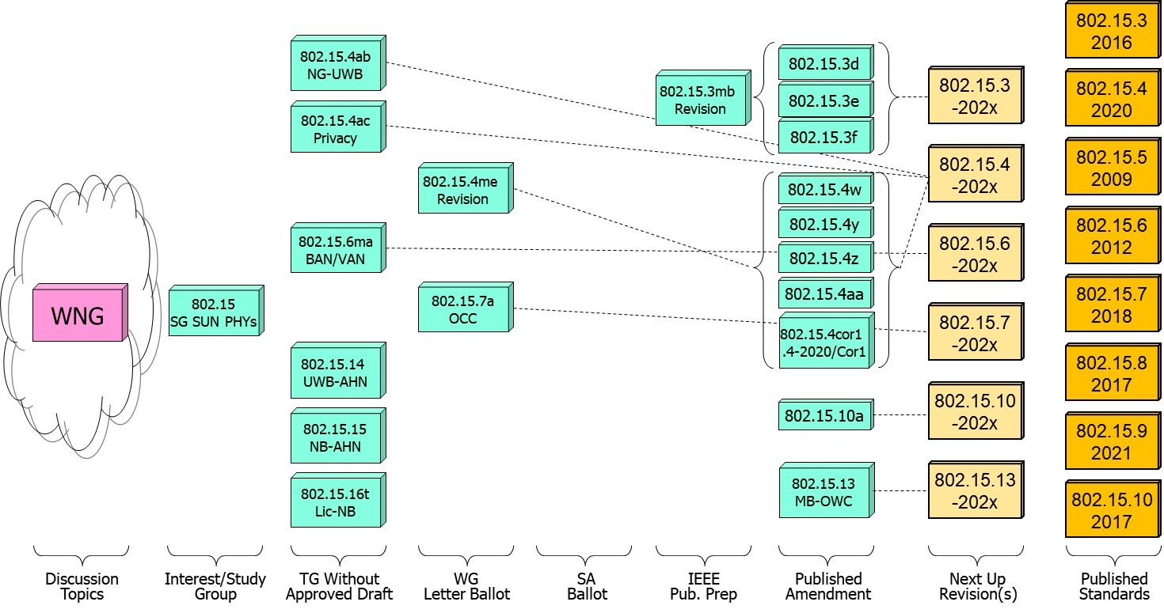
802.15 WG Standards Pipeline

Slide 87
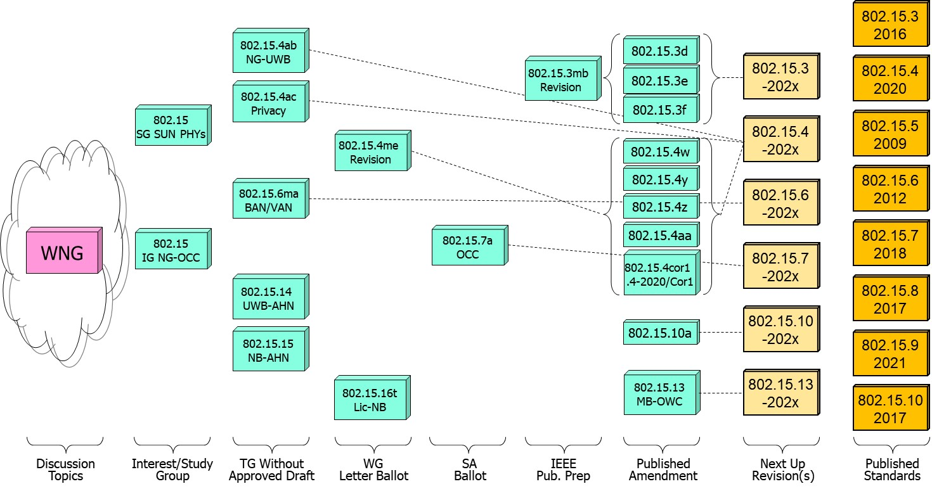
802.15 WG Standards Pipeline (updated)

Slide 88
SG Next Generation SUN PHYs
What is it?
  Next Gen SUN/Smart Utility Network OFDM
  Long range PHY to enable city wide simple star networks, dense networks with >10K nodes, Power efficient for battery operated end node.
  Enhancing OFDM with Long Range extension with improved link budget and higher reliability while remaining compliant with existing worldwide regulatory requirements.
  Target PHY is the existing SUN-OFDM PHY .
Status:
  Continue PAR and CSD development for extending the SUN PHYs.

Slide 89
802.15.4ab Next Generation UWB
What is it:
  Builds on 802.15.4z increasing footprint and usefulness to additional usages beyond range measurement and improve IR signal limitations.
  Main areas of enhancements relates to ranging resiliency (NB assisted operation), sensing, data rates, support for additional spectrum.
Status:
  Preparations towards going into Initial WG ballot: identify/complete missing std. pieces, and complete comment collection resolution.

Slide 90
802.15.4ab Next Generation UWB
Major areas of discussion:
  Continued discussion of co-existence and LBT of NB operation.

Slide 91
802.15.4ac Privacy
What is it:
  Modifications to the IEEE Std 802.15.4 medium access control
  Improved user privacy to protect from user tracking and profiling attack.
  Amongst the mechanisms MAC address randomization and rolling MAC address.
Status:
  In draft development.
  Progress on the identified issues of current standard: static MAC address , MAC address set across multiple radios in a single physical device, MAC address refresh, security context refresh for group and unicast, network discover and more.

Slide 92
802.15.16t Narrow Band Licensed Operation (NB-Lic)
What is it:
  Licensed Narrow Band (NB) Operation in channels bandwidth between 5 – 100KHz in the VHF/UHF bands such as 160MHz, 450MHz, 700MHz and 900MHz, taking advantage of the superior channel propagation properties. Targeted usages mission critical operation.
Status and main discussion topics:
  Group completed the informal comment resolution and draft now starting initial WG ballot phase.

Slide 93
802.15.6ma - Enhanced Dependability Body Area Network (ED-BAN)
What is it:
  Enhancements to the BAN (Body Area NW) Ultra Wideband (UWB) physical layer (PHY) and media access control (MAC) to support enhanced dependability to a human BAN (HBAN) and support for vehicle body area networks (VBAN).
  This revision focuses on international operation.
Status:
  Continue resolution of (informal) comment collection and assess readiness to go to initial WG ballot.

Slide 94
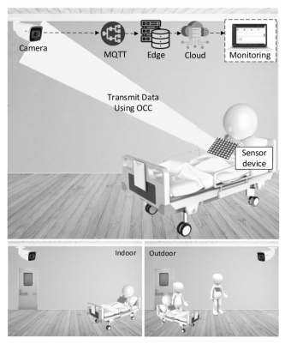
Next Generation Optical Camera Communication (OCC)
What is it:
  Interest group to evaluate the interest of a new OCC standard.
  Future applications include indoor/outdoor and submerged applications.
Status:
  Formation meeting for the IG, reviewed submissions on applications and usages.

Slide 95
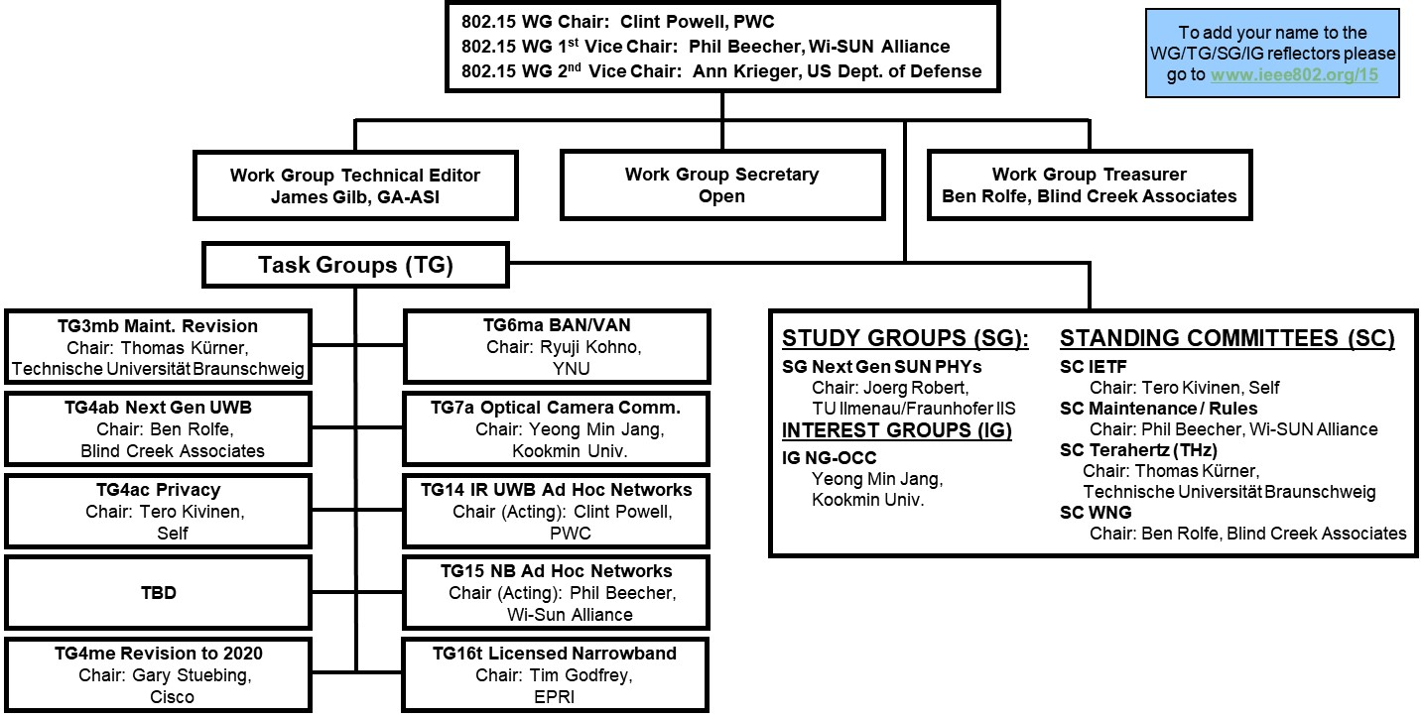

Slide 96
802.18 Liaison Report – January 2024
Date: 17 January 2024
Author:

Slide 97
RR-TAG at a glance
Membership as of 18 November 2023
  55 voters (including 8 on LMSC)
  4 nearly voters
  15 aspirants
Officers
  Chair: Edward Au (Huawei Technologies)
  Co-Vice Chair: Stuart Kerry (OK-Brit; Self)
  Co-Vice Chair: Al Petrick (Skyworks Solutions)
  Secretary: VACANT
  IEEE SA Program Manager: Jodi Haasz (IEEE SA)
Ad-hoc chair
  IEEE Statement Update on Spectrum (ISUS): VACANT

Slide 98
Progress since the 2023 November plenary (1)
Reviewed the latest ongoing consultations.
Approved the following IEEE 802 LMSC submissions:
Topics | DCN
EU RSPG’s consultation “Work programme for 2024 and beyond” | 18-23/0134r7

Slide 99
Progress since the 2023 November plenary (2)
Discussed the latest topics related to spectrum and regulation in Europe, North America, and Asia Pacific.
Update from ETSI BRAN on 7 November 2023 (18-23/0129r0).

Slide 100
Objectives this week: Wednesday AM1
Review draft response to the following consultations
  Colombia ANE: 6 GHz band coexistence study
    Document: 18-24/0006
  US FCC: Unlicensed Use of the 6 GHz Band: Second Report and Order, Second Further Notice of Proposed Rulemaking, and Memorandum Opinion and Order (ET Docket No. 18-295; GN Docket No. 17-183)
    Document: 18-24/0007
Review and discuss the possibility of preparing response to selected ongoing consultations
  UK Ofcom: Ofcom’s proposed Plan of Work 2024/25

Slide 101
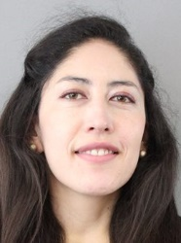
Objectives this week: Thursday AM1 (1)
Member enrichment activities
  Topic: An introduction to CEPT FM61 - WAS/RLANs
  Author: Andrea Mora (L'agence nationale des fréquences), Chair, FM61
  A 30-minutes invited presentation introducing the newly established project, CEPT FM61
  Document: 18-24/0008
Source: Andrea Mora

Slide 102
Objectives this week: Thursday AM1 (2)
Review and consider approval of the draft response of the following ongoing consultation
  Colombia ANE: 6 GHz band coexistence study
    Document: 18-24/0006
Discuss the latest topics related to spectrum and regulation in Europe, North America, and Asia Pacific, including:
  Overview on the Results of WRC-2023 relevant for THz Communications
    Document: 15-24/0030

Slide 103
Officer elections in March 2024
The officer elected positions, including Chair and Vice Chair(s), are open for election in the IEEE 802 March 2024 mixed-mode plenary.
  Nominations will be opened on Sunday, 11 February 2024, received and closed the end of Monday, 11 March 2024. Self-nomination is valid.
  Introductory statements made by candidates with Q&A during the IEEE 802.18 opening meeting at 10:30am MT on Tuesday, 12 March 2024.
  Elections take place during the IEEE 802.18 closing meeting at 8:00am MT on Thursday, 14 March 2024, through DirectVoteLine.
  All positions require majority confirmation vote.
  The Chair and Vice Chair(s) are subject to confirmation by IEEE 802 EC, and must provide and have had accepted statements of affiliation and support to IEEE 802 EC recording secretary before the IEEE 802 EC closing plenary on Friday, 15 March 2024.

Slide 104
802.19 WG January 2024 Liaison Report
Date: 2024-1-17
Authors:

Slide 105
IEEE 802.19 Overview
IEEE 802.19 group reviews coexistence assessment documents (CAD) produced by working groups developing new wireless standards for unlicensed devices.
IEEE 802.19 develops standards for coexistence between wireless standards of unlicensed devices.
Group has 47 voters as of January 2024.
Group had one session on Monday.
Position | Person
Working Group Chair | Steve Shellhammer (Qualcomm)
Working Group Vice Chair | Tuncer Baykas (Ofinno)
Liaison To/From 802.11 | Tuncer Baykas (Ofinno)
Liaison To/From 802.15 | Ben Rolfe (Blind Creek Associates)

Slide 106
Agenda
Liaison reports from 802.11 and 802.15
Enhancing Sub-1GHz SG (Waiting for NesCom decision)
  900MHz Radio Environment Measurement Results in the Tokyo Area
  Spectrum use in US License-exempt Frequency Bands
  Japanese 920 MHz Regulation Update
    Latest Japanese 920 MHz regulation with English translation https://www.arib.or.jp/kikaku/kikaku_tushin/std-t108.html

Slide 107
March 2024 Elections
At the March IEEE 802 Plenary session we will be holding elections for Working Group Chair and Vice Chair
If you are interested in running for either of these positions, please contact the WG Chair by Monday March 4, 2024

Slide 108
Wi-Fi Alliance (WFA) Liaison Update
Date: 2024-01-08
Authors:
Name | Company | Address | Phone | Email
Carlos Cordeiro | Intel |  |  | Carlos.Cordeiro@intel.com

Slide 109

Major updates (1/2)
Wi-Fi CERTIFIED 7TM program launched on Jan 08!
  https://www.wi-fi.org/news-events/newsroom/wi-fi-alliance-introduces-wi-fi-certified-7
Wi-Fi Alliance Services demonstrated commercial readiness of its Automated Frequency Coordination (AFC) system
The next WFA F2F member meeting will take place Feb 20th-22nd, 2024, in Singapore

Slide 110
Major updates (2/2)
Technical activity at WFA that has recently (since Q1/23) led to certification
  Wi-Fi 7
Technical activity at WFA that is expected to lead to certification
  QoS Management
  EasyMesh
  6 GHz standard power
  Wi-Fi Direct
  Wi-Fi proximity ranging/location R2

Slide 111
Additional work areas
Examples of additional WFA technical work
  Security
  Automated Frequency Coordination
  Customer Experience
  Wi-Fi HaLow
  Wi-Fi Data Elements
Examples of additional WFA activity that may lead to technical work
  XR (Augmented / Virtual / Mixed Reality)
  Automotive
  Healthcare
  Operators
  Internet of things
Regulatory

Slide 112
Recent publications
Wi-Fi Alliance® introduces Wi-Fi CERTIFIED 7™, https://www.wi-fi.org/news-events/newsroom/wi-fi-alliance-introduces-wi-fi-certified-7
Wi-Fi Alliance® celebrates the 2023 World Radiocommunication Conference (WRC-23) decisions on the 6.425-7.125 GHz frequency band, https://www.wi-fi.org/news-events/newsroom/wi-fi-alliance-celebrates-the-2023-world-radiocommunication-conference-wrc-23
Wi-Fi Alliance® subsidiary demonstrates commercial operation readiness, https://www.wi-fi.org/news-events/newsroom/wi-fi-alliance-subsidiary-demonstrates-commercial-operation-readiness
Wi-Fi Alliance® commends FCC on expanding regulatory framework for 6 GHz, https://www.wi-fi.org/news-events/newsroom/wi-fi-alliance-commends-fcc-on-expanding-regulatory-framework-for-6-ghz
New Wi-Fi CERTIFIED 6® testing to support authorization of 6 GHz Standard Power Devices, https://www.wi-fi.org/news-events/newsroom/new-wi-fi-certified-6-testing-to-support-authorization-of-6-ghz-standard-power

Slide 113
Further information
For more information on current areas of work, see http://www.wi-fi.org/who-we-are/current-work-areas
If these sound like interesting topics, please plan to sign up and participate
Further general information at http://www.wi-fi.org/

Slide 114
IEEE 802.11-IETF Liaison Report
Date: 2024-01-17
Authors:

Slide 115
Abstract
This presentation contains the IEEE 802.11 – IETF liaison report for January 2024.

Slide 116
IETF Meetings
Upcoming Meetings:
  March 16-22, 2023 – Brisbane, QLD, AU
  July 20-26 – Vancouver, BC, CA
http://www.ietf.org
  Newcomer training: https://www.ietf.org/about/participate/get-started/
  April 2016: Wireless Tutorial (Donald Eastlake), 802.11 & 802.15 tutorials (Dorothy Stanley, Charlie Perkins), see 11-16/500, September 2016: Pat Thaler & Juan Carlos – 802.1E (Privacy Considerations) and 802.c (Local MAC address usage) https://datatracker.ietf.org/group/edu/materials/

Slide 117
IETF- IEEE 802 Liaison Activity
Joint meetings, agenda and presentations
  http://www.iab.org/activities/joint-activities/iab-ieee-coordination/
  Proceedings: https://datatracker.ietf.org/iabasg/ietfieee/meetings/
  Coordination topics include: Capability Discovery, Data Center Bridging, use of Local Address in virtualization and IoT, MAC address randomization, DETNET/TSN/RAW, YANG models, pervasive monitoring
  IETF-IEEE 802 coordination teleconferences: October 23, 2023

Slide 118
IETF protocol use with 802.11 technology
There have been no RFCs published in the last two months that reference IEEE 802.11

Slide 119
BOFs at IETF 119 March 16-22, 2024
See https://datatracker.ietf.org/wg/bofs/
wimse | Workload Identity in Multi System Environments

Slide 120
IETF/IRTF groups being (re-)chartered
See https://datatracker.ietf.org/group/chartering/
hrpc | Human Rights Protocol Considerations
ccamp | Common Control and Measurement Plane
dult | Detecting Unwanted Location Trackers
grow | Global Routing Operations
lisp | Locator/ID Separation Protocol
mls | Messaging Layer Security
multi | Multiformats
nmop | Network Management Operations
opsawg | Operations and Management Area Working Group

Slide 121
YANG Model Catalog
YANG catalog development
  A YANG model catalog and registry that allows users to find models relevant to their use cases from the large and growing number of YANG modules being published.
  YANG Catalog was developed through a collaboration between the IETF and the Broadband Forum, and contains many data models, including from other Standards Development Organizations (SDOs) such as the IEEE, as well as some vendor-specific data models. Interest and participation from other SDOs, equipment vendors, open source projects and network operators is encouraged.
See https://www.ietf.org/blog/yang-catalog-latest-developments-ietf-100-hackathon/
See https://yangcatalog.org/ and https://1.ieee802.org/yangsters/

Slide 122
IoT-related work
6LO
  Working Group website: http://datatracker.ietf.org/wg/6lo/
  Focus: IPv6 over Networks of Resource-constrained Nodes
Updates
  Revised: IPv6 Neighbor Discovery Multicast and Anycast Address Listener Subscription: https://datatracker.ietf.org/doc/draft-ietf-6lo-multicast-registration/ (November 2023)
    Mentions IEEE 802.11 as one possible Low-power and Lossy Network to which this specification is applicable
  Some other specifications reference IEEE 802.15.4.

Slide 123
IoT-related work (cont.)
ROLL: Working Group website: http://datatracker.ietf.org/wg/roll/
  Focus: Routing over Low Power and Lossy Networks
CORE: (Constrained RESTful Environments) Working Group website: http://datatracker.ietf.org/wg/core/
  Focus: framework for resource-oriented applications intended to run on constrained IP networks.
IoT Directorate:
  Reviews IETF drafts that are IoT related
  See: https://datatracker.ietf.org/group/iotdir/about/

Slide 124
MADINAS WG
See http://datatracker.ietf.org/wg/madinas/
MAC Address Device Identification for Network and Application Services
  This is the IETF’s equivalent of IEEE 802.11bh – how to deal with the implications of the deployment of random and changing MAC addresses.
Updates
  Updated: Randomized and Changing MAC Address: https://datatracker.ietf.org/doc/draft-ietf-madinas-mac-address-randomization/ (January 2024)
  Updated: Randomized and Changing MAC Address Use Cases and Requirements: https://datatracker.ietf.org/doc/draft-ietf-madinas-use-cases/ (January 2024)

Slide 125
EAP Method Update (EMU)
See http://datatracker.ietf.org/wg/emu/
  This working group has been chartered to provide updates to some commonly used Extensible Authentication Protocol methods including of EAP-TLS, EAP-AKA, EAP-AKA’ (for 5G), EAP-SIM, etc.
  The group should document any recently gained new knowledge on vulnerabilities or the possible implications of pervasive surveillance or other new concerns.
Updates
  Awaiting AD Write-up: Tunnel Extensible Authentication Protocol (TEAP) Version 1: https://datatracker.ietf.org/doc/draft-ietf-emu-rfc7170bis/ (September 2023)
  For adoption: Using the Extensible Authentication Protocol with Ephemeral Diffie-Hellman over COSE (EDHOC): https://datatracker.ietf.org/doc/draft-ingles-eap-edhoc/ (November 2023)
  Updated/for adoption: EAP-FIDO: https://datatracker.ietf.org/doc/draft-janfred-eap-fido/ (December 2023)

Slide 126
Operations Area Working Group
http://datatracker.ietf.org/wg/opsawg/
Updates
  Revised: Authorized update to MUD [Manufacturer Usage Description] URLs: https://datatracker.ietf.org/doc/draft-ietf-opsawg-mud-acceptable-urls/ (January 2024)
Background
  Of interest: RFC 6632, An Overview of the IETF Network Management Protocols, see https://tools.ietf.org/html/rfc6632
  Automated network management, including YANG data models, see https://www.ietf.org/topics/netmgmt/

Slide 127
Internet Area Working Group
https://datatracker.ietf.org/wg/intarea/
Updates
  In RFC Editor’s queue: IANA Considerations and IETF Protocol and Documentation Usage for IEEE 802 Parameters: https://datatracker.ietf.org/doc/draft-ietf-intarea-rfc7042bis/ (Nov 2023)
    Discusses several aspects of IEEE 802 parameter and their use in IETF protocols, specifies IANA considerations for assignment of points under the IANA OUI, and provides some values for use in documentation.
  Revised: Protocol Numbers for SCHC: https://datatracker.ietf.org/doc/draft-ietf-intarea-schc-protocol-numbers/ (October 2023)
    Requests an Ethertype for use of native Static Context Header Compression over IEEE 802 networks (for IP and non-IP protocols).

Slide 128
Transport Layer Security (TLS)
Transport Layer Security Working Group website: http://datatracker.ietf.org/wg/tls/
Updates
  New: TLS 1.3 Extension for Using Certificates with an External Pre-Shared Key: https://datatracker.ietf.org/doc/draft-ietf-tls-8773bis/ (January 2024)
  New: Legacy RSASSA-PKCS1-v1_5 codepoints for TLS 1.3: https://datatracker.ietf.org/doc/draft-ietf-tls-tls13-pkcs1/ (November 2023)
  Awaiting revision after WGLC: The Transport Layer Security (TLS) Protocol Version 1.3: https://datatracker.ietf.org/doc/draft-ietf-tls-rfc8446bis/ (December 2023)

Slide 129
Deterministic Networking (DETNET)
DETNET: https://datatracker.ietf.org/wg/detnet/charter/
  The Deterministic Networking (DetNet) Working Group focuses on deterministic data paths that operate over Layer 2 bridged and Layer 3 routed segments, where such paths can provide bounds on latency, loss, and packet delay variation (jitter), and high reliability.
  The IEEE 802.11be activities seem like they may fit in with DetNet and there was a joint IEEE-IETF DetNet discussion in Bangkok (November 2018).
  Addresses Layer 3 aspects in support of applications requiring deterministic networking.
  The Working Group collaborates with IEEE 802.1 Time Sensitive Networking (TSN), which is responsible for Layer 2 operations, to define a common architecture for both Layer 2 and Layer 3.
  Example applications for deterministic networks include professional and home audio/video, multimedia in transportation, engine control systems, and other general industrial and vehicular applications being considered by the IEEE 802.1 TSN Task Group.
Updates:
  In IESG Evaluation: Deterministic Networking (DetNet): Packet Ordering Function: https://datatracker.ietf.org/doc/draft-ietf-detnet-pof/ (January 2024)
  Revised: Reliable and Available Wireless Architecture: https://datatracker.ietf.org/doc/draft-ietf-raw-architecture/ (October 2023)
  Revised: Reliable and Available Wireless Framework: https://datatracker.ietf.org/doc/draft-ietf-raw-framework/ (September 2023)

Slide 130
Autonomic Networking Integrated Model and Approach (ANIMA)
ANIMA: https://datatracker.ietf.org/group/anima/about/
  ANIMA designs protocols to allow network operations to be carried out without requiring low-level management of individual devices
Updates:
  Publication requested: BRSKI-AE: Alternative Enrollment Protocols in BRSKI: https://datatracker.ietf.org/doc/draft-ietf-anima-brski-ae/ (December 2023)
  In WGLC: Constrained Bootstrapping Remote Secure Key Infrastructure (cBRSKI): https://datatracker.ietf.org/doc/draft-ietf-anima-constrained-voucher/ (January 2024)

Slide 131
References
RFC 7241, “The IEEE 802/IETF Relationship” (RFC 4441 update)
  https://datatracker.ietf.org/doc/rfc7241/
IEEE 802 Liaisons list is available
  http://ieee-sa.centraldesktop.com/802liaisondb/FrontPage

