Slide 1
Simulation on coexistence of AMP traffic and existing traffic Part 2
November 2023
Doc.: IEEE 802.11-23/2107r0
Date: 2023-11-09
Authors:
Name | Affiliation | Address | Phone | Email
Hao wang | OPPO |  |  | wanghao6@oppo.com
Weijie Xu |  |  |  | xuweijie@oppo.com
Yinan Qi |  |  |  | v-qiyinan@oppo.com

Slide 2
Abstract
November 2023
Doc.: IEEE 802.11-23/2107r0
To further address the concerns on whether there is impact on legacy traffic from AMP traffic. Additional simulations are performed besides those in [1][2][3], including:
Coexistence of AMP traffic and Voice
Coexistence of AMP traffic and Video
Coexistence of AMP traffic and FTP when AMP devices initiate the transmission
The impact of AMP traffic’s duty cycle

Slide 3
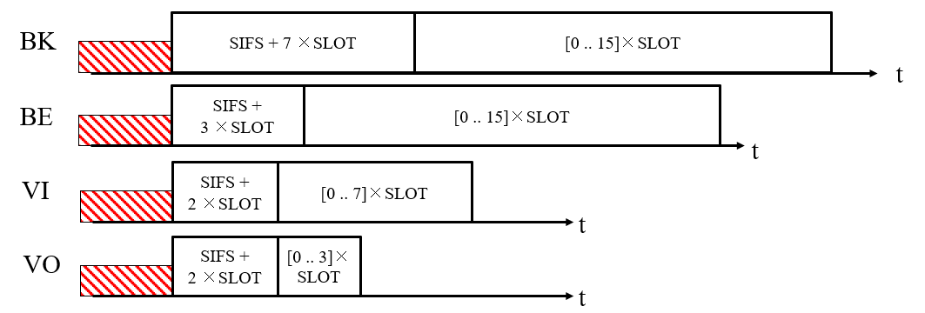
Simulation 1: Coexistence of AMP traffic and Voice
November 2023
Doc.: IEEE 802.11-23/2107r0
The interference impact from AMP traffic to VoIP was evaluated.
AC_BK is set for AMP traffic.
Txop sharing mechanism is assumed for AMP transmission.

Slide 4
November 2023
Doc.: IEEE 802.11-23/2107r0
Scenario
3000 AMP-STAs
Query all AMP-STAs every 60s
1ms per query
Access Category Background
VoIP Traffic: 100B @ 20ms
Access Category Voice
KPI: VoIP packet delay

Slide 5
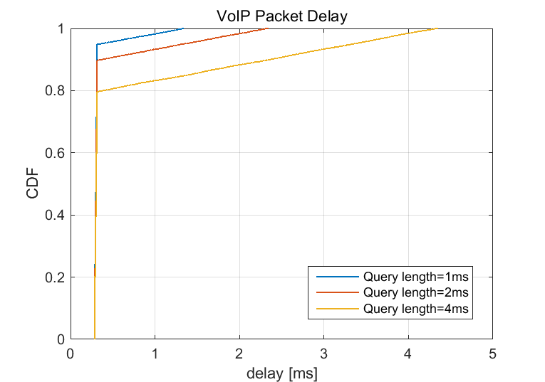
AMP STA number n =3000, Query every 60s
November 2023
Doc.: IEEE 802.11-23/2107r0

Slide 6
Simulation 2: Coexistence of AMP traffic and video
November 2023
Doc.: IEEE 802.11-23/2107r0
The interference impact from AMP traffic to video was evaluated.
AC_BK is set for AMP traffic.
Txop sharing mechanism is assumed for AMP transmission.

Slide 7
November 2023
Doc.: IEEE 802.11-23/2107r0
Scenario
3000 AMP-STAs
Query all AMP-STAs every 60s
1ms per query
Access Category Background
Video Traffic: 7500B@20ms(3Mbps streaming rate)
WiFi data rate: 20Mb/s
Access Category Video
KPI: Video packet delay

Slide 8
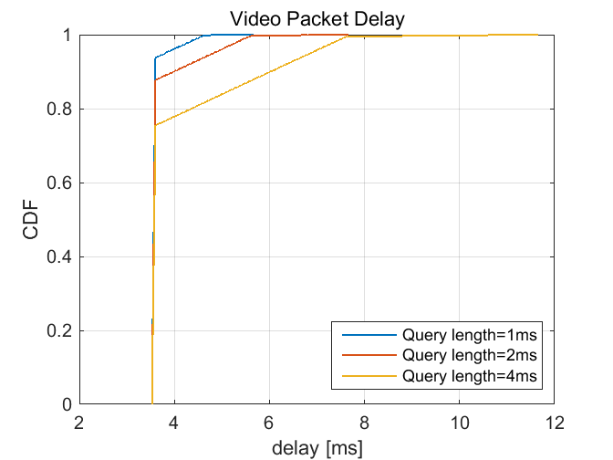
November 2023
Doc.: IEEE 802.11-23/2107r0
AMP STA number n =3000, Query every 60s

Slide 9
Simulation 3: Case where AMP STA initiates its traffic
November 2023
Doc.: IEEE 802.11-23/2107r0
The interference impact from AMP traffic to FTP was evaluated.
AC_BK is set for AMP traffic and AC_Default for FTP.
In this simulation, the AMP STA initiates its transmission.
10,100 AMP STAs are assumed, although there will even less number of AMP STA in real deployment .

Slide 10
November 2023
Doc.: IEEE 802.11-23/2107r0
Scenario
3000 AMP-STAs
848µs per query
Access Category Background
FTP Downloads, 1MB per file, 6Mb/s
Access Category Default
KPI: FTP Download delay

Slide 11
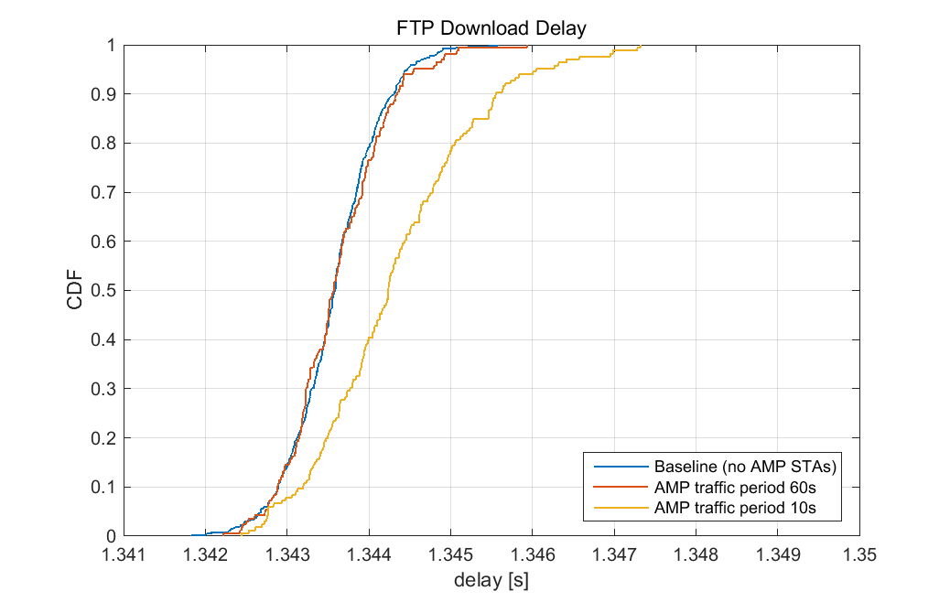
AMP STA number n =10
November 2023
Doc.: IEEE 802.11-23/2107r0
Notes:
增加period = 10
增加voip以及video共存的结果

Slide 12
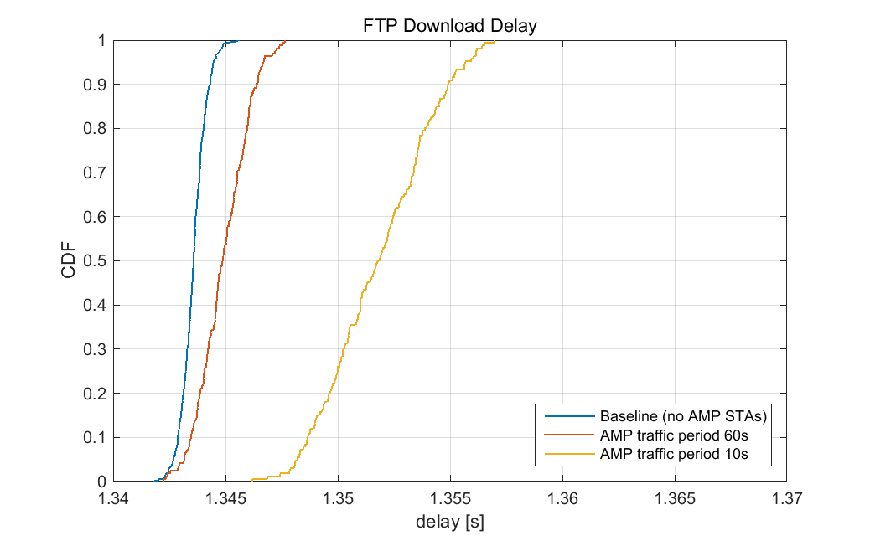
AMP STA number n =100
November 2023
Doc.: IEEE 802.11-23/2107r0
Notes:
增加period = 10
增加voip以及video共存的结果

Slide 13
Simulation 4: The impact of AMP traffic duty cycle
November 2023
Doc.: IEEE 802.11-23/2107r0
The interference impact from AMP traffic to FTP was evaluated in the simulation.
AC_BK is set for AMP traffic and AC_Default for FTP.
In this simulation, very short AMP query interval, e.g. 3s (though it is impossible to have such extreme setting in real scenario) are also evaluated to see the impact of AMP traffic duty cycle .

Slide 14
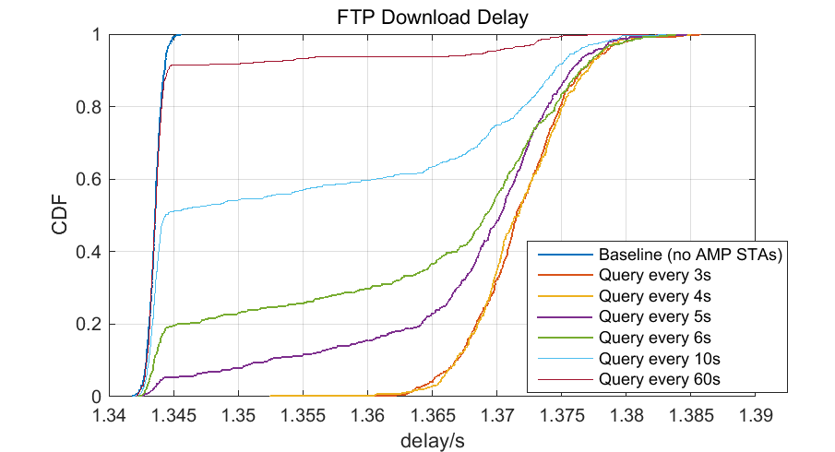
November 2023
Doc.: IEEE 802.11-23/2107r0
AMP STA number n =3000

Slide 15
November 2023
Doc.: IEEE 802.11-23/2107r0
Summary
Based on all the evaluations, we have the following observations:
Even in very extreme AMP traffic scenario, the impact to the existing traffic including FTP download, voice, video etc. is very minor.
The similar observations for both AMP traffic triggered by AP and AMP traffic initiated by AMP STA itself.
There is no need to have restriction on the TxOP length or PPDU length.
Slide 15
Weijie Xu (OPPO)

Slide 16
Reference
November 2023
Doc.: IEEE 802.11-23/2107r0
IEEE 802.11-23/1601r1, AMP Communication Channel Usage Estimation
IEEE 802.11-22/1627r6, AMP Communication Channel Usage Estimation Part 2: AC_BK
IEEE 802.11-23/2107r0, Simulation on coexistence of AMP traffic and existing traffic

