Slide 1
Multi-Link Operation for mmWave Wi-Fi Sensing
Date: 2023-11-15
Authors:

Slide 2
Introduction
IMMW SG focuses on leveraging MAC/PHY specifications in the Sub 7 GHz band for the carrier frequency operation between 42.5 and 71 GHz [1], [2].
The new MAC/PHY amendment should provide the opportunity for [3], [4]:
  Enhanced throughput
  Increased coverage
  Low Latency
  Integrated mmwave and Sub-7 GHz band
The increased bandwidth because of mmwave and Sub-7 GHz integration can be leveraged to improve sensing in addition to enhanced throughput.

Slide 3
Multi-Link Operation
The aggregated throughput and sensing resolution enhancement at both APs and STAs is achieved through multi-link operation [4].
Throughput and sensing resolution enhancement require increment in the frequency spectrum.
The bandwidth of 6 GHz band cannot be extended due to limited availability of wider bandwidth channels.
The recommended minimum bandwidth that aligns with the sub 7-GHz PHY is 80 MHz. A wider bandwidth of 1 GHz is available for high-end devices.

Slide 4
Characteristics of mmWave Band
Short transmission range.
High throughput/ high-resolution sensing.
LOS dominant links.

Slide 5
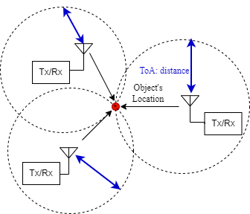
WiFi Positioning
WiFi positioning system requires multiple APs for accurate and reliable position estimation.
Triangulation is used to locate an object where multiple APs increase the effective bandwidth for localization [5].
  The location of the participating APs is known.
The integrated mmWave band and its additional bandwidth can be leveraged to locate nearby users without multiple devices.

Slide 6
Proposed Approach
  We are exploiting multi-bands-based Wi-Fi networks for localization.
  Location of the nearby users/STAs can be estimated using the mmwave band. Because of small coverage it is not able to provide coverage to the farthest users/STAs.
  Since mmwave band provides larger bandwidth and improved range resolution, fewer number of devices are sufficient to locate a nearby user/STA and triangulation can be avoided.
  However, due to limited coverage farther users/STAs get access via sub-7 GHz band and triangulation is required to localize them due to limited bandwidth.

Slide 7
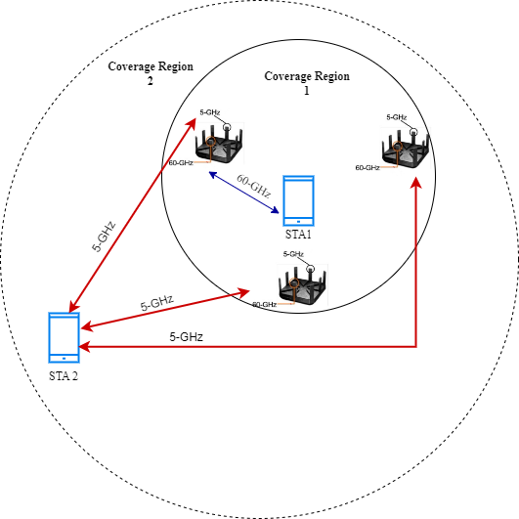
System Model 1 for Proposed Approach
In this scenario, the location of WiFi APs is fixed.
Each AP is equipped with multiple bands.
STA1 is located near to the APs.
STA2 is farther, i.e. outside the room.
Location of the nearby STAs can be estimated using the mmWave band without employing triangulation.
Since mmWave band is restricted in coverage, the farthest STAs can be localized using conventional triangulation approach.

Slide 8
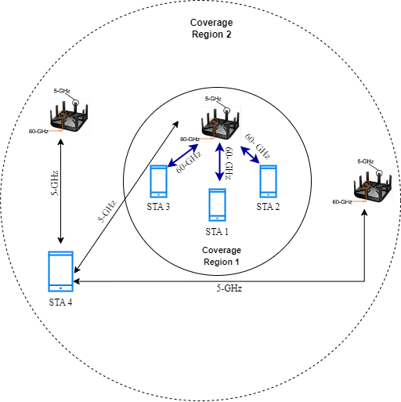
System Model 2 for Proposed Approach
In the second system model, the APs are relocated based on the position of STAs.
Only one AP is used for localizing indoor STAs, hence rest of the two APs which were participating in the triangulation procedure are moved outside coverage region 1.
Within coverage region 1, mmWave band is used for localization.
Rest of the two APs are moved to coverage region 2 for coverage enhancement and localizing STA 4.

Slide 9
Target Considerations for the Proposed Approach
Optimizing the number of APs.
Increasing the coverage.
Improving sensing.
User location-based clustering.
Exploiting Multi-link operation.
Reduce the number of APs for localization exploiting MLO.
Optimizing the AP location based on user location for coverage enhancement.

Slide 10
Conclusions
A new approach for sensing based on a Wi-Fi network is suggested where two scenarios are presented by exploiting MLO.
Based on the proposed approach, the range/coverage could be further enhanced with an efficient number of APs being used.

Slide 11
References
[1] 23/0481r2, “Integrated mmWave Study Group Creation “, March 2023.
[2] 23/0188r6, “802.11 March 2023 WG Motions”, March 2023.
[3] 22/0030r1, “Look ahead to next generation”, January 2022.
[4] 22/1083r1, “Next generation SG formation”, July 2022.
[5] C. Yang and H. -r. Shao, "WiFi-based indoor positioning",
in IEEE Communications Magazine, vol. 53, no. 3, pp. 150-157, March 2015.

