Slide 1
Considerations on Multiple Multi-AP groups
Date: 2023-11-14
Authors:

Slide 2
Abstract
The main tasks of this proposal:
Recap Multi-AP technology and application scenarios
Proposed a set of possible architectures for Multiple Multi-AP groups
Summary & direction for further work

Slide 3
Background
Multi-AP coordination is widely discussed in TGbe and UHR WG as a key technology proposed by 11be
Proposals [1][2][3][4][8][9][10][14][15] fully discussed and summarized the framework, establishment, and joint transmission scheme of Multi-AP coordination
Proposals [5][6][7][12][13] have attempted to combine Multi-AP coordination with other technologies to further explore the potential of Multi-AP
These references focus on a single Multi-AP coordination group. However, the problems on the boundary of Multi-AP coordination group due to factors such as physical environment or AP hardware performance has not been discussed
We would like to propose an effective framework that can be applied to multiple Multi-AP coordination groups and realize the improvement of system performance with less overhead

Slide 4
Roaming requirements
UHR presents requirements for high throughput and low latency [1][6][9][12][13]
[11] Cisco Systems has sorted out a number of possible roaming approaches
[6][7][12] elaborates on STA roaming in the UHR based on the AP MLD conceptualization
In [13], Samsung proposed a Multi-AP Coordination architecture rooted on the virtual BSS (V-BSS) concept, which includes a Multi AP Coordinator (C-AP) and several Anchor APs (A-AP)
  This is an excellent idea, and it is extremely efficient to have one coordinator to manage the global APs

Slide 5
Roaming requirements (Cont’d)
The signaling transmission overhead, arithmetic requirements, and energy consumption of leaving the global information of APs to be computed by a particular AP or an independent device [14] are potential problems that cannot be ignored
As a compromise, we follow the idea of Multi-AP Coordination and propose a possible architecture for Multiple Multi-AP groups with greater realizability in Wi-Fi 8

Slide 6
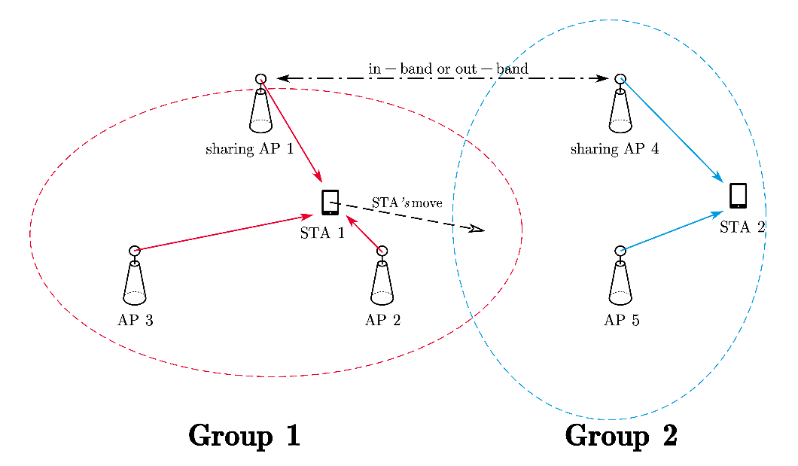
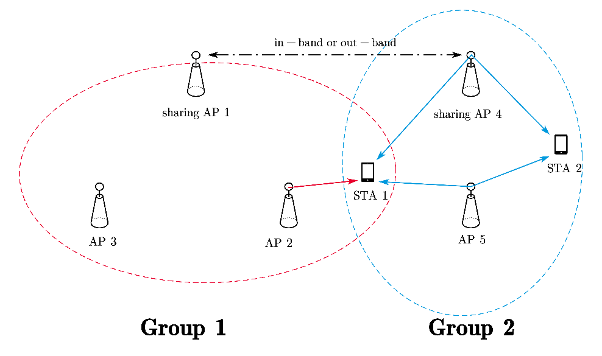
The architecture for Multiple Multi-AP groups
Due to the consideration of application scenarios, the architecture of Multiple Multi-AP groups mainly faces the following two scenarios:
Scenario A: STA associated with an AP in a Multi-AP group, all APs that have been associated belong to this Multi-AP group as Fig 1
  ·The operation of the Multi-AP group is described in [9][15]
Scenario B: An STA associated with an AP in a Multi-AP group (group 1) that has associated APs belonging to different Multi-AP groups shown in Fig 2
  ·In this scenario, the sharing AP₁ of Multi-AP group 1 needs to collaborate with the sharing AP₋₁s of other groups
Fig 1. Scenario A
Fig 2. Scenario B

Slide 7
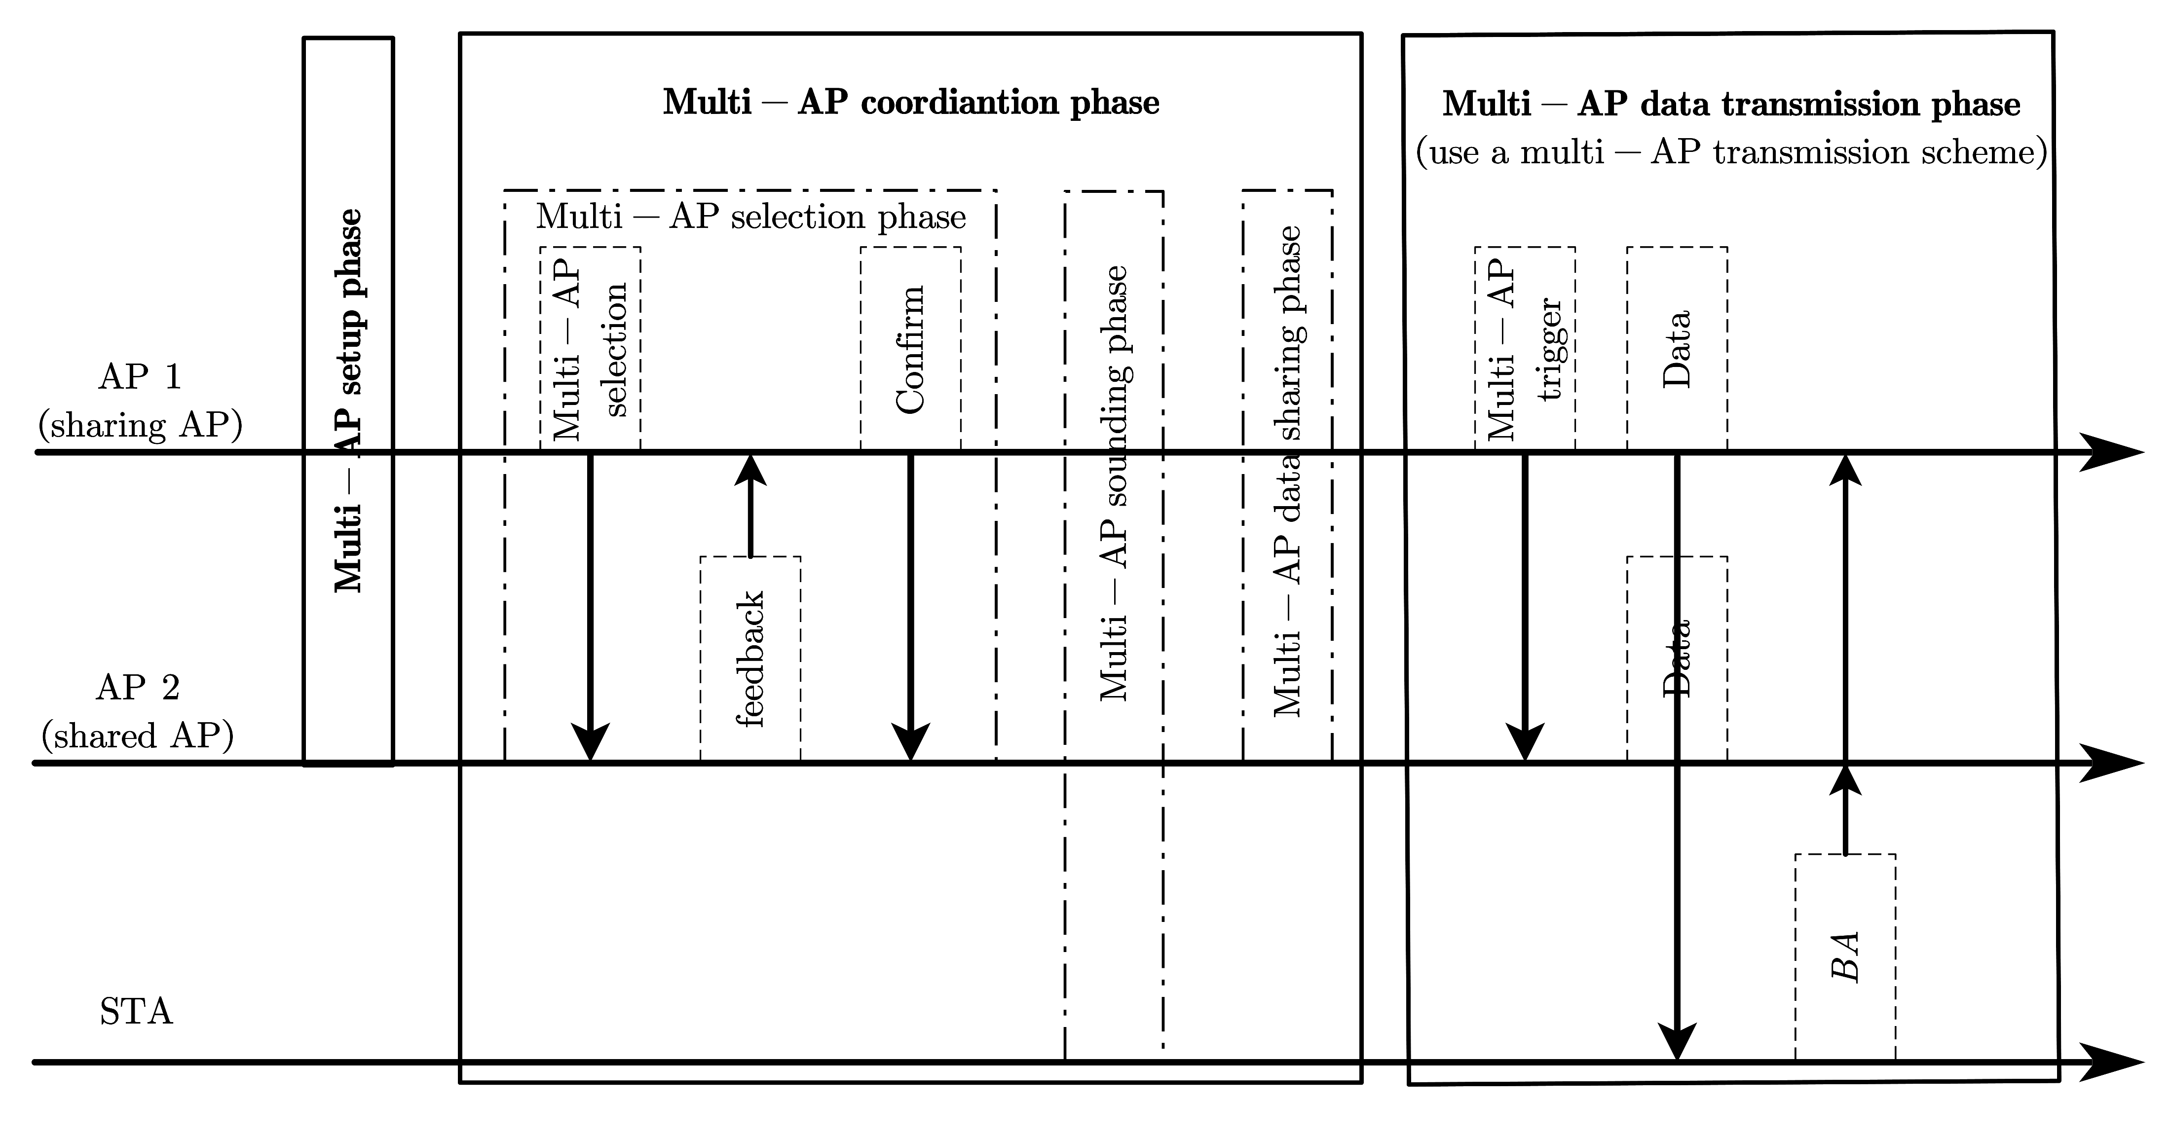
The architecture for Multiple Multi-AP groups (Cont’d)
Scenario A ：associated with an AP in a Multi-AP group, all APs that have been associated belong to this Multi-AP group
  The operation of the Multi-AP group is described in [9][15] as shown in Fig 3
Fig 3
Notes:
Multi-AP setup phase:
Exchanging information between multiple APs;
Grouping multiple candidate APs, e.g., AP candidate sets,
Multi-AP coordination phases
Exchanging information between sharing AP and shared AP(s),
Multi-AP selection phase: sharing AP selects shared AP(s),
Multi-AP channel sounding phase (optional): APs perform sounding jointly/individually with STA(s).
Multi-AP data sharing phase (optional): sharing AP shares data to shared AP
Multi-AP data transmission phase:
Using downlink/uplink multi-AP transmission schemes, such as coordinated spatial reuse (CSR), coordinated OFDMA/TDMA, coordinated beamforming (CBF), joint transmission/reception (JT/JR), etc.

Slide 8
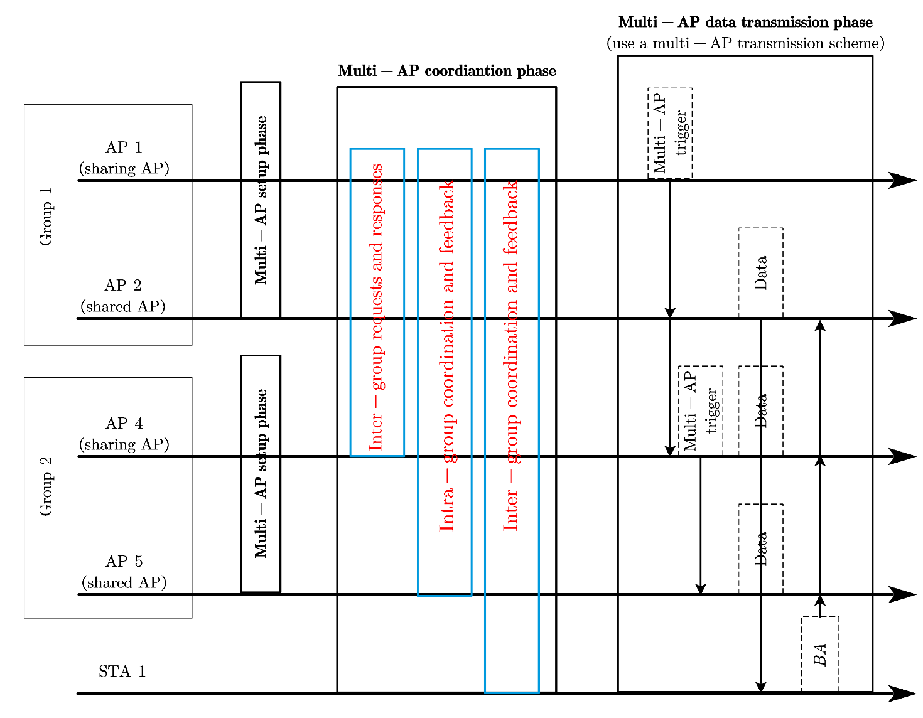
The architecture for Multiple Multi-AP groups (Cont’d)
Scenario B：An STA associated with an AP in a Multi-AP group (group 1) has associated APs belonging to different Multi-AP groups
    In this case, the sharing AP1 of Multi-AP group 1 needs to collaborate with the sharing AP₋₁s of other groups
    These sharing APs can discover each other through beacon frames, or reported by the STA in the group, so as to get the information of the other sharing APs
    The sharing APs should interact with each other to establish/maintain Multi-AP Coordination for the STA to ensure the QoS and other performance requirements of the STA
Fig 4

Slide 9
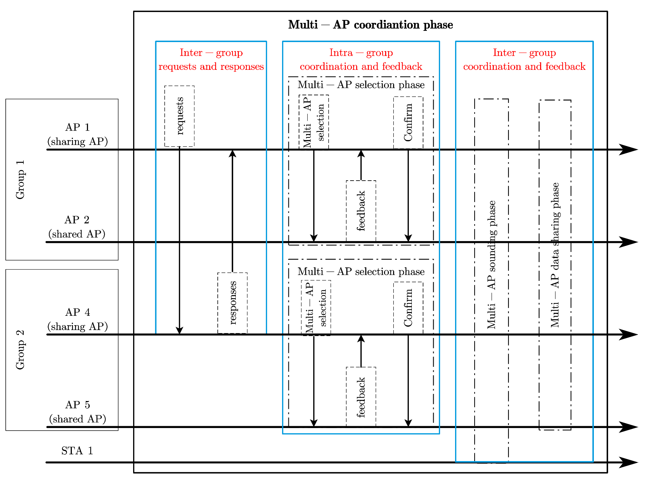
The architecture for Multiple Multi-AP groups (Cont’d)
    Multi-AP coordination phases need to add several extra phases like group coordination phases
      1. Inter-group requests and responses
      2. Intra-group coordination and feedback
      3. Inter-group coordination and feedback
Fig 5

Slide 10
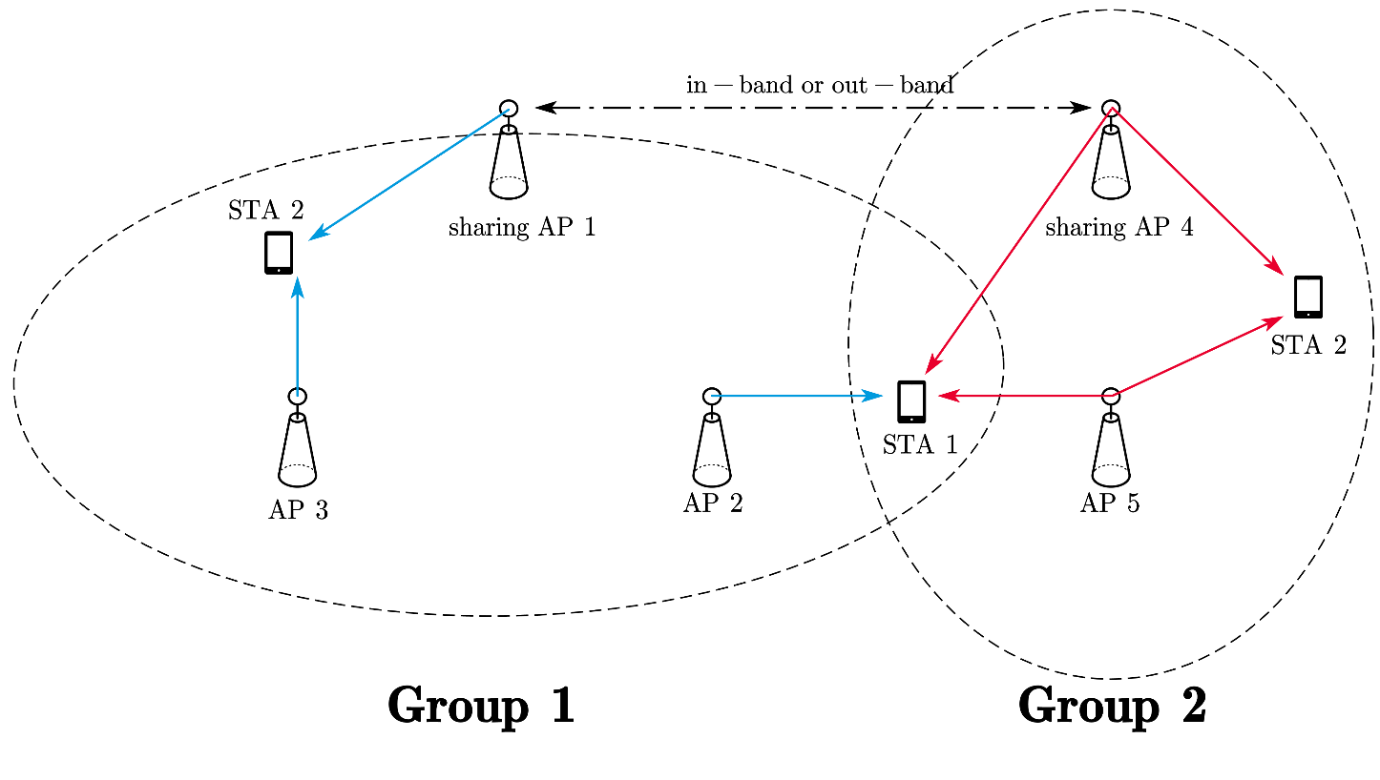
The architecture for Multiple Multi-AP groups (Cont’d)
For all scenarios, we are trying to implement a scheduling method that determines, for each STA in the Multiple Multi-AP groups, which APs in the Multiple Multi-AP groups should participate in each joint transmission
The implementation of the scheduling algorithm is considered to be carried out by one of the APs or a centralized controller [14]
Fig 6

Slide 11
Summary
Points out a potential future direction for Multi-AP Coordination
Proposes a possible architecture for Multiple Multi-AP groups
Requires an efficient scheduling method for multiple Multi-AP groups.
  For each STA, coordinate which APs from which groups participate in each Multi-AP transmission
  For each AP, coordinate whether and how to participate in the coordinated transmission for each STA
  In order to realize the low latency and high throughput data transmission required by UHR with limited overhead

Slide 12
References
[1] 11-22-1516-00-0uhr-considerations-on-multi-ap-coordination
[2] 11-22-1512-00-0uhr-multi-ap-coordination-for-uhr
[3]11-19-1895-02-00be-setup-for-multi-ap-coordination
[4]11-19-1961-04-00be-multi-ap-group-establishment
[5]11-23-0231-00-0uhr-thoughts-on-seamless-roaming-under-the-non-collocated-ap-mld-architecture
[6]11-23-0170-01-0uhr-smooth-roaming-discussion
[7]11-23-0632-01-0uhr-smooth-roaming-follow-up
[8]11-23-0665-01-0uhr-resource-management-for-multi-ap-coordination
[9] 11-23-1461-01-0uhr-considerations-on-multi-ap-operation
[10] 11-23-1562-00-0uhr-multi-ap-for-reliability-with-coherent-and-non-coherent-transmissions
[11]11-23-0324-01-0uhr-roaming-requirements
[12]11-22-1910-03-0uhr-seamless-roaming-for-uhr
[13 11-22-1394-00-0uhr-virtual-bss-and-multi-ap-transmissions
[14]11-20-0064-01-00be-overview-of-multi-ap-operation-in-11be
[15]11-20-1713-02-00be-multi-ap-coordination-recap-and-additional-considerations

