Slide 1
802.11bb Light Communications Awards
Date: 2023-11-16
Authors:

Slide 2
Abstract
This presentation contains the list of awards for the P802.11bb Light Communications project

Slide 3
802.11bb – the Chat GPT version from Sheldon Cooper
In the world of bits and beams so tight,
LiFi emerges, a Sheldonite's delight.
Photons dance, transmitting with glee,
No Wi-Fi chaos, just data harmony.
Sheldon nods in his precise esteem,
LiFi's brilliance, a data-driven dream.
No more lag, no spectrum brawl,
LiFi triumphs, in Sheldon's thrall.
Pretty Accurate ☺ - with minor mishaps ;)

Slide 4
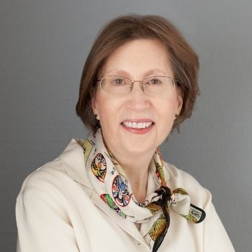
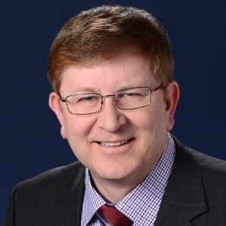
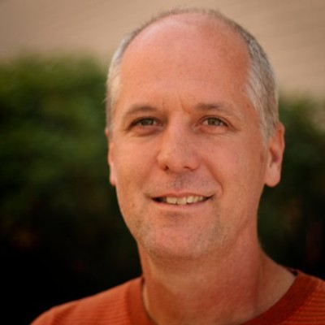
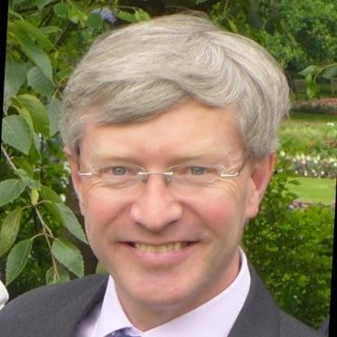
WG Officer Awards We could not have done it without you!
Dorothy Stanley
(802.11 Chair)
Jon Rosdahl
(802.11 Vice Chair)
Robert Stacey
(802.11 Vice Chair)
Stephen McCann
(Secretary)

Slide 5
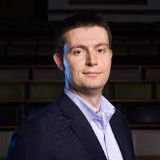
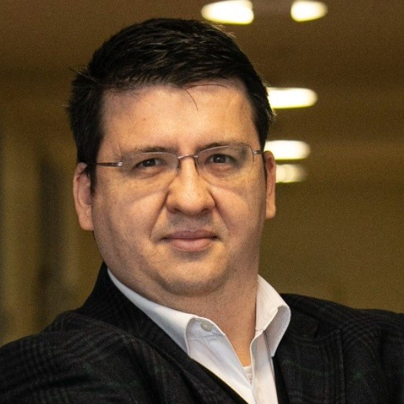
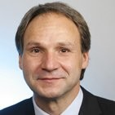
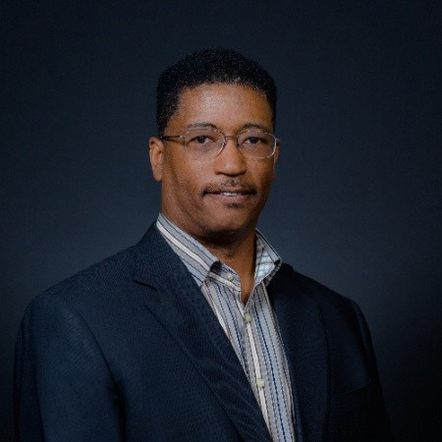
802.11bb TG Officers
Nikola Serafimovski
(TG Chair)
Tuncer Baykas
(TG Vice Chair and
Secretary)
Volker Jungnickel
(TG Editor)
Harry Bims
(TG Editor)
Thank you for your special contribution!!

Slide 6
Significant Contributions Received from:
Nancy Lee
Chong Han
Matthias Wendt (venue)
Ardimas Purwita
Kai Lennert Bober (venue)
Murat Uysal

Slide 7
Contributions Received from:
Sang-Kyu Lim (venue)
Suhwook Kim (venue)
Jinsoo Choi (venue)
Osama Aboul-Magd (venue)
Oliver Pengfei Luo
Li Qiang (John)
Jiamin Chen
Mostafa Afgani
Tamas Weszely
Jean-Paul Linnartz
Athanasios Stavridis
Malte Hinrichs
Farshad Miramirkhani

Slide 8
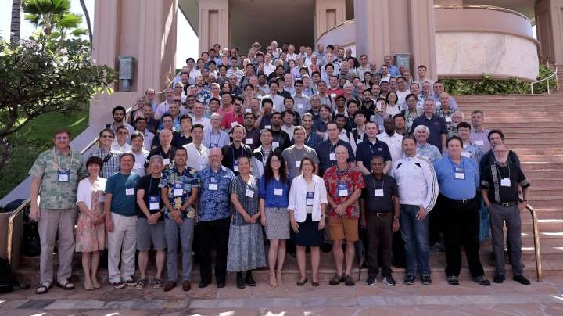
…. and the rest of 802.11 WG

Slide 9
…and the journey ends for a new one to begin!
Thank you all for bringing light to 802.11!

Slide 10
References

