Slide 1
802.11bb Light Communications Awards
Date: 2023-11-16
Authors:

Slide 2
Abstract
This presentation contains the list of awards for the P802.11bb Light Communications project

Slide 3
Equitable Evaluation of IEEE 802.11az-2022
We asked ChatGPT what its thoughts are on the new IEEE 802.11az Standard.
To get an unbiased opinion we fed ChatGPT with the Complete IEEE 802.11az-2022 standard.
You wouldn’t believe what we got....

Slide 4
The 802.11bb – the Chat GPT version
In a realm where light and data entwine, A dance of photons, a symphony divine. LiFi whispers secrets through the air, A technology marvel, beyond compare.
Gleaming photons pirouette and play, Invisible threads weave data's ballet. No more the cables, confined and tight, LiFi sets information free, a radiant light.
Beneath the lamp's soft, illuminating glow, Bits and bytes in a spectral flow. A language of light, so swift and bright, LiFi writes the future in the language of light.
No crowded airwaves, no frequencies fight, LiFi sails smoothly through the night. A silent whisper, a flicker so sly, LiFi connects, as the old ways say goodbye.
Through glass and walls, it gracefully strides, LiFi dances where WiFi hides. A network of light, in every beam, A digital dream, a luminous scheme.
In classrooms, offices, and homes so sweet, LiFi's embrace makes connectivity neat. No shadows of lag, no latency's plight, LiFi beams information at the speed of light.
In the city's heart and the countryside, LiFi's presence is felt far and wide. A beacon of progress, a shimmering sprite, LiFi leads us into the era of light.
So here's to the future, bright and clear, Where LiFi whispers in every ear. In the dance of photons, where data takes flight, LiFi, the poet of the digital light.
Pretty Accurate ☺ - with minor mishaps ;)

Slide 5
802.11bb TG Officers
Tuncer Baykas
(TG Vice Chair and
Secretary)
Volker Jungnickel
(TG Editor)
Harry Bims
(TG Editor)
Nikola Serafimovski
(TG Chair)
Thank you for your special contribution!!

Slide 6
Significant Contributions Received from:
Nancy Lee
Chong Han
Matthias Wendt
Ardimas Purwita
Kai Lennert Bober
Murat Uysal

Slide 7
Contributions Received from:
Oliver Luo
Liqiang (John)
Jiamin Chen
Osama Aboul-Magd
Sang-Kyu Lim
Suhwook Kim
Jinsoo Choi
Mostafa Afgani
Tamas Weszely
Jean-Paul Linnartz
Athanasios Stavridis
Kai Lennert Bober
Malte Hinrichs
Farshad Miramirkhani

Slide 8
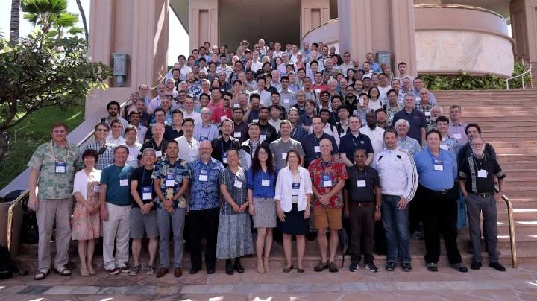
…. and the rest of 802.11 WG

Slide 9
…and the journey ends for a new one to begin!
Thank you all for bringing light to 802.11!

Slide 10
References

