Slide 1
BLE interference to XR/VR Wi-Fi
Authors:
Name | Affiliation | Address | Email
Menzo Wentink | Qualcomm | Utrecht, The Netherlands | mwentink qti qualcomm
Bin Tian | Qualcomm | San Diego, CA, USA
Pooria Pakrooh | Qualcomm | San Diego, CA, USA
Steve Shellhammer | Qualcomm | San Diego, CA, USA

Slide 2
Introduction
These slides analyze the impact of NB signals, e.g. Bluetooth Low Energy (BLE), on low latency Wi-Fi applications like XR/VR and on Beacon Rx
  this effort is triggered by proposals in 802.15.4ab to use NB without LBT
  BLE is analyzed with and without LBT

Slide 3
Simulation settings – BLE
BLE settings
  14 dBm at central and peripheral
  416 us Tx time at central, 150 us IFS, 80 us Tx time at peripheral
  2 MHz channel width
  Rx level on BLE link: –33 dBm
  Rx level of BLE at Wi-Fi: –50 dBm
  BLE stays on the same channel (no frequency hopping)
  BLE with LBT uses CCA trigger
    CCA trigger uses a short LBT before each BLE transmission
    a channel is evacuated when the number of consecutive CCA busies reaches 3
  BLE arrival intervals / duty cycle

Slide 4
Simulation settings – Wi-Fi
Wi-Fi settings
  14 dBm at AP and STA
  160 MHz, MCS2, 2x2, 800 ns GI (432 Mbps)
  75 Mbps fixed rate (XR/VR)
  2428 us / packet (without interference)
  14 ms average interarrival time (72 Hz)
  17% duty cycle without interference
  RTS/CTS/A-MPDU/BA frame exchange
  Rx level on Wi-Fi link: –77 dBm to –32 dBm
  Rx level of Wi-Fi at BLE: –50 dBm

Slide 5
Topology
Wi-Fi
XR/VR
-50 dBm
-77 to -34 dBm
BLE
-50 dBm
att 0 to 45 dB
(pl 46 to 91 dB)
-50 dBm
-77 to -34 dBm

Slide 6
Simulations XR/VR

Slide 7
BLE without LBT
Tail latency increases significantly for BLE duty cycles > 10%
nb_r3303aj

Slide 8
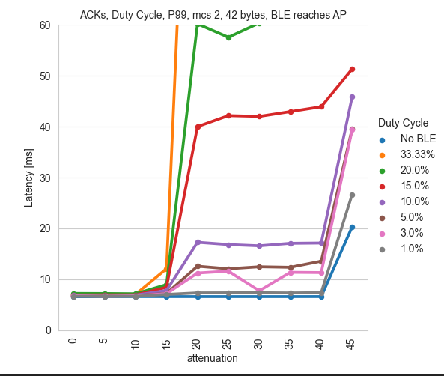
BLE without LBT
(Meta)
(with ACK, duty cycles are a factor 0.2 larger)
Meta

Slide 9
BLE with LBT
With LBT, the latency impact to Wi-Fi is minor even for high BLE duty cycles
nb_r3303ai

Slide 10
Conclusions (XR/VR latency)
An NB signal like BLE has significant impact on Wi-Fi latency, especially for high Tx duty cycle
Adding simple LBT to BLE provides significant improvement
Recommend that .15 and .11 work together to define and adopt a coexistence scheme like LBT

Slide 11
Impact on Beacon Rx

Slide 12
Simulation settings – BLE
BLE settings
  14 dBm at central and peripheral
  416 us Tx time at central, 150 us IFS, 80 us Tx time at peripheral
  2 MHz channel width
  Rx level on BLE link: –33 dBm
  Rx level of BLE at Wi-Fi: –50 dBm
  BLE stays on the same channel (no frequency hopping)
  BLE with LBT uses CCA trigger
    CCA trigger uses a short LBT before each BLE transmission
    a channel is evacuated when the number of consecutive CCA busies reaches 3
  BLE arrival intervals / duty cycle

Slide 13
Simulation settings – Wi-Fi
Wi-Fi settings
  14 dBm at AP and STA
  160 MHz BSS
  450 us Beacon every 100 ms (0.45% duty cycle)
  Rx level on Wi-Fi link: –77 dBm to –32 dBm
  Rx level of Wi-Fi at BLE: –50 dBm

Slide 14
BLE without LBT
Just 5% BLE duty cycle can cause 10% beacon loss
33% BLE duty cycle can cause almost 60% beacon loss
nb_lbe_bc_r3401a

Slide 15
BLE with LBT
LBT solves the issue entirely
nb_lbe_bc_r3401b

Slide 16
Conclusions (Beacon Rx)
NB signals like BLE can have a significant impact on Wi-Fi Beacon Rx
  even just 5% BLE duty cycle can cause 10% Beacon loss
  33% BLE duty cycle can cause almost 60% Beacon loss
Adding simple LBT to BLE solves this issue entirely
Recommend that .15 and .11 work together to define and adopt a coexistence scheme like LBT

