Slide 1
End-to-End Congestion Control,
L4S and Implications for Wi-Fi
Authors:
Date: 2023-11-14
Name | Affiliation | Address | Phone | Email
Greg White | CableLabs |  |  | g.white@cablelabs.com
Lili Hervieu | CableLabs |  |  | l.hervieu@cablelabs.com
Luther Smith | CableLabs
Darshak Thakore | CableLabs

Slide 2
Agenda
Background
  What is congestion
  How does end-to-end congestion control work on the Internet
What is L4S?
  New standardized mechanism for congestion control (Prague)
  New standardized network mechanism for AQM (DualPI2)
  New standardized usage for Explicit Congestion Notification
How does L4S fit with Wi-Fi?
  WLAN is different from (and the same as) other networks

Slide 3
Rate Control in the Internet
Q: How does each sender know how fast to send its traffic?
A: The sender implements a “Congestion Control” algorithm that tries to probe for the available capacity on the path.
Sender 1
Receiver 1
1 Gbps
1 Gbps
…
100 Mbps
…
1 Gbps
1 Gbps
Sender N
Receiver N
Slide 3

Slide 4
Flow Control in TCP/QUIC
In steady-state operation, the sender utilizes acknowledgements from the receiver to pace data onto the link.
  Each time an Ack is received a new packet is sent*
  Referred to as: “Ack Clocking”
*more precisely, each time new bytes are Ack’ed, an equivalent number of bytes are transmitted.

Slide 5
Example
1
100 Mbps
2
10 Mbps
3
100 Mbps
4
10 ms RTT
11 ms RTT
10 ms RTT
client
node
node
server
Bandwidth Delay Product (BDP) =
Bottleneck Link Bandwidth * Round Trip Time
BDP = 10 Mbps * 31 ms
= 38750 bytes (26 packets)

Slide 6
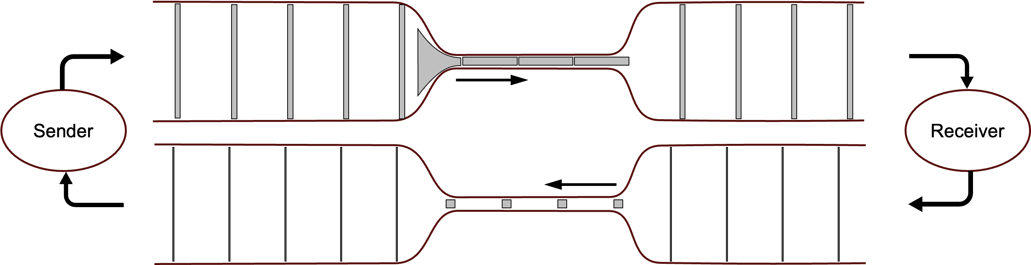
Bottleneck Link Fully Utilized packets in flight = BDP (26 pkts)
1
100 Mbps
2
10 Mbps
3
100 Mbps
4
10 ms RTT
11 ms RTT
10 ms RTT
client
node
node
server
Data packets →
← Acknowledgements

Slide 7
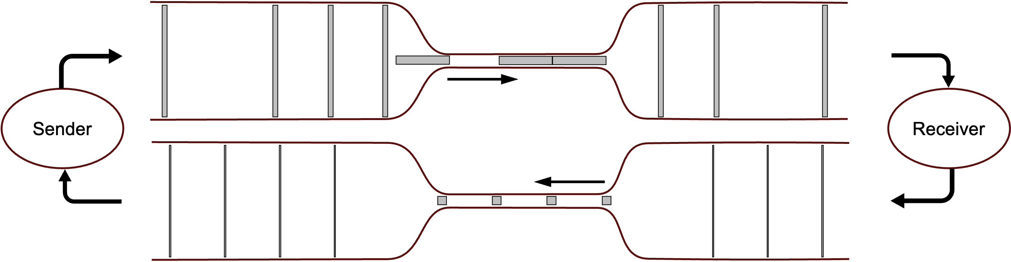
Bottleneck Link Underutilized packets in flight < BDP
1
100 Mbps
2
10 Mbps
3
100 Mbps
4
10 ms RTT
11 ms RTT
10 ms RTT
client
node
node
server
Link underutilized!

Slide 8
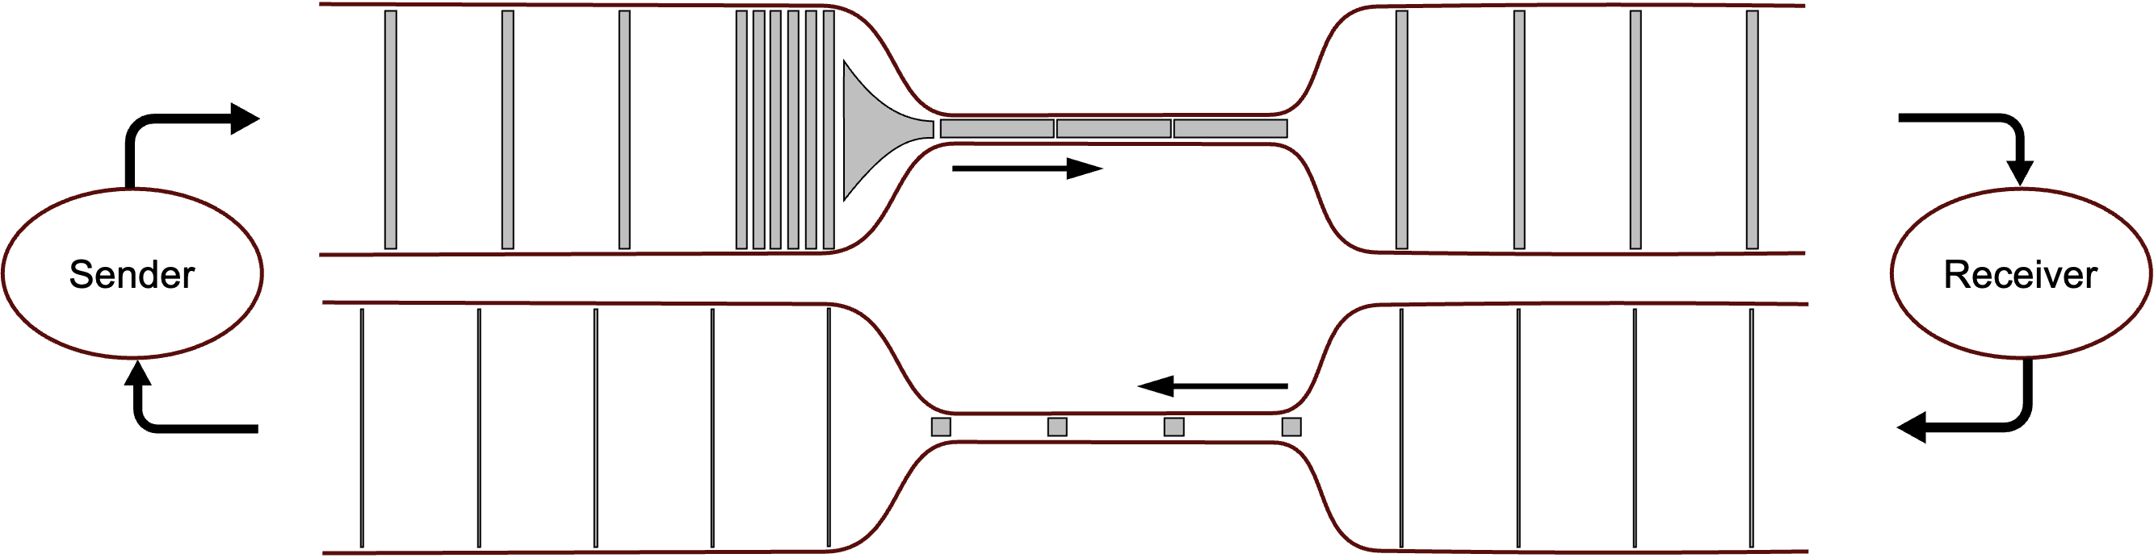
Buffering Delay packets in flight > BDP
1
100 Mbps
2
10 Mbps
3
100 Mbps
4
10 ms RTT
11 ms RTT
10 ms RTT
client
node
node
server
Buffering delay!

Slide 9
queuing delay
Base RTT
Bottleneck Rate
underutilization

Slide 11
TCP Congestion Window
The number of packets that the sender allows to be in-flight is called the Congestion Window (cwnd).
Ideally, sender sets cwnd = BDP
  For Max Throughput, want: cwnd ≥ BDP
  For Min Latency, want: cwnd ≤ BDP
However, the sender never knows what the BDP is
  D (RTT) is different for different connections, and can vary over time
  B (bandwidth) can be different for different connections, and varies over time
    Available free capacity on a shared link as competing flows come & go
    Variable speed links (e.g. wireless)
TCP sender constantly adjusts cwnd to try to ensure cwnd ≈ BDP
  aka “Congestion Control”

Slide 12
TCP Congestion Control Behavior
Since 1986: “TCP Reno”
  Additive Increase / Multiplicative Decrease
    Increase “congestion window” by 1 segment each round trip time
    Cut congestion window by half upon detecting any loss (in a round trip)
  Emergent behaviors
    Multiple connections sharing a bottleneck tend toward fair sharing of the link
      inversely proportional to their RTTs
    Can fully utilize a bottleneck link if the link buffer ≥ BDP (!)
  Influenced design of network gear
    Link buffers sized based on interface bandwidth and worst-case RTT (e.g. 300ms)
Congestion Window (cwnd):
Amount of data the sender allows to be “in flight” (not yet acknowledged) at any point in time
BDP: Bandwidth Delay Product
– Link bandwidth
– TCP connection base RTT

Slide 13
Reno Operating Region
Reno Operating Region
(BDP + BufSize)/2

Slide 14
Reno Operating Region
jitter
“standing queue delay”
Reno Operating Region
(BDP + BufSize)/2

Slide 15
History of TCP Congestion Control
Reno (1986)
Many proposals that didn’t really catch on …
  Vegas, Tahoe, BIC, Westwood, FAST, etc.
  … mainly due to coexistence issues
Cubic (2008)
  Better scalability than Reno
    Like Reno on low BDP paths
    More aggressive on high BDP paths
  Majority of current OSes default to Cubic.

Slide 16
More recent history of CC
DCTCP (2010) – Data Center TCP
  Use Explicit Congestion Notification
  Send Congestion Experienced upon hitting shallow threshold (BDP/7)
  Achieves high thoughput, with very low latency and zero packet loss
  Only usable intra-data-center, not on the Internet
  Inspiration for L4S better use of ECN
BBR (2016) – Bottleneck Bandwidth & RTT
  Try to explicitly model the BDP and then set cwnd = BDP_{est}
  Use sender-driven pacing instead of ACK clocking
  Ignore packet loss as a congestion signal
  Significant “fairness” issues and instabilities – but better throughput with lower average delay
  Deployed by Google and several others

Slide 17

Congestion and Latency
Latency increases in a congested link…
  Not because there is too much traffic for the available bandwidth
    Majority of traffic is “congestion controlled” – it adjusts its rate based on available bandwidth
  Not because “latency increases with offered load”
    In real life, there is no such thing as “offered load”
… because congestion control is “ossified”
  Everyone implemented TCP “Reno” – designed in 1986
  Since then, everything needs to be “Reno-friendly”
  Network gear got optimized for TCP Reno throughput

Slide 18



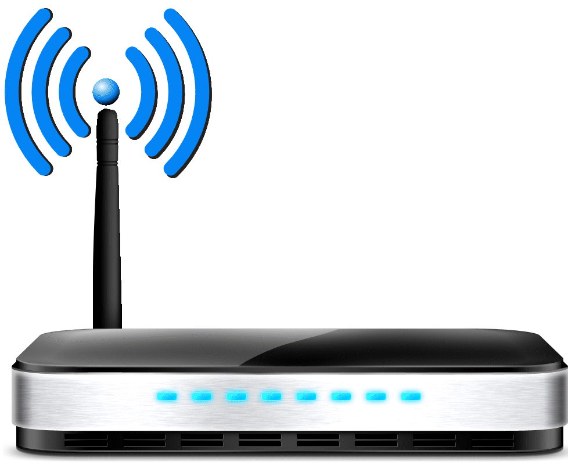
Latency/Jitter/Loss at the bottleneck link
‘Bottleneck’ link is where packet buffering (latency/loss) happens
  slowest link in the path between sender and receiver
The most common bottleneck links are:
  Access Network
  Wi-Fi WLAN
ISP Core Network
Peer Network
client
Home
gateway
Access
node
Server
Notes:
Access network isn’t *always* the bottleneck, but it often is, and it is intended to be
Sometimes the bottleneck is the home WiFi
Sometimes the bottleneck can be in the server, or in a link between the access network and the server
It is also the shared bottleneck for all of the clients in a household, so applications impact one another

Slide 19
What is L4S?
Slide 19

Slide 20


The Solution
End-to-end problem involving:
  Application behavior (e.g. congestion control)
  Network bottleneck implementation
Root cause is insufficient feedback when congestion occurs
The Solution: Low Latency, Low Loss, Scalable Throughput (L4S)
  Latency isolation & high-fidelity congestion feedback at network bottlenecks
  New congestion control algorithm at sender

Slide 21

L4S: Why is it important?
Perfect for applications that want high data rates, consistent ultra-low latency, and near-zero packet loss
  Cloud gaming, cloud VR/AR applications
  High quality video conferencing
Also beneficial for other applications that are latency bound
  General HTTP traffic (web and web-like apps)
Defined by the Internet Engineering Task Force
  Published as RFC9330, RFC9331, RFC9332 in January 2023.

Slide 22

L4S: Some details
Improves on Closed-loop Feedback Control
  via Explicit Congestion Signals (RFC9331)
Requires support in sender, receiver and network bottleneck
  Sender support
    A congestion controller built against the “Prague requirements” (RFC9331)
    Identification of L4S support in the IP header
  Bottleneck link support
    Provide immediate indication of queuing delay using ECN marking
      Sender no longer needs to infer congestion based on RTT variation or loss
      Disambiguates congestion from other delay/loss sources
  Receiver support
    “Accurate ECN” feedback
ECN = Explicit Congestion Notification
RTT = Round-Trip Time

Slide 23
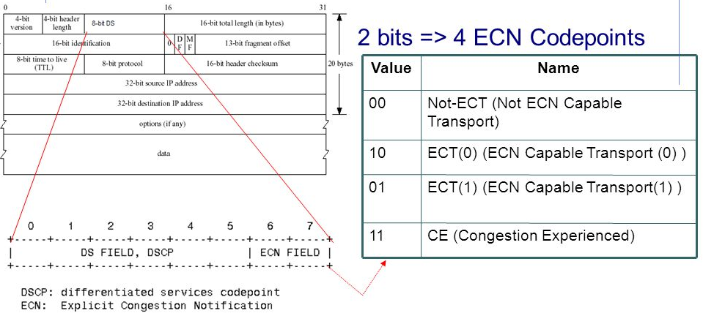
How does it work
Marking packets to control the rate
CE-marking feedback in Layer 4 or above
10% echoed marks
L4S Sender
Application
Sets IP.ECT1
L4S Receiver
Application
Echoes CE in L4++
ECT1
Network node
ECT1
Bottleneck node
CE|ECT1
Network node
CE|ECT1
11Mbps
11Mbps → 10Mbps
Eg: 10% marks
Slide 23

Slide 24
How does it work
Low Latency Congestion Control behavior: Prague (RFC9331)
queuing delay
Prague Operating Region
Base RTT
Prague Operating Region
Bottleneck Rate
underutilization
Slide 24

Slide 25

Incremental Deployment of L4S
Coexistence of L4S & Classic senders via separate queuing
  Dual Queue (RFC9332) – Two equal-priority queues:
    Low Latency (L4S)
    Classic
  Flow Queuing (RFC tbd) – Separate queue for each “flow”
Separation, not prioritization
  Buffering latency can be solved without prioritization
  Priority is orthogonal

Slide 26
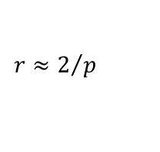
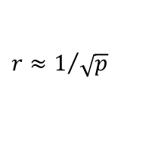
How does it work
Fairness to Classic traffic: DualPI2 (RFC9332)
Network node
Interactive applications
set L4S ECT1 in IP header
and use L4S CC
&
>1ms
ECN
Classifier
Congestion Control
Overrules scheduling
Prague
p_{L}
q_{L}
ect(1),
ce
ect(0),
non-ect
L4S
CE
marker
$$r≈2/p$$
90%
WRR
$$r≈1/{\sqrt{p}}$$
Classic
10%
Drop
Reno/Cubic
q_{C}
2p
Download applications
set non-ECT and
use Classic CCs
Every 15ms
PI2
p²
p_{C}
Slide 26

Slide 27
L4S status in standards
IETF
RFC9330, RFC9331, RFC9332 published in Jan '23
L4S is technology-agnostic
Leverages bits in the IP header
In principle, doesn’t “require” other standards
January 2023
3GPP
Active work item for 5G Release 18
Release 19 L4S features under discussion
Summer 2022
January 2019
Wi-Fi ?
Discussions underway in Wi-Fi Alliance
Project proposed in Wireless Broadband Association
Multiple proposals in IEEE 802.11
CableLabs
L4S is part of the DOCSIS 3.1 standard published 2019
(Low Latency DOCSIS specification) mandatory Jan 2021
4
Slide 27

Slide 28
How does L4S fit with Wi-Fi?
Slide 28

Slide 29
How Does L4S Fit with Wi-Fi?
Supporting L4S in Wi-Fi equipment is important
  The WLAN can often be the bottleneck link
  Accurate congestion signaling could significantly improve user experience
But, is Wi-Fi different?
  Shared medium
  Highly-variable channel capacity
  Statistical, highly-variable media access
  Packet aggregation for efficiency
Slide 29

Slide 30
Is Wi-Fi different?
Shared medium
  Many bottleneck links are shared, other applications can decide to send traffic at any time, this is normal
Highly-variable channel capacity
  Other wireless links (e.g. 5G) also share this attribute
  This is hard for all congestion control algorithms (compromise between throughput and latency)
  L4S traffic may not be able to fully utilize all channel capacity
  Buffered classic traffic can better fill brief increases in link capacity
Statistical, highly-variable media access
  The details might be specific to Wi-Fi, but all network technologies can have very indeterministic behavior
  Need to optimize marking strategy accordingly
Packet aggregation for efficiency
  Not ideal for low latency, maybe can be improved in the future?
Slide 30

Slide 31
How can a Wi-Fi device decide when to signal congestion?
Goal of the CE mark is to cause the sender to adjust its rate, and this can take several round trips (10s of ms)
Will need to limit the impact of media access delay variation in setting CE marks.
Media access delay is not relevant for congestion signaling.
No congestion should be signaled if waiting data can be send in the next TXOP, or AQM will reduce rate without reduction in latency
Slide 31

Slide 32
L4S and Wi-Fi in ns3
Multi-company project kicking off to implement L4S support in the 802.11 link model in ns3
  Start with what is possible using the existing MAC
  Explore limits to performance across a wide range of scenarios
  Investigate MAC changes to address performance gaps
If you are interested in contributing to this project, please contact CableLabs ( g.white@cablelabs.com or l.hervieu@cablelabs.com ).

Slide 33
Wrap up
L4S is implementable and very important for Wi-Fi (and Wi-Fi is very important for L4S apps)
  L4S drastically reduces Latency-under-Load (up to 100x lower latencies)
  Proven technology (L4S in Nokia Wi-Fi APs on top of many existing chipsets)
  Implementable with current 802.11 MAC, but improvements are expected with further optimizations
  L4S Applications are being rolled out
  Developer platforms and OSs are adding L4S support
  Other network technologies support L4S and are rolling out field trials (DOCSIS)
  Other network technologies started L4S standardization (5G)
Slide 33

