Slide 1
Basic SBP Feature Set
Date: 2023-11-14
Authors:

Slide 2
Sensing by Proxy Feature of 802.11bf
During Letter Ballot 2.0, we have identified that there are controversial needs on SBP
  They seem to be highly contradictive
  There are multiple CIDs on this topic in LB 276 as well.
SBP is considered an essential feature to enable STA-side use cases
SBP is causing implementation overhead, linked to negotiation during session setup and to reporting.

Slide 3
Challenges during Setup
The AP has to identify responders
There are many options and features the SBP initiator can request from the sensing sessions
The AP has to negotiate parameters requested by the SBP initiator with sensing
Depending on the number of responders required and the parameter set requested, considerable amount of time and resources might by needed on the part of AP to setup the relevant sensing sessions for SBP.

Slide 4
Challenges of SBP Reporting
The AP has to be able to collect and combine multiple reports from the sensing responders in the TB sensing session that is set up based on the SBP request.
Depending on the number of responders, a decent amount of data can be created that needs to be processed by the AP, possibly on higher layers and fed back to the PHY. Such features seem to be tricky to implement while normal communications operation has to be provided as well.

Slide 5
Idea: Basic SBP
To reliably enable client-side use cases, it might make sense to define a basic SBP feature set
It shall put minimal demands on the AP (minimal negotiation for sensing session setup and minimal reporting overhead)
It shall be a mandatory capability of AP Sensing STAs

Slide 6
Proposal
Split the Sensing by Proxy feature into a
mandatory ‘Basic SBP’ feature and an optional ‘advanced SBP’ feature.
The Basic SBP feature offers two variants:
Opportunistic: (SBP responder driven)
Everything is defined by SBP responder
Initiator-Driven: (SBP initiator driven)
Everything is defined by SBP initiator

Slide 7
Opportunistic SBP
The SBP initiator only requests ‘an SBP session’ with a minimal parameter set (e.g. max number of responders, max bandwidth).
  No list of responders
To limit reporting overhead, the maximum refresh rate that is indicated in the availability window element may be limited
SBP Responder can decide on reporting details.
Everything else is up to the SBP Responder/ Sensing Initiator.
This approach is similar to the concept proposed in 21/1692r4.

Slide 8
Initiator-Driven SBP
The SBP initiator provides a complete set of parameters including a list of responders, BW, availability window.
Requested parameter shall be a subset of the AP’s capabilities.
There is no reporting implemented in this feature.
If the SBP responder is not able to set up a session with these settings, i.e. one sensing responder rejects the sensing request, the SBP responder may reject the SBP request.
This approach is similar to 22/0670r1.

Slide 9
Why two different versions?
The initial SBP proposals had vastly different use cases
On refinement, it is clear that having one solution might work, but at the cost of high complexity.
It is more useful, at least for initial deployment, to simplify SBP with a mandatory set of two basic SBP features that serve most of the needs of different use cases, but with drastically reduced implementation complexity.

Slide 10
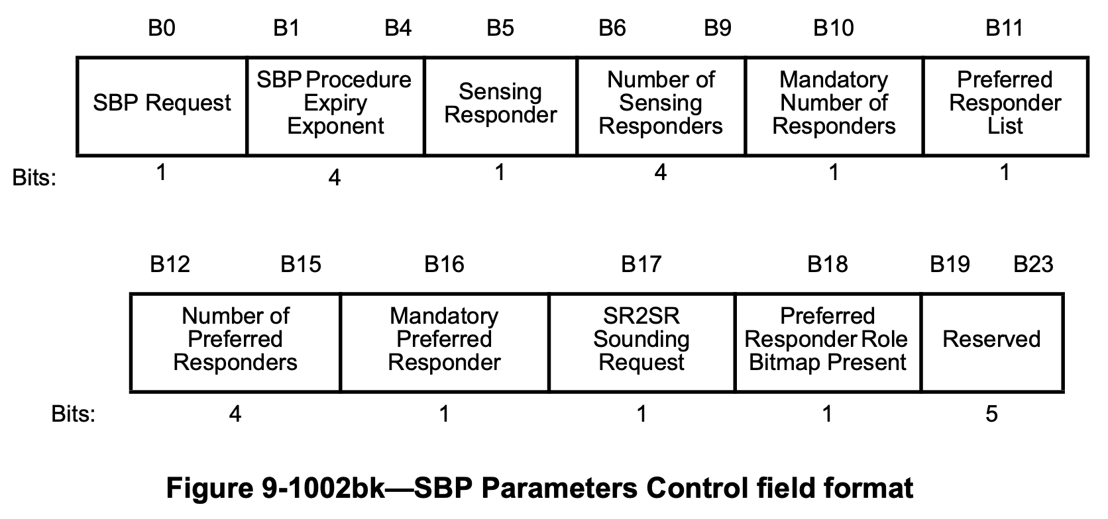
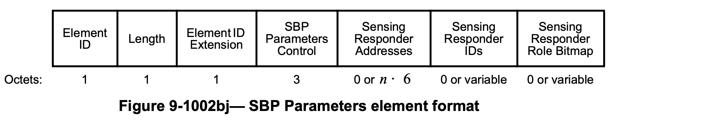
Required Changes:
Need a field ‘SBP Type’ in SBP Parameters element (or as part of one of the fields) to signal type of SBP.
  Two bits ‘SBP Type’ in SBP Parameters Control field: 00: SBP / 01: Basic SBP, Opportunistic Variant / 10: Basic SBP, Initiator-Driven Variant / 11: Reserved
Need to modify draft text to define consequences of setting SBP Type.
  Specific fields of SBP Parameters Control field and Sensing Measurement Parameters field shall be set to specific values.
Add additional reject reason codes for SBP. E.g.
  AP resource limitation – not capable of fulfilling this request
  Matching responders not found
OR
SBP Type
1
Add field here
Add two bits here

Slide 11
Strawpoll
Do you support to add a mandatory Basic Sensing by Proxy feature set to the 802.11bf draft?
Yes / No / Abstain

