Slide 1
Initial Control / Response Control frame transmission rules
Authors:
Date: 2023-11-13

Slide 2
Introduction
Initial Control frames (e.g., RTS or MU-RTS) serve to poll for a STA’s presence before the actual data frame transmission.
Roughly, a STA responds with a CTS if NAV is not set and it receives the RTS or MU-RTS.
However, absence of CTS does not prevent the ICF transmitter to attempt initiating more TXOPs.
Increases BO count at the initiator STA with repeated failures => increased latency, more power etc.
Creates unnecessary interference to medium for other STAs.
Clearly, having some rules for ICF transmitter to regulate its transmissions would improve network efficiency.

Slide 3
Proposal
After experiences an ICF failure to STA-2, a STA-1 limits the number of future ICF transmissions to STA-2 for a certain timer duration (e.g., max PPDU length or max PPDU length/2).
If STA-1 is AP, then it may still transmit to other non-AP STAs during this time following baseline channel access rules.
STA-1 resumes regular channel access rules after receiving any valid PPDU from STA-2 since that indicates STA-2 is available.
Since UL transmissions are typically less frequent, may consider different timer duration rules for UL and DL.
Note: the rules then are similar to medsync rules defined for EMLSR and NSTR in 11be and we may also consider just reusing/updating those rules.

Slide 4
Proposal (contd.)
For the case when the STA-2 successfully receives the ICF but is unable to respond in baseline because NAV is set, we can allow the STA-2 to send a short Control frame in response that signals the remaining NAV duration.
Note: similar exceptions to short frames are there for 11ax TF transmissions.
This is then similar to DTS frame transmission in DMG and the short Control frame may have a similar design.
Any third-party STA that receives the short Ctrl frame would not set its NAV from this frame (e.g., set any Duration field to zero).
The design can be well aligned with other proposals about STAs unavailability due to any types of coex issues
Will not be sent
STA-1
ICF
ICF
ICF
ICF
ICF
RCF
(busy, be back in X ms)
X ms
STA-2
NAV set at STA-2
Notes:
CF-end cases maybe rare but could be handled by having STA-2 send some frame to STA-1..

Slide 5
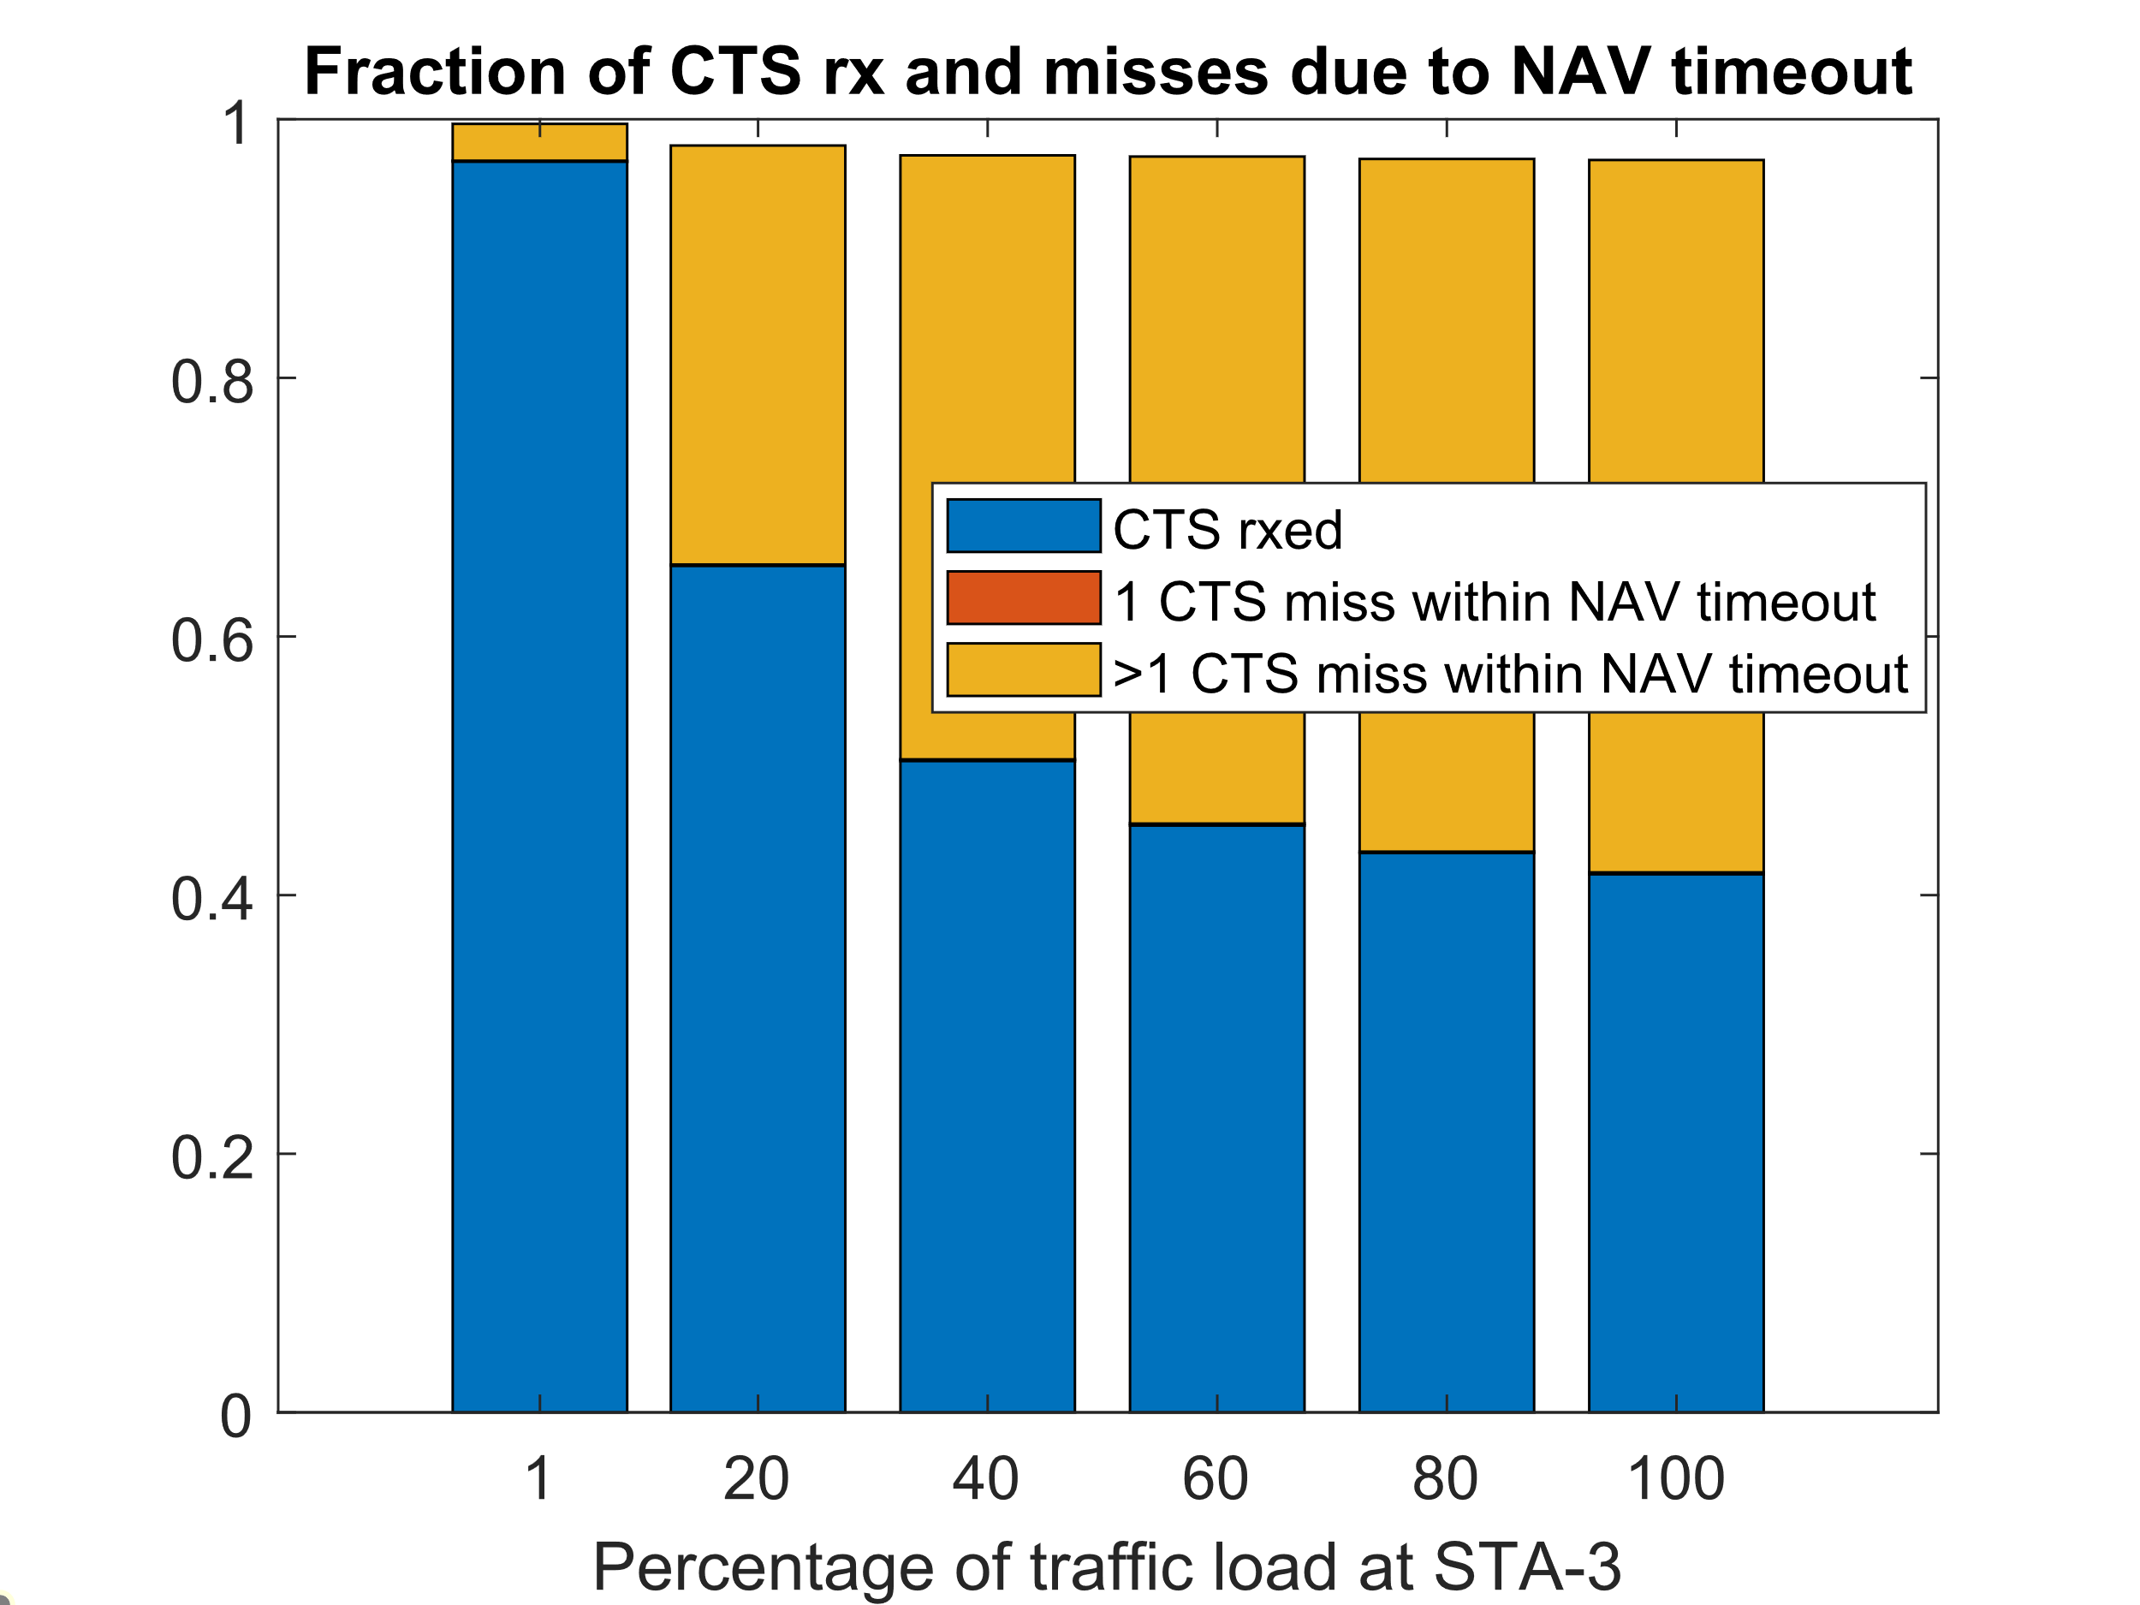
Evaluation of RTS retransmission events
We plot of ratio of CTS misses per transmitted RTS as function of traffic load in network corresponding to events where NAV will be set at intended destination.
STA-1 generates a packet for STA-2 on average every 2ms and attempts to initiate a TXOP with an RTS.
A third party STA-3, hidden to STA-1, is receiving some traffic which causes STA-3 to often set NAV around STA-2.
It shows that as the traffic load at STA-3 increases, there is significant number of occurrences where a single event of NAV being set at STA-2 would cause repeated RTS failures at STA-1.
STA 3 source of data
STA 3
STA 2
STA 1
Data frame every 2 ms

Slide 6
Preliminary simulation results for DTS-like response
When NAV is set from CTS (i.e. traffic sink is nearby)
When both sides do not support DTS, the per link throughput is 24.2Mbps vs 18.9Mbps = 42.1.6 total
When both sides support DTS, the per link throughput is 20.1Mbps vs 20.3Mbps = 40.4 total
When orange is legacy and blue support DTS, the per link throughput is 20.2Mbps vs 20.4Mbps = 40.6 total
Average Cw size @ RTS sender vs STA1
Both do not support 35 vs 59
Both support: 19 vs 19
Only one support: 30 vs 20
When NAV is set from RTS (i.e. traffic source is nearby)
When both sides do not support DTS, the per link throughput is 53.7 Mbps vs 7.6Mbps = 61.4 total
When both sides support DTS, the per link throughput is 51.1 vs 9.1 = 61.2 total
Average Cw size @ RTS sender vs STA1
Both do not support 16 vs 154
Both support: 16 vs 61
RTS sender
CTS responder
STA 2
STA 1
NAV set from CTS
2x2x20, MCS3; full buffer;
STA1 hidden from RTS sender/CTS responder
CTS responder
RTS sender
STA 2
STA 1
NAV set from RTS
If STA1 is hidden from RTS sender, it may have difficulties reaching STA2 which may not be responding to STA1 due to either NAV set or medium busy. In such a case DTS would increase chances for STA1 for medium access

