Slide 1
Close-range AMP Backscattering in 2.4GHz
Date: 2023-11-11
Authors:

Slide 2
Introduction
Backscattering is one of the candidate technologies to enable ambient power operation [1, 2]
Several contributions have discussed the challenges and potential solutions for long range (~meter) backscattering [3, 4, 5]
In this presentation, a new category of close-range (~10cm) AMP backscattering use case is proposed for 2.4GHz

Slide 3

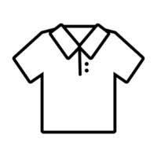


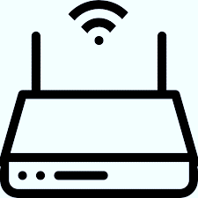





AMP Backscattering Applications [1]
Smart Home
  Locate personal belongings
  Read expiration dates of food, trigger new order
Smart factory
  Production control, warehouse inventory,
  asset management, anti-counterfeiting, worker
  presence detection
Smart agriculture
  Supply chain and asset management
Combine the physical world with the virtual world
  connect items to the cloud
Read range requirement: several meters

Slide 4



















RFID Markets
34 Billion UHF Tag ICs shipped in 2022! (Source: RAIN ALLIANCE 2023)
Markets
Use Cases
Benefits
Retail
Item level tracking from source to consumer
Product authentication and brand protection
Consumer self-checkout at terminal
Manufacturing and distribution process optimization
Airline baggage tracking
Electronic toll collection
Vehicle registration and vehicle access management
Increased supply chain visibility
Improved shopping experience
Reduced waiting time at checkout
Proof of product originality
Reduce number of mishandled parcels and airline baggage
Increased operations and manufacturing efficiency
Convenient access to vehicle related services
Enables sustainability by reducing waste
Pharma
Parcel services
Industrial IoT
Aviation
Vehicle Identification
Retailers & brands
80+ Billion UHF Tag ICs by 2026! (Source: VDC 2022)

Slide 5
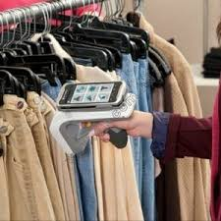
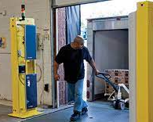
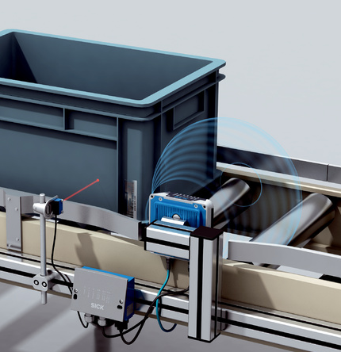

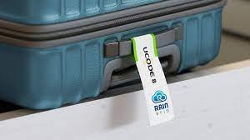
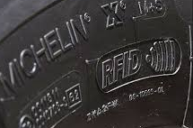
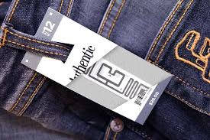

TODAY: RFID for B2B Applications
Inventory control with
UHF handheld reader
Warehouse dock door with UHF reader
Conveyor belt
UHF reading
Self-checkout at
UHF terminal
Airline baggage tag with UHF
Embedded UHF tire tag
Apparel UHF tag
Automatic Vehicle ID
Read range: ~10m, need specialized RFID reader

Slide 6



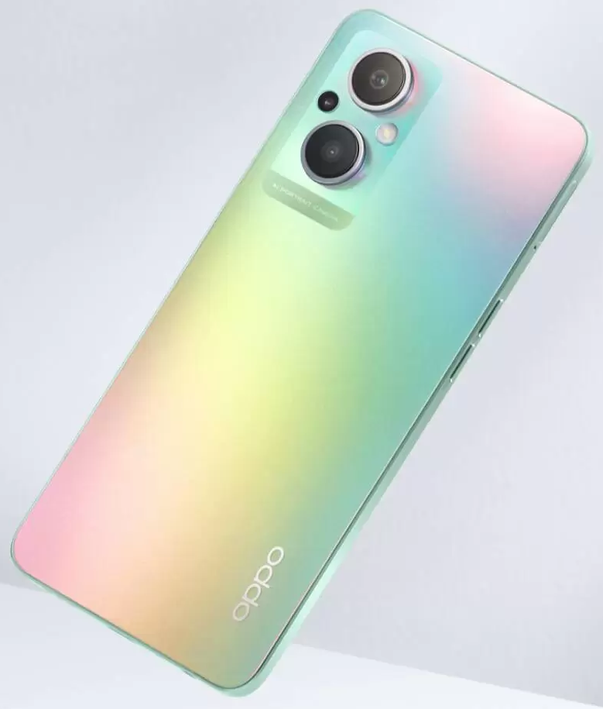



TOMORROW
What if 10’s of billions of tags can be read with a mobile device?
Read range requirement: 5~10cm

Slide 7
UHF + AMP Tag
One tag for both B2B and B2C applications
  B2B: sub-1GHz backscattering with ~10m range
  B2C: 2.4GHz backscattering with ~5cm range
New use cases enabler:
  Consumer gets product related information
    product properties, warranty, item history, promotion
  Consumer self check-out with personal device
    read tag and pay, no need to go cashier
  Beyond sale
    ease of product registration, recycle information
  Connect the physical world with the virtual world
  Create digital twin, connect items to the cloud

Slide 8
WiFi AMP Tag Reading Architecture
WiFi reader: WiFi transceiver with 2+ antennas
  one antenna sends reading energizer signal and
  another antenna receiving backscattered tag signal
  No major RF and digital changes to popular mobile devices
An AMP tag with similar backscattering modulation as UHF tag

Slide 9


Link Budget Analysis
Friis propagation model: Prx = Pt + Gtx + Grx + 20log10( ) – 20log10(4 d) – L (dB)
  WiFi antenna gain: Gtx = Grx = 2dB
AMP tag activation power: -20dBm
Backscattered modulation loss: L = 6dB
$$λ$$
$$π∙$$

Slide 10
Technical Feasibility
Applications for close-range backscattering (~10cm)
WiFi reader Tx power:
  0dB is sufficient to energize the tag
WiFi reader dynamic range:
  30~50dB dynamic range in 2.4GHz (assume 20dB antenna isolation)
  9~10 bit ADC is sufficient to decode the tag data
AMP tag backscattering:
  simple modulation techniques, like OOK, compatible with RFID
  enables ultra low cost tag

Slide 11
Standards Definition
Energizer waveform by WiFi reader:
  Same 2.4GHz medium access and protection mechanism applies (backward interoperability)
  Leverage DSSS or OFDM waveform
Backscattering modulation scheme, e.g. OOK
  Simplify MAC header
WiFi tag reading control frame
  Leverage WUR PPDU
WiFi tag reading protocol

Slide 12
Summary
AMP + RFID is an enabler of many B2C use cases
Faster and easier market adoption
  AMP 2.4GHz backscattering technique can be as simple as RFID
AMP reader can be an add-on feature to existing 2x2 WiFi devices without major hardware upgrade
Suggest AMP PAR to be open to support the technical requirements for 2.4GHz close-range backscattering

Slide 13
References
[1] 11-18-0498-08-00fd-fd-tig-report
[2] 11-23-0056-00-0amp-802-11-compatible-backscatter-prototype
[3] 11-23-0106-00-0amp-some-thoughts-on-backscatter-modulation
[4] 11-23-0836-02-0amp-discussion-of-existing-technologies-and-technical-challenges-in-amp
[5] 11-23-1195-00-0amp-thoughts-on-amp-iot-and-par

Slide 14
Appendix
5.2: This amendment defines:
- at least one mode of data communication in sub-1 GHz band
at least one mode of data communication in 2.4 GHz band
  Including backscattering communication
at least one mode of RF energy harvesting

