Slide 1
Data Tones Grouping in Tone-Distributed RUs
Date: 2024-01-10
Authors:

Slide 2
Abstract
In this contribution, we follow up on the discussion of grouping of the data tones in Tone-Distributed RUs (dRUs) and show the PER performance of data tones grouping.

Slide 3
Background
Tone-Distributed Resource Unit (dRU) is proposed in [1] as a solution for long range
In [2], pilot design and CFO impact have been discussed and the authors have shown how the choice of the pilot tones can significantly impact the performance for different CFO which is further extended in [4]
The authors of [3] proposed reusing the RU allocation indication of rRUs for dRUs
In [5], the authors discussed further considerations for dRUs including channel widths for dRU transmissions, dRU transmission given preamble puncturing, and dRUs sizes allowed in each channel width
In [6], the authors have shown the impact of pilot tone allocation on the performance of dRUs and have discussed other considerations, including the grouping of data tones in dRUs.
In [7], the authors proposed a use case for using dRUs in the downlink

Slide 4
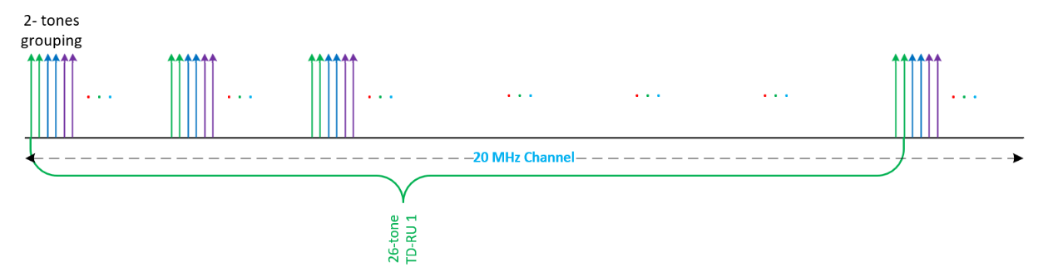
Grouping of Data Tones
The tones of a 26-tone dRU in 20 MHz channel may be selected in different ways:
  Method 1: One tone out of each 9 tones is allocated to each dRU in turn [2] (See Slide 7).
  Method 2: Two or more consecutive tones are allocated to each dRU in turn uniformly.
Example: a 26-tone dRU has 24 data tones and 2 pilot tones, the 24 data tones may be grouped in different ways:
    2×12 12 groups each of 2 data tones
    3×8 8 groups each of 3 data tones
    4×6 6 groups each of 4 data tones

Slide 5
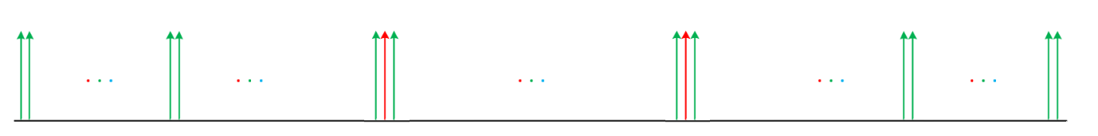
Grouping of Data Tones
The groups of data tones can be symmetrically located across the channel bandwidth
  The pilot tones are positioned in the middle of two of the data groups (in case of 26-tone dRUs)
The group of data tones including the pilot tone can be used to improve the phase estimation by filtering out the noise, especially in low SNR scenarios
  This can start from the LTF symbol(s) and can be carried forward to the data symbols
The group of data tones can further be used to enhance the channel estimation through simple channel smoothing
Data tones
Pilot tones

Slide 6
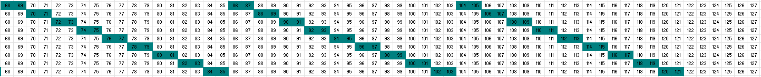
Grouping of Data Tones – Full Picture

Slide 7
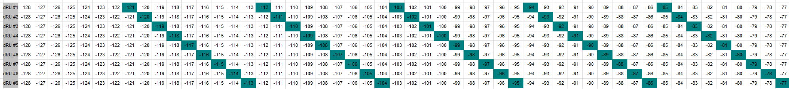
Ungrouped Data Tones

Slide 8
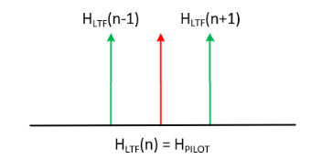
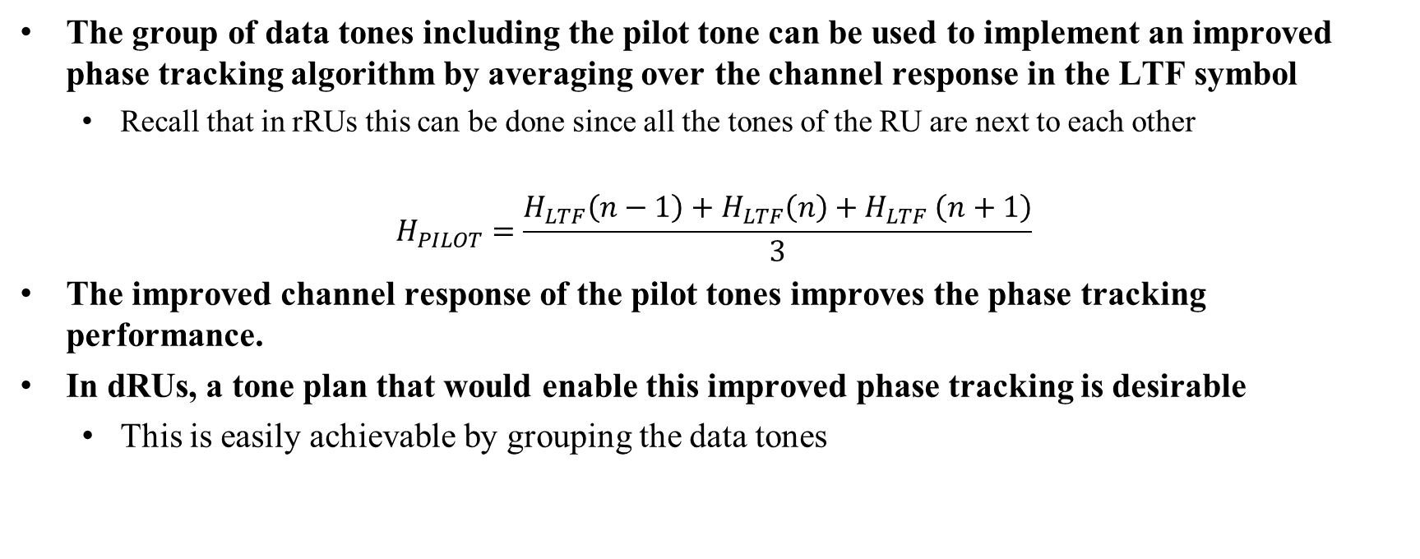
LTF-Assisted Phase Tracking
The group of data tones including the pilot tone can be used to implement an improved phase tracking algorithm by averaging over the channel response in the LTF symbol
  Recall that in rRUs this can be done since all the tones of the RU are next to each other
$$H_{PILOT}=\frac{H_{LTF}\left(n−1\right)+H_{LTF}\left(n\right){+ H}_{LTF}\left(n+1\right)}{3}$$
The improved channel response of the pilot tones improves the phase tracking performance.
In dRUs, a tone plan that would enable this improved phase tracking is desirable
  This is easily achievable by grouping the data tones

Slide 9
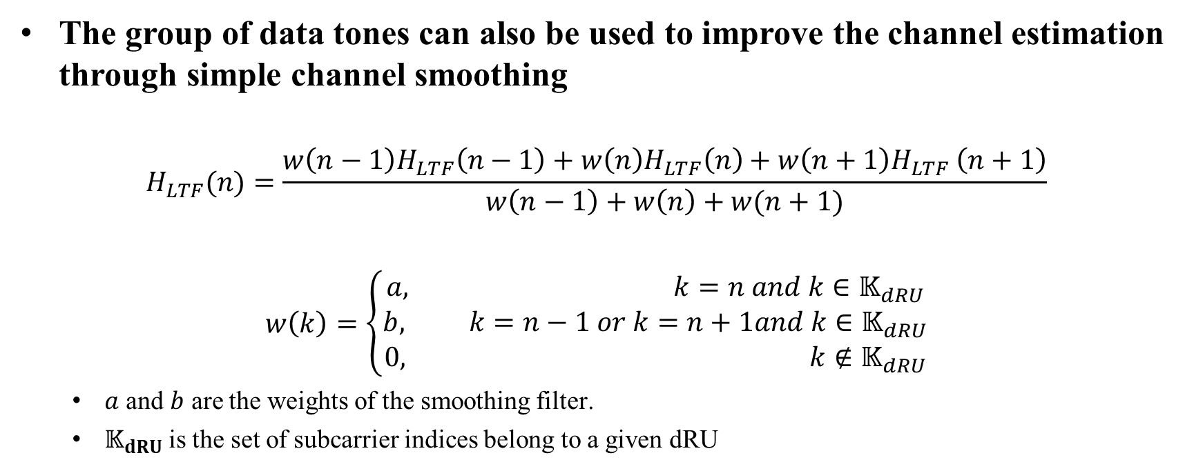
Channel Smoothing
The group of data tones can also be used to improve the channel estimation through simple channel smoothing
$$H_{LTF}(n)=\frac{{w\left(n−1\right)H}_{LTF}\left(n−1\right)+w\left(n\right)H_{LTF}\left(n\right){+ w\left(n+1\right)H}_{LTF}\left(n+1\right)}{w\left(n−1\right)+w\left(n\right)+w(n+1)}$$
$$w\left(k\right)=\left\{\begin{aligned}a, k=n and k∈𝕂_{dRU} \\ b, k=n−1 or k=n+1and k∈𝕂_{dRU} \\ 0, k∉𝕂_{dRU}\end{aligned}\right.$$
  $a$ and $b$ are the weights of the smoothing filter.
  $𝕂_{dRU}$is the set of subcarrier indices belong to a given dRU

Slide 10
Considerations of Grouping of Data Tones
Several considerations for data tones grouping of dRUs
  Simplicity: Larger dRUs may be simply comprised of smaller dRUs
  Performance: Some tone plans may have a better PER performance than others
  Maximum Power Boost: A tradeoff between the maximum power boost and the mitigation of CFO may be considered
  Diversity vs Phase Tracking: Grouping of data tones enables LTF-assisted phase tracking which in turn improves the performance, but may also impact the gain of frequency diversity in dRUs
Group Size | Power Boost Factor [dB]
1 | 8.13
2 | 8.13
3 | 6.37
4 | 5.12

Slide 11
Simulation Environment
Simulation Parameters
  Channel Bandwidth = 20 MHz (nine 26-tones dRUs)
  LDPC Coding , MCS = 0, MCS = 3 and MCS = 7
  SISO with Channel Model D
  Residual CFO: [dRU1:+CFO, dRU2: -CFO, …, dRU9: +CFO]
    CFO = 0 and 300 Hz are considered
    Phase tracking is always used
  SNR is defined as the average SNR per user.
  The dRUs are comprised using 2×12 grouping scheme (see Slide 6)
  Ungrouped dRUs tone plan is referring to Method 1 in Slide 4
  Packet Size = 100 bytes
  Pilot Positions: in the middle of the 4th and the 9th data tones groups
  Channel smoothing weights a = 2 and b = 1
  The PER for the first dRU is considered

Slide 12
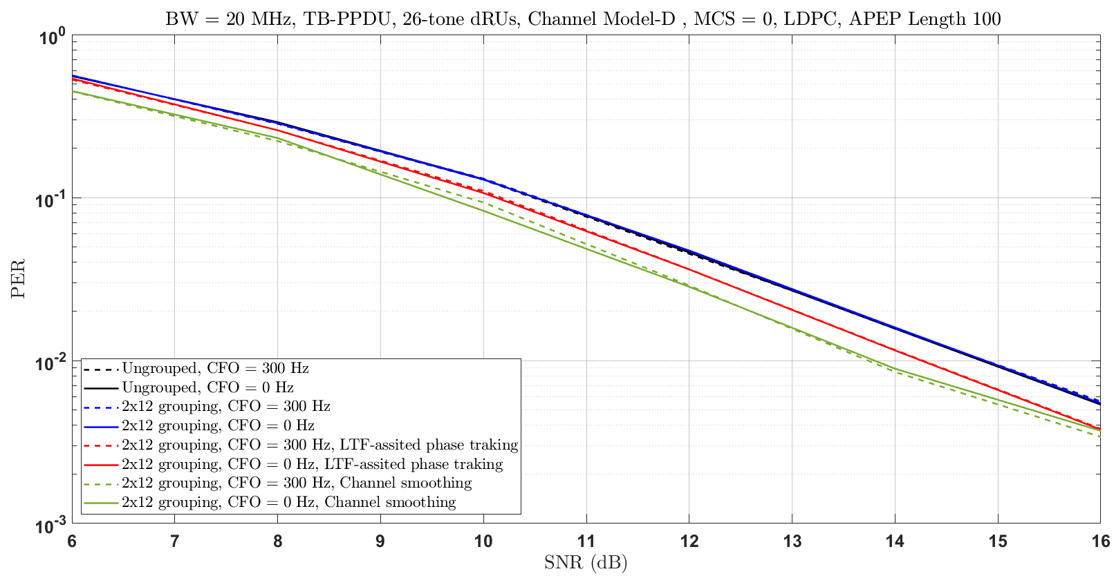
MCS 0 in Channel D
Grouping of data tones yields a nice PER performance improvement if LTF-assisted phase tracking is applied (red curves).
Further PER performance improvement is also achievable if channel smoothing is applied (green curves) .
No loss in the performance of data tones grouping if conventional phase tracking is applied (blue curves). The performance is no worse than the ungrouped data tones (black curves).

Slide 13
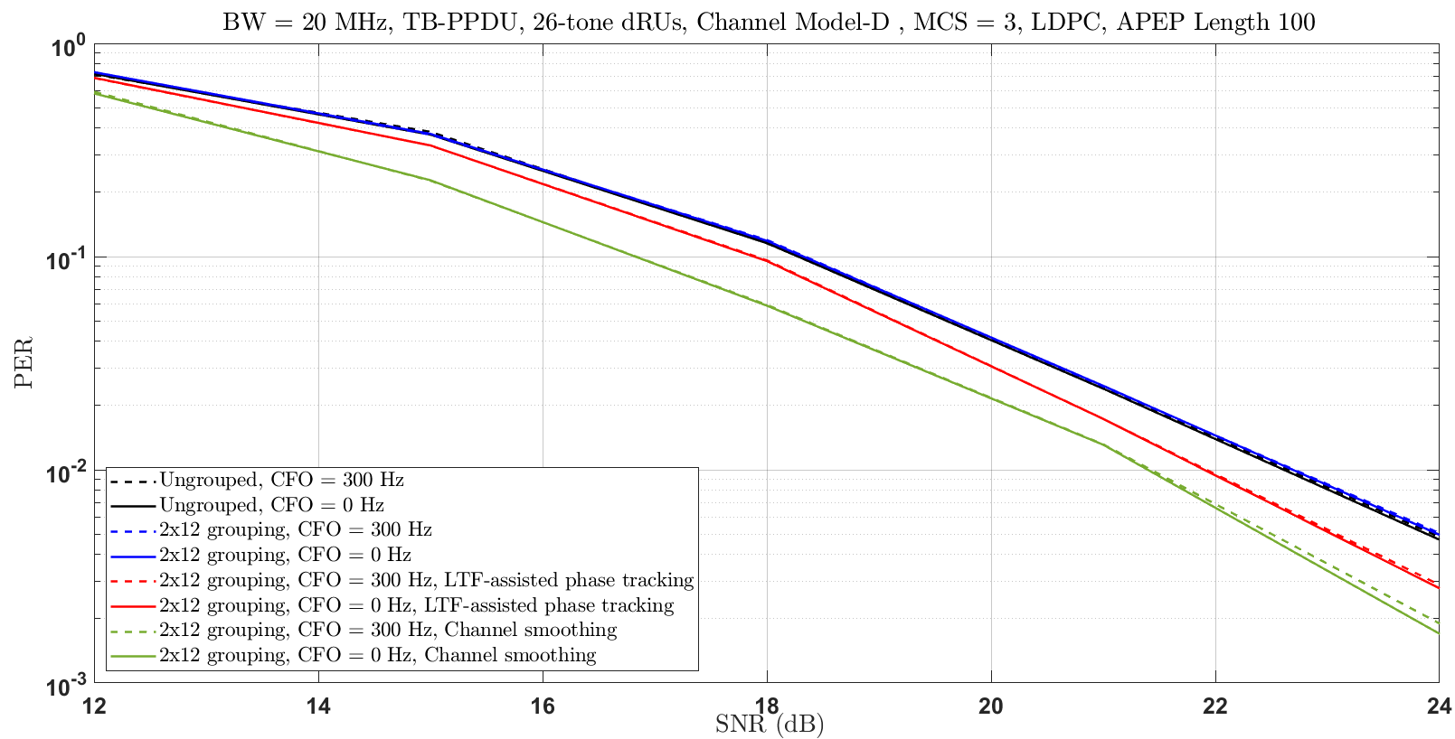
MCS 3 in Channel D
Similar performance is achievable for MCS = 3.

Slide 14
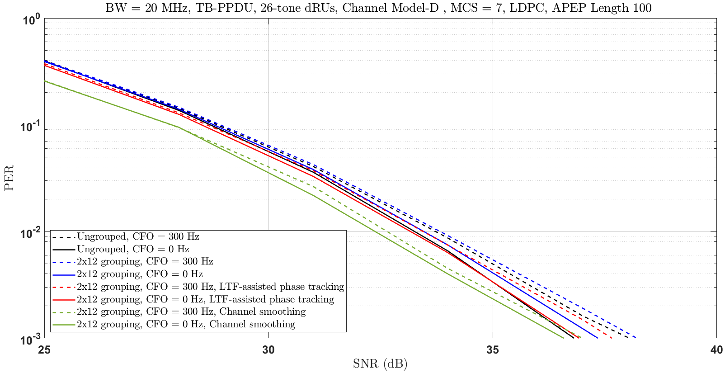
MCS 7 in Channel D
In higher MCSs, the performance of grouped tones is consistently better than that of the ungrouped tones for larger CFOs.

Slide 15
Conclusions and Way Forward
Grouping of data tones brings improvements to the phase tracking performance and the channel estimation through channel smoothing which in turn improves the PER performance, especially in low SNR scenarios
  Recall that dRUs are proposed to support long range applications where low SNR are more probable.
  Close to 1.5 dB of improvement in the PER performance is achievable (compared to the ungrouped tones).
A tradeoff may be considered between improving the PER performance gain through better phase tracking and channel smoothing versus the loss due to less diversity.
Other techniques may be considered to bring further improvements to the PER performance of the Tone-Distributed RUs (dRUs).

Slide 16
SP1
Do you support grouping of the data tones of dRUs to allow for channel smoothing and improved phase tracking
Yes
No
Abs
This SP is for information gathering only

Slide 17
References
[1] 11-23/0037r0, UHR Feature to Overcome PSD Limitations Distributed-Tone Resource Units
[2] 11-23/1115r0, CFO Impact and Pilot Design for dRU
[3] 11-23/1117r0, dRU Signaling for UHR
[4] 11-23/1447r0, CFO Impact and Pilot Design for dRU Follow up
[5] 11-23/1448r0, Further Considerations on dRU
[6] 11-23/1511r1, Pilot Tone Allocation and Other Considerations of Tone-Distributed RUs for UHR
[7] 11-23/1516r0, Use case for distributed RUs in Downlink

Slide 18
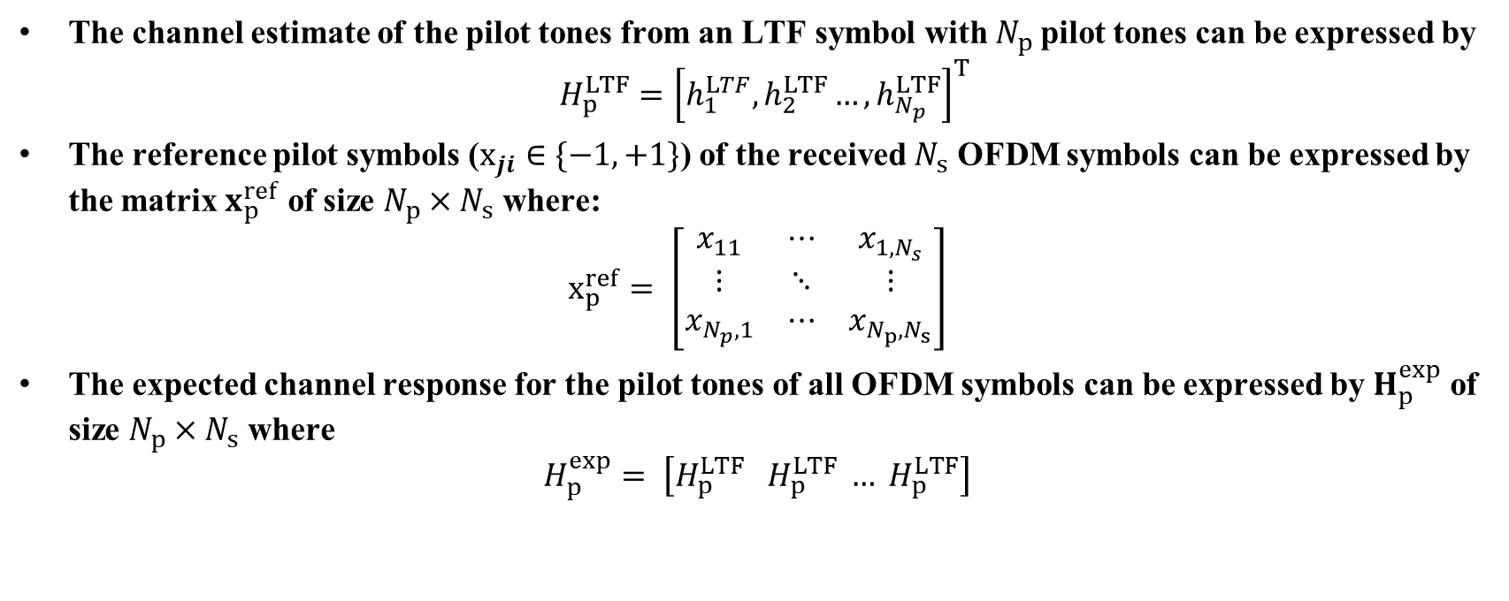
Backup – LTF-assisted Phase Tracking
The channel estimate of the pilot tones from an LTF symbol with $N_{p}$pilot tones can be expressed by
$$H_{p}^{LTF}={\left[h_{1}^{LTF},h_{2}^{LTF}…,h_{N_{p}}^{LTF}\right]}^{T}$$
The reference pilot symbols ($x_{ji}∈\{−1,+1\}$) of the received $N_{s}$ OFDM symbols can be expressed by the matrix $x_{p}^{ref}$ of size $N_{p}×N_{s}$ where:
$$x_{p}^{ref}= \left[\begin{matrix}x_{11} & ⋯ & x_{1,N_{s}} \\ ⋮ & ⋱ & ⋮ \\ x_{N_{p},1} & ⋯ & x_{N_{p},N_{s}}\end{matrix}\right]$$
The expected channel response for the pilot tones of all OFDM symbols can be expressed by $H_{p}^{exp}$ of size $N_{p}×N_{s}$ where
$$H_{p}^{exp}= \left[H_{p}^{LTF} H_{p}^{LTF} … H_{p}^{LTF}\right]$$

Slide 19
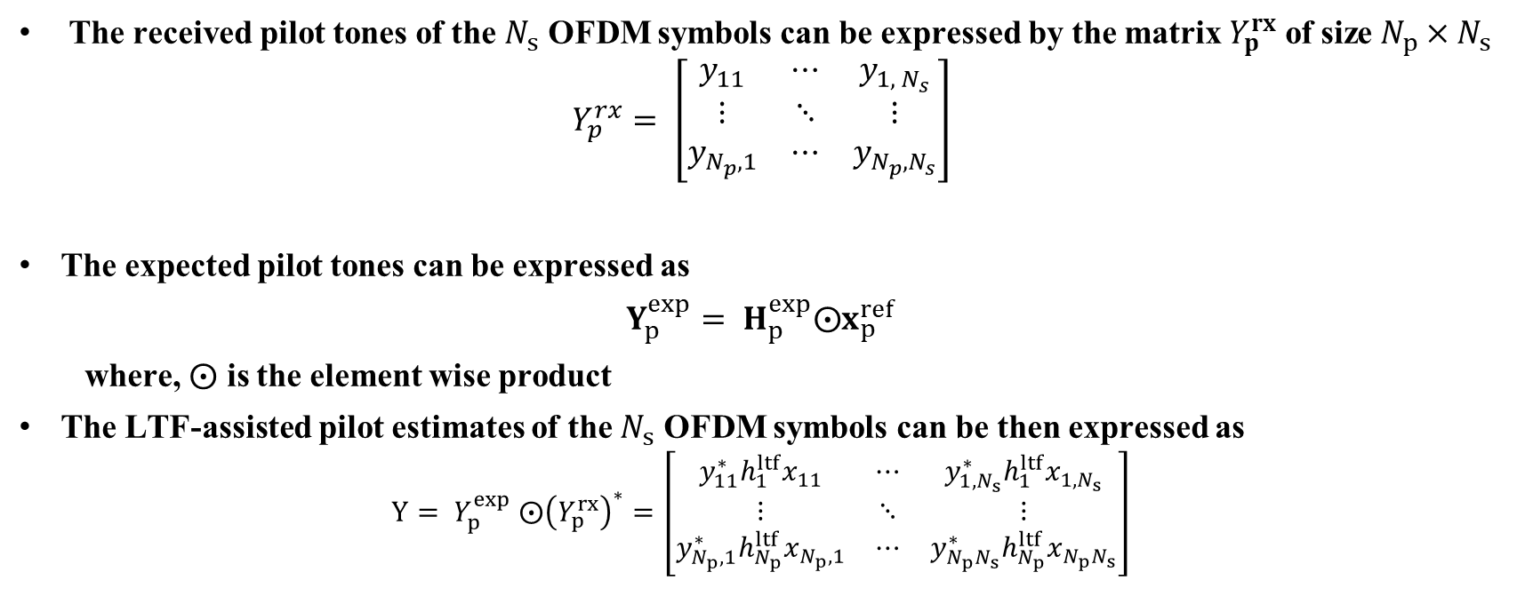
Backup – LTF-assisted Phase Tracking
The received pilot tones of the $N_{s}$ OFDM symbols can be expressed by the matrix $Y_{p}^{rx}$ of size $N_{p}×N_{s}$
$$Y_{p}^{rx}= \left[\begin{matrix}y_{11} & ⋯ & y_{{1, N}_{s}} \\ ⋮ & ⋱ & ⋮ \\ y_{N_{p},1} & ⋯ & y_{N_{p},N_{s}}\end{matrix}\right]$$
The expected pilot tones can be expressed as
$Y_{p}^{exp}= H_{p}^{exp}⨀x_{p}^{ref}$
where, $⨀$ is the element wise product
The LTF-assisted pilot estimates of the $N_{s}$ OFDM symbols can be then expressed as
$${Y= Y}_{p}^{exp} ⨀{\left(Y_{p}^{rx}\right)}^{∗}=\left[\begin{matrix}y_{11}^{∗}h_{1}^{ltf}x_{11} & ⋯ & {y_{1,N_{s}}^{∗}h}_{1}^{ltf}x_{1,N_{s}} \\ ⋮ & ⋱ & ⋮ \\ y_{N_{p},1}^{∗}h_{N_{p}}^{ltf}x_{N_{p},1} & ⋯ & y_{N_{p}N_{s}}^{∗}h_{N_{p}}^{ltf}x_{N_{p}N_{s}}\end{matrix}\right]$$

Slide 20

Backup – LTF-assisted Phase Tracking
The CPE $Φ_{j}$ of the OFDM symbol $j∈\{1,2, …, N_{s}\}$ can be estimated by summing each column of the Y matrix and computing the phase of each summed column
$$Φ_{j}=∠\sum_{i=1}^{i=N_{p}}{y_{ij}^{∗}h_{i}^{ltf}x_{ij}}$$

