Slide 1
Considerations for DSO Sub-band switch delay
Date: 2023-11-10
Authors:

Slide 2
Abstract
This document identifies two problems related to the sub-band switch delay associated with Dynamic Sub-band Operation (DSO) and proposes solutions to address them.

Slide 3
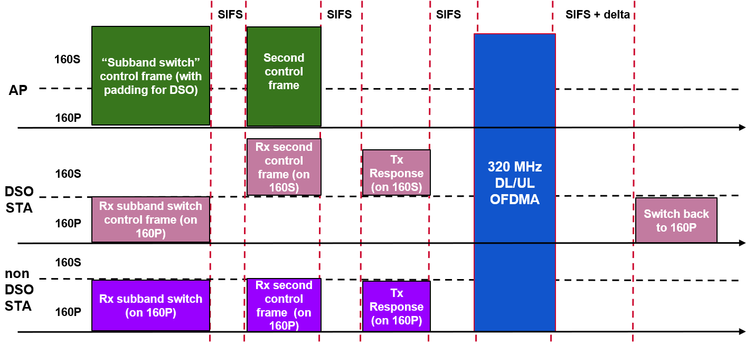
Dynamic Sub-band Operation - Recap
As the maximum supported bandwidth by WiFi rises, non-AP STAs may operate with a smaller supported bandwidth than the AP.
To exploit the full bandwidth supported by an AP efficiently, Dynamic Sub-band Operation (DSO) was proposed in 11-22-2204r0.
  In a TXOP, an AP can indicate to DSO-capable clients the sub-band on which they will be served within the TXOP.
  The AP initiates transmission to the DSO STAs after sufficient delay to allow the DSO devices to perform the channel switch. The AP also ensures protection of the TXOP for the duration of this switch.
  At the end of the TXOP the DSO STAs switch back to the primary channel.

Slide 4
Existing proposals in UHR
11-22-2204r0
  Proposed the high-level idea of DSO.
  Proposes that AP send a sub-band switch control frame as a special initial control frame (can be modification of MU-RTS or BSRP) to indicate a DSO non-AP STA its allocated sub-band.
  The frame can have sufficient padding to cover the sub-band switch latency.
  The frame may/may not require ACK.
11-23-843r1
  Proposes use of DSO as a mode that can be enabled/disabled by a non-AP STA, along with indication/update of necessary DSO parameters.
11-23-1496r0
  Proposes to perform DSO (similar to 2204r0) but using EMLSR operation. Suggests merging the EMLSR initial control frame with the Sub-band switch control frame.

Slide 5
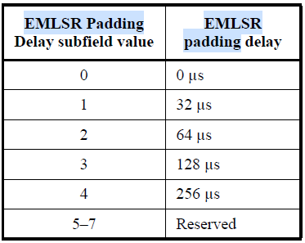
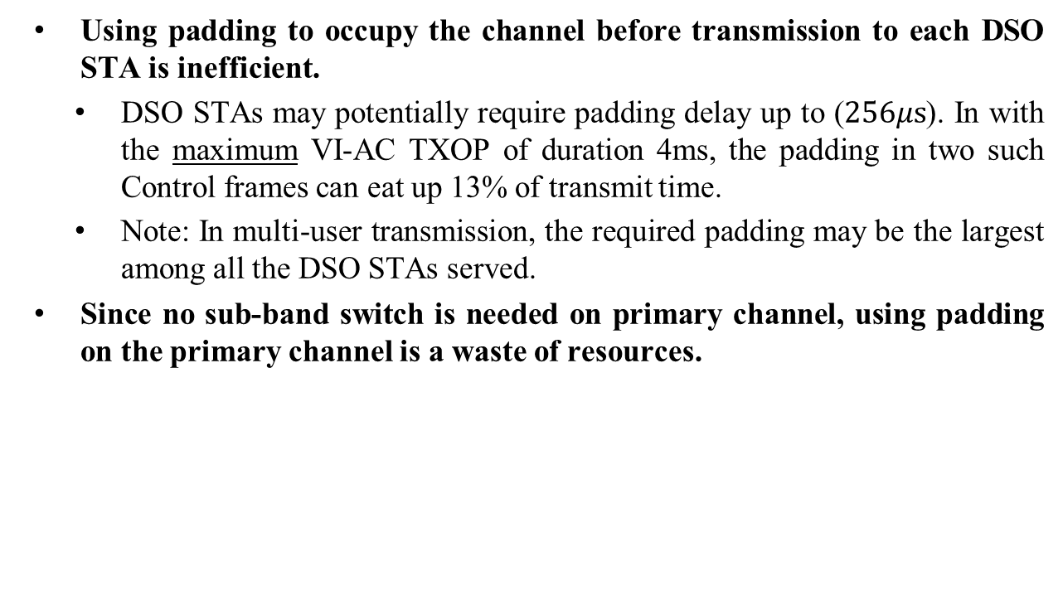
Problem 1: Padding overhead
Using padding to occupy the channel before transmission to each DSO STA is inefficient.
  DSO STAs may potentially require padding delay up to ($256μs$). In with the maximum VI-AC TXOP of duration 4ms, the padding in two such Control frames can eat up 13% of transmit time.
  Note: In multi-user transmission, the required padding may be the largest among all the DSO STAs served.
Since no sub-band switch is needed on primary channel, using padding on the primary channel is a waste of resources.
SBS IC
(padding)
Data to DSO
ACK

Slide 6
Proposed solution 1
The sub-band switch initial control (SBS IC) frame may include indication for DSO STAs served later in the TXOP.
The SBS IC frame may not solicit an ACK/CTS response from DSO STAs served later in the TXOP.
  During the time required for such DSO STAs to switch, the AP can:
    Send data/control signaling to other STAs which are not performing sub-band switching.
    Serve the DSO STAs which have already switched.
Note: ACK/CTS may still be solicited from some of the DSO STAs.
TXOP
Frequency
SBS IC
Data for STA2
Data for STA1
Data for STA4
Data for STA3
…
…
Time

Slide 7
Proposed solution 1 - examples
TXOP Duration
BA
BA
BA
BA
MPDUs for DSO STA4
MPDUs for DSO STA3
MPDUs for DSO STA2
MPDUs for STA1
BA
BA
BA
BA
Frequency
SBS IC for DSO STAs
Serve non-DSO STAs
SIFS
SIFS
SIFS
Primary
Time
Transmission Start Time for DSO STAs 2-4
STAs 2-4 switch back to primary channel
TXOP Duration
MPDU for STA4
MPDU for STA3
MPDU for STA2
MPDU for STA1
BA
BA
BA
BA
MPDU for STA7
MPDU for STA6
MPDU for STA5
MPDU for STA1
BA
BA
BA
BA
SBS IC for STAs 1-7
ACK from STAs 1-4
Frequency
SIFS
SIFS
SIFS
SIFS
SIFS
(Padding)
Primary
Short Sub-band switch delay for STAs 2-4
Time
STAs 2-7 switch back to primary channel
Long Sub-band switch delay for STAs 5-7

Slide 8

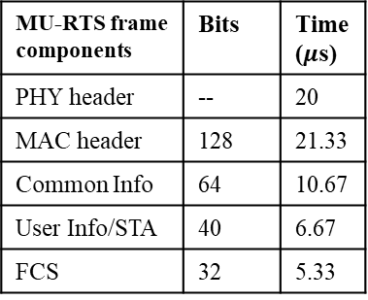
Overhead comparison in an example scenario
Consider AP wins a TXOP of duration 2.5ms with the TXOP bandwidth being 160MHz.
Let us assume the AP intends to serve 6 DSO-capable 80MHz STAs within the TXOP in the secondary 80MHz channel as illustrated below. The primary 80MHz may be used to serve non-DSO devices within the TXOP.
We assume the STAs have Channel Switch Times of $\{0, 16, 256, 32, 64, 128\}μs$, respectively.
We assume the SBS IC frame is transmitted with a data rate of 6Mbps. We assume the fields of SBS IC can be comparable in size to MU-RTS frame.
MU-RTS frame components | Bits | Time ($μ$s)
PHY header | -- | 20
MAC header | 128 | 21.33
Common Info | 64 | 10.67
User Info/STA | 40 | 6.67
FCS | 32 | 5.33
Secondary 80MHz
Tx to STA1
Tx to STA3
Tx to STA5
Tx to STA2
Tx to STA4
Tx to STA6
Primary 80MHz
Non-DSO STAs
TXOP duration

Slide 9
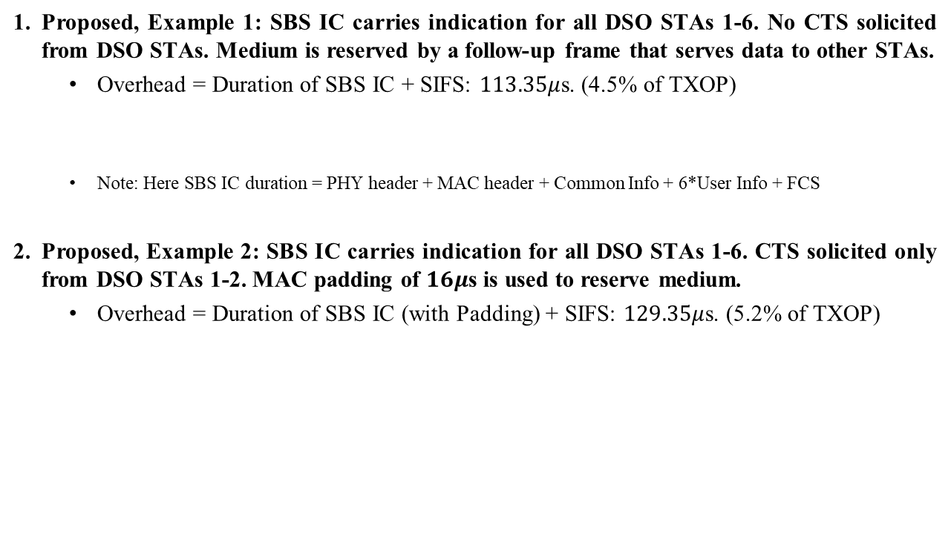
Overhead comparison results
Proposed, Example 1: SBS IC carries indication for all DSO STAs 1-6. No CTS solicited from DSO STAs. Medium is reserved by a follow-up frame that serves data to other STAs.
  Overhead = Duration of SBS IC + SIFS: $113.35μ$s. (4.5% of TXOP)
  Note: Here SBS IC duration = PHY header + MAC header + Common Info + 6*User Info + FCS
Proposed, Example 2: SBS IC carries indication for all DSO STAs 1-6. CTS solicited only from DSO STAs 1-2. MAC padding of $16μ$s is used to reserve medium.
  Overhead = Duration of SBS IC (with Padding) + SIFS: $129.35μ$s. (5.2% of TXOP)
SBS IC
Data to non-DSO
Data to DSO
SBS IC (padding)
Data to DSO
ACK from STA 1,2

Slide 10
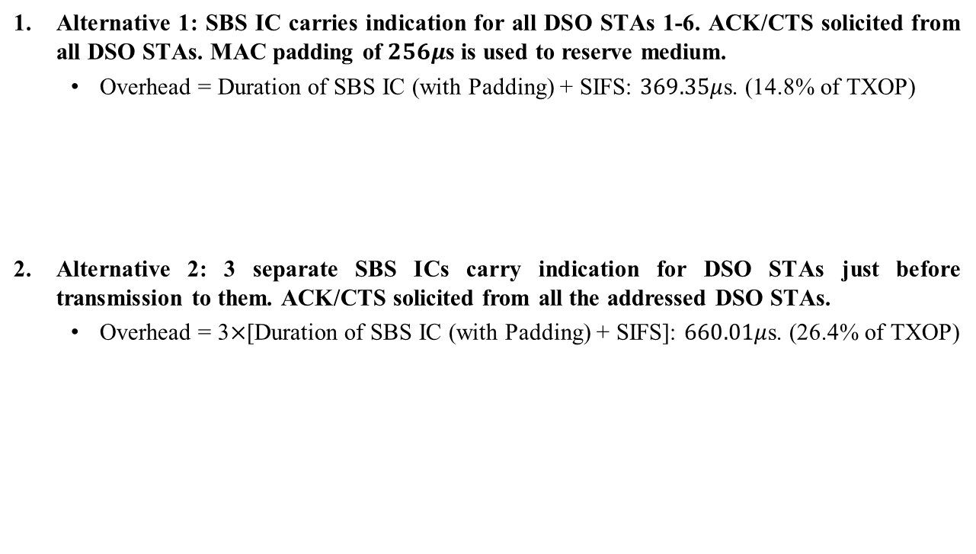
Overhead comparison results
Alternative 1: SBS IC carries indication for all DSO STAs 1-6. ACK/CTS solicited from all DSO STAs. MAC padding of $256μ$s is used to reserve medium.
  Overhead = Duration of SBS IC (with Padding) + SIFS: $369.35μ$s. (14.8% of TXOP)
Alternative 2: 3 separate SBS ICs carry indication for DSO STAs just before transmission to them. ACK/CTS solicited from all the addressed DSO STAs.
  Overhead = 3$×$[Duration of SBS IC (with Padding) + SIFS]: $660.01μ$s. (26.4% of TXOP)
SBS IC (padding)
Data to DSO
ACK from STA1-6
SBS IC1
Data to STA1-2
SBS IC2
Data to STA3-4
SBS IC3
Data to STA5-6
ACK
ACK
ACK

Slide 11
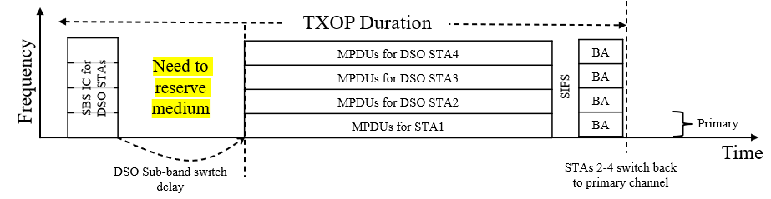
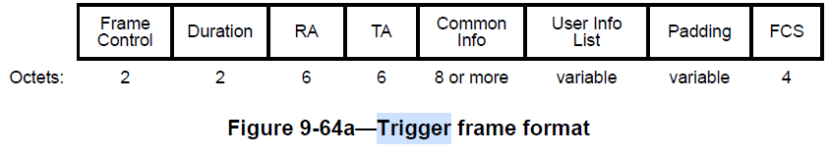

Problem 2: Performing FCS check
At least in some cases, padding may be needed to reserve the medium till the duration of sub-band switch of DSO STAs.
In any control frame, the padding field comes before the Frame Check Sequence (FCS). If a receiving STA performs the switch during the padding, it will not be able to perform FCS-check to detect frame errors.
  Although PHY padding (such as Packet Extension) can be used to reserve medium, they are limited in their maximum duration ($16μ$s).
  Note: This issue is not encountered in EMLSR since it has a weak radio continuously listening to the ICF during link switch.

Slide 12
Proposed solution 2
No ACK/CTS is solicited from the DSO STAs in response to SBS IC frame. The medium can be reserved for the sub-band switch delay by transmitting a follow-up frame after the SBS IC frame.
  The follow-up frame can be aggregated in same PPDU or can be in another PPDU.
  The follow-up frame can carry data or control signaling to other STAs.
  The follow-up frame can carry MAC padding if necessary.
  This mechanism doesn’t require any major spec changes.
TXOP Duration
Follow-up frame with necessary padding
MPDUs for DSO STA4
MPDUs for DSO STA3
MPDUs for DSO STA2
MPDUs for STA1
BA
BA
BA
BA
Frequency
SBS IC for DSO STAs
SIFS
Primary
Time
DSO Sub-band switch delay
STAs 2-4 switch back to primary channel

Slide 13
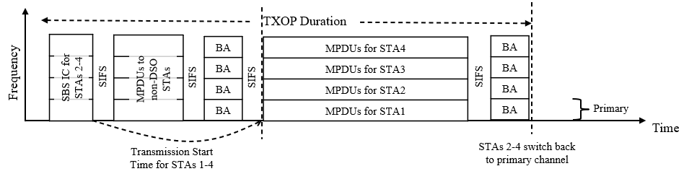
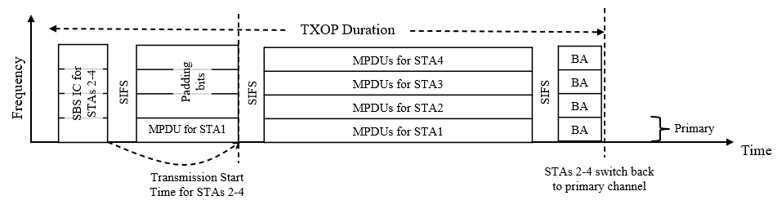
Examples of follow-up frame
It can be a frame containing data to STAs that don’t need sub-band switching in MU-PPDU format. On a sub-band with no recipient STAs, the RUs may not be assigned to any STA, and padding bits can be transmitted.

Slide 14
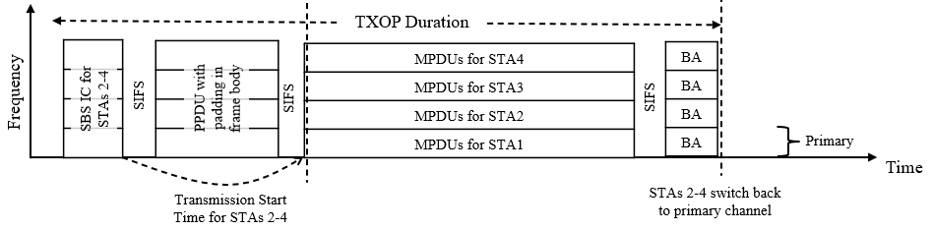
Examples of follow-up frame
It can be a PPDU for which the payload contains just padding bits.

Slide 15
Conclusion
Using padding in SBS IC frame to reserve medium for the time required for DSO sub-band switch can be inefficient.
Enabling pre-allocation of sub-bands to DSO STAs, and selectively soliciting ACK/CTS from some DSO STAs reduces the need for padding, thus improving efficiency.
FCS check is not possible if existing mechanisms for padding are used for reserving the medium during DSO sub-band switch.
A follow-up frame can be used to reserve the medium during the DSO-sub-band switch. This allows FCS check and improves resource utilization.

Slide 16
References
11-22-2204-00-0uhr-dynamic-subband-operation.pptx
11-23-0843-01-0uhr-considerations-on-dynamic-subchannel-operation.pptx
11-23-1496-00-0uhr-emlsr-dynamic-subband-operation.pptx

Slide 17
Backup slides

Slide 18
Straw polls
SP1: Do you agree to allow DSO Sub-band Switch initial control frame to address DSO STAs that are served much later in a TXOP without soliciting ACK/CTS from them?
  Yes
  No
  Abstain
SP2: Do you agree to allow an AP to use a follow-up frame to the DSO Sub-band Switch initial control frame to reserve the medium for the time required for the DSO Sub-band switch?
  Yes
  No
  Abstain

Slide 19

How many MPDUs can be sent in the DSO sub-band switch delay ?
Maximum MPDU size = 11454 Bytes.
PHY rate @ MCS 10 = 120 Mbps per 20 MHz.
Air-time of a max. size MPDU under single spatial stream:
  160MHZ TXOP: $95.4μs$.
  320MHz TXOP: $47.7μs$.

