Slide 1
High-Level Perspectives on Distributed Tone RU for 11bn
Date: 2023-11-02
Authors:
Name | Affiliations | Address | Phone | Email
Shengquan Hu | Mediatek | 2840 Junction Ave. San Jose, CA, 95134 |  | Shengquan.hu@mediatek.com
Jianhan Liu |  |  |  | jianhan.liu@mediatek.com
Gary Anwyl
Thomas Pare

Slide 2
Introduction
6GHz spectrum was opened for Wi-Fi since 11ax
There are two main power modes in 6GHz bands: Standard Power (SP) and Low Power Indoor (LPI)
For SP mode, it is required to operate with AFC, however
  AFC doesn’t cover entire 6GHz spectrum, > 43% of 6GHz spectrum is LPI channel only
  AFC may not be always available due to AFC server/operator down/offline
  LPI can cover a broad class of indoor products that do not require cost of AFC implementation
For LPI mode, the PSD limitations are very tough. For non-AP STA in LPI mode, the PSD limitation is -1dBm/MHz. This will significantly limit UL coverage range
  For an example, for 52-tone RU, STA only can transmit about 5dBm, it is far away from the max allowed transmit power of 24dBm
Efficient utilization of 6GHz spectrum and achieving reliable communication in 6GHz band is one of the key objectives for 11bn UHR system
Distributed tone RU (dRU) introduced in [1] can significantly boost transmission power and enhance overall 6GHz spectrum efficiency. dRU and AFC can be considered as complementary technologies to improve the adoption and efficiency of 6GHz spectrum
Other than using dRU for power boost in 6GHz LPI, dRU can also be used for some other scenarios such as VLP in 6GHz band, 2.4/5GHz bands in some regions that also have PSD limitations.
In this contribution, we will share our thoughts on dRU for 11bn from high-level perspective, such as optimal power boost gain, distribution bandwidth, dRU size, dRU operation modes, etc

Slide 3
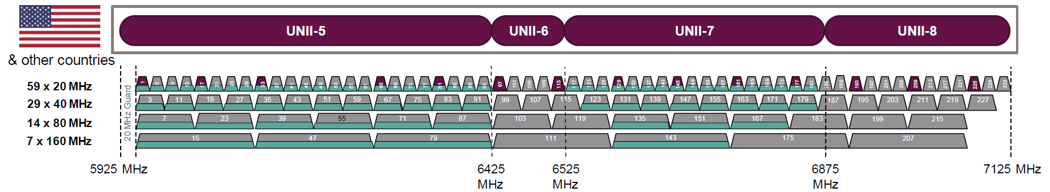
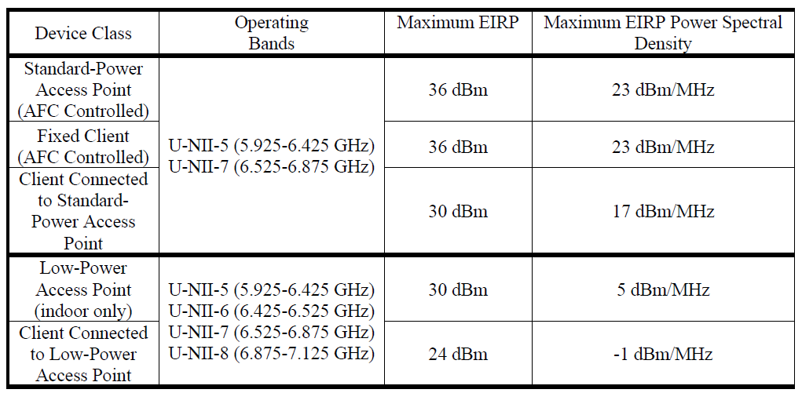
6GHz Spectrum and PSD Requirement
Strict PSD requirement of -1dBm/MHz for 6GHz LPI will cause reduced coverage range and UL/DL Tx power imbalance
LPI optional when AFC not available
LPI only (>40% of overall spectrum)
Tx Power (dBm) without tone distribution
rRU size | STA-Tx Pwr (dBm)
26 | 2.08
52 | 5.09
106 | 8.18
242 | 11.77
484 | 14.78
996 | 17.91
LPI for both AP and STA
Strict PSD requirement
Reduced coverage range
DL & UL Tx Power unbalance
Slide 3
Shengquan Hu, Mediatek Inc.

Slide 4
Distributed Tone RU (dRU) for Power Boost in 6GHz LPI
Spread or distribute the tones over wider spectrum to minimize number of tones in 1MHz to boost Tx power
Note that the PSD limitations are defined by per MHz and for each STA. If we distribute tones of a small-size RU over a wide bandwidth, then the tones for each STA become non-contiguous and therefore each tone can be transmitted with higher power.
For convenience, we call the RUs defined in 11ax and 11be with contiguous tones as regular RUs (rRU) and call the RUs with distributed tones as distributed tones RU (dRU).
1MHz
dRU
rRU
Tone distribution
Up to 11dB power boost gain
freq
freq
RU Size | rRU Tx Power (dBm) | dRU Tx Power (dBm)
 |  | dRU→BW20 | dRU→BW40 | dRU→BW80
RU26 | 2.08 | 10.21 | 13.22 | 13.22
RU52 | 5.09 | 11.46 | 13.22 | 16.23
RU106 | 8.18 | 11.74 | 14.55 | 16.31
RU242 | 11.77 |  | 14.46 | 16.89
RU484 | 14.78 |  |  | 17.47
power boost
RU Size | BW20 | BW40 | BW80
 | Power Boost (dB) | Power Boost (dB) | Power Boost (dB)
RU26 | 8.13 | 11.14 | 11.14
RU52 | 6.37 | 8.13 | 11.14
RU106 | 3.56 | 6.37 | 8.13
RU242 | N/A | 2.69 | 5.12
RU484 | N/A | N/A | 2.69
Slide 4
Shengquan Hu, Mediatek Inc.

Slide 5
Distributed-Tone Resource Units (dRU) in UL TB OFDMA
dRU is particularly useful in UL TB OFDMA.
  As shown in the following figure, STA1, STA2 and STA3 can all boost its transmit power by using dRU.
  Compared to using same size rRU, all the tones get higher transmit power and therefore overall spectrum efficiency is enhanced significantly.
Slide 5
Shengquan Hu, Mediatek Inc.

Slide 6
Rate vs Range Improvement by dRU
Wi-Fi 8 will be aimed at Ultra-High Reliability, RvR enhancement is one of 11bn targets
Simulation results show the significant RvR improvement can be achieved by dRU
Rate vs Range
Power Boost
RU Size | BW20 | BW40 | BW80
 | Power Boost (dB) | Power Boost (dB) | Power Boost (dB)
RU26 | 8.13 | 11.14
RU52 | 6.37 | 8.13 | 11.14
RU106 | 3.56 | 6.37 | 8.13
RU242 | N/A | 2.69 | 5.12
RU484 | N/A | N/A | 2.69
rRU
dRU
40% range increase @60Mbps
~100% Tput increase @60m
> 40m range extension
BW80
4 OFDMA UL users
242-tone RUs per user
D-NLOS
2ss, 2T4R
40m
Slide 6
Shengquan Hu, Mediatek Inc.

Slide 7
Optimal dRU Power Boost Gains
For subcarrier spacing = 78.125kHz in 11ax/11be, there are about ceil(1000/78.125)=13 tones in 1MHz
The dRU distribution gain can be computed as: 10*log10(13/n), where n is the number of tones in 1MHz for a dRU
The max dRU power boost gain will be 10*log10(13/1) =11.14dB, i.e. 1 tone in 1MHz
The optimal power boost gain and minimum number of tones in 1MHz for a dRU over a distribution BW is given as below
RU Size | BW20 |  | BW40 |  | BW80
 | #Tone/MHz | Power Boost (dB) | #Tone/MHz | Power Boost (dB) | #Tone/MHz | Power Boost (dB)
RU26 | 2 | 8.13 | 1 | 11.14 | 1 | 11.14
RU52 | 3 | 6.37 | 2 | 8.13 | 1 | 11.14
RU106 | 6 | 3.56 | 3 | 6.37 | 2 | 8.13
RU242 | N/A | N/A | 7 | 2.69 | 4 | 5.12
RU484 | N/A | N/A | N/A | N/A | 7 | 2.69
RU996 | N/A | N/A | N/A | N/A | N/A | N/A
Slide 7
Shengquan Hu, Mediatek Inc.

Slide 8
Distribution BW for dRU
dRU transmission with distribution BW = 20MHz, 40MHz, 80MHz are proposed for 11bn
  80MHz is mandatory BW for non-AP STAs in 11be
  Smaller RU26/52 can be boosted with almost full distribution gain in 20/40/80MHz
  dRU26 on BW40 and dRU52 on BW80 harvest the maximum 11dB power boost gains. 26-tone and 52-tone RUs distributed over wider BW beyond 80MHz will not further benefit power boost gains
  Distribution on 20/40MHz allows dRU transmission with punctured mode in 80MHz subblock
  Not support dRU over 60(=20+40)MHz
80MHz operation STA in wider BW160/320 can perform dRU transmission on 80MHz subblock basis, fits well with 80MHz distribution BW
Non-AP STA can transmit regular 242/484/996-tone RUs in 80MHz with 12~18dBm, Each 80MHz frequency subblock either uses larger regular RUs/MRUs or distributed tone RUs (dRUs)
Per-80MHz signaling makes it more flexible to enable dRU distribution up to 80MHz
Slide 8
Shengquan Hu, Mediatek Inc.

Slide 9
dRU Size
We propose that dRU only supports the same set of RU sizes as rRU, i.e. 26-tone, 52-tone, 106-tone, 242-tone, 484-tone RU
Different dRU size can be supported for different distribution BW, but only supports the most useful dRU size to reduce implementation & testing complexity
For distribution BW 20MHz
  26/52/106-tone dRU can be supported
  No distribution gain for 242-tone RU on BW20
For distribution BW40MHz
  26/52/106/242-tone dRU can be supported
  No distribution gain for 484-tone RU on BW40
For distribution BW80MHz
  52/106/242/484-tone dRU will be supported
  Both 26-tone and 52-tone dRU achieve maximum power boost gain of ~11dB, but dRU52 can transmit 3dB higher power than dRU26. AP may be better schedule dRU52 instead of dRU26
  No distribution gain for 996-tone RU on BW80
Distribution of MRU(52+26) & MRU(106+26) can achieve marginal benefit, but could add implementation complexity
  E.g. 8.13dB gain for dMRU(52+26) on 80MHz vs 8.05dB gain for dRU106 on 80MHz
  Channel smoothing for dMRU will be more complicated than dRU
  Prefer not to support dMRU
Slide 9
Shengquan Hu, Mediatek Inc.

Slide 10
dRU Operation Mode
To balance the flexibility and complexity, we propose the following dRU operation modes for 11bn
dRU on entire PPDU with BW20/40/80MHz
For 20/40/80MHz PPDU, dRU can distribute tones over entire PPDU BW to maximize the transmit power
e.g. dRU on BW80
Hybrid Mode with dRUs and rRUs
  For a wider BW spectrum such as 160MHz/320MHz in 6GHz band, it has high possibility across different power mode region due to either SP/AFC is not available or part of spectrum is LPI only.
  Each OFDMA user may be scheduled with different RU size, a user with larger RU/MRU such as RU996 or MRU(484+242) may be using rRU on a frequency segment, and a user with smaller RU such as 26/52/106 etc may be using dRU to boost power on another frequency segment.
  It is important to support hybrid of dRU and rRU in larger BW to achieve higher throughput, better spectral efficiency
  Hybrid mode is only for 160MHz and 320MHz BW
  Hybrid mode is not supported within 80MHz frequency subblock, i.e. either dRU or rRU is transmitted in 80MHz, no mixed dRU/rRU in 80MHz subblock
  The minimum size of rRU in hybrid mode in 160/320MHz PPDU will be 242
Example of hybrid mode for BW160
dRU on 1st 80M segment
rRU on 2nd 80M segment
Example of hybrid mode for BW320
dRU on 1st 80M segment
rRU on 2nd 80M segment
dRU on 3rd 80M segment
rRU on 4th 80M segment
Slide 10
Shengquan Hu, Mediatek Inc.

Slide 11
dRU Operation Mode
dRU in punctured 80MHz subblock
  OBSS interference and in-device co-existence interference are the main sources to cause puncturing in 6GHz band. Puncturing with 20MHz granularity will be flexible enough.
  In a punctured 80MHz subblock, the only allowed distribution BWs are 20MHz and 40MHz
  dRU will not be allowed to distribute over 20+40=60MHz
  Within the punctured 80MHz subblock, mixed-dRU/rRU transmission will not be supported, i.e. either dRU or rRU is transmitted in each 20 and 40 segment
80MHz
dRU on 20M segment
dRU on 40M segment
20MHz subblock is punctured
80MHz
80MHz
 | punctured
dRU on 20M segment
dRU on 40M segment
dRU on 80M segment
80MHz
80MHz
 | punctured
 | punctured
dRU on 20M segment
dRU on 40M segment
rMRU(484+242)
Slide 11
Shengquan Hu, Mediatek Inc.

Slide 12
Summary
In this contribution, we shared our high-level views on dRU for 11bn:
  dRU can boost transmission power up to 11dB, significantly enhance the spectrum efficiency of 6GHz LPI and improve the coverage range
  dRU distribution BW can be up to 80MHz
  dRU should keep the same set of RU sizes as rRU
  Each distribution BW may support different dRU sets
  Hybrid mode with dRU or rRU in each 80MHz subblock can be operated for BW160/320
  dRU with distribution BW20/40 is allowed in punctured 80MHz subblock

Slide 13
Straw Poll #1
Do you support that 11bn introduces distributed tone RUs (dRU)?
Slide 13
Shengquan Hu, Mediatek Inc.

Slide 14
Straw Poll #2
Do you support that the allowed distribution BWs of an dRU in 11bn are 20MHz, 40MHz, 80MHz?
Slide 14
Shengquan Hu, Mediatek Inc.

Slide 15
Straw Poll #3
Do you support that the allowed dRU sizes in 11bn are 26-tone, 52-tone, and 106-tone in distribution BW 20MHz?
Slide 15
Shengquan Hu, Mediatek Inc.

Slide 16
Straw Poll #4
Do you support that the allowed dRU sizes in 11bn are 26-tone, 52-tone, 106-tone and 242-tone in distribution BW 40MHz?
Slide 16
Shengquan Hu, Mediatek Inc.

Slide 17
Straw Poll #5
Do you support that the allowed dRU sizes in 11bn are 52-tone, 106-tone, 242-tone and 484-tone in distribution BW 80MHz?
Slide 17
Shengquan Hu, Mediatek Inc.

Slide 18
Straw Poll #6
Do you agree that 11bn supports the hybrid mode with dRUs and rRUs (regular RU) in an OFDMA transmissions if UHR PPDU bandwidth is larger than 80MHz?
  Non mixing dRU and rRU in one 80MHz frequency subblock
  Minimum size of rRU in hybrid mode in 160MHz and 320MHz is 242
Slide 18
Shengquan Hu, Mediatek Inc.

Slide 19
Straw Poll #7
Do you support that in a punctured 80MHz frequency subblock, the only allowed distribution BWs are 20MHz and 40MHz in 11bn?
Slide 19
Shengquan Hu, Mediatek Inc.

