Slide 1
Extend IMMW scope to include optical bands
Date: 2023-11-14
Authors:

Slide 2
Abstract
This contribution highlights use cases, where light communication (LC) can complement RF and leverage obvious synergies. For industrial and residential use cases, 802.11 should support seamless mobility with RF, enable high area capacity and precise positioning. Integration of LC within MLO and, support of higher bandwidth are required. Due to the overlap of new LC features with mm-wave, 802.11 WG should consider optical bands in the scope defined by IMMW SG.

Slide 3
Outline
Light Communication
  use cases and requirements
Features
  integration into MLO
  higher bandwidth operation
  points for further study
Summary

Slide 4
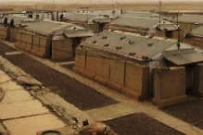


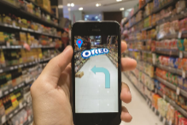





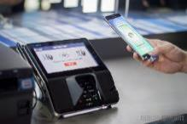

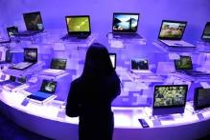
LC as complement where RF has limitations
Defence & Environment | Data & Industrial | Office & Commercial | Retail & Financial | Smart City & Transport | Consumer & Lifestyle
Secure commun., Harsh environm., Underwater | Data centres, Industry 4.0 and Future IoT | Secure office: Dense network for Offloading | Shop analytics: Precise positioning for Payments and Back office | Connected street-lights as backhaul for public Wi-Fi | Smart home: Reuse light infrastructure, Mobile devices for Entertainment

Slide 5
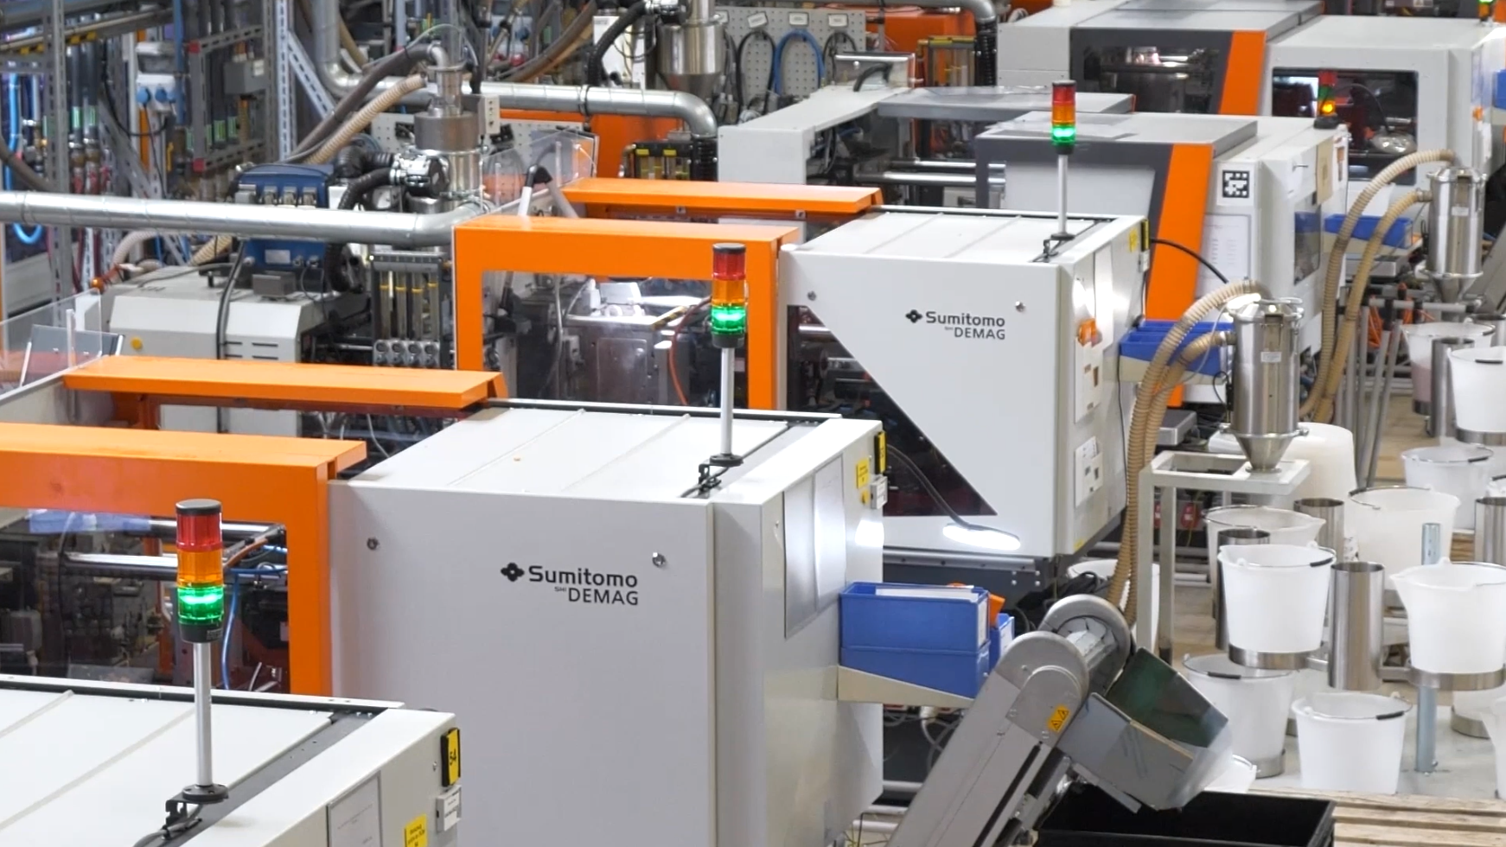
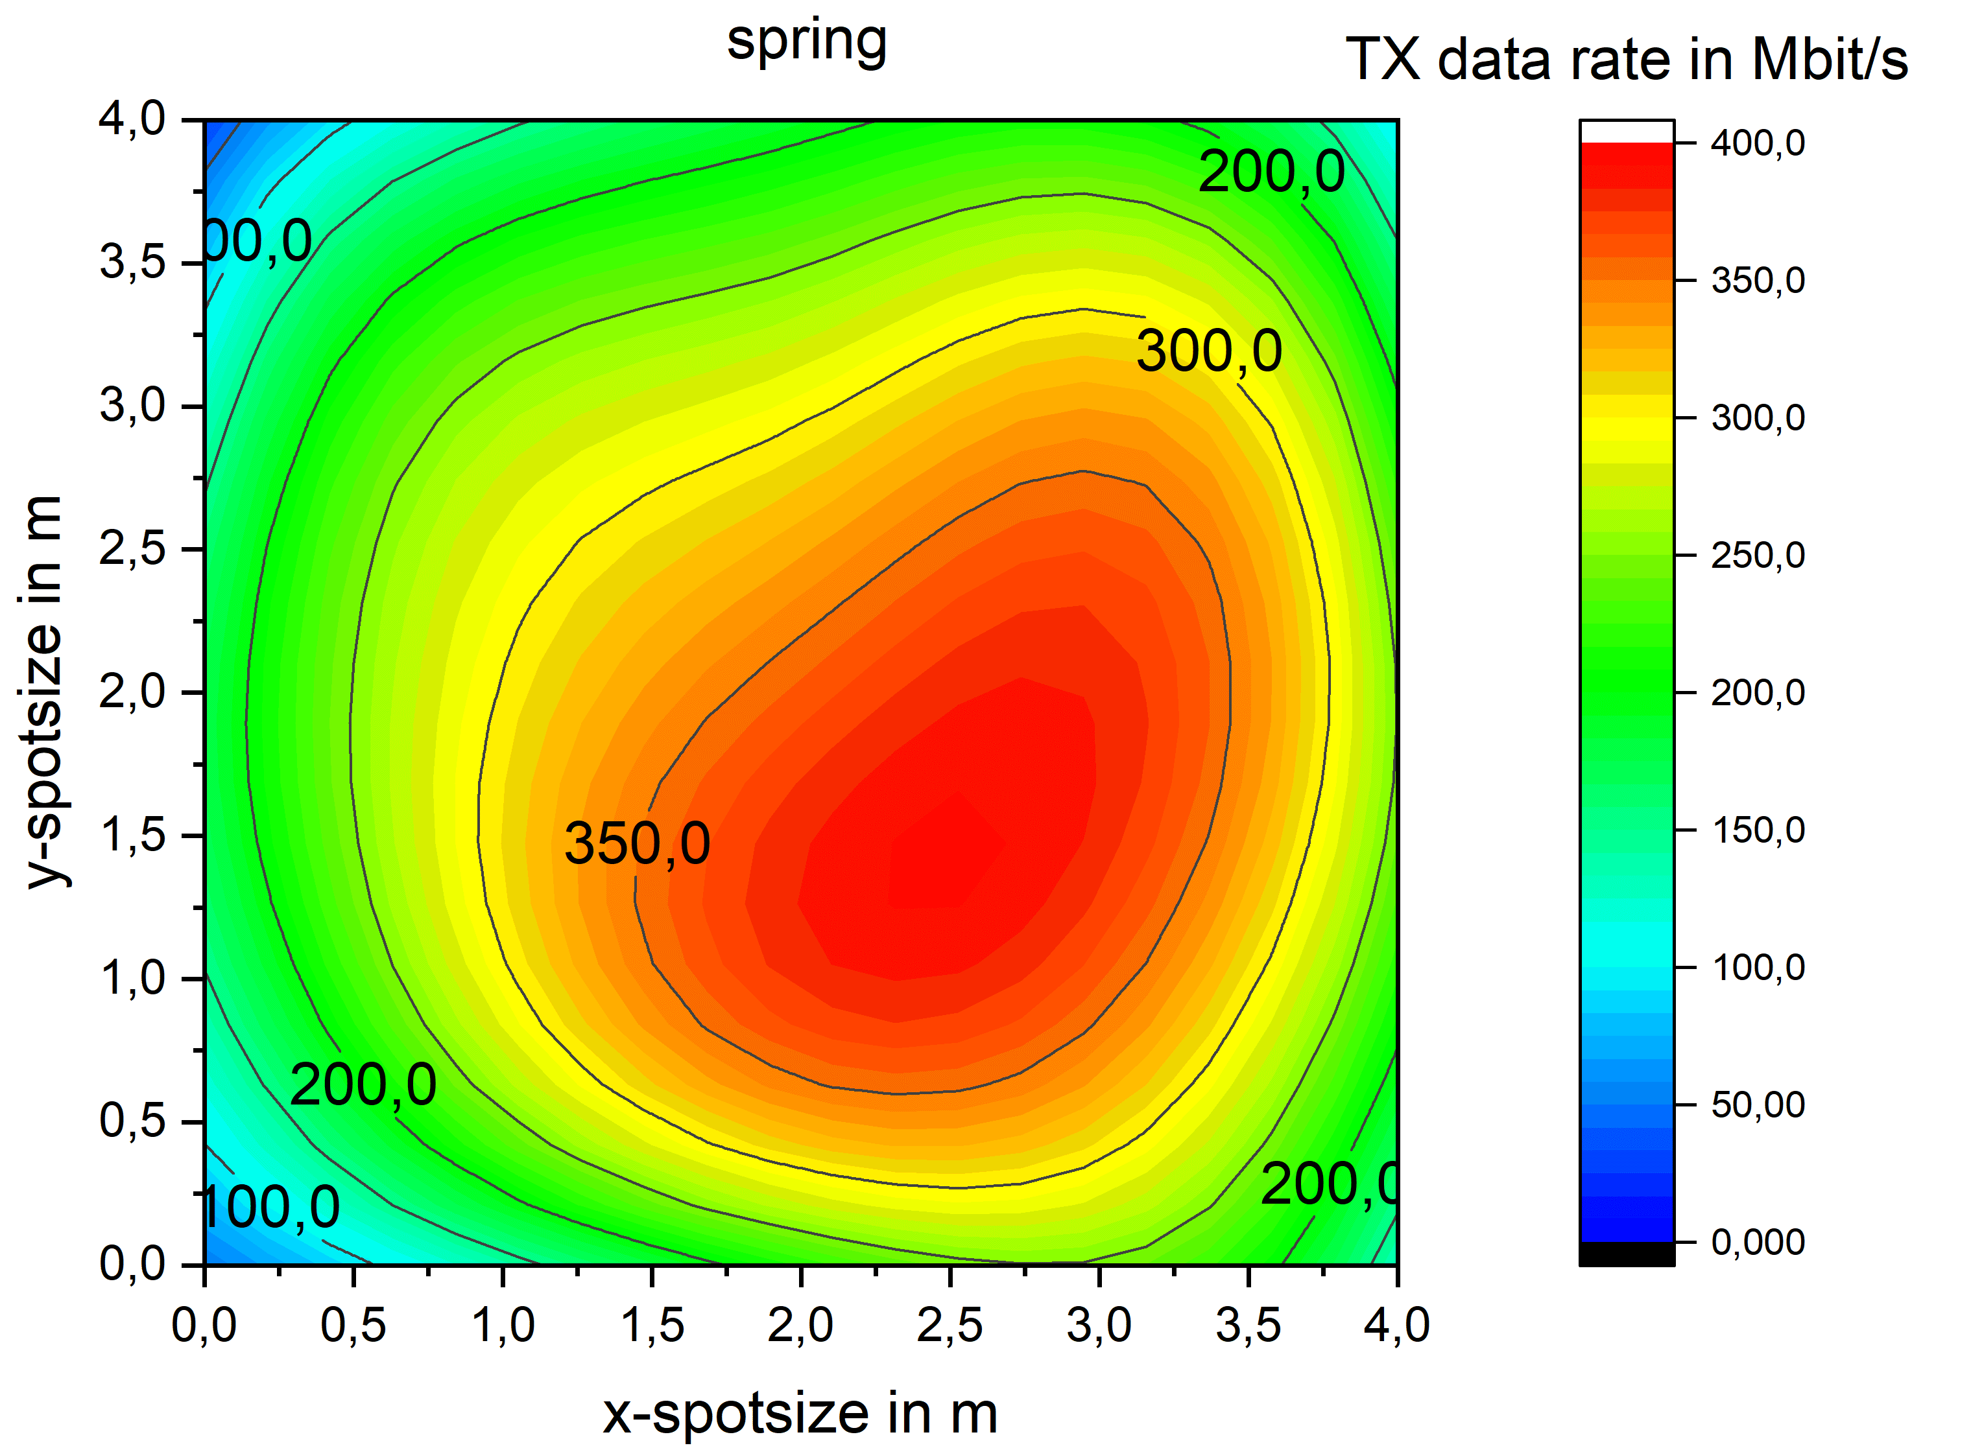
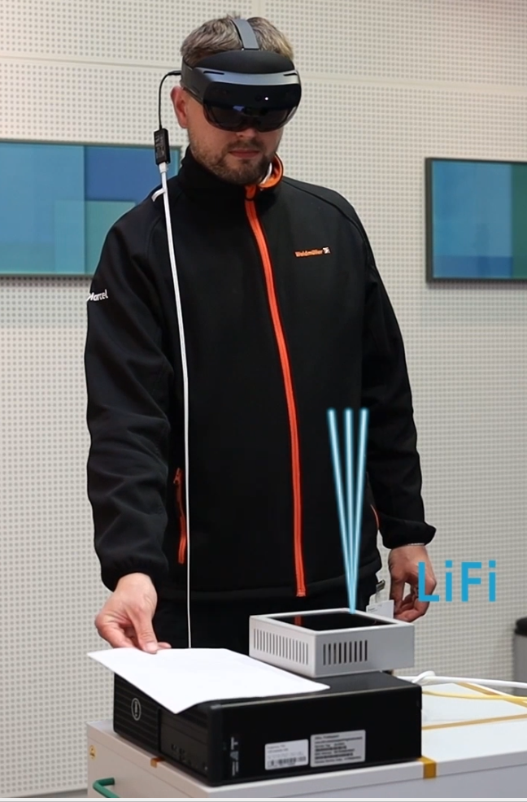
Use cases and requirements
Industrial communication: For reliability, multiple optical frontends are used to cover a hotspot area and, overcome blockage. Outside that area, a parallel RF link is available.
Current solution: 4 ms latency for RF/LC handover when implemented at the network layer [3]. Apps like XR require lower latency → Seamless mobility between LC and RF is required
Future solution: Integrate LC into MLO

Slide 6
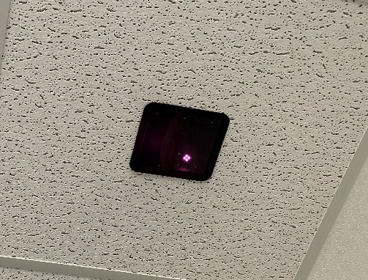
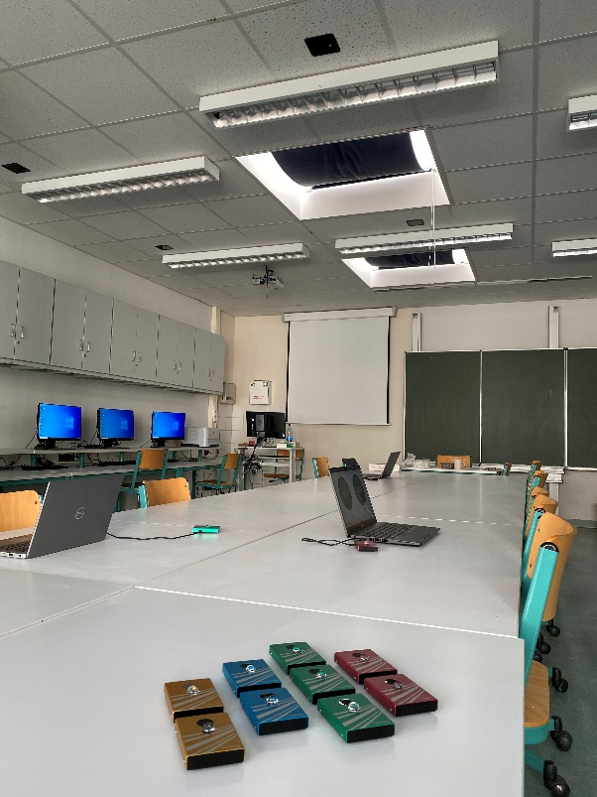
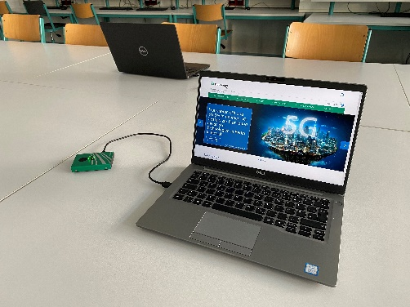
Use cases and requirements
Classroom
  multiple frontends at the ceiling
  mobile devices on the tables
Current solution
  80 MHz, single spatial stream
  transmit and receive same signal through multiple optical frontends
Future solutions
  high area capacity
    more bandwidth
    multiple spatial streams

Slide 7
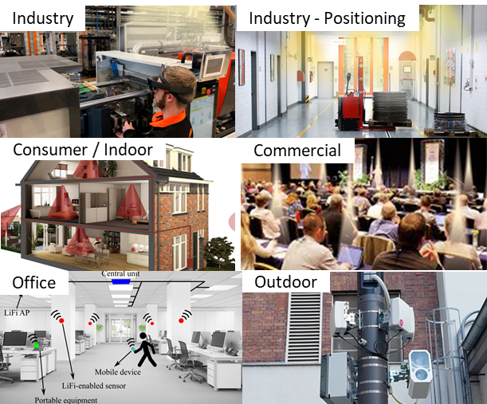
Use cases and requirements
Industrial positioning
  automated guided vehicle transports spare parts in the shop floor
  requires cm precision
Current solution
  SoA uses camera and stripes on the floor, not easily reconfigurable
Future solution
  LC is promising: Few centimeters precision shown in research [6, 7]
    due to LOS-based propagation
  optimize FTM via LC

Slide 8
Why mm-wave and LC in one project?
MLO becomes available in 11be
  further optimized mechanism in 11bn
Reusing the baseband
  ability to scale through parallel operation
  different RF frontends are used
Enhanced Multilink Operation
Multilink Operation
Enhanced Multilink Operation
Sub7GHz
BB
Sub7GHz
BB
Sub7GHz BB
Sub7GHz
BB
Sub7GHz
BB
Sub7GHz
BB
Sub7GHz
BB
Sub7GHz
BB
Sub7GHz
BB
Sub7GHz
BB
Sub7GHz
BB
Sub7GHz
BB
Initial scope:
  mm-wave frontend is added
  Sub7 GHz baseband (BB) is reused again
2.4 GHz front-end
2.4 GHz front-end
2.4 GHz front-end
5 GHz
front-end
5 GHz
front-end
mm-wave front-end
5 GHz
front-end
6 GHz
front-end
mm-wave front-end
LC
front-end
6 GHz front-end
6 GHz front-end
Extended scope: Integrate LC in MLO
  LC optical frontend is added
  Sub7 GHz baseband (BB) is reused again

Slide 9
mm-wave and LC
Both are expected to sell in low volumes, initially → max. HW/SW reuse is important
Both do have limited range/coverage, do not pass through walls → no interference, high spatial reuse
Both are interesting as an underlay for 2.4/5/6 GHz BSS → offload traffic near the AP
Both are high power and benefit from parallel operation of lower bands → maintain association, save power, seamless mobility, etc.

Slide 10
Features for scope
Required
  integration of LC into MLO
  higher bandwidth operation
For further study
  unified IF interface for mm-wave and LC
  consistent channel models for all bands
  MIMO and FTM adapted to LC

Slide 11
Summary
This contribution has reviewed use cases, requirements and corresponding features for the evolution of LC.
higher bandwidth and MLO integration are required, same as for mm-wave
points for further study have been mentioned
Due to overlaps, it is proposed to extend the scope of IMMW SG beyond mm-wave and include optical bands.

Slide 12
Higher bandwidth
LC channel can support 320 MHz and more bandwidths
  Same as mm-wave
    besides 11n/ac/ax, LC can also reuse baseband signals from 11be/bn/…
    LC optical antennas support 320 MHz and more using VCSEL array instead of LED, slides 12-13 in [5]
  Other than mm-wave,
    LC applies frequency shift to LC IF, instead of mm-wave carrier frequency
LC channel is less impaired
  less frequency-selective
    LOS is dominant, fading where NLOS is noticeable (room corners, multiple optical antennas) [8, 9]
  less time-variant
    LC signal is same as e.g. Equation (19-1) for an LC PHY with HT support, where fc is the LC IF
    Doppler frequency relates to LC IF fc = 26…326 MHz, not to RF carrier frequency fc = 45/60 GHz
  less CFO and phase noise

Slide 13
References
[1] IEEE Std 802.11bb-2023, https://standards.ieee.org/ieee/802.11bb/10823/
[2] IEEE 802 Tutorial “IEEE 802 Standards on Light Communication” at March 2023 Plenary Meeting https://mentor.ieee.org/802.11/dcn/23/11-23-0277-01-0000-ieee-802-standards-on-light-communication.pdf
[3] A. Paraskevopoulos et al., "Software-defined LiFi - RF network for Industry 4.0 applications," IECON 2022, Brussels, Belgium, https://ieeexplore.ieee.org/document/9969087
[4] 11-23/0221r1 “Hybrid LC and RF in UHR” https://mentor.ieee.org/802.11/dcn/23/11-23-0221-01-0uhr-hybrid-lc-and-rf-in-uhr.pptx
[5] 11-23/0091 “New Light Communication Features” https://mentor.ieee.org/802.11/dcn/23/11-23-0091-00-0wng-light-communication-for-uhr.pptx
[6] S. M. Kouhini et al., "LiFi Positioning for Industry 4.0," in IEEE JSTQE, vol. 27, no. 6, pp. 1-15, 2021 https://ieeexplore.ieee.org/abstract/document/9479791
[7] C. Kottke et al., "In-building Optical Wireless Positioning Using Time of Flight," OFC 2023 San Diego, CA, USA, https://ieeexplore.ieee.org/abstract/document/10117339
[8] S.M. Mana et al. “Experiments in Non-Line-of-Sight Li-Fi Channels”, Global Li-Fi Congress 2019, Paris, France, https://ieeexplore.ieee.org/abstract/document/8864131
[9] S. M. Mana et al., "LIDAR-Assisted Channel Modelling for LiFi in Realistic Indoor Scenarios," in IEEE Access, vol. 10, pp. 59383-59399, 2022, https://ieeexplore.ieee.org/abstract/document/9777967

