Slide 1
Discussions on AMP Link Budgets
Date: 2023-11-08
Authors:
Name | Affiliations | Address | Phone | Email
Wei Lin | Huawei | Huawei, Shenzhen, China |  | lin.linwei@huawei.com
Lei Huang |  | Huawei, Singapore
Bin Qian |  | Huawei, Shenzhen, China
Zhi Mao |  | Huawei, Shenzhen, China
Ying Li |  | Huawei, Shenzhen, China
Rojan Chitrakar |  | Huawei, Singapore
Shuqiao Chen |  | Huawei, Singapore
David Xun Yang |  | Huawei, Shenzhen, China

Slide 2
Related Submissions
[1] IEEE 802.11-23/1562r8, Draft Technical Report on support of AMP IoT devices in WLAN
[2] IEEE 802.11-03/940r4, TGn Channel Models
[3] IEEE 802.11-11/0968r3, TGah Channel Model – Proposed Text
[4] IEEE 802.11-15/0425r1, Corrections to TGah Channel Model

Slide 3
Recap of AMP Link Budget Computations in [1]
The consideration of link budget computations were extensively discussed in [1]
AMP-only device are assumed since AMP-assisted IoT device has similar coverage as the current Wi-Fi device
Three types of AMP IoT device with backscatter transmitter are assumed:
Case 1: energy is harvested from RF and without power storage
Case 2: energy is harvested from RF and with power storage
Case 3: energy is harvested from light and with power storage (Tx LNA Supported)
One type of AMP IoT device with active transmitter are also assumed:
Case 4: energy is harvested from light and with power storage, and the difference from case 3 is that an active transmitter is used and the maximum transmission power is assumed to be -15dBm
It should be noted that Friis equation is applied in the link budget evaluation [1]

Slide 4
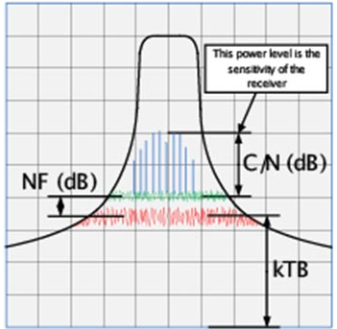
Discussion on AMP Link Budget
Simple Friis equation is too optimistic for link budget evaluations on S1G or 2.4GHz channels
According to the defined channel models [2]-[4], shadowing fading shall be considered on either S1G (2~4 dB decreasing) or 2.4GHz (3~5 dB decreasing) channels
Furthermore, breaking point at 10 meter distance shall be considered [2]-[4]
Assume the sensitivities of the receivers have taken into account kTB, NF, and minimum SNR
Sensitivity = 10xlog10(kTB) + 30 + NF + C/N
Noise figure: the amount of noise power added by the electronic circuitry in the receiver to the thermal noise power from the input of the receiver.
kTB: The total thermal noise power is a function of three quantities, 1) Boltzmann’s constant “k” in Joules/˚K, 2) temperature in ˚Kelvin, and 3) the overall bandwidth of the channel selective filtering in the receiver.

Slide 5
Recap of AMP IoT Device Types in [1]
For AMP-only devices, three types of AMP IoT device with backscatter transmitter are assumed, while one type of AMP IoT device with active transmitter are also assumed in [1]
Receiver sensitivities for Backscatter IoT devices of Case 1 to Case 3 are -20dBm, -30dBm, -45dBm individually, for the power storage capabilities increases from Case1 to Case 3 (Case 1 has no power storage)
Receiver sensitivities for Active IoT devices of Case 4 is -45dBm, and the maximum uplink transmitting distance of Case 4 is the longest among all cases (259.49m at S1G band) without backscattering loss
Transmission model assumption: direct link between AP and AMP device

Slide 6
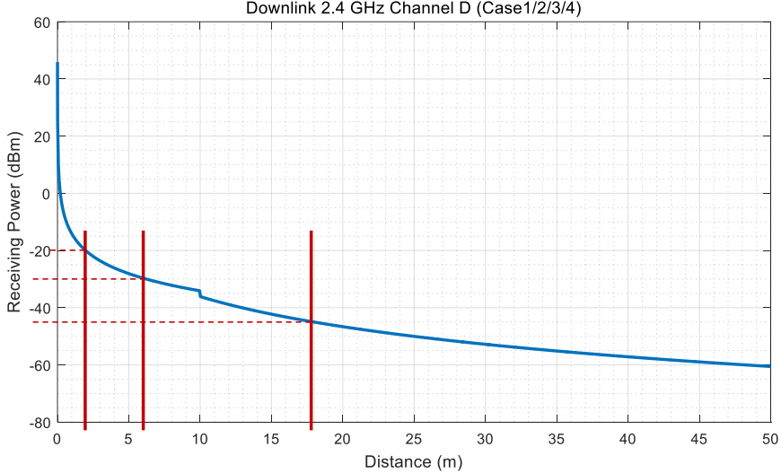
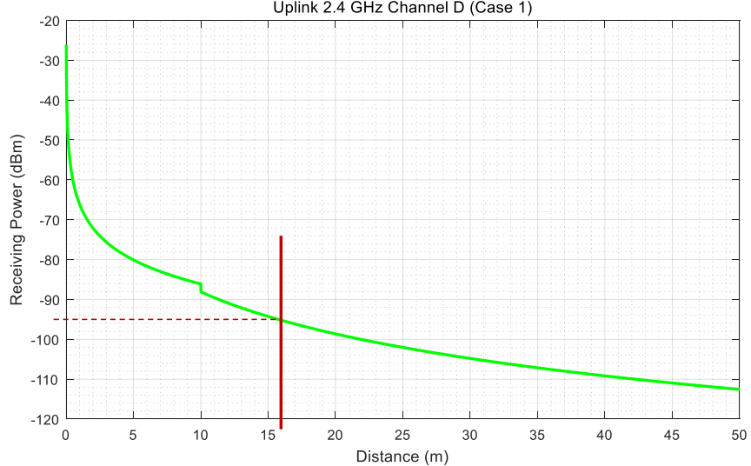
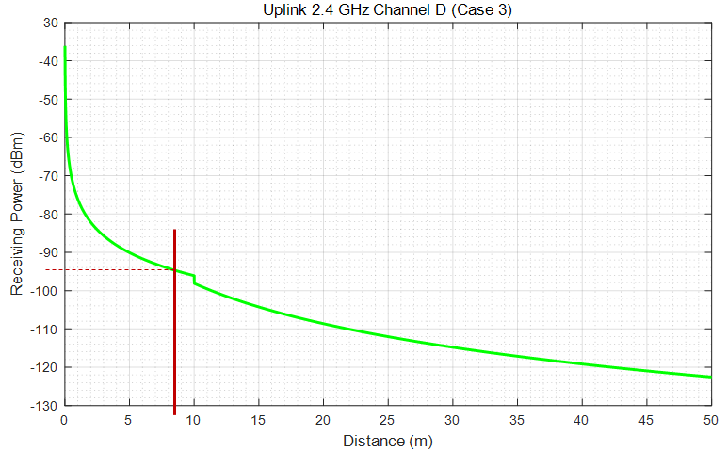
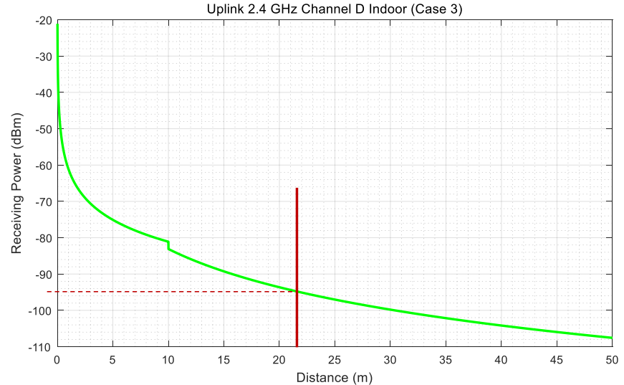
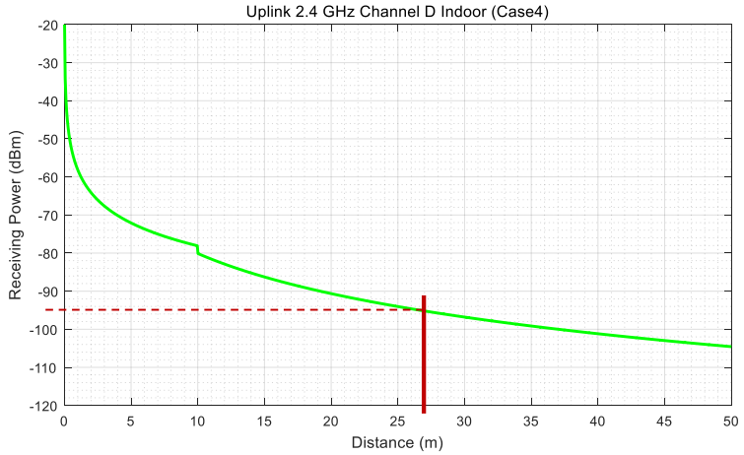
Adjusted AMP Link Budget on 2.4GHz
Adjusted Link budgets with 11n channel D at 2.4 GHz
Case 1
Case 2
Case 1
Case 3/4
Case 2
Case 4
Case 3

Slide 7
Discussion on AMP Link Budget
Adjusted Link budgets with 11n channel model at 2.4GHz
 | Case 1 | Case 2 | Case 3 | Case 4
Frequency (GHz) | 2.4 | 2.4 | 2.4 | 2.4
EIRP of AP (dBm) | 27 | 27 | 27 | 30
Receiver sensitivity of AP (dBm) | -95 (Note 1) | -95 (Note 1) | -95 | -95
Antenna gain of IoT device (dBi) | 2 | 2 | 2 | 2
Minimum receiving power for IoT device (dBm) | -20 (Note 2) | -30 (Note 2) | -45 (Note 3) | -45 (Note 3)
Max. commun. distance from AP to IoT device (m) (Friis [1]) (Note 6) | 2.8 | 8.87 | 49.85 | 49.85
Max. commun. distance from AP to IoT device (m) (11n Channel D) | 2 | 6 | 17.8 | 17.8
Backscattering loss at IoT device (dB) | 5 | 5 | 5 | /
Maximum transmission power of IoT device (dBm) | / | / | / | -15 (Note 5)
Low Noise Amplifier factor (dB) | 0 | 0 | 30 (Note 4) | /
Max. commun. distance from IoT device to AP (m) (Friis [1]) (Note 6) | 39.60 | 12.52 | 70.42 | 99.47
Max. commun. distance from IoT device to AP (m) (11n Channel D) | 16 | 8.8 | 21.9 | 27
*Notes: Reuse the receiver sensitivity of an 802.11 ah AP The minimum required signal power for an IoT device is -20dBm when the IoT device can’t store power itself. It can be -30dBm when the IoT device has the capability of power storage. -45 dBm is assumed as the sensitivity of ultra-low power receiver. LNA with 30 dBm gain is assumed to boost the backscattering signal, it can have ultra-low power consumption. Ultra-low power active transmitter is assumed. Distances calculated with Friis Equation in [1]

Slide 8
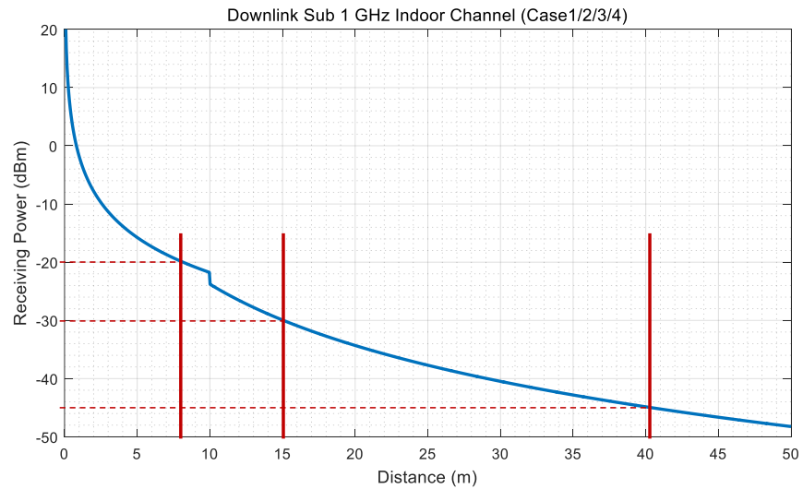
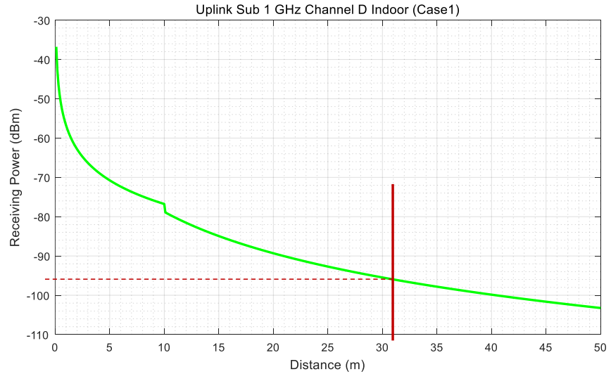
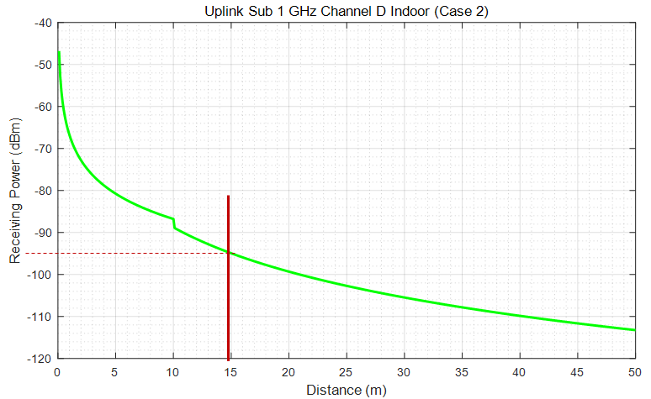
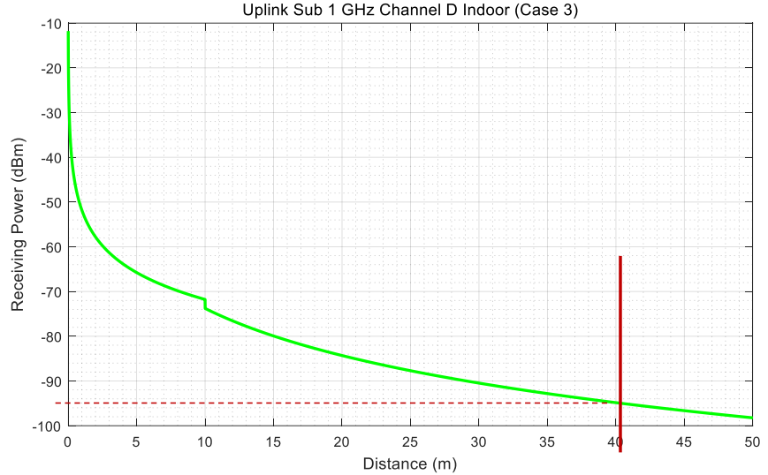
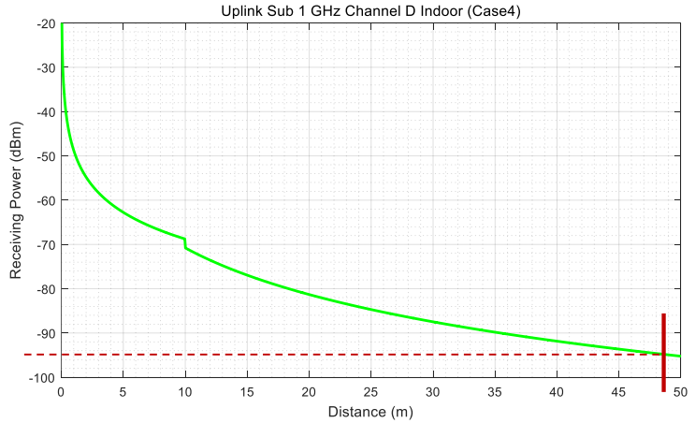
Discussion on AMP Link Budget
Adjusted Link budgets with 11ah (indoor) channel D at sub 1GHz
Case 1
Case 2
Case 3/4
Case 1
Case 2
Case 3
Case 4

Slide 9
Discussion on AMP Link Budget
Adjusted Link budgets with 11ah channel model at Sub-1GHz
 | Case 1 | Case 2 | Case 3 | Case 4
Frequency (MHz) | 920 | 920 | 920 | 920
EIRP of AP (dBm) | 30 | 30 | 30 | 30
Receiver sensitivity of AP (dBm) | -95 (Note 1) | -95 (Note 1) | -95 | -95
Antenna gain of IoT device (dBi) | 2 | 2 | 2 | 2
Minimum receiving power for IoT device (dBm) | -20 (Note 2) | -30 (Note 2) | -45 (Note 3) | -45 (Note 3)
Max. commun. distance from AP to IoT device (m) (Friis [1]) (Note 6) | 10.33 | 32.67 | 183.71 | 183.71
Max. commun. distance from AP to IoT device (m) (11ah Channel D Indoor) | 8 | 15 | 40.2 | 40.2
Backscattering loss at IoT device (dB) | 5 | 5 | 5 | /
Maximum transmission power of IoT device (dBm) | / | / | / | -15 (Note 5)
Low Noise Amplifier factor (dB) | 0 | 0 | 30 (Note 4) | /
Max. commun. distance from IoT device to AP (m) (Friis [1]) (Note 6) | 103.31 | 32.67 | 183.71 | 259.49
Max. commun. distance from IoT device to AP (m) (11ah Channel D Indoor) | 31 | 15 | 40.1 | 48.7
*Notes: Reuse the receiver sensitivity of an 802.11 ah AP The minimum required signal power for an IoT device is -20dBm when the IoT device can’t store power itself. It can be -30dBm when the IoT device has the capability of power storage. -45 dBm is assumed as the sensitivity of ultra-low power receiver. LNA with 30 dBm gain is assumed to boost the backscattering signal, it can have ultra-low power consumption. Ultra-low power active transmitter is assumed. Distances calculated with Friis Equation in [1]

Slide 10
Summary
Friis equation is too optimistic for link budget evaluations on S1G or 2.4GHz channels
With 11ah (Sub-1G) or 11n (2.4G) channel models, the actual maximum communication distances are greatly reduced for both downlink and uplink communications
It can be observed that, there are significant downlink and uplink coverage imbalances
Uplink coverages are larger than downlink coverages in most cases, especially for very low power AMP-Only devices (i.e., Case 1)
To overcome the downlink & uplink imbalance, relay devices maybe required

Slide 11
Thank You

Slide 12
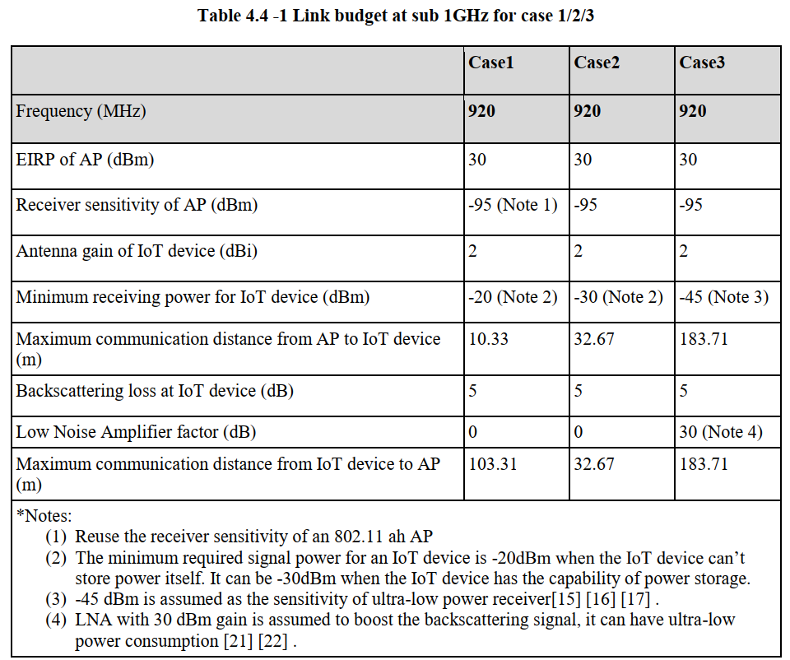
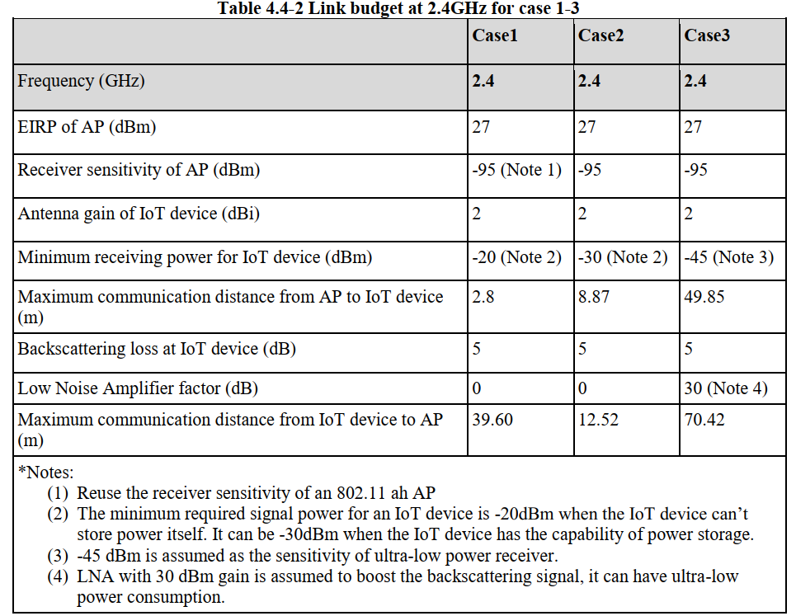
Recap of AMP Link Budget Computations in [1]
The Link Budget Evaluations for Case1/2/3 at both Sub 1 GHz and 2.4GHz → Backscatter Transmitters

Slide 13
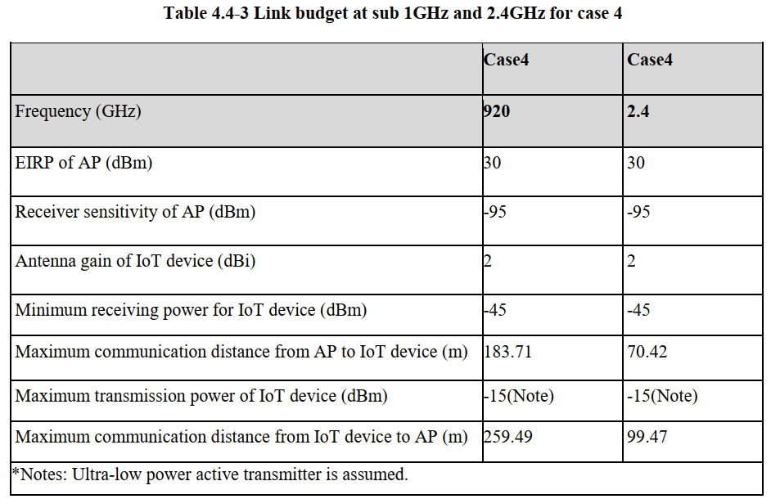
Recap of AMP Link Budget Computations in [1]
The Link Budget Evaluations for Case 4 at both Sub 1 GHz and 2.4GHz → Active Transmitters

