Slide 1
Location Dependent Performance of C-SR
Date: 2023-11-10
Authors:

Slide 2
Introduction
Coordinated Spatial Reuse (C-SR) is one of the Multi-AP coordination schemes for TGbn[1][2]
C-SR allows multiple stations to transmit simultaneously by suppressing inter-BSS interference through Tx power control
C-SR can improve system throughput with lower complexity
In this contribution, we show C-SR simulation results when changing the positional relationship between APs and STAs

Slide 3
Assumption for the C-SR Simulation
In this contribution, C-SR allows two APs to transmit DL packets at the same time
The AP which obtains TXOP, called Sharing AP, collects pathloss information between all AP-STA
Assume that Sharing AP can control both APs' transmission in TXOP
Sharing AP determines whether only a single AP transmits or both APs transmit simultaneously with C-SR depending on which method achieves higher system throughput
In C-SR, Sharing AP determines the combination of Tx power for each AP that maximizes system throughput
The system throughput is calculated by selecting MCSs that satisfy PER≦10% for the combination of Tx power
In single AP transmission, only Sharing AP transmits to the associated STA with maximum Tx power
Sharing AP
Shared AP
Pathloss
(Sharing AP-STA1)
Pathloss
(Shared AP-STA2)
Pathloss
(Shared AP-STA1)
Pathloss
(Sharing AP-STA2)
STA1
STA2

Slide 4
Simulation Setup
Compare the following methods
11ax OBSS_PD based SR
Sharing AP transmits data with max Tx power
Shared AP transmits data with Tx power that meets OBSS_PDmax = -62dBm/20MHz
For Shared AP, MCS is determined to satisfy PER≦10%
C-SR
Sharing AP determines the combination of Tx power and MCS for each AP
If a single AP transmission maximizes system throughput, only Sharing AP transmits with maximum Tx power
MCS is determined based on SINR to satisfy PER≦10%
Definition of Throughput
Throughput is calculated as follows
MACTxByte: Successfully transmitted MSDU data byte size
TxTime: PHY transmission time for data
System throughput is the sum of throughput of each BSS
$$Throughput[bps]=\frac{MACTxByte×8[bit]}{TxTime[sec]}$$

Slide 5
Simulation Setup
1[m]
Simulation Environment
Layout
One AP and one STA are placed in each 10[m] x 10[m] room
The distance between APs is 12[m]
STAs are deployed a granularity of 1[m]
Parameter
10[m]
10[m]
1[m]
STA1
AP1
AP2
10[m]
Frequency, Bandwidth | 5[GHz], 80[MHz]
Tx Power | 0 ~ 21[dBm]
Tx/Rx Antenna | (AP, STA) = (4, 1)
Stream | 1 per STA
Beamforming | YES
MCS index | 0 ~ 11
Fading Model | Model-D
Noise Figure | 7 [dB]
Path loss model | Eq.(1)
y
STA2
x
12[m]
Eq(1): Pathloss = $40.05+20×\log_{10}\left(f_{c}/2.4\right)+20×\log_{10}\left(min\left(d, 5\right)\right)+\left(d>5\right)×35×\log_{10}\left(d/5\right)+10×W$
𝑑 = max(2D distance[m], 1)
$f_{c}$ = 5[GHz]
𝑊 = number of walls traversed

Slide 6
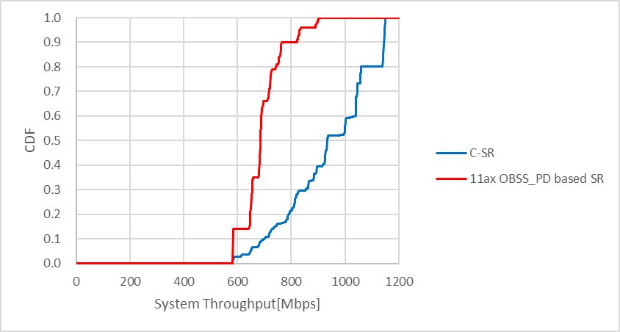
Simulation Result 1
Comparison of 11ax OBSS_PD based SR and C-SR
At the CDF = 0.9, C-SR achieves 1.4 times higher throughput than 11ax OBSS_PD based SR

Slide 7
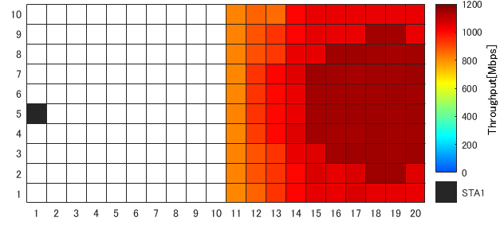
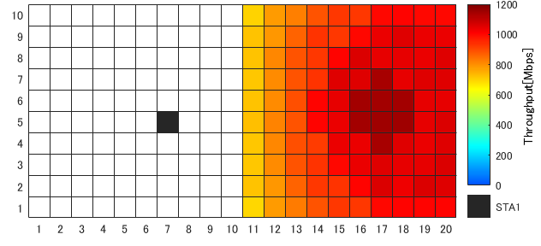
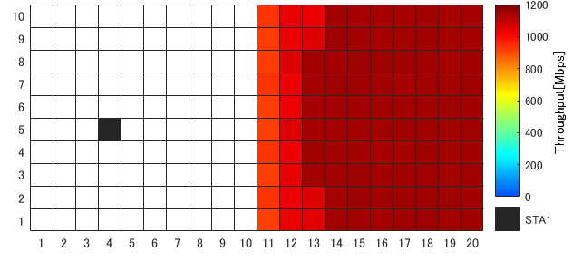
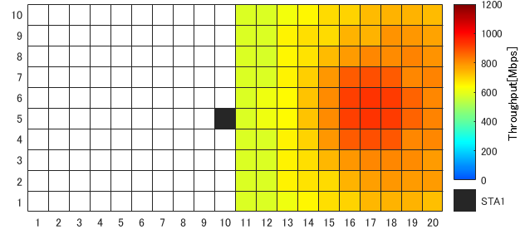
Simulation Result 2
Each heatmap shows the system throughput per STA2 location, with specific STA1 location
STA1 (x, y) = (1, 5)
STA1 (x, y) = (7, 5)
AP1
STA1
AP2
STA1 (x, y) = (4, 5)
STA1 (x, y) = (10,5)
C-SR throughput is improved:
When each STA is close to its associated AP
When STA is far from OBSS AP
When STA2 was in yellowish-green squares, single AP transmission was chosen.
Otherwise, C-SR transmission was chosen.
Slide 7

Slide 8
Summary
This contribution showed heatmaps of the throughput property when APs and STAs are in specific locations
The simulation results showed C-SR throughput is improved when each STA is close to its associated AP or when STA is far from OBSS AP
As a future work, it will be necessary to consider the overhead for Sharing AP to collect pathloss information between all APs and STAs, and the fairness of throughout for each AP in C-SR

Slide 9
References
[1] Kosuke Aio (Sony Corporation), “Recap on Coordinated Spatial Reuse Operation,” 22/1822r0, November 2022.
[2] Sungjin Park (LG Electronics), “Coordinated Spatial Reuse Procedure,” 20/0410r4, March 2020.
[3] Kosuke Aio (Sony Corporation), “Overhead Analysis of Coordinated Spatial Reuse,” 23/0616r0 2023.
[4] Kanke Wu (Qualcomm), “Performance of Coordinated Spatial Reuse,” 23/1037r0 2023.

