Slide 1
Enhancement of BSR Using A-ctrl
Date: 2023-07-19
Authors:

Slide 2
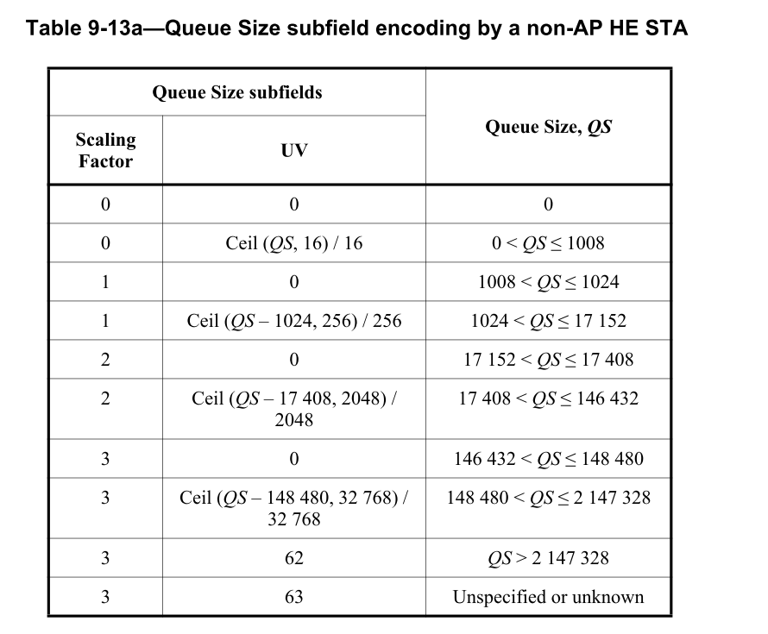
Recap of Buffer Status Report
In 802.11, a non-AP STA can report the queue size (buffer unit size) of a TID in QoS control field
  The report can be used to respond AP’s BSR poll (BSRP) or be carried in UL frames to inform AP how many data of a TID to be transmitted from the STA side
  QS subfield in QoS control field is the most popular method to report BSR
An 8-bit queue size (QS) subfield is defined in QoS control field and for HE STA, the maximum QS to report is 2,147,328 octets
BSR in A-ctrl field serves as an alternative way but is not widely implemented

Slide 3
Problem Statement
With more bandwidth in 6GHz and higher MCS introduced in 802.11, the report is easily exceeded within a PPDU
  For example, a 5.484 ms PPDU with 320MHz, 2SS, and HE MCS8, the data can be carried are 2,328,480 octets
    The QS size in that PPDU cannot be reported accurately
    Note that the QS subfield in QoS control field contains the data within the PPDU and the data waiting to be transmitted
For TB PPDUs, AP cannot allocate enough resources to a non-AP STA with inaccurate BSR and then the throughput may drop
Furthermore, in UHR, the throughput is to be increased by at least 25% so that the problem is getting worse in following generations of 802.11

Slide 4
Thoughts
Considering the limited size of QS subfield and backward capabilities, it is better to add another field to extend the reported queue size other than to further update the QS subfield definition by a larger granularity
  Granularity increase also causes less accurate BSR
Instead of using current BSR in A-ctrl, to define an A-ctrl subfield as an extension of QS subfield is a more promising way
  no change to current definition for HE STA, no backward capability issue
  The extension is needed for a non-AP STA when QS subfield is not enough

Slide 5
A-ctrl Proposal
For a non-AP STA to report queue size larger than 2,147,328 octets, the first step is to set the QS subfield <SF, UV> to <3, 62>
The non-AP STA can carry another subfield defined in A-ctrl field in the same frame to indicate an accurate and larger queue size which is above the QS currently can support

Slide 6
A-Ctrl Design Example
A-ctrl design example 1, keep the SF as the same as 32,768 (SF0) in QS subfield
  QS = 2,147,328 + SF0*(UVE+1), UVE max is 255
  UVE = ceil ((QS - 2,147,328)/SF0) - 1
    Consider 61 + UVE + 1, Max is 61+256 = 317, the maximum QS to be reported is 12,534,784
A-ctrl design example 2, increase the SF to 32,768*4 (SF1)
  QS = 2,147,328 + SF1*(UVE+1), UVE max is 255
    the maximum QS to be reported is 43,697,152
  UVE = ceil ((QS - 2,147,328)/SF1) – 1
The SF applied in the A-ctrl UVE is by default with no extra indication
Control ID value | Meaning | UV extension (UVE)
TBD | Extension of UV in QoS QS subfield | 8 bits
NOTE: For 6GHz, the max AMPDU size is calculated based on Nss=8
39200 (N_DBPS)*396 (symbols for max PPDU length) /8 (bits/byte) * 8 (Nss) = 15,523,200 bytes (max AMPDU size defined in 11be Table 9-34)
39200 is from 11be Table 36-86 MCS13 N_DBPS

Slide 7
Conclusion
To support a larger queue size report, propose to define an A-ctrl subfield cooperating with the QS subfield of the QoS control field

Slide 8
Straw Poll 1
Do you agree to define a mechanism cooperating with the QS subfield of the QoS control field to report a larger queue size?

