Slide 1
IMMW technical scope proposal
November 2023
Date: 2023-11-10
Authors:
Name | Affiliation | Address | Phone | Email
Laurent Cariou | Intel | 2111 NE 25th Ave, Hillsboro OR 97124, USA | +1-503-712-5560 | laurent.cariou@intel.com
Robert Stacey |  |  |  | robert.stacey@intel.com
Carlos Cordeiro |  |  |  | carlos.cordeiro@intel.com

Slide 2
Principle for IMMW scope
November 2023
The key principle is to limit the scope of IMMW to the minimum necessary to enable a lower band PHY to operate in mmWave (proposal in next slide)
This limited scope is critical to not only ensure minimal standard changes, but also minimal implementation complexity and larger market adoption
Leave optimizations and enhanced features for generations after IMMW
Pave the way for long term evolution of 802.11 and its market adoption
Potential for enhanced features for multiple generations
In other words: just focus on the least complexity solution in IMMW to enable operation in the band
So much benefits by just doing that

Slide 3
IMMW KPIs
KPIs that we discussed in UHR SG are very similar to the ones that we would target for IMMW
Capacity/low latency:
natural reduced latency of every transmission
14 GHz of spectrum allows for huge increase in frequency reuse, especially with 320MHz channels (43 non overlapping channels), leading to each link (AP-STA) using a part of the spectrum on its own without any interference
guaranteed QoS (latency, throughput, QoS, …) even in very dense environments. In other words: target is to allow sustaining predictable and ambitious throughput and latency-constraints applications even in the densiest environments
mmWave is likely the only way to distribute capacity by the time we get to 2030, when 10s of Gbps will be commonplace
https://ziplyfiber.com/internet/multigig
https://techxplore.com/news/2023-03-comcast-hypes-10g-network-good.html
Ranging/sensing:
mmWave is the only way to get to cm-level accuracy

Slide 4
What is the minimum necessary feature set to enable mmWave in IMMW?
Only an SU PPDU format
Reusing as much as possible lower band PPDU design
A limited set of bandwidth (choosing a set of BWs between 160 and 1280MHz for instance)
Reusing lower band channel bonding. For example:
Build on the MLO framework which can easily be extended to support other bands
A simple beamforming training solution
Basic sector sweep, with help/support from lower band (using MLO framework), and reusing NDP frames
Basic MAC rules for operation on mmWave band
Simplified assuming no mmWave-only devices and networks
Simplified using MLO framework
No other features needed
11ac PHY numerology
mmWave PHY numerology
 | 20 | 40 | 80 | 160
N_{DFT} | 64 | 128 | 256 | 512
ΔF | 312.5KHz
T_{DFT} | 3.2μs
T_{s} | 50ns | 25ns | 12.5ns | 6.25ns
T_{GI} | TDFT/4 = 0.8μs
N_{GI} | 16 | 32 | 64 | 128
 | 160 | 320 | 640 | 1280
N_{DFT} | 64 | 128 | 256 | 512
ΔF | 2.5MHz
T_{DFT} | 0.4μs
T_{s} | 6.25ns | 3.12ns | 1.56ns | 0.78ns
T_{GI} | TDFT/4 = 100ns
N_{GI} | 16 | 32 | 64 | 128
x8

Slide 5
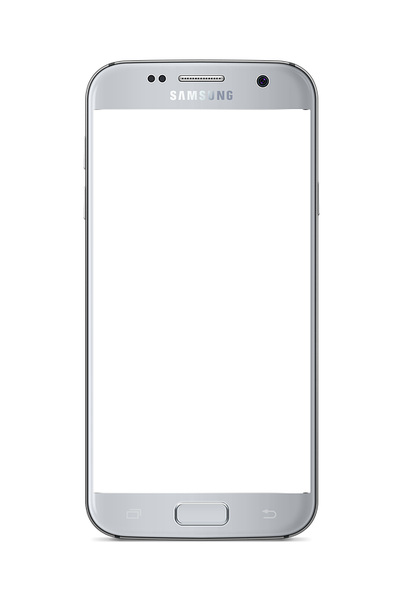
mmWave operation as a natural extension to MLO
September 2022
MLO built to be scalable → simple to add band​
Design can be much simplified by requiring every 60 GHz capable device to also support 2.4/5/6 GHz​
No 60 GHz only devices​
MLO can be used to facilitate 60 GHz operation:​
Discovery/association can be done in lower band​
60 GHz TWT schedules can be negotiated in lower band​
Broadcast transmissions in lower band​
Beamforming training done at 60 GHz, but sequence can be triggered
or scheduled in lower band​
Seamless fall back to lower band in case 60 GHz link breaks
60 GHz coverage
Lower band coverage

Slide 6
Other clarifications
November 2023
The proposal is not to use 11ad/ay
Define new waveform reusing lower band PHY …
New channelization based on min BW of around 160 MHz
Not considering backward compatibility with 11ad/ay, but basic coexistence (likely energy detection-based)

Slide 7
Conclusions
November 2023
Thanks to a mmWave PHY design reusing lower band design,
we are simplifying the standard and implementation work and bringing complexity to levels that we believe are realistic for high-end Wi-Fi devices
Thanks to MLO framework,
We can further reduce standard and implementation work
We provide important tools to help with power consumption and blockage issue in mmWave band
We want to define only what is necessary to enable basic operation (through limitations in PAR)

Slide 8
Reference documents presented in WNG and UHR SG
22/0030, Look ahead to next generation, Ming Gan (Huawei)
22/0046, Next generation after 802.11be, Laurent Cariou (Intel)
22/0729, Next generation after 802.11be - follow-up, Laurent Cariou (Intel)
22/1083, Next Generation SG formation, Ming Gan (Huawei)
22/1395, Thoughts on high frequency band, Myeongjin KIM (Samsung)
22/1566, Views on UHR, Sigurd Schelstraete (MaxLinear)
22/1580, a Perspective On Proposed Uhr Features For Enterprise Use Cases, Brian Hart (Cisco)
22/1595, answering some questions in SG, Laurent Cariou (Intel)
22/1398, RR-TAG mmWave Spectrum Survey, Rich Kennedy (Unlicensed Spectrum Advocates)
22/1466, Potential PHY Features for UHR, Eunsung Kim (LG)
22/1804, Band Complexity Discussion, Vinko Erceg (Broadcom)
22/1865, Considerations on the PHY for 60 GHz, Miguel Lopez (Ericsson)
22/1872, Considerations on PHY Designs for mmWave Band, Eunsung Park (LG)
22/1884, mmWave operation for UHR, Laurent Cariou (Intel)
23/0066, Thoughts on Utilizing mmWave, Mengshi Hu (Huawei)

