Slide 1
Zero-MUI Coordinated Beamforming
Date: 2023-11-09
Authors:

Slide 2
Introduction
Co-BF is one of the Multi-AP cooperation schemes being considered for UHR/TGbn
Partial nulling in the context of Co-BF was discussed in [1]
In this contribution we discuss nulling in Co-BF in more detail, in particular how to cope with more Rx antennas than the number of streams

Slide 3
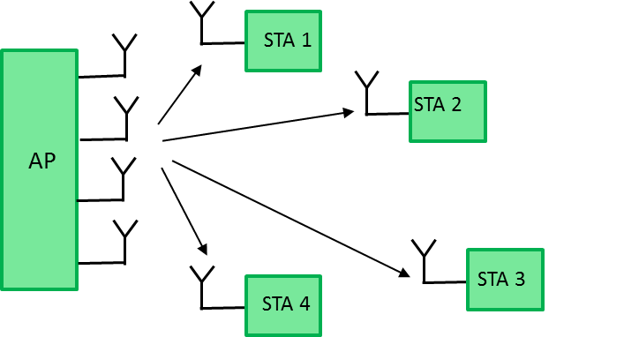
MU-MIMO: Basics
Let us assume an AP with transmit antennas, and STAs each with a single Rx antenna
The simplest solution to eliminate Multi-User Interference (MUI) is Zero-Forcing (ZF) precoding; this means choosing precoder such that (the STAs feedback to the AP):
where is a diagonal matrix
This may be achieved with the (unit average power) BF matrix
An array of antennas can create nulls

Slide 4
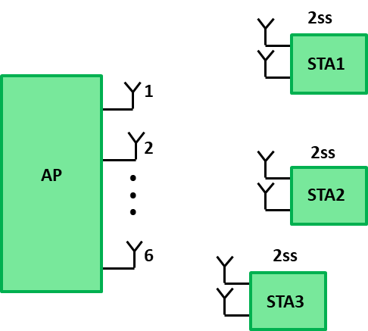
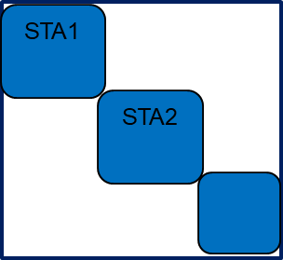
MU-MIMO: Multiple Spatial Streams
Let us now consider an AP with 6 transmit antennas, and 3 STAs each with 2 Rx antennas, and 2 spatial streams transmitted per STA
Now the transmitted signal takes the form
and the received signal at the first STA reads
Precoder
for STA1
Data symbols
for STA1

Slide 5
MU-MIMO: Multiple Spatial Streams (cont.)
In this case, of course we want (e.g. for )
or in other words
which leads to zero MUI and is perfectly
aligned with existing SVD based feedback
A common solution is the PINV of

Slide 6
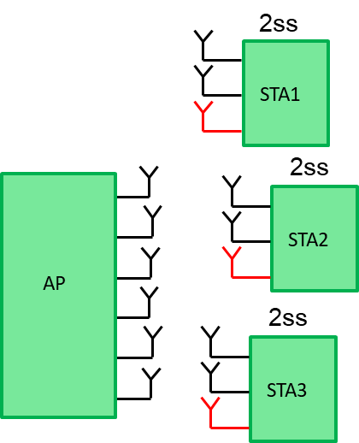
MU-MIMO: Zero MUI with more Antennas than SS
Now let’s make things more interesting by assuming 3 Rx antennas at each STA, but maintaining 2SS for each one
We can extrapolate the previous approach, such that
But this means that the AP must have at least
8 Tx antennas
  So we did something good (added an Rx antenna)
  but this leads to a big setback???

Slide 7
MU-MIMO: Zero MUI with more Antennas than SS (cont.)
Let’s consider a different approach based on SVD; let us separate the ‘used’ (first two) singular components from the ‘unused’ (last component):
Now we consider a different precoding scheme such that:
which means that we can work with 6 Tx antennas,
which is a good starting point
Does this approach achieve zero MUI?
In the next slides we will evaluate it

Slide 8
MU-MIMO: Zero MUI with more Antennas than SS (cont.)
The received signal at STA #1 is
But are in the null-space of , so this is where
the ‘magic’ happens:
The MUI from all STAs is modulating

Slide 9
MU-MIMO: Zero MUI with more Antennas than SS (cont.)
This means that at high SNR, the number of Rx DoFs we need to ‘sacrifice’ is equal to the rank of the (MU) Interference Covariance matrix (e.g. via MVDR)
  At high interference-to-noise ratio, this would coincide with
So in our case we need to give up a single DoF in order to fully mitigate the MUI from all STAs (which is exactly what we have)
Therefore, PINV precoding on -s followed by MVDR/MMSE
at Rx lead to zero MUI!

Slide 10
MU-MIMO: Recap & Current Feedback
In order to achieve zero MUI in the DL MU-MIMO case, STAs need to feedback the corresponding to the used streams
  The corresponding (values of the) matrix are also fed-back so the AP can compute power-loading and predict performance (e.g. PPSNR)
If the AP wants to transmit fewer streams than the number of columns of the matrix , it can do so freely
  Using the example in previous slides, if the AP decides to transmit a single stream to the STA, then are in the null space of (the now rank-1) and the ‘magic’ still happens:
  The MUI from all STAs is modulating (the now rank-2) but the STA has 2 ‘free’ DoF so it can remove the MUI in its entirety

Slide 11
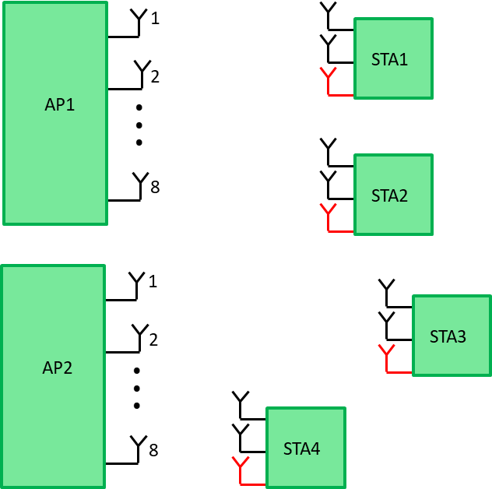
Co-BF in TGbn – Problem Statement
Co-BF is one of the potential AP Cooperation schemes for UHR/TGbn
With Co-BF, each AP transmits (in MU-MIMO style) to its STAs, while placing a null on the other AP’s STAs
  This scheme is relatively simple – synchronization requirements are mild and no joint precoder computation is required
However, in the case of more Rx antennas than
streams, the method we discussed earlier collapses
  What we discussed in previous slides will now apply
  to each AP separately – the MUI would be modulated
  over one vector for each AP
For example, with 2 APs, the MUI would be
modulated over 2 vectors, so MVDR (with a
single DoF) will fail
  So adding more Rx antennas will not solve the problem

Slide 12
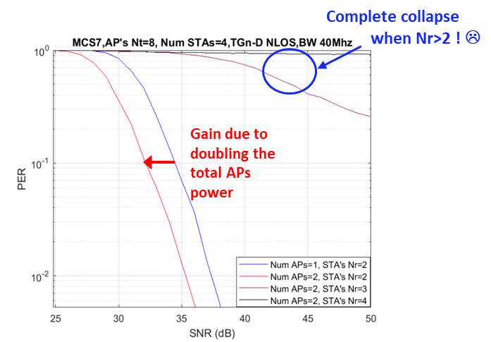
Co-BF in TGbn – Problem Statement (cont.)
The total collapse is evident from the figure below
  We see that when the number of Rx antennas at the STA side is larger than the number of SS, the performance collapses

Slide 13
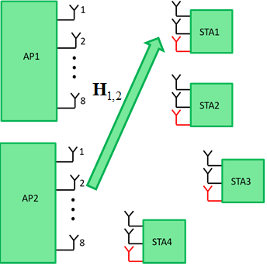
Co-BF in TGbn – Naïve Approach
  Assume (naively) all APs know all channels
  AP #1 knows that in order to mitigate the MUI of AP #1, STA #1 will project onto the null-space basis of which is
  Thus, the interference from AP #2 to STA #1 takes the form
  The key point here is that if we make sure
  and are in the null-space of the
  2x8 matrix , then we have zero MUI

Slide 14
Co-BF in TGbn – Potential (Practical Feedback) Approach
Let us consider the following, slightly different process:
  STA #1 computes the feedback to AP #1 as usual
  STA #1 knows that in order to mitigate the MUI of AP #1, it will project onto the null-space basis of which is
  The interference from AP #2 to STA #1 again takes the form
  And just like in the previous slide, the key point
  here is that if we make sure and are
  in the null-space of the 2x8 matrix , then
  we have zero MUI

Slide 15
Co-BF in TGbn – Potential (Practical Feedback) Approach
So specifically for AP #2 we can think about the following:
  STA #1 computes the SVD of (instead of )
  STA #1 feedbacks (the conjugate of) the (2) vectors computed in the previous step (this reuses the existing feedback format)
  AP #2 computes the precoders as usual (based
  on the feedback ), such that
But there are more aspects to consider,
including transmission of a lower rank
(using fewer streams than fed-back); this
is discussed in the next slide

Slide 16
Co-BF in TGbn – Potential (Practical Feedback) Approach
In order to accommodate lower rank and reduce the complexity, we consider the following:
  STA #1 computes the orthonormal basis of (the row space of)
  This can be carried out using, for example, QR decomposition or Gram-Schmidt which require lower complexity than an SVD
  STA #1 feedbacks the (conjugate of) the (2)
  vectors of the basis of to AP #2,
  denoted (same format)
  AP #2 computes the precoders as usual (based
  on the new feedback), such that
  This approach can be easily extended
  to 3 or more APs

Slide 17
Co-BF in TGbn – Potential (Practical Feedback) Approach
The following figure compares the performance between the existing (per-AP/STA) feedback, denoted ‘regular’, and the approach described in the previous slides (#13-#16)
denoted ‘enhanced’
It is clear to see how the error
floor associated with the existing
feedback is solved using this
approach

Slide 18
Conclusions
We explained how precoding is carried out today in MU-MIMO and how the precoder is designed for more Rx antennas than the number of streams
We showed how it is sufficient in MU-MIMO to feedback the singular vectors, and the AP can use any subset of these and still maintain zero MUI
This cannot be extended trivially to the case of Co-BF, as explained and shown in simulation results
We proposed a potential approach that completely solves this problem and maintains the existing feedback format

Slide 19
References
[1] 11-22/0766r1: Performance of C-BF and C-SR (Ron Porat et al)
Notes:
at least one mode of operation capable of improved support, compared to 802.11be, for applications with stringentworst-case latency and jitter requirementscompared to 802.11be // i.e., avoid “worst-case”

Slide 20
Appendix – MATLAB Code Example
% Two APs, each with 8 Tx antennas, and 4 STAs, each with 3 Rx antennas - we create all channels
H_11 = 1/sqrt(2)*(randn(3,8)+1i*randn(3,8)); % channel from AP #1 to STA #1
H_12 = 1/sqrt(2)*(randn(3,8)+1i*randn(3,8)); % channel from AP #2 to STA #1
H_21 = 1/sqrt(2)*(randn(3,8)+1i*randn(3,8)); % channel from AP #1 to STA #2
H_22 = 1/sqrt(2)*(randn(3,8)+1i*randn(3,8)); % channel from AP #2 to STA #2
H_31 = 1/sqrt(2)*(randn(3,8)+1i*randn(3,8)); % channel from AP #1 to STA #3
H_32 = 1/sqrt(2)*(randn(3,8)+1i*randn(3,8)); % channel from AP #2 to STA #3
H_41 = 1/sqrt(2)*(randn(3,8)+1i*randn(3,8)); % channel from AP #1 to STA #4
H_42 = 1/sqrt(2)*(randn(3,8)+1i*randn(3,8)); % channel from AP #2 to STA #4
Notes:
at least one mode of operation capable of improved support, compared to 802.11be, for applications with stringentworst-case latency and jitter requirementscompared to 802.11be // i.e., avoid “worst-case”

Slide 21
Appendix – MATLAB Code Example (cont.)
% Using the traditional/existing method – interference alignment doesn’t work
[U_11,D_11,V_11] = svd(H_11,'econ');
[U_21,D_21,V_21] = svd(H_21,'econ');
[U_31,D_31,V_31] = svd(H_31,'econ');
[U_41,D_41,V_41] = svd(H_41,'econ');
Null_AP1_STA1 = null([V_21(:,1:2)'; V_31(:,1:2)'; V_41(:,1:2)']); % null precoder from AP #1 to STA #1
Null_AP1_STA2 = null([V_11(:,1:2)'; V_31(:,1:2)'; V_41(:,1:2)']); % null precoder from AP #1 to STA #2
W_11 = Null_AP1_STA1*(randn(2,2)+1i*randn(2,2))/sqrt(2); % precoder from AP #1 to STA #1, using random per-STA precoding (in practice would be based on channel)
W_21 = Null_AP1_STA2*(randn(2,2)+1i*randn(2,2))/sqrt(2); % precoder from AP #1 to STA #2, using random per-STA precoding (in practice would be based on channel)
[U_12,D_12,V_12] = svd(H_12,'econ');
[U_22,D_22,V_22] = svd(H_22,'econ');
[U_32,D_32,V_32] = svd(H_32,'econ');
[U_42,D_42,V_42] = svd(H_42,'econ');
Null_AP2_STA3 = null([V_12(:,1:2)'; V_22(:,1:2)'; V_42(:,1:2)']); % null precoder from AP #2 to STA #3
Null_AP2_STA4 = null([V_12(:,1:2)'; V_22(:,1:2)'; V_32(:,1:2)']); % null precoder from AP #2 to STA #4
W_32 = Null_AP2_STA3*(randn(2,2)+1i*randn(2,2))/sqrt(2); % precoder from AP #2 to STA #3, using random per-STA precoding (in practice would be based on channel)
W_42 = Null_AP2_STA4*(randn(2,2)+1i*randn(2,2))/sqrt(2); % precoder from AP #2 to STA #4, using random per-STA precoding (in practice would be based on channel)
Interference_at_STA1 = [H_11*W_21, H_12*[W_32 W_42]];
Interference_rank_at_STA1 = rank(Interference_at_STA1,1e-6); % interference rank is 2, not 1!
Interference_at_STA2 = [H_21*W_11, H_22*[W_32 W_42]];
Interference_rank_at_STA2 = rank(Interference_at_STA2,1e-6); % interference rank is 2, not 1!
Interference_at_STA3 = [H_32*W_42, H_31*[W_11 W_21]];
Interference_rank_at_STA3 = rank(Interference_at_STA1,1e-6); % interference rank is 2, not 1!
Interference_at_STA4 = [H_42*W_32, H_41*[W_11 W_21]];
Interference_rank_at_STA4 = rank(Interference_at_STA2,1e-6); % interference rank is 2, not 1!
Notes:
at least one mode of operation capable of improved support, compared to 802.11be, for applications with stringentworst-case latency and jitter requirementscompared to 802.11be // i.e., avoid “worst-case”

Slide 22
Appendix – MATLAB Code Example (cont.)
% Using the suggested method – interference alignment now works!!
H_12_eq = U_11(:,1:2)'*H_12;
[Q,R] = qr(H_12_eq',0); % Gram-Schmidt can be used as well
V_12_eq = Q;
H_22_eq = U_21(:,1:2)'*H_22;
[Q,R] = qr(H_22_eq',0); % Gram-Schmidt can be used as well
V_22_eq = Q;
Null_AP2_STA3 = null([V_12_eq'; V_22_eq'; V_42(:,1:2)']); % null precoder from AP #2 to STA #3
W_32 = Null_AP2_STA3*(randn(2,2)+1i*randn(2,2))/sqrt(2); % precoder from AP #2 to STA #3, using random per-STA precoding (in practice would be based on channel)
Null_AP2_STA4 = null([V_12_eq'; V_22_eq'; V_32(:,1:2)']); % null precoder from AP #2 to STA #4
W_42 = Null_AP2_STA4*(randn(2,2)+1i*randn(2,2))/sqrt(2); % precoder from AP #2 to STA #4, using random per-STA precoding (in practice would be based on channel)
Interference_at_STA1 = [H_11*W_21, H_12*[W_32 W_42]];
Interference_rank_at_STA1_new = rank(Interference_at_STA1,1e-6); % interference rank is 1 now!
Interference_at_STA2 = [H_21*W_11, H_22*[W_32 W_42]];
Interference_rank_at_STA2_new = rank(Interference_at_STA2,1e-6); % interference rank is 1 now!
Notes:
at least one mode of operation capable of improved support, compared to 802.11be, for applications with stringentworst-case latency and jitter requirementscompared to 802.11be // i.e., avoid “worst-case”

