Slide 1
Simulation on coexistence of AMP traffic and existing traffic
November 2023
Doc.: IEEE 802.11-23/1994r0
Date: 2023-11-09
Authors:
Name | Affiliation | Address | Phone | Email
Hao wang | OPPO |  |  | wanghao6@oppo.com
Weijie Xu |  |  |  | xuweijie@oppo.com
Yinan Qi |  |  |  | v-qiyinan@oppo.com

Slide 2
Background
November 2023
Doc.: IEEE 802.11-23/1994r0
There was concern on whether there is interference to legacy traffic from AMP traffic. For that, simulations had been done in[1][2]. Based on the simulation in [1], it can be the impact from AMP traffic(even in extreme traffic scenario) is very minor. If there is further restriction on the access class for AMP traffic, the impact is further reduced and negligible[2].

Slide 3
Simulation 1: default AC for both AMP and the existing traffic
November 2023
Doc.: IEEE 802.11-23/1994r0
The interference impact from AMP STA communication to Wi-Fi FTP download was evaluated in the simulation.
Default IEEE 802.11 access category is set for both AMP traffic and the existing traffic.
Note: the same Txop sharing mechanism is assumed for AMP transmission.
BK
SIFS + 7 ×SLOT
[0 .. 15]×SLOT
t
BE
SIFS +
3 ×SLOT
[0 .. 15]×SLOT
t
t
SIFS +
2 ×SLOT
[0 .. 15]×SLOT
Default
t
t

Slide 4
November 2023
Doc.: IEEE 802.11-23/1994r0
Simulation scenario
100 / 300 / 1000 / 3000 AMP-STAs
848µs per query
FTP Downloads, 1MB per file, 6Mb/s
KPI: FTP Download delay

Slide 5
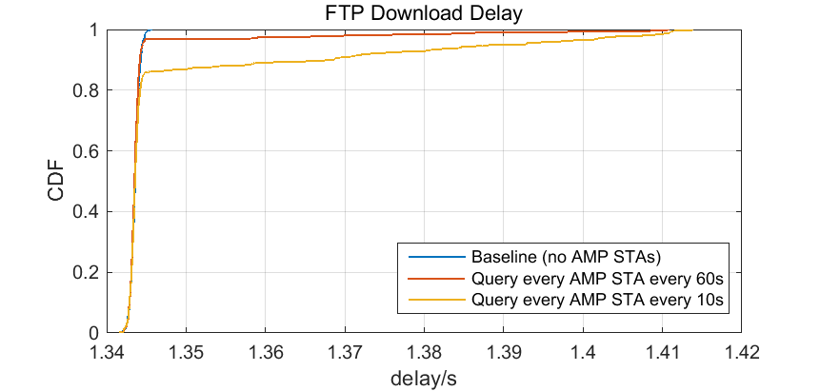
AMP STA number n =100
November 2023
Doc.: IEEE 802.11-23/1994r0

Slide 6
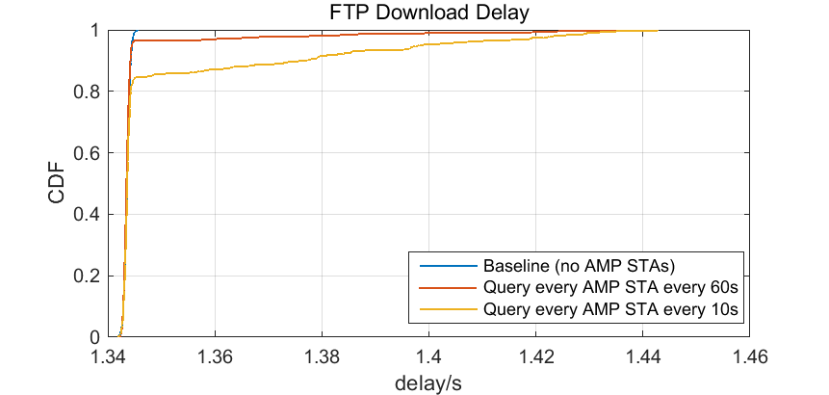
AMP STA number n =300
November 2023
Doc.: IEEE 802.11-23/1994r0

Slide 7
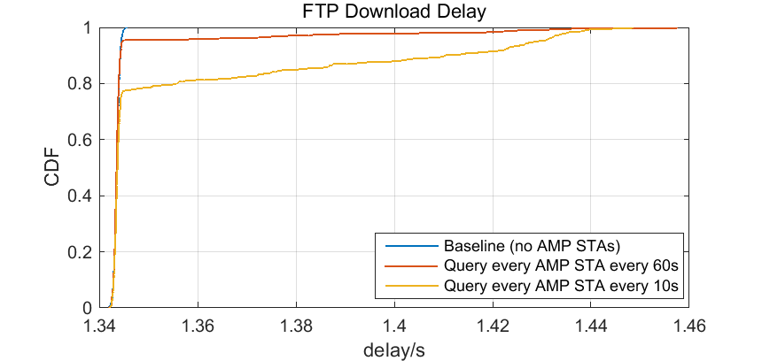
AMP STA number n =1000
November 2023
Doc.: IEEE 802.11-23/1994r0

Slide 8
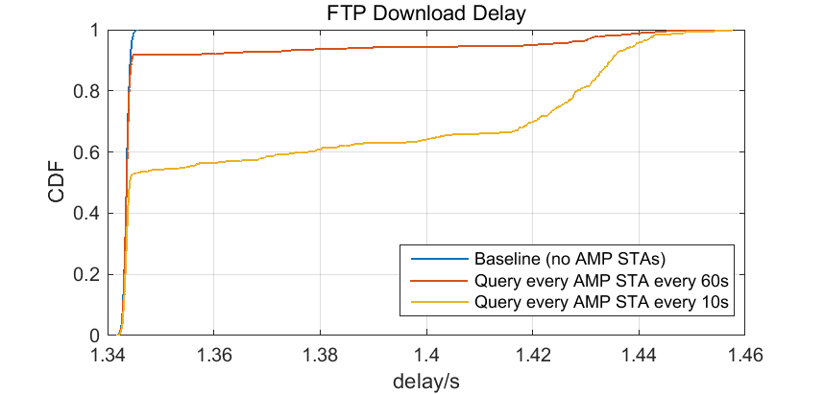
AMP STA number n =3000
November 2023
Doc.: IEEE 802.11-23/1994r0

Slide 9
Simulation 2: Lower AC for AMP traffic
November 2023
Doc.: IEEE 802.11-23/1994r0
The interference impact from AMP STA communication to Wi-Fi FTP download was evaluated in the simulation.
AC_default is set for the existing traffic while AC_BK is set for AMP traffic (AC_BE/AC_default for AMP are also tested).
Note: the same Txop sharing mechanism is assumed for AMP transmission.
BK
SIFS + 7 ×SLOT
[0 .. 15]×SLOT
t
BE
SIFS +
3 ×SLOT
[0 .. 15]×SLOT
t
t
SIFS +
2 ×SLOT
[0 .. 15]×SLOT
Default
t
t

Slide 10
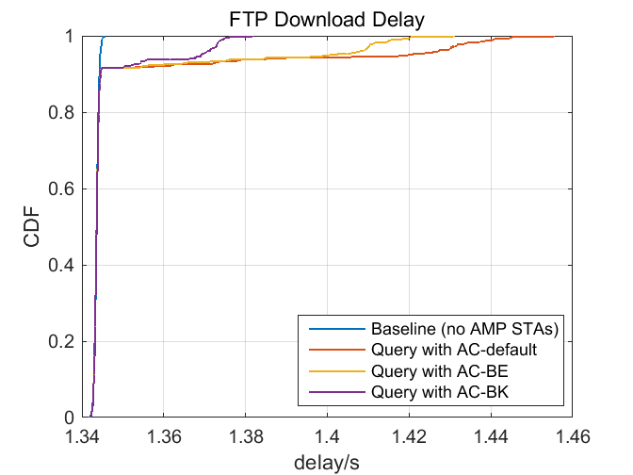
AMP STA number n =3000, Query every 60s
November 2023
Doc.: IEEE 802.11-23/1994r0

Slide 11
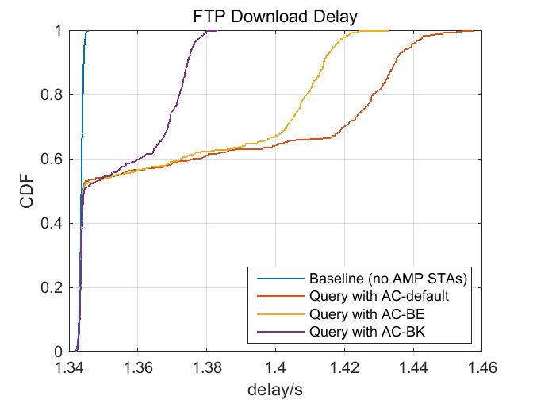
AMP STA number n =3000, Query every 10s
November 2023
Doc.: IEEE 802.11-23/1994r0

Slide 12
November 2023
Doc.: IEEE 802.11-23/1994r0
Summary
In this submission, the impacts (from AMP traffic) on the existing traffic are evaluated. The very similar results as in[1][2] are collected. So, we have the same observations:
Even in extreme AMP traffic scenario, the impact to the existing traffic is very minor.
If there is further restriction on the access class for AMP traffic, the impact is further reduced and negligible.
Slide 12
Weijie Xu (OPPO)

Slide 13
Reference
November 2023
Doc.: IEEE 802.11-23/1994r0
IEEE 802.11-23/1601r1, AMP Communication Channel Usage Estimation
IEEE 802.11-22/1627r6, AMP Communication Channel Usage Estimation Part 2: AC_BK

