Slide 1
Complexity Reduction for AI CSI Compression
Date: 2023-11
Authors:

Slide 2
Background
In the AIML TIG technical report draft [1], two sub-cases are considered for the CSI feedback compression use case
  Sub-case A: System throughput improvement
  Sub-case B: Compression complexity reduction compared with Givens Rotation operation
For sub-case A, we studied an autoencoder-based CSI feedback scheme in [2]. It adopts a CNN-based encoder (CNN-ENC) and achieves ~95% times feedback bits reduction and ~200% system throughput improvement.
In this contribution, we focus on sub-case B and study the technical feasibility of reusing a CNN-ENC structure, i.e., cutting out several blocks of CNN-ENC to reduce the computational complexity of CSI compression.

Slide 3
Proposed CSI feedback compression
The CSI feedback scheme proposed in [2] adopts a structure with concatenated CNN blocks (CNN-ENC).
To reuse the structure in sub-case B, we simply bypass some of the CNN blocks (CNN-ENC-T: a tailored version of CNN-ENC), which reduces computational complexity but has a larger number of feedback bits.
CNN-ENC
V
Pre-processing
CNN block
CNN block
CNN block
CNN block
Post-processing
Quantization
compressed feedback
(1280 bits)
CNN-ENC-T
V
Pre-processing
CNN block
CNN block
CNN block
CNN block
Post-processing
Quantization
compressed feedback
(4096 bits)

Slide 4
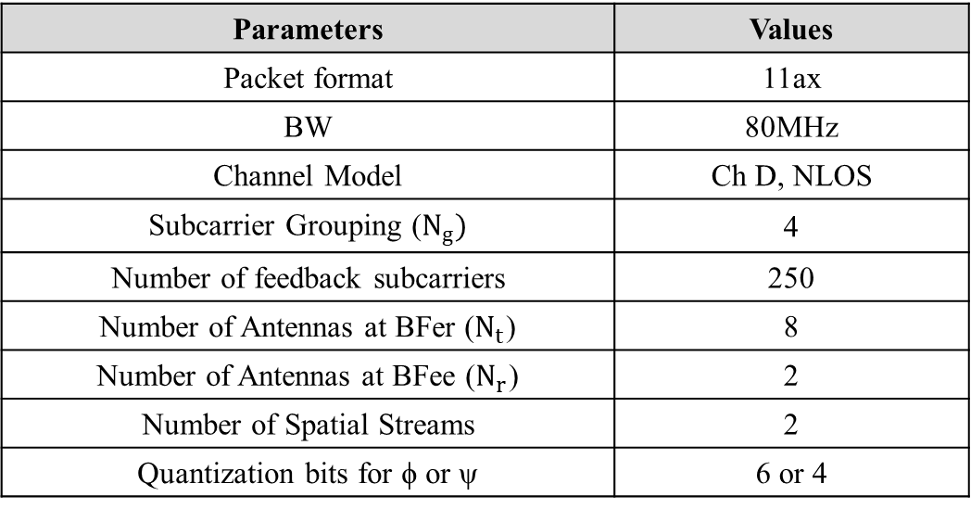
Performance evaluations
The simulation setup is shown as follows.
Parameters | Values
Packet format | 11ax
BW | 80MHz
Channel Model | Ch D, NLOS
Subcarrier Grouping ($N_{g})$ | 4
Number of feedback subcarriers | 250
Number of Antennas at BFer ($N_{t}$) | 8
Number of Antennas at BFee ($N_{r}$) | 2
Number of Spatial Streams | 2
Quantization bits for ϕ or ψ | 6 or 4

Slide 5
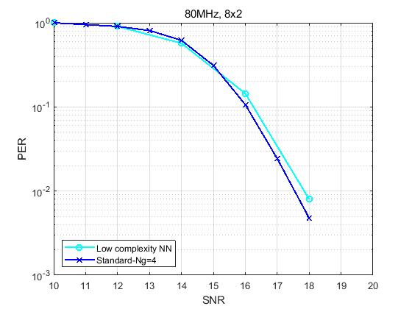
Performance evaluations
Compared with the 802.11ax CSI feedback scheme using a Givens rotation, the PER performance loss of the tailored CNN-based encoder (CNN-ENC-T) is smaller.

Slide 6
Performance evaluations
Compared with a Givens rotation, the tailored CNN-based encoder (CNN-ENC-T) reduces the computational complexity of the CSI compression.
Scheme | Feedback overhead per CSI report (bits) | Number of multiplications per CSI report
Givens Rotation [3] | 32500 (130 per subcarrier) | 900K
CNN-ENC-T | 4096 (~16 per subcarrier) | 348K
* The analysis of the Givens Rotation in [3] is performed with BW=20MHz. We simply multiply the values by 4 here for comparison, since the number of subcarrier is ~4 times.

Slide 7
Summary
In this contribution, we studied the compression complexity reduction for CSI feedback compression use case.
The proposed scheme achieves lower computational complexity by cutting out some CNN blocks of the neural network used in [2], which has shown good system throughput improvement, resulting in a flexible architecture suitable for both subcases of CSI feedback compression use case.
It would be useful to mention this scheme in the AIML TIG Technical Report Draft (11-23-1350) before it is complete.

Slide 8
References
[1] 11-22-0987-17-aiml-aiml-tig-technical-report-draft
[2] 11-23-0290-04-aiml-study-on-ai-csi-compression
[3] 11-23-0755-00-aiml-aiml-assisted-complexity-reduction-for-beamforming-csi-feedback-using-autoencoder

