Slide 1
Discussions on Model Reuse
Date: 2023-11
Authors:
Name | Affiliations | Address | Phone | Email
Peng Liu | Huawei | Huawei Base, Bantian, Longgang, Shenzhen, Guangdong, China, 518129 |  | Jeremy.liupeng@huawei.com
Ziyang Guo
Ross Jian Yu

Slide 2
Introduction
In [2], we have shown that the same DNN-based hidden layer structure can be applied to both the channel access [3] and rate adaptation [4] use cases.
In [5], we have shown that a similar DNN-based structure can also be taken as the Encoder for CSI compression use case
In this contribution, we investigate whether the same structure can also be applied to the channel classification use case [6].

Slide 3
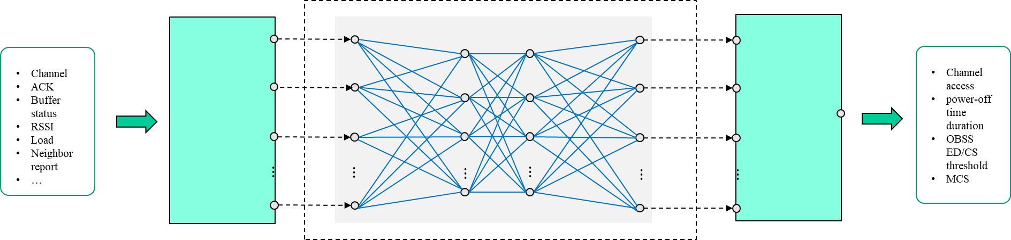
Recap I: Neural Network Model Architecture[1]
Train@AP
Components | Descriptions | Thoughts on Standardization
Input | local radio measurements at PHY/MAC layer, defined in Sec.4.3.11 of 802.11-2020 or customized A sequence of historical observations | Standardize some basic and common inputs for a variety of use cases
Pre-processing | Format conversion (e.g., normalization) to NN friendly format Feature extraction or augmentation Could be NN or other algorithms | If Pre-processing is left for implementation, the output of Pre-processing (i.e., the input of core NN) shall be standardized
Core Neural Network | Structure, e.g., DNN or CNN Layer types, number of layers, number of neurons per layer, activation function | Standardize several basic and mandatory model structure such as DNN and CNN Alternatively, consider ONNX[6] or NNEF[7] on top of the 802.11 Explore model reuse
Post-processing | Map neural network output to specific transmission scheme Probability distribution or ArgMax | Both types can be considered to be standardized
Training data report
AP
Model deployment/sharing
Non-AP 3
Non-AP 1
Inference@non-AP STA
Non-AP 2
Input/
measurements
Pre-processing
Core Neural Network
Post-processing
Output/decision

Slide 4
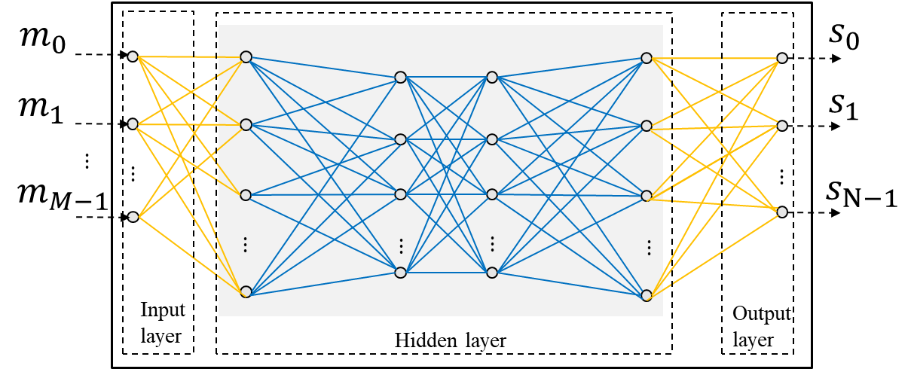
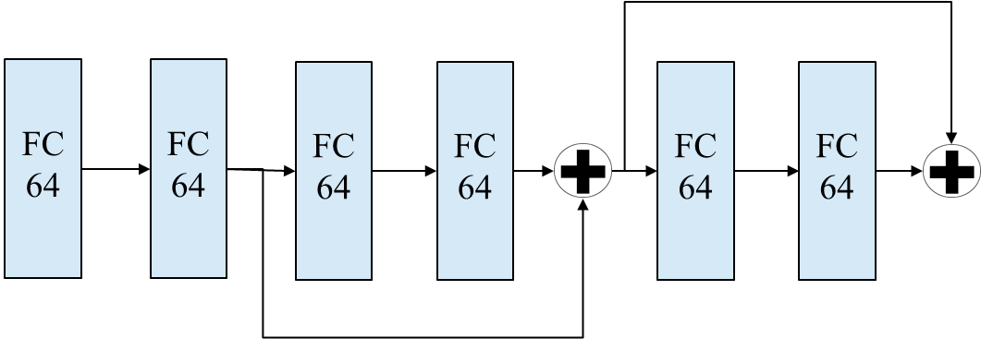
Model Reuse Exploration
In [2], we have shown that the same DNN-based hidden layer structure can be applied to both the channel access [3] and rate adaptation [4] use cases.
In [5], we have shown that a similar structure can also be taken as the Encoder for CSI compression.
In this contribution, we further explore model reuse, i.e., investigate whether the same structure can also be applied to the channel classification use case [6].
channel access
rate adaptation
Auto-encoder based CSI compression
Channel classification?
Lightweight
Battery-friendly

Slide 5
Channel Classification
Many transmission schemes and parameter optimization are based on channel conditions.
In [6], a ML-based channel classification method is proposed, the basic idea of which is to classify a channel as a frequency flat channel, low frequency channel and high frequency selective channel, and determine the subcarrier grouping value adaptively .
In this contribution, we study whether a channel classification task can be conducted using the neural network structure studied in channel access, rate adaptation and CSI compression.
Class | Feature | IEEE channel Model | N_{g}
Class I | Frequency flat channel | A | N_{g} = N_{ST}
Class II | Low frequency selective channel | B, C | N_{g} = 16
Class III | High frequency selective channel | D, E, F | N_{g} = 4

Slide 6

Neural Network Based Channel Classification
Input: the real and image parts of $H_{1,1}$ on all subcarriers
Output: channel type, i.e., 6 types representing channel models A-F

Slide 7
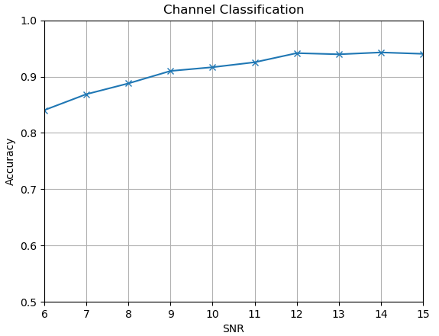
Simulation Results
Parameter | Value
Packet format | 11ax
Channel model | A, B, C, D, E, F
Channel condition | LOS, NLOS
Number of data | ~120K
Number of training data | 80% of data
Number of testing data | 20% of data
Learning algorithm | Neural network
Optimizer | Adam
Number of hidden layers | 6
Number of neurons per hidden layer | 64
Activation function | ReLU for hidden layers, Softmax for output layer

Slide 8
Thoughts on Model Reuse
The technical feasibility has been checked, even the use cases looks quite different, e.g., channel access, CSI compression and channel classification
Maximize the utility of AI/ML to support a range of use cases and expand to support more use cases not discussed in AIML TIG
Simplify the model management[2], such as signaling and model sharing
The full-connected model in this contribution is only an example to illustrate the technical feasibility. Other models ought to be able to achieve the same effect.
Suggest to study the small and lightweight model at first to cover low-end STA. It is shown that for most wireless AI use cases in the TIG, small and lightweight model performs well.

Slide 9
Summary
In this contribution, we have shown that one model structure is feasible to reuse in multiple use cases, including channel access, rate adaptation, encoder for CSI compression and channel classification.
It would be useful to mention model reuse in the AIML TIG Technical Report Draft (11-23-1350) before it is complete.

Slide 10
Reference
[1] 11-23-0750-00-aiml-discussions-on-neural-network-model-sharing-for-wlan
[2] 11-23-1182-01-aiml-follow-up-discussions-on-neural-network-model-sharing-for-wlan
[3] 11-22-1522-01-aiml-drl-based-channel-access
[4] W. Lin, Z. Guo, P. Liu, M. Du, X. Sun and X. Yang, "Deep Reinforcement Learning based Rate Adaptation for Wi-Fi Networks," 2022 IEEE 96th Vehicular Technology Conference (VTC2022-Fall), London, United Kingdom, 2022, pp. 1-5, doi: 10.1109/VTC2022-Fall57202.2022.10012797.
[5] 11-23-0290-04-aiml-study-on-ai-csi-compression
[6] 11-23-0032-03-aiml-ml-based-adaptive-subcarrier-grouping-for-beamforming-feedback

