Slide 1
Coordinated spatial re-use for UHR
Date: 2023-11-13

Slide 2
Introduction
Previous submissions [1,2] presented Multi-AP joint transmission
  While JT performs well under ideal conditions, the synchronization requirements and the amount of data exchange between APs are an issue in many use cases
  Coordinated spatial-re-use (C-SR) provides multi-AP coordination at much lower complexity, but spatial re-use in 802.11ax/be has issues [3, 4]
This contribution:
  Enhance C-SR to be aware of interference
  STA feedback proposal for C-SR
  C-SR performance results for the in-home scenario

Slide 3
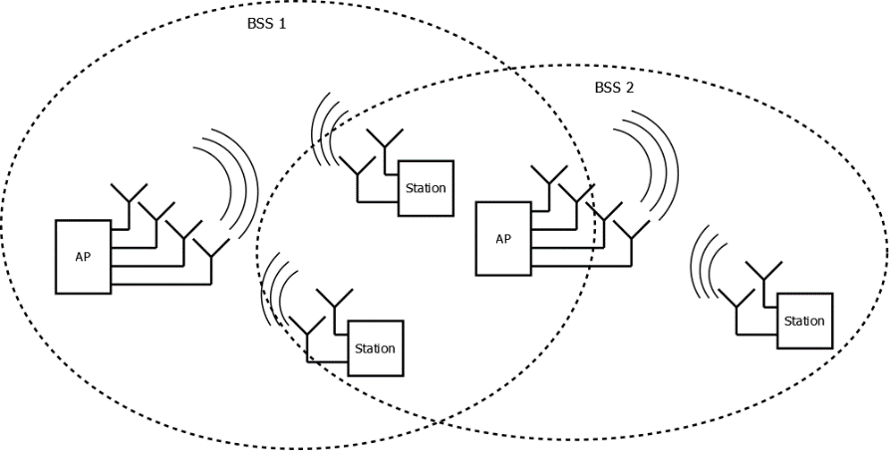
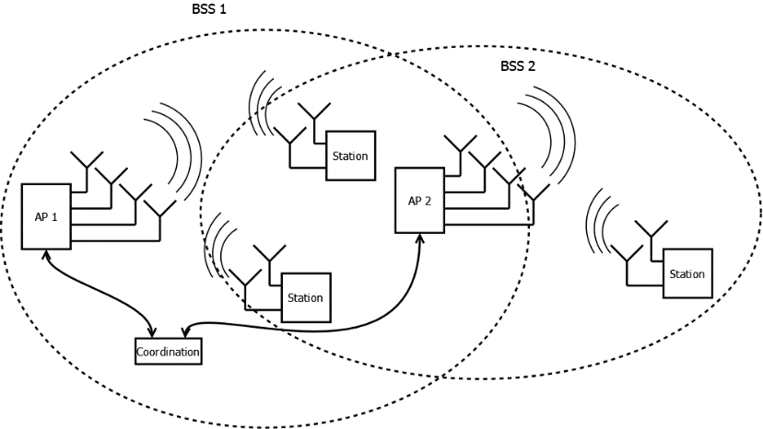
OBSS Cooperation Scenarios - Terminology
Half-Coordinated OBSS
No joint coordination
Primary AP gains channel and operates without consideration for the secondary APs
Secondary APs limit interference into primary transmission
AP-STA association is fixed
Fully Coordinated OBSS
APs do joint optimization of transmit power and MCS
AP-STA association is fixed

Slide 4
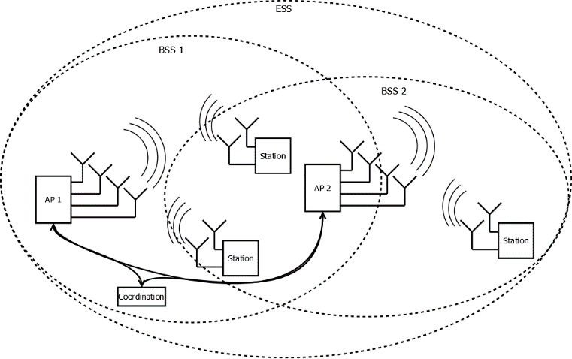
ESS Cooperation Scenarios
ESS (fully coordinated)
  Differently from OBSS cases, AP-STA association is optimized
  APs do a joint optimization of transmission settings like transmit power and MCS (can be part of one of the APs)
  Results are in the appendix

Slide 5


In-Home Scenario
Coverage Simulation
Residential scenario based on [5]
3 AP placement options:
  Nearly Co-located APs + 1 wall
  10m distance/1 wall between APs
  20m distance/2 walls between APs
In OBSS case, STAs are assigned to APs according to position (Room 1, 2 to AP1, Room 3, 4 to AP2)
4 STAs served simultaneously
In ESS case, STA assignment is optimized

Slide 6
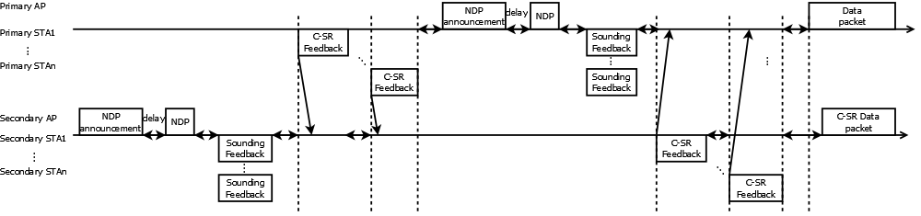
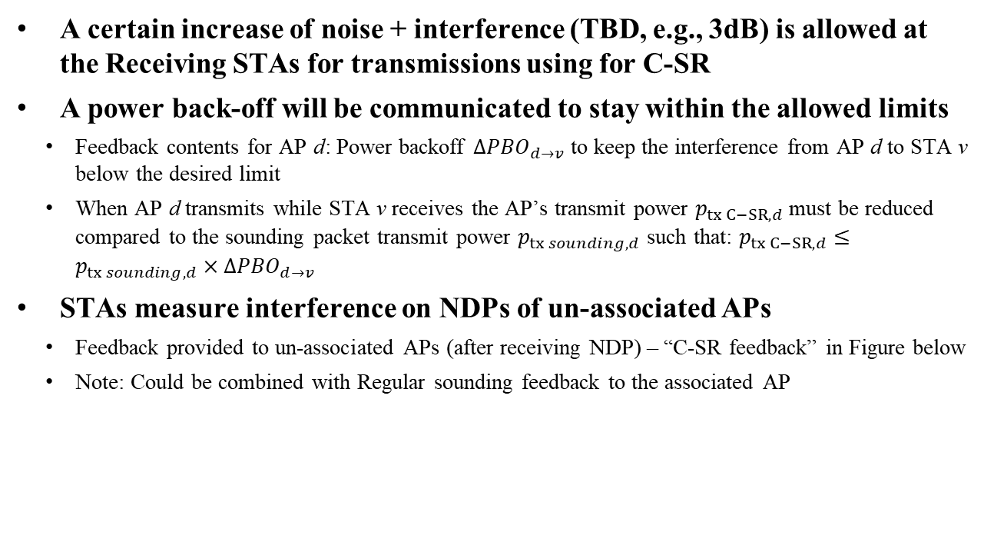
C-SR principles
A certain increase of noise + interference (TBD, e.g., 3dB) is allowed at the Receiving STAs for transmissions using for C-SR
A power back-off will be communicated to stay within the allowed limits
  Feedback contents for AP d: Power backoff ${ΔPBO}_{d→v}$ to keep the interference from AP d to STA v below the desired limit
  When AP d transmits while STA v receives the AP’s transmit power $p_{tx C−SR,d}$must be reduced compared to the sounding packet transmit power $p_{tx sounding,d}$ such that: $p_{tx C−SR,d}≤p_{tx sounding,d}{ ×ΔPBO}_{d→v}$
STAs measure interference on NDPs of un-associated APs
  Feedback provided to un-associated APs (after receiving NDP) – “C-SR feedback” in Figure below
  Note: Could be combined with Regular sounding feedback to the associated AP

Slide 7
Simulation Assumptions
Half coordinated:
  3dB noise increase due to interference is allowed
  MCSs are selected with knowledge of the interference level (no packet losses due to unexpected interference)
Fully coordinated and ESS:
  Optimization objective used in simulations is maximum aggregated throughput
    May not be optimal for fairness (see slide 14)
    Other objectives can be considered to improve fairness

Slide 8
Aggregated Throughput (1)

Slide 9
Aggregated Throughput (2)
Observations
Increased (aggregated) throughput (compared to TDMA) only for large separation between APs
In other cases, TDMA gives higher aggregated throughput
  Full coordination optimum coincides with TDMA (see discussion on optimization criteria in later 14)

Slide 10
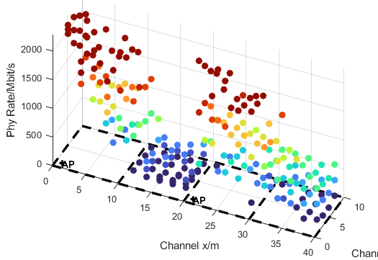
Half-Coordinated OBSS – individual rates (1)
  Avg. per-STA rates similar to TDMA
  Secondary channel rate>0 in most cases (potential latency improvement)
  Room 2 (max. sum-rate)
    Low rates of primary transmission
    Secondary transmission not usable
APs at 20m distance

Slide 11
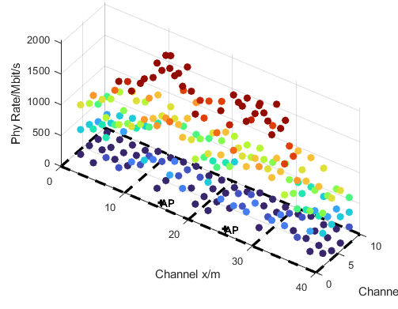
Half-Coordinated OBSS – individual rates (2)
  Data rates comparable to TDMA
  Secondary channel rate >0Mbit/s for 80% of cases
  Secondary transmission rates are low, but available in the whole area
APs at 10m distance

Slide 12
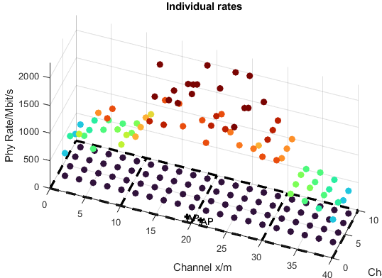
Half-Coordinated OBSS – individual rates (3)
  Primary rates ok, but spatial re-use not usable
  Performance penalty for primary due to C-SR transmissions is much higher than the (additional) secondary channel rate
APs co-located

Slide 13
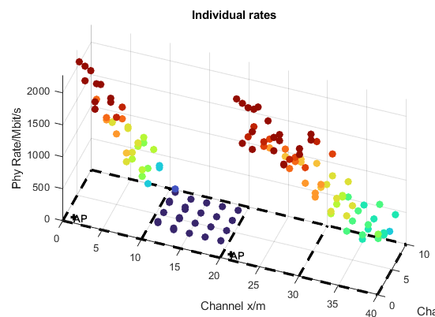
Fully Coordinated OBSS – individual rates
  Max. sum-rate results in low data rates for STAs between the APs
  Some fairness criteria needed
    See next slide
APs at 20m distance
At 10m AP distance or less, fully coordinated
coincides with TDMA (because it gives the highest sum rate)

Slide 14
Fairness in fully coordinated C-SR
Sum-Rate Optimization Issues
  With a large separation between interfering APs (e.g., 20m distance case), max. sum rate is achieved when both APs transmit with full power
  With less separation (e.g., 10m distance), max. sum rate is often achieved when one AP transmits full power, and transmits zero power
    the max. sum-rate criteria is not applicable for power optimization

Slide 15
Conclusions
Location of APs is essential
  Results highly dependent on favorable placement of APs
Average throughput doesn’t increase much with C-SR
Best case throughput increases significantly (2x)
Even if (aggregated) throughput gain is limited, C-SR may be useful for latency reduction
  secondary APs are not blocked during primary AP’s transmission
  Low-rate transmission possible for time-sensitive traffic
Fairness criterion for joint optimization needs further study

Slide 16
References
[1] “Multi-AP Simulations: framework and Joint Transmission results”, IEEE 802.11-23/1176r1
[2] “Multi-AP Simulations: follow-up”, IEEE 802.11-23/1975r0
[3] “Spatial Reuse in Coordinated M-AP for UHR”, IEEE 802.11-23-0058r0
[4] Sigurd Schelstraete (Maxlinear), “SINR-aware Spatial Reuse”, IEEE 802.11-22/1970r0, November 2022
[5] Simone Merlin, etc., “TGax Simulation Scenarios”, IEEE 802.11-14/0621r3

Slide 17
APPENDIX

Slide 18
Simulation parameters
Parameter | Value
TX/RX Antennas | 4/2
APs/STAs | 2/4 (2 STAs per AP)
Spatial streams | 1 or 2 (optimized)
Bandwidth | 160 MHz
AP TX Power | 21 dBm
Channel model | D NLOS [5]
MCS | 0-13 (optimized)
Frequency | 5.25GHz, ±0.07ppm
GI | 1.6µs
TX/RX SNR | 41dB/43dB
Channel aging/Doppler | 1.2km/h, 6Hz
BF quantization | ideal
Precoder type | ZF (O-BSS), MMSE (C-ESS)
Sounding interval | 10ms
Overhead | Sounding and MAC overhead not considered
Resource allocation | 2 STAs served by one AP 50% time for per AP
Parameter | Value
Noise+interference increase | 3dB

Slide 19
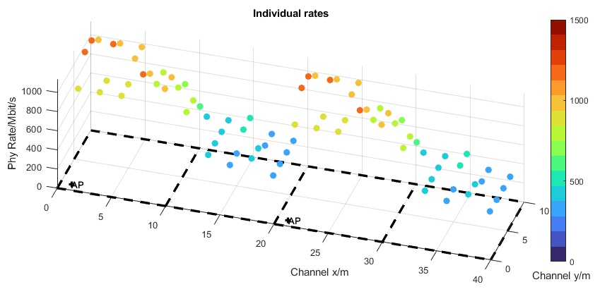
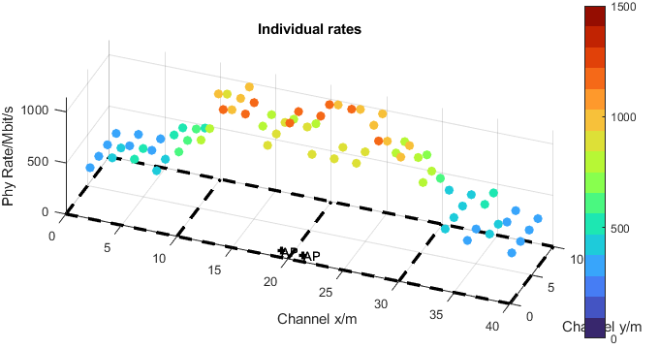
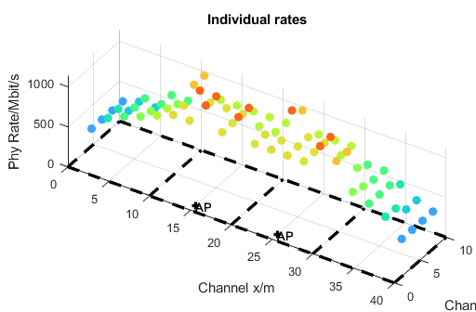
TDMA Individual Rates
20m Distance between APs
10m Distance
Back-to-Back

Slide 20
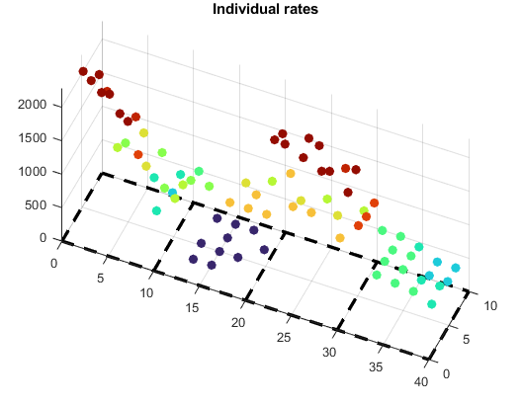
TDMA and C-SR ESS
(APs at 20m distance)
  Best possible mode is selected (w.r.t. sum rate)
  Highest C-SR sum rate may result in zero rate for some STAs

Slide 21
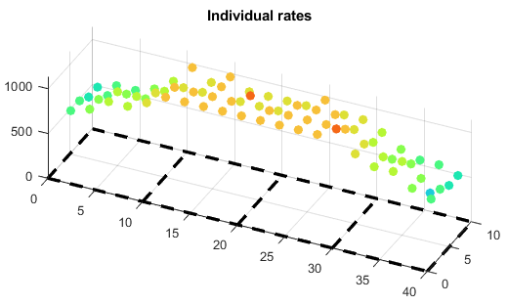
TDMA and C-SR ESS
(APs at 10m distance)
  Best possible mode is selected (w.r.t. sum rate)
  TDMA sum rate is always higher than C-SR sum rate

Slide 22
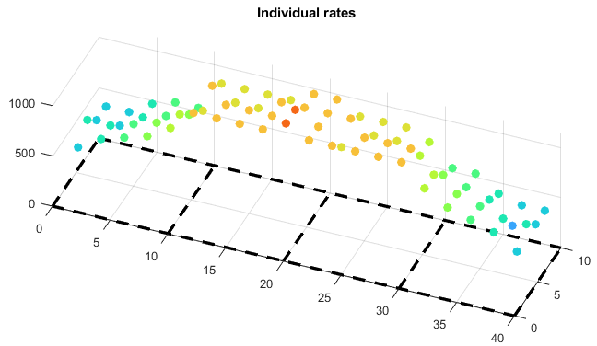
TDMA and C-SR ESS
(APs co-located)
  Best possible mode is selected (w.r.t. sum rate)
  TDMA sum rate is always higher than C-SR sum rate

