Slide 1
Flexible sub-7Ghz and mmWave Integration in IMMW
Date: 2023-11-06
Authors:
Name | Affiliations | Address | Phone | email
Yanchun Li | Huawei | Huawei Industrial Base, Bantian, Longgang District Shenzhen, 518129 |  | liyanchun@huawei.com
Jian Li
Chao He
Zhibiao Liang

Slide 2
Abstract
This contribution discusses the benefits of integrated mmWave and lower band for Wi-Fi.
mmWave and lower band integration by reusing 11be multi-link techniques can allow low complexity implementation and also utilize both band flexibly.

Slide 3
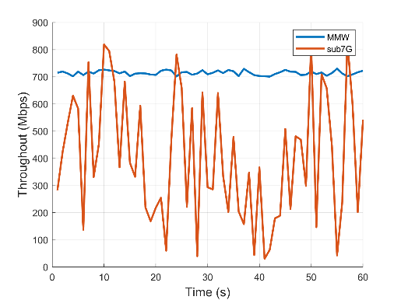
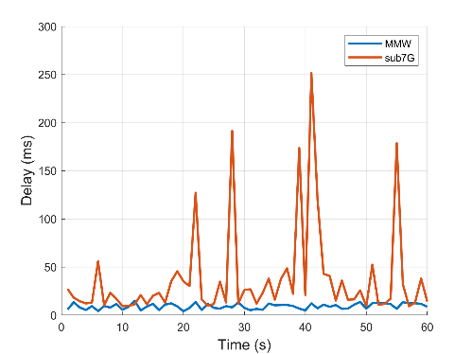
Use Cases for integrated mmW
Cloud XR
Stage Broadcast
mmW can provide a ultra-high rate high reliability link
stage
35m
MMW
MMW
Smooth experience without jitter
Dense spatial reuse
40m
Interactive VR(8K*8K@visual field
3D_120fps_12bit_24K) Requirements : throughout> 2.35Gbps, delay jitter< 10ms [1].
Requirements：throughout>200Mbps, delay jitter<20ms
[1] Mangiante, S., Klas, G., Navon, A., GuanHua, Z., Ran, J., & Silva, M. D. (2017, August). Vr is on the edge: How to deliver 360 videos in mobile networks. In Proceedings of the Workshop on Virtual Reality and Augmented Reality Network (pp. 30-35).

Slide 4
Sub 7GHz has high rate capability in PHY but very congested spectrum
IMMW allows WiFi STA to use mmWave spectrum altogether with existing sub-7GHz
Moderate BW allows attractive Tput capability while maintain an acceptable cost.
Rate in existing sub-7GHz and mmWave Specs.
 | Sub-7 GHz |  |  | IEEE 802.11 mmWave Specs
 | 11be |  |  | 11ad | 11aj |  |  | 11ay
 |  |  |  |  | CDMG PHY | CMMG PHY
BW | 160MHz | 320MHz | 320MHz NSS2 | 2.16GHz | 1.08GHz | 540MHz | 1.08GHz | 2.16GHz
Max. allowed Nss |  | 8 |  |  |  | 4 |  | 8
 |  |  |  |  |  | 64-QAM
Modulation |  | 4x OFDM |  | SC only (dropped OFDM mode in REVmd) | Control/SC/LP-SC | Control/SC/OFDM |  | SC only
Subc Num |  | 4x996 tone RU
MCS |  | 5/6, 4k-QAM |  |  | 13/16, pi/2-64-QAM |  |  | 7/8.pi/2-64-QAM
Theoretical Rate |  | 2.882Gbps | 5.6Gbps |  | 3.453Gbps@SC,NSS=1 | 1.876Gbps@SC,NSS=1 | 3.753Gbps@SC,NSS=1 | 8.085Gbps

Slide 5
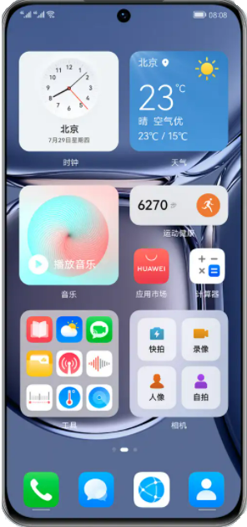
Opt.1 Benefits of reusing processing capability
mmW has low latency and low congestion. Unified PHY/MAC design allows sub-7GHz processing capability (e.g. FEC and/or FFT processing, etc), to be used by mmW. In dense environment, Tput can decrease more than 50% due to collision… In the case of congestion, the actual rate is far lower than the theory rate.
320MHz+320MHz bandwidth stitching in mmW can have higher realistic rate than 320MHz 2x2 MIMO.
Sub7G: interference exists between the two APs
IMMW: no interference between different rooms;
Narrow beamformed signal also eliminates interference between APs in same room
AP1
AP1
Sometimes, two rooms are close to each other, but a single AP cannot cover the two rooms. In this case, interference exists between the two APs.
STA1
AP2
STA1
IMMW: Millimeter wave has higher wall penetration loss.
AP2
STA2
STA2
[1] Naribole, S., Lee, W. B., & Ranganath, A. (2019, September). Impact of MU EDCA channel access on IEEE 802.11 ax WLANs. In 2019 IEEE 90th Vehicular Technology Conference (VTC2019-Fall) (pp. 1-5). IEEE.

Slide 6
Opt.2 Benefits of reusing processing power + simultaneous transmissions
Sub7G ensure UHR by multi-link in MAC layer
Sub-7GHz Link
Multi-Link
Sub7G
MMW
Sub7G
STA can support up to 4 streams in sub-7GHz.
So, STA has 4 spatial stream processing capability in baseband.
However, MIMO channel deficiency limits to practical stream number to 2.
STA allocate two streams to mmWave band.
Sub-7G
MMW
Sub-7G
Baseband processing unit
Baseband processing unit

Slide 7
Various ways to implement high throughput.
 | Opt.1a (Maximal reuse) | Opt.1b | Opt.2 | Opt.3 (High Tput)
Use Case | mmW and lower band (reuse HW, non-simultaneous) |  | MMW +sub 7 (reuse HW, simultaneous) | MMW (reuse design)
BW | 320MHz mmWave *2Nss | 640MHz mmWave (320MHz+320MHz BW stitching) | 320MHz*NSS2@sub-7GHz +640MHz mmWave | >2 GHz mmWave
Data Rate | 2.8Gbps | 2.8Gbps | 5.6Gbps (sub-7GHz) + 2.8Gbps (mmWave) mmW as plus | >10Gbps
Benefits | Interference-free Provide high MAC efficiency at mmWave band when lower band is over congested. |  | When low band can’t support 4 spatial streams, 2 chain baseband can be spared for mmWave. | Absolute rate advantage.
 | Limitations: only one of links is active at same time. |  | e.g. A MIMO 4x4:4ss PHY can be reconfigured to 2+2.

Slide 8
Conclusion
mmWave Wi-Fi can reuse the sub7G PHY processing capability in flexible way. It can allow attractive performance and experience while keep low cost.

