Slide 1
Consideration on UHR Relay Architecture
Date: 2023-11-08
Authors:
Name | Company | Address | Phone | Email
Kosuke Aio | Sony |  |  | Kosuke.Aio@sony.com
Yusuke Tanaka |  |  |  | Yusuke.YT.Tanaka@sony.com
Ryuichi Hirata |  |  |  | Ryuichi.Hirata@sony.com
Ken Tanaka |  |  |  | Ken.A.Tanaka@sony.com
Thomas Handte |  |  |  | Thomas.Handte@sony.com
Dana Ciochina |  |  |  | Dana.Ciochina@sony.com
Daniel Verenzuela |  |  |  | Daniel.Verenzuela@sony.com
Xia Qing |  |  |  | Qing.Xia@sony.com

Slide 2
Introduction
UHR SG defines Rate-vs-Range throughput improvement as scope [1].
Relay communication is effective for improving Rate-vs-Range throughput [2] – [5]
  Relay communication to STAs that cannot receive signals from AP is expected to enable communication between AP and STAs.
  Relay communication to STAs with low SNR from AP is expected to improve throughput by improving SNR of STAs.
This contribution reviews the current standards/products related to relay communication and discusses the next-generation relay architecture.

Slide 3
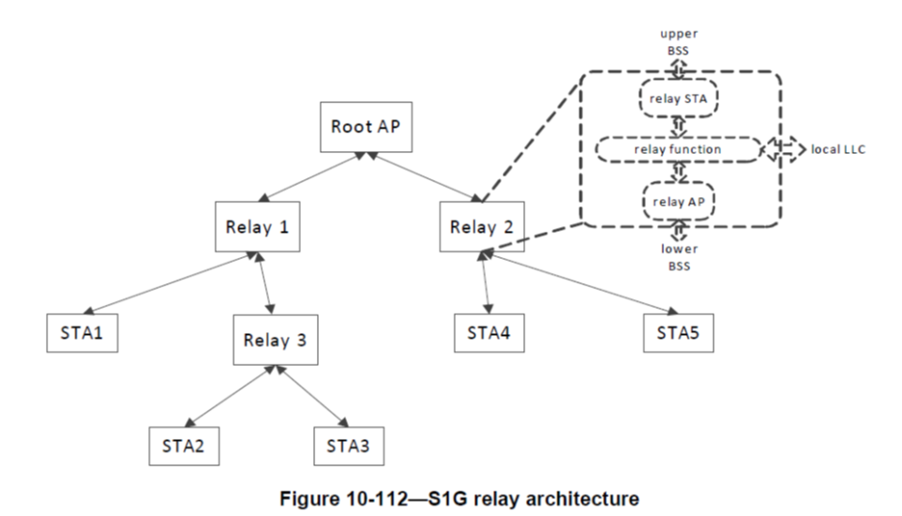
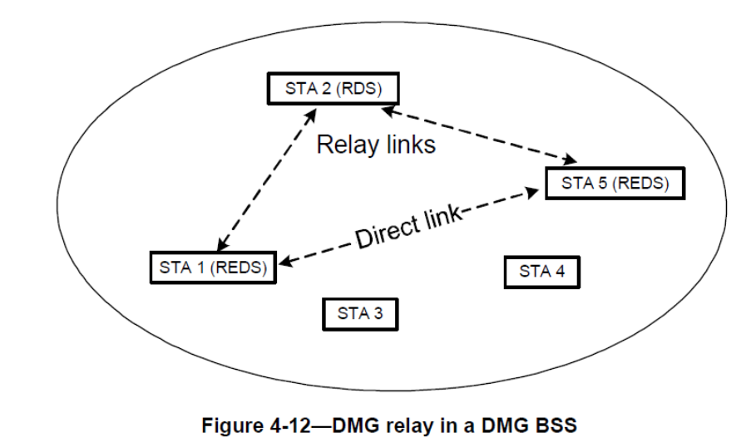
Recap on Relay Communication (1/3)
IEEE802.11 spec
  WDS (Wireless Distributed System)
    Enable wireless communication between APs (Ad-hoc mode)
  Mesh (11s)
    Relay operation and routing to build a mesh network between APs/STAs
  DMG Relay (11ad)
    Operation for 60GHz band wireless relay (Link Switching, Link cooperation)
  S1G Relay (11ah)
    Operation for sub-1GHz band wireless relay (Implicit Ack, TXOP sharing)

Slide 4
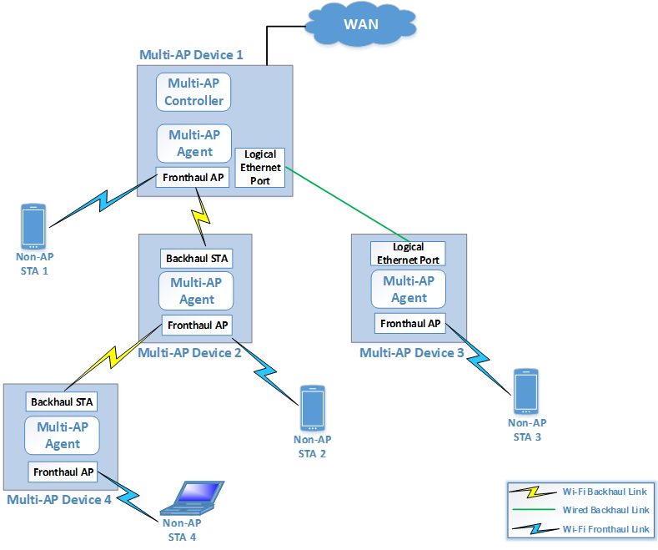
Recap on Relay Communication (2/3)
Wi-Fi Alliance (Products)
  EasyMesh
    Enables wireless relay of multiple installed in-home APs.
    Define routing and network management by upper layers (PHY/MAC layers aren’t target of this spec).
    AP for wireless relay has both STA Entity and AP Entity.
    There are lot of products of EasyMesh-like AP.

Slide 5
Recap on Relay Communication (3/3)
Relay type
  “Full-Duplex” vs. “Half-Duplex”
    FD (Full Duplex) : Can transmit Fronthaul/Backhaul simultaneously
      Both In-band and Out-band
    HD (Half Duplex) : Cannot transmit Fronthaul/Backhaul simultaneously
  “Amplify and Forward” vs. “Decode and Forward”
    AF (Amplify and Forward) : Received signals are amplified and relayed without decoding
    DF (Decode and Forward) : Received signals are decoded, re-coded, amplified and relayed
Enabled relay type for each spec/feature
Spec | Feature | FD-AF | FD-DF | HD-AF | HD-DF
802.11 | WDS |  |  |  | 〇
 | Mesh |  |  |  | 〇
 | DMG Relay | 〇 |  |  | 〇
 | S1G Relay |  | 〇 |  | 〇
WFA | EasyMesh |  | 〇 |  | 〇

Slide 6
Future Directions of Relay Architecture
Since coverage extension with high reliability is required for next generation Wi-Fi, it is desirable to decode once at the relay node.
  AF (Amplify and Forward) accumulates noise, making it difficult to improve reliability.
Currently, many standards/products can be configured for Out-Band Full-Duplex (FD) and we should consider on this type.
  In S1G Relay and EasyMesh, it is assumed that the relay node has both STA Entity and AP Entity, and each can be configured with a different channel (band).
  The relay node can be just after the MAC SAP (for S1G Relay) or in the DS (Distributed System) (for Easy Mesh). In both cases, the relay operation is performed after all processing at MAC layer is completed.
  Of course, a more simplified relay node could be introduced.
Notes:
変化点は？

Slide 7
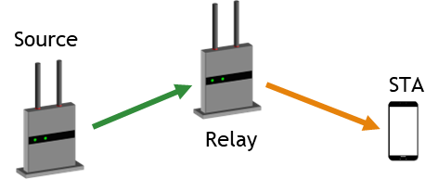
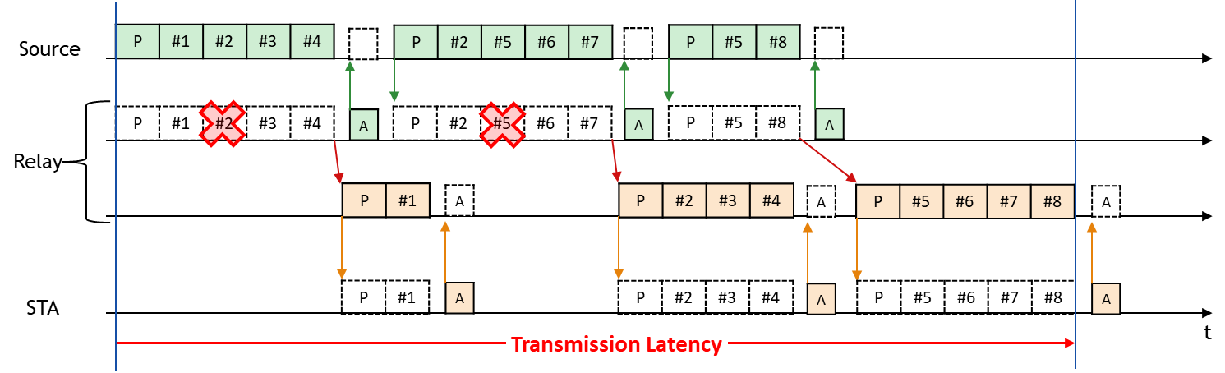
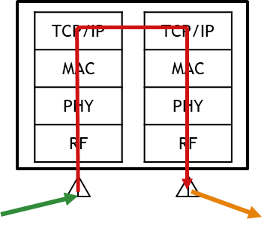
Issues of Current Relay Node
When relaying packets after processing in MAC layer, throughput may be reduced because some packets are buffered in the "Reordering Buffer".
  When some packets are lost on the backhaul, packets after the lost packet are buffered in Reordering Buffer of the relay device. (packets before the lost packet are transferred to STA).
  In this case, even if the channel of Fronthaul link is idle, sufficient relay transmission is not performed, resulting in a decrease in throughput (longer transmission time).
: Backhaul Link
: Fronthaul Link

Slide 8
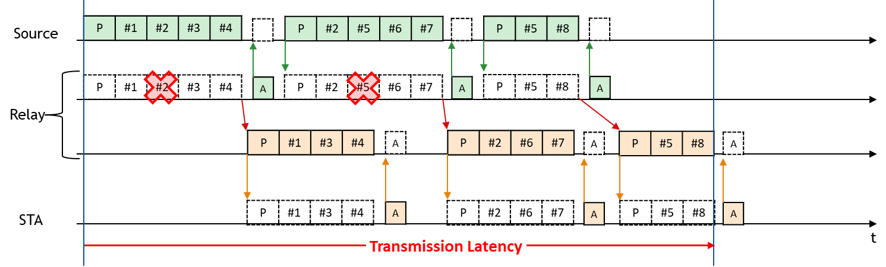
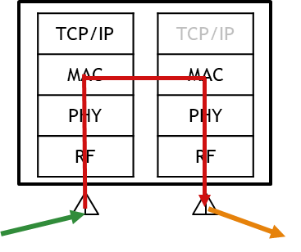
New Architecture: Relay MLD Node
Relay MLD Node: Newly defined node that relays before Reordering Buffer using MLO Architecture.
  Relay MLD Node: MLD with both STA Entity and AP Entity
  By relaying in the middle of MAC layer to skip Reordering Buffer, packets after the lost packet in Backhaul can be relayed sequentially. It is expected to avoid throughput degradation during relay communication.
  Further reduction of latency may be expected by skipping some blocks (Encryption/Decryption, Linux layer, and so on).
: Backhaul Link
: Fronthaul Link

Slide 9
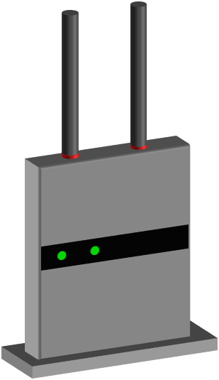

Simulation Parameters
Evaluated the performance of Relay MLD Node
Scenario
: Backhaul Link
: Fronthaul Link
Parameter (Data)
Source
Packet Size | 1500 byte
Num. of Packets | 280
Max Aggregation Size | 256
PPDU | HE, short Guard Interval
MCS | Fix: MCS11 (1024QAM 5/6)
BW | 80MHz
Tx Spatial Stream | 2
Packet Error Rate | From 0% To 10% For both Backhaul/Fronthaul
STA
Relay
Full Duplex : Backhaul & Fronthaul are set to different channel and can transmit simultaneously.
Relay node can start transmission after receiving a MPDU.
Same parameters of Backhaul/Fronthaul.
Both Source/Relay have already obtained TXOP.
Metric
Effective throughput is calculated from the time required to complete all packet transmissions (Transmission Time)
Normal Relay : Only successfully acquired packets before the lost packet in backhaul are relayed.
MLO Relay : All successfully acquired packets in backhaul are relayed.

Slide 10
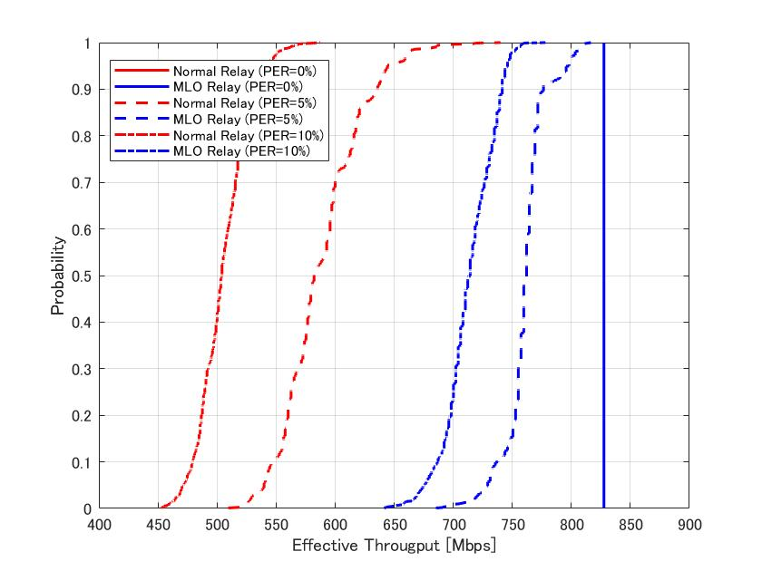
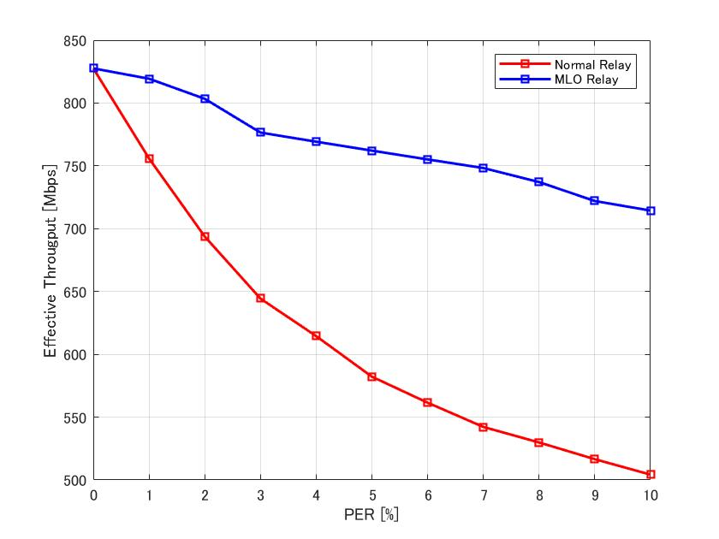
Simulation Results
CDF of Effective Throughput
50%-tile Effective Throughput vs PER
x1.42
x1.42
x1.42
Under PER=10% environment, enabling relay transmission without Reordering Buffer is expected to improve effective throughput by nearly 1.4x.

Slide 11
Discussion Points
Relay MLD Node architecture needs further study
  We only considered about Reordering Buffer here, but there are various trade-offs depending on the point of relay communication. For example
    Encryption/Decryption
      If Relay MLD Node can skip Encryption/Decryption, the processing time can be shortened, and the transmission delay may be reduced.
      However, an association between Source Node and STA is required, so an additional association process will need to be defined.
    Scoreboard
      If Relay MLD Node can have a Scoreboard, retransmission processing through the Relay Node can be implemented.
      However, Relay MLD Node must hold the relayed packets for a certain period.
Spec impact of an MLD having both AP Entity and STA Entity also needs to be considered.

Slide 12
Summary
We reviewed the current standards/products related to relay communication and discusses the for next-generation relay architecture.
  From spec/product aspects both, “Out-band Full Duplex” and “Decode and Forward” relay communication will be major for next generation Wi-Fi.
We proposed new relay architecture: Relay MLD node and evaluated the performance.
  By skipping Reordering Buffer, effective throughput was improved by nearly 1.4x under PER=10%.
  There are many future discussion points about the detail architecture.

Slide 13
Reference
[1] Laurent Cariou (Intel), “UHR proposed PAR,” 23/0480r3, July 2023
[2] Rui Cao (NXP), “UHR rate-vs-range enhancement with relay,” 22/1980r1, Nov 2022
[3] Dongguk Lim (LG Electronics), “Features to consider for efficient Relay operation,” 23/1138r1, July 2023
[4] Serhat Erkucuk (Ofinno), “Relaying for Low Latency Traffic in UHR,” 23/1146r1, July 2023
[5] Kiseon Ryu (NXP), “UHR relay follow up,” 23/1175r0, Aug 2023

Slide 14
Appendix
BER Analysis (Backhaul BER (256QAM, AWGN, LDPC))
AF Relay
BER < 1e-9 at SNR >= 35dB
DF Relay
BER < 1e-9 at SNR > 25

