Slide 1
EC report for sending P802.11-2020/Cor2 to SA ballot
Date: 2023-11-17
Authors:

Slide 2
WG ballot series details
P802.11-2020 Cor2 Ballot Series | LB278 (D1.0)
Approve | 272
Disapprove | 1
Abstain - Lack of expertise | 25
Invalid (disapprove w/o comment) | 0
Invalid abstain - Lack of time | 2
In valid abstain – Other | 1
Approval percentage (>75%) | 99.63%
Disapproval percentage | 0.37%
Abstain percentage (<30%) | 4.67%
Pool = Voters - Ex-officio | 535
Return rate (>50%) | 56.16%
Ballot duration (days) | 30
Ballot open | 25-Sep-23
Ballot close | 25-Oct-23

Slide 3
LB 278 comments
1 comment received from the single disapprove voter
CID | Commenter | Page | Comment | Proposed Change | Resn Status | Resolution
1 | Mark RISON | 1.39 | It's not an element, it's an ANQP-element, and we don't have multiple names for them either, it's just the "EBCS ANQP-element". Similarly the field is "Info ID" not "Information Identifier (ID)". And it's obvious it's a number and we didn't use "Number" for Cor 1 (but we did refer to the amendment being corrected). | Change the title of the corrigendum to: Correct IEEE 802.11bc Assignment of Info ID for EBCS ANQP-element | J | REJECTED The comment refers to the title of the corrigendum. The title is defined in the PAR and thus out of scope.

Slide 4
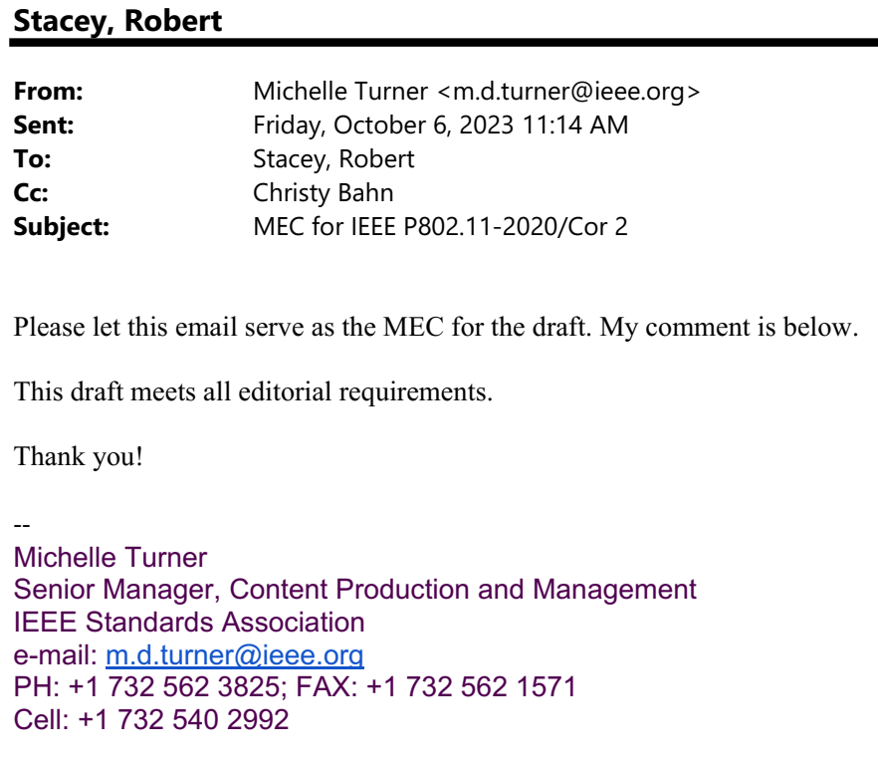
IEEE SA Mandatory Editorial Coordination
802.11 Mandatory draft review (MDR) not needed
Single page of technical content
Prepared by WG editor familiar with editorial requirements
MEC review did not find any issues

Slide 5
P802.11-2020/Cor2 Timeline
 | Open | Close
Initial WG ballot (D1.0) | Sept 25, 2023 | Oct 25, 2023
EC Approval for SA Ballot | Nov 17, 2023
Initial SA Ballot (D1.0) | Nov 20, 2023 | Dec 20, 2023 (30 days)
EC to RevCom (pre-post to meet 19 Dec 2023 deadline) | Jan 9, 2024
RevCom/SASB | Jan 30, 2024/Feb 2024

Slide 6
EC motion: P802.11-2020/Cor 2 D1.0 to SA Ballot
Motion
Approve sending IEEE P802.11-2020/Cor2/D1.0 to SA Ballot
See https://mentor.ieee.org/802.11/dcn/23/11-23-1959-01-0000-ec-report-p802-11-2020-cor2-to-sa-ballot.pptx for supporting documentation
Moved: Dorothy Stanley
Seconded: Jon Rosdahl
WG11 report to EC: (Y/N/A) 117/0/13
WG11 to SA ballot: (Y/N/A) 111/0/10
WG11 PAR re-affirm: (Y/N/A) 116/0/9

