Slide 1
Coordinated R-TWT for Multi-AP scenarios - Follow up
Date: 2024-1-16
Authors:
Name | Affiliation | Address | Phone | Email
Liuming Lu | OPPO |  |  | luliuming@oppo.com
Chaoming Luo
Liangxiao Xin
Ning Gao
Yapu Li
Liuming Lu (OPPO)

Slide 2
Introduction
11be has specified R-TWT for the delivery of latency-sensitive traffic in one BSS, But
The benefit of R-TWT is impacted by OBSS interferences due to lack of the coordination of R-TWT operation between APs in OBSS scenario.
For 11bn it is appropriate time to extend R-TWT in one BSS to R-TWT in OBSSs, and coordinated R-TWT has been introduced during the UHR discussion.
11bn will focus on the specification of Ultra High Reliability capability for both an isolated Basic Service Set (BSS) and overlapping BSSs.
The function of Coordinated R-TWT is not limited to a mechanism for the delivery of latency-sensitive traffic, furthermore it can be considered as a tool for the coordination of multi-AP operation to avoid or reduce OBSS interferences and increase the efficiency of communication in OBSS scenario.
This contribution focus on how to improve the specification of coordinated R-TWT as a tool not only for the delivery of latency-sensitive traffic but also for multi-AP coordination.

Slide 3
Recap
11be has specified R-TWT operation:
“R-TWT operation enables the STAs in a BSS to use enhanced medium access protection and resource reservation mechanisms for delivery of latency sensitive traffic.”
In [2-4] we have introduced two types of Coordinated TWT in OBSS scenario
Coordinated R-TWT Type 1 (Half-Coordinated )
The coordinated AP and its associated STAs protect the frame exchanges in BSS of the coordinating AP during Coordinated R-TWT SPs (such as transmission with limited TX. power)
Coordinated R-TWT Type 2 (Fully-Coordinated )
The member STAs exchange frames with their associated APs by the scheduled coordinated transmission scheme during Coordinated R-TWT SPs
The coordinated transmission schemes may include C-TDMA/C-SR/C-MU-MIMO/C-Beamforming etc.

Slide 4
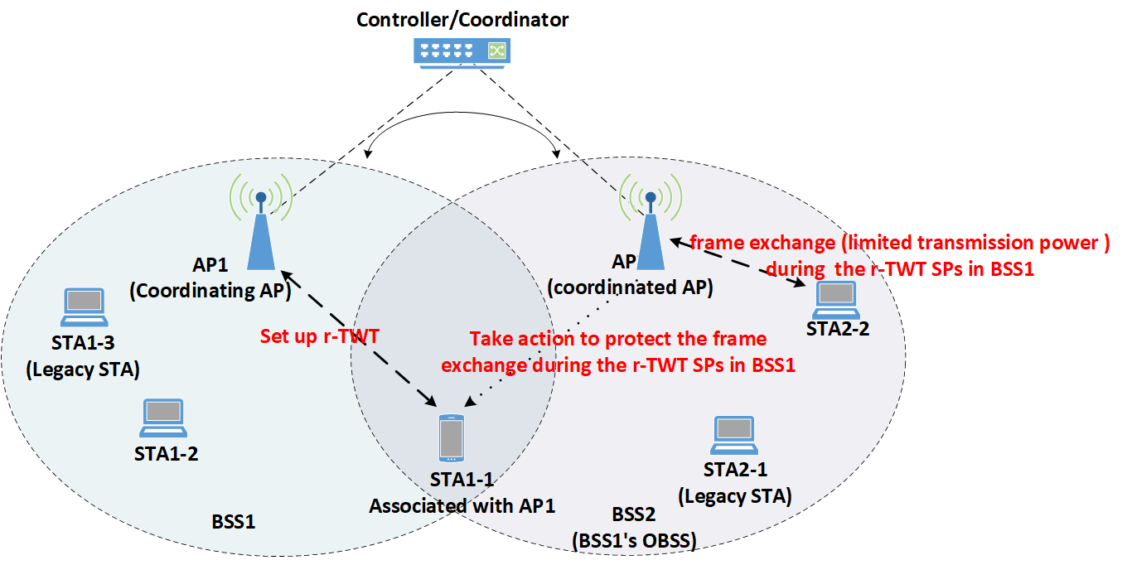
Coordinated R-TWT Type 1
The R-TWT schedule information is shared among APs, for example:
AP1 in BSS1 shares the information for R-TWT SPs with member STAs in BSS1 with the AP2 in BSS2. AP2 can regard the R-TWT schedule as OBSS R-TWT schedule since there may be no member STAs in BSS2 for the R-TWT SPs.
AP2 announces the R-TWT schedule information to its associated STAs
AP2 and its associated STAs also use enhanced medium access protection during the R-TWT SPs
Ensure low-latency QoS Data frames to be first delivered in BSS1 during SPs
Reduce impact on transmission efficiency in BSS2
Spatial reuse can be considered to allow the medium to be reused during SPs.
the allowed transmit power of AP2 and their related associated STAs can be predetermined

Slide 5
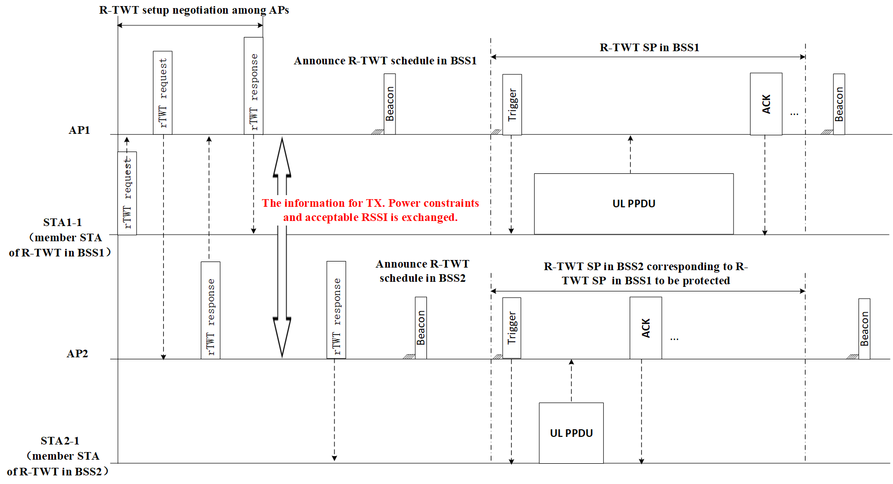
Signaling for Type1 Coordinated R-TWT
Coordinated R-TWT setup is negotiated among APs
STA1-1 send a request for coordinated R-TWT setup, and AP1 also send this request to AP2.
AP2 can accept or reject the R-TWT request from BSS1
The information for TX. Power constraints and acceptable RSSI of AP1 and STA1-1 is exchanged.
After successful coordinated R-TWT setup
STA1-1 exchanges frames initiated by AP1 during R-TWT SP in BSS1 with allowed TX. power.
AP2 initiates frame exchange with the STAs that satisfy the TX. constraints with allowed TX. power during R-TWT SP in BSS2 corresponding to R-TWT SP in BSS1 to be protected
Figure. Signaling for Type1 Coordinated R-TWT

Slide 6
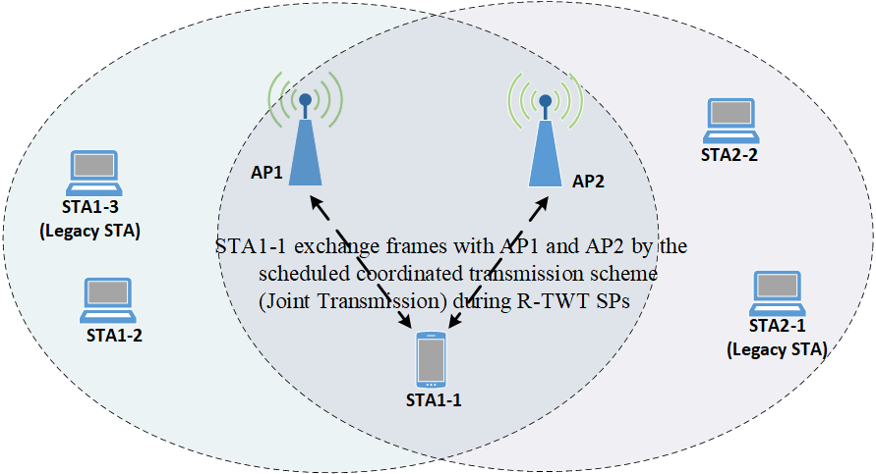
Coordinated R-TWT Type 2
The member STAs exchange frames with their associated APs by the scheduled coordinated transmission scheme during Coordinated R-TWT SPs, for example:
AP1 and AP2 support one or more of coordinated transmission schemes, such as C-TDMA/C-SR/C-MU-MIMO/C-Beamforming etc.
STA1-1 has set up Type2 Coordinated R-TWT membership with the scheduled coordinated transmission scheme (such as C-TDMA)
STA1-1 exchanges frame with AP1 and/or AP2 by the scheduled coordinated transmission scheme during R-TWT SPs

Slide 7
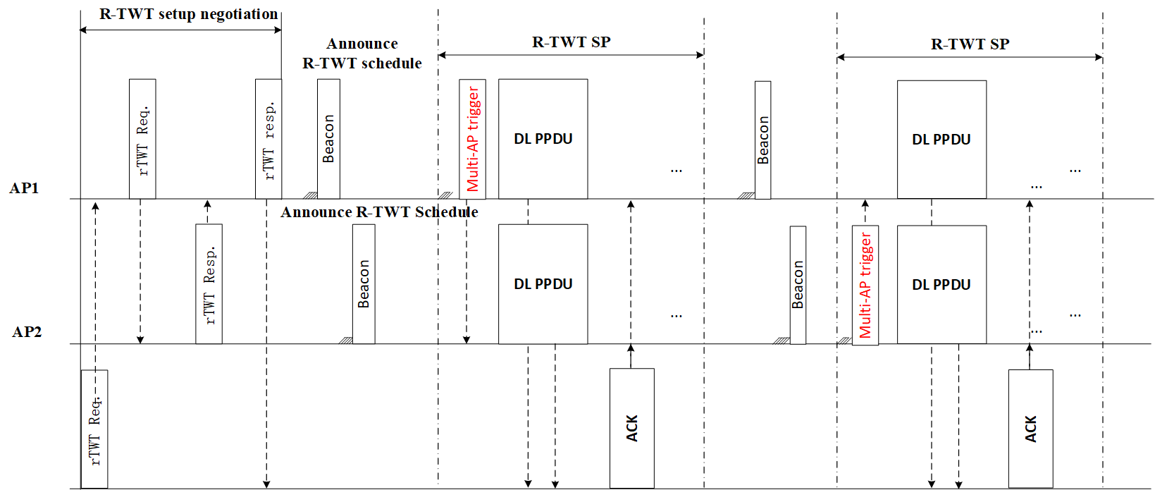
Signaling for Type2 Coordinated R-TWT
Coordinated R-TWT setup is negotiated among APs
STA1-1 send a request for coordinated R-TWT setup, and AP1 also send this request to AP2.
AP2 can accept or reject the R-TWT request from BSS1
the scheduled coordinated transmission scheme and related transmission parameters are exchanged.
After successful Coordinated R-TWT setup
If obtaining the TXOP any AP (AP1 or AP2) initiate the frame exchanges with the R-TWT member STA by the scheduled coordinated transmission scheme during R-TWT SPs
Figure. Signaling for Multi-AP operation Type2 (tight coordination)

Slide 8
Overall Summary
Qualitative overview of the different types of Coordinated R-TWT
Coordinated R-TWT Types | Requirements | KPI for delivery of low latency traffic | Medium Usage efficiency | interference management
Coordinated R-TWT Type 1(Half-Coordinated ) | coordinated transmission schemes (such as C-TDMA/C-SR/C-MU-MIMO/C-Beamforming) is not needed to be supported. | High | Medium | Medium
Coordinated R-TWT Type 2 (Fully-Coordinated ) | At least one of coordinated transmission schemes (such as C-TDMA/C-SR/C-MU-MIMO/C-Beamforming) needs to be supported | High | High | High
A combination of different types of Coordinated R-TWT can also be used:
  To minimize the latency for delivery of low latency traffic
  TO maximize the medium usage efficiency

Slide 9
Summary
Coordinated R-TWT is suggested to provide higher reliability for delivering low latency traffic and/or the scheduled coordinated transmission scheme(s) including enhanced medium access protection for reserved resource during scheduled time across different overlapping BSSs.
Two types or modes of coordinated R-TWT can be considered based on different levels of requirements for interoperation among APs
(1) Type1 Coordinated R-TWT
The coordinated AP takes actions to protect the frame exchange during the scheduled SPs in BSS of the coordinating AP (such as transmission with limited TX. power)
TX. Power constraints and acceptable RSSI for related STAs are negotiated among APs for SP scheduling.
(2) Type2 Coordinated R-TWT
The member STAs exchange frames with APs by the scheduled coordinated transmission scheme during scheduled SPs
the scheduled coordinated transmission scheme and related transmission parameters are exchanged for SP scheduling

Slide 10
SP #1
Do you agree to define in 11bn a mode or type of coordinated R-TWT to provide higher reliability for delivering low latency traffic including enhanced medium access protection for reserved resource during scheduled time among overlapping BSSs?

Slide 11
SP #2
Do you agree to define in 11bn a mode or type of coordinated R-TWT to provide higher reliability for the scheduled coordinated transmission scheme(s) including enhanced medium access protection for reserved resource during scheduled time among overlapping BSSs?
Note: the scheduled coordinated transmission scheme(s) is TBD

Slide 12
SP #3
Do you agree to define in 11bn a negotiation mechanism among APs for coordinated R-TWT setup?
Note: the parameter to be negotiated is TBD.

Slide 13
Reference
[1] IEEE 802.11be Draft 5.0
[2] https://mentor.ieee.org/802.11/dcn/23/11-23-0046-02-0uhr-multi-ap-coordination-for-low-latency-traffic-delivery-usage-scenarios-and-potential-features.pptx
[3] https://mentor.ieee.org/802.11/dcn/22/11-22-1556-01-0uhr-multi-ap-coordination-for-low-latency-traffic-delivery.pptx
[4] https://mentor.ieee.org/802.11/dcn/22/11-22-1899-00-0uhr-multi-ap-operation-for-low-latency-traffic-delivery-follow-up.pptx
[5] https://mentor.ieee.org/802.11/dcn/22/11-22-1809-00-0uhr-a-perspective-on-uhr-features-for-operator-residential-deployments.pptx
[6]https://mentor.ieee.org/802.11/dcn/23/11-23-0297-00-0uhr-rtwt-for-multi-ap.pptx
[7] https://mentor.ieee.org/802.11/dcn/23/11-23-1499-00-0uhr-proposed-amendments-for-multi-ap-coordination-language-in-eht-sfd.pptx
Liuming Lu (OPPO)

