Slide 1
Information sharing between layers
Date: 2023-12-18
Authors:

Slide 2
Abstract
In this contribution, we discuss information sharing between layers.
Especially higher layer (e.g. Application layer) controls PHY layer according to information from PHY layer (e.g. measurement results/statistics) .

Slide 3
Background 1
UHR PAR [1]
  Main KPI
  increasing throughput by 25% in at least one Signal to Interference and Noise Ratio (SINR) level (Rate-vs-Range).
  reducing latency by 25% for the 95th percentile of the latency distribution.
  reducing MAC Protocol Data Unit (MPDU) loss by 25%.
  It is worth considering new approach and idea to achieve this goal.

Slide 4
Background 2
TGbf is currently developing an interface to pass CSI (channel state information) to higher layers. The purpose is to sense behavior of something by analyzing CSI
Specific direction is to make AI/ML learn combination of the CSI and features of objects in an area of interest, estimating the objects with constructed AI/ML model.
It means that CSI is one of PHY layer information and it is only used within PHY/MAC layer in the past though, PHY layer related information will be utilized in higher layer (e.g. Application layer) for broad purpose and AI/ML will the key in the future.

Slide 5
Motivation 1
MLO (Multi-Link Operation) is being specified in EHT.
  Bundling multiple links will realize high-capacity communication.
  Selecting non-congested link among multiple links will realize low latency communication especially for small size packet.
In most cases this kinds of link selection will be implemented within PHY/MAC layer by utilizing PHY layer measurement results/statistics. This kind of handlings are expected to be proprietary, not to be open. Manipulation from higher layer by third party is not allowed, it may be low flexible.

Slide 6



Motivation 2
On the other hand, there is a request for 802 networks to be more open and AI-driven function leading better performance with limited cost of HW [2]
There is some open innovative projects like OpenWiFi[3], OpenWRT[4], dd-wrt[5] exploring better function under limited open information.
Making more “interfaces” which open more PHY layer information (e.g. measurement results/statistics) to higher layer may produce breakthrough with AI/ML in manipulating PHY layer (e.g. link selection).

Slide 7
Objective
Open more PHY layer information ( e.g. measurement results/statistics) to higher layer.
It is possible that higher layer (e.g. Application layer) manipulates PHY/MAC layer function ( e.g. link selection ) according to PHY layer information provided that PHY/MAC layer delegate some proper function to higher layer.
With this approach, it may become possible to accommodate more various applications that has different traffic requirement running on a STA. It means possibility to ensure good performance for each applications on the STA in some scenario.

Slide 8
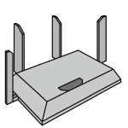

Scenario1
  Which application traffic should be mapped to which link ?
  Higher layer decide it according to PHY information.
Signal Quality
STA
Good but congested
Link1
AP
APP1
APP2
APP3
Link2
Application
Medium
AI/ML
Bad
Link3
  map an application to an appropriate link
statistics info
of Lower layer
control how to use
Lower layer resources
Link1
AP
Link2
PHY・MAC
STA
Link3
STA

Slide 9
Scenario2
  Higher layer changes application traffic characteristics according to PHY information
Signal Quality
STA
Good
Link1
AP
APP1
Application
Bad
Link2
AI/ML
  change streaming bit rate according to PHY statistics
statistics info
of Lower layer
change application
traffic characteristics
AP
Link1
PHY・MAC
STA
Link2
STA

Slide 10
Scenario 3
STAs PHY layer information is sent to peer APs higher layer and APs higher layer utilizes it to perform Multi-AP coordination.
Some Multi-AP related contribution[6, 7] shows that Coordinated AP collects link quality information from Shared APs and STAs to evaluate interferences and control link characteristics (power, MCS etc).
Coordinator AP
Coordinator AP collects
PHY layer statistics info and application traffic requirements of each STA
Shared AP
Perform coordination
according to collected info.
STA

Slide 11
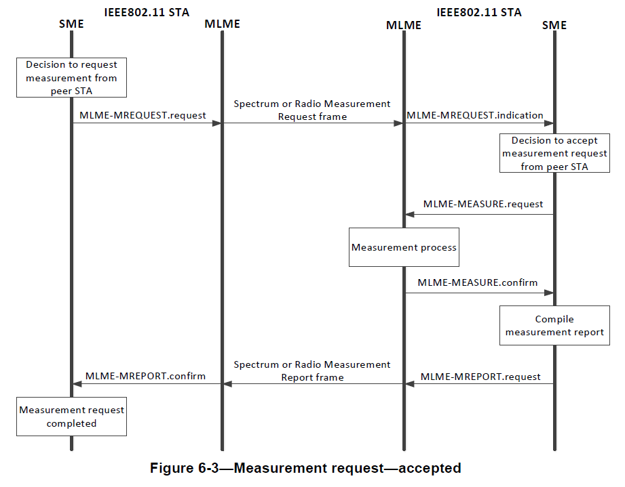
Existing PHY information shared to SME
Gathering some PHY layer statistics
information of peer STA is
already specified in Amendment 11k.
Our intention is to
Use these “legacy” measurement technique effectively,
Extend kinds of PHY measurement results/statistics which are shared to SME,
Use STAs’ PHY measurement results/statistics not only for
peer other STA but also for STA itself, so that its higher layer (e.g. Application layer) manipulates PHY layer.
(cited from IEEE802.11-2020)

Slide 12
Summary
Use “legacy” as possible as effectively and proactively,
measurement technique like 11k,
Extend kinds of PHY layer measurement results/statistics whatever possible,
Get PHY layer measurement/statistics of STA itself and utilizes those at higher layer processing within the STA to control PHY layer,
Explore possibility for higher layer to use AI/ML for controlling PHY layer provided that PHY/MAC layer delegate some proper function to higher layer
will be helpful to develop UHR.

Slide 13
Reference
[1] 11-23-0480r3 UHR proposed PAR
[2] 11-22-0460r3 Making the Case for Open, Softwarized, Data-Driven 802.11 Networks
[3] https://telecominfraproject.com/openwifi/
[4] https://openwrt.org/start
[5] https://dd-wrt.com/
[6] 11-23/1832r0 Multi-AP Coordinated Spatial Reuse
[7] 11-23/1990r1 Multi AP Transmissions: On the Link Quality Metric

