Slide 1
Impact of Tx EVM on MIMO Detection
Date: 2024-01-10
Authors:
Name | Affiliations | Address | Phone | email
Genadiy Tsodik | Huawei |  |  | Genadiy.tsodik@huawei.com
Shimi Shilo
Doron Ezri
Yoav Levinbook
Oded Redlich

Slide 2
Background
MIMO techniques are widely used in wireless systems (e.g. WLAN) to achieve higher spectral efficiency and increase the throughput
In order to exploit the maximum gain of MIMO transmissions, nonlinear (near ML) detection is often applied at the receiver side, as it significantly outperforms linear detection
However, in practice nonlinear detection is sensitive to RF impairments and requires a higher Tx EVM in order to achieve the desired performance
Strong impairments may have a significant impact on the performance of nonlinear detectors, such that in some cases linear detection outperforms nonlinear detection
We look into this issue in order to understand what may be done to ensure WLAN receivers can employ near ML detectors to yield a large performance gain (as expected from theory)

Slide 3
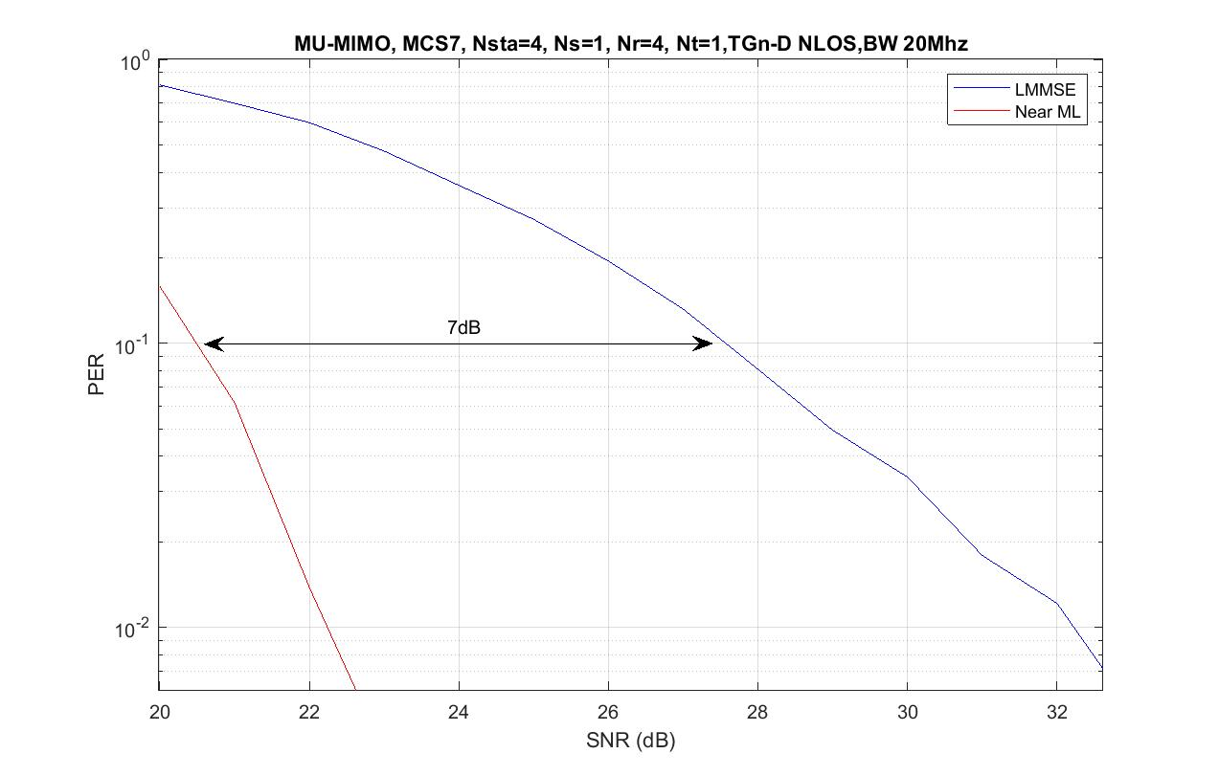
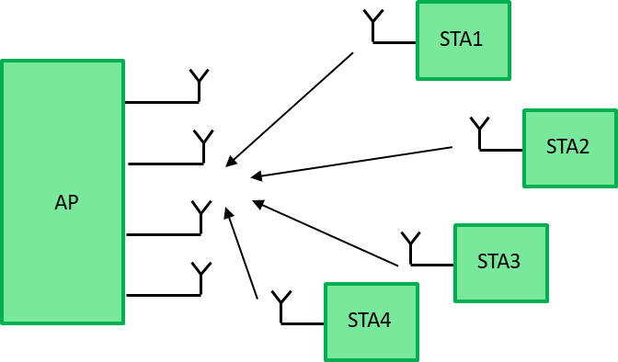
Expected Gain of Non-Linear Decoder
We expect a significant gain that can be achieved by a nonlinear detector in case of MIMO transmission (MU or SU)
It is clear that near-ML detection is much more complex, but one may consider this higher complexity worth the effort in order to achieve a significant performance improvement

Slide 4
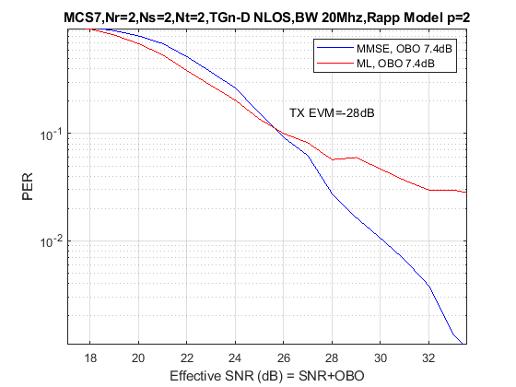
Practical Scenario
In practice, RF impairments that cause a Tx EVM degradation lead to completely different results
We simulated MIMO detection when we apply the OBO that needed to meet standard Tx EVM requirement (OBO = 7.4dB)
This misconception may make non-linear detection less attractive and prevents achieving higher efficiency in WLAN communication
MMSE outperforms ML!
x-axis adjusted to SNR+OBO

Slide 5
Tx EVM Impact on MIMO performance
The spec mandates maximal Tx EVM per MCS – for example you must have Tx EVM lower (better) than -27dB for MCS 7
How you get there (better RF, higher output back-off) is up to each vendor
So let’s try to analyze the impact of Tx EVM on MIMO detection
Let’s assume for simplicity that instead of the transmitter transmits where and is the EVM power
So the received signal with Tx EVM is

Slide 6
Short Proof of the Tx EVM Impact
The Covariance of the colored noise is of course
And the ML receiver for this model involves whitening with inverse Cholesky of
When the Tx EVM component is more dominant, i.e. when we get
So in this case the optimal (EVM-aware) MLD coincides with linear detection
$${\tilde{s}}_{ML}=\underset{s∈\text{QA}{\text{M}}^{M}}{argmin}{\left(y−Hs\right)}^{∗}{\left(σ^{2}HH^{∗}\right)}^{−1}\left(y−Hs\right)=\underset{s∈\text{QA}{\text{M}}^{M}}{argmin}{\left\|H^{−1}y−s\right\|}^{2}$$

Slide 7
How can we resolve this issue?
As we showed in the previous slide, the problem happens when the Tx EVM component is stronger than the white noise in the covariance of the colored noise
And we observed this issue when we used an OBO that meets standard Tx EVM requirements
Following this understanding, we may assume that standard Tx EVM requirement better fits linear detection in case of MIMO transmission
Thus, operating with OBO that meets standard Tx EVM requirement may limit MIMO performance when non-linear detection is employed
So maybe we need to set OBO differently when near-ML detection is applied at the receiver?

Slide 8
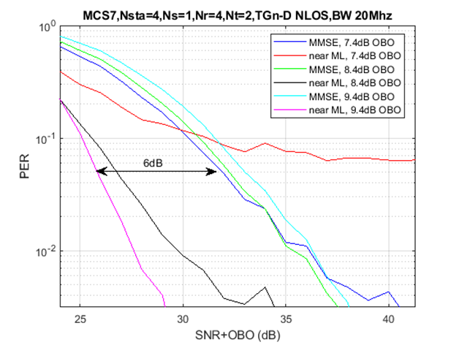
Simulation With Larger OBO
We simulated the same scenarios, where we use a larger BO than that needed to meet standard Tx EVM requirements
In particular we compared again the results of nonlinear detection with those of MMSE
We can see that the impact of OBO on PER in case of MMSE detection is very small (although increasing OBO may improve MMSE as well)
But near-ML is impacted significantly
We can see that near ML detection outperforms MMSE detection by 6dB (including consideration of the reduced power due to higher BO)

Slide 9
Summary
While in theory nonlinear MIMO detection is superior to linear detection, in practice it suffers from the impact of RF impairments
An additional Tx EVM improvement of 1-2dB may result in PER gain of many dBs for a MIMO transmission (e.g. 6dB gain as shown on the previous slide)
We may significantly improve performance if we adjust the Tx EVM for the specific MIMO scheme and the detector type being employed by the receiver

