Slide 1
Impact of Tx EVM on MIMO Detection
Date: 2023-10-12
Authors:
Name | Affiliations | Address | Phone | email
Genadiy Tsodik | Huawei |  |  | Genadiy.tsodik@huawei.com
Shimi Shilo
Doron Ezri
Yoav Levinbook
Oded Redlich

Slide 2
Background
MIMO techniques are widely used in wireless systems (e.g. WLAN) to achieve higher spectral efficiency and increase the throughput
In order to exploit the maximum gain of MIMO transmissions, nonlinear (near ML) detection is often applied at the receiver side, as it significantly outperforms linear detection
However, in practice nonlinear detection is sensitive to RF impairments and requires a higher Tx EVM in order to achieve the desired performance
  Strong impairments may have a significant impact on the performance of nonlinear detectors, such that in some cases linear detection outperforms nonlinear detection
We look into this issue in order to understand what may be done to ensure WLAN receivers can employ near ML detectors to yield a large performance gain (as expected from theory)

Slide 3
Background – Tx Power
We assume that in most devices the max available power for high MCS values is set such that Tx EVM matches the standard requirement (or close to it) for single-stream Tx in an AWGN channel
However, the Tx EVM required for MIMO operation is usually higher than that required for single stream transmission (due to sensitivity of the non-linear components)
Devices can indicate the power headroom, but the relationship with their Tx EVM isn’t clear
How should the transmit power be set accurately, in case of MIMO transmission, such that the nonlinear components are reduced?

Slide 4
MIMO Performance with Standard Tx EVM
We simulated the MIMO performance using the same Back-Off (BO) required to match the standard Tx EVM
In order to account for the impact of a larger BO (for example lower Tx power) we use SNR+OBO instead of SNR to compare between the different BO values
Simulation parameters are:
  The required BO is 7.4dB
  MU-MIMO 4x4, PA model – RAPP2
  Near ML: K-Best Detection
As we can see in the figure on the right,
at the BO value of 7.4dB, MMSE detection
outperforms ML detection

Slide 5

Theoretical Analysis of Tx EVM Impact
First, we analyze and show the impact of Tx EVM on the performance: the Tx signal includes EVM and is modeled as
The received MIMO signal reads
This means that assuming the EVM is Gaussian, the optimal MLD includes a whitening stage with inverse Cholesky of the Covariance (regular MLD has no whitening)
At high EVM, when , we get
So in case of high Tx EVM, the optimal MLD coincides with linear detection
$${\hat{s}}_{\text{ML}}=\underset{s∈\text{QA}{\text{M}}^{M}}{argmin}{\left(y−Hs\right)}^{∗}{\left(σ^{2}HH^{∗}+ρ^{2}I\right)}^{−1}\left(y−Hs\right)$$

Slide 6
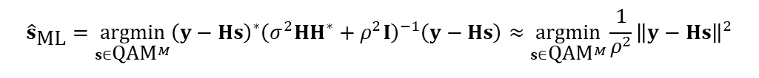
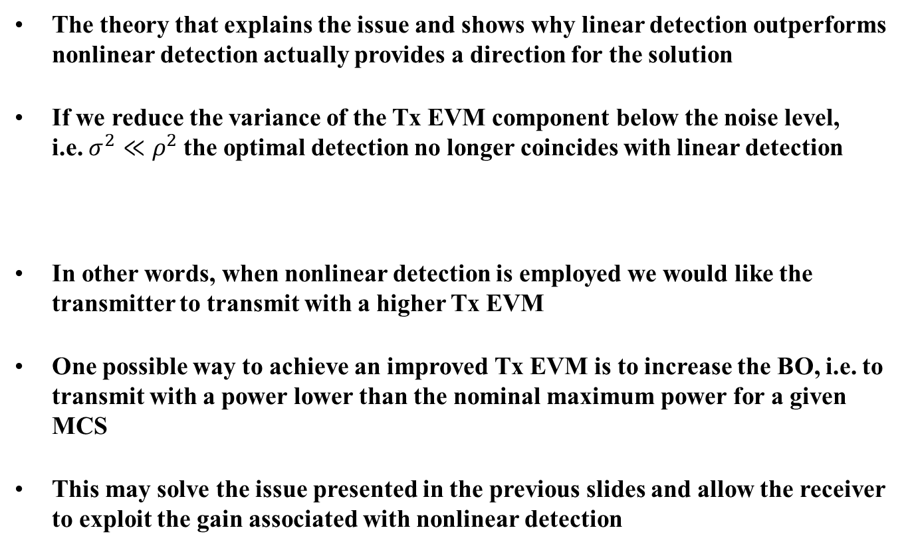
How can we improve the performance?
The theory that explains the issue and shows why linear detection outperforms nonlinear detection actually provides a direction for the solution
If we reduce the variance of the Tx EVM component below the noise level,
i.e. $σ^{2}≪ρ^{2}$the optimal detection no longer coincides with linear detection
In other words, when nonlinear detection is employed we would like the transmitter to transmit with a higher Tx EVM
One possible way to achieve an improved Tx EVM is to increase the BO, i.e. to transmit with a power lower than the nominal maximum power for a given MCS
This may solve the issue presented in the previous slides and allow the receiver to exploit the gain associated with nonlinear detection
$${\hat{s}}_{\text{ML}}=\underset{s∈\text{QA}{\text{M}}^{M}}{argmin}{\left(y−Hs\right)}^{∗}{\left(σ^{2}HH^{∗}+ρ^{2}I\right)}^{−1}\left(y−Hs\right)≈\underset{s∈\text{QA}{\text{M}}^{M}}{argmin}\frac{1}{ρ^{2}}{\left\|y−Hs\right\|}^{2}$$

Slide 7
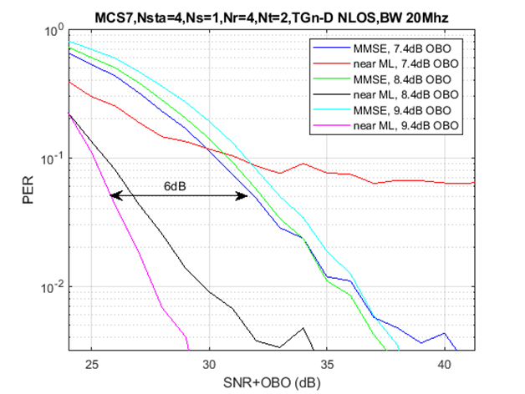
Simulation Results – Comparison w. MMSE
We simulated the same scenarios, where we use a larger BO, than that needed to meet standard Tx EVM requirements
In particular we compared the results of nonlinear detection with those of MMSE
We can see that the impact of OBO on
PER in case of MMSE detection is very
small (although increasing OBO may
improve MMSE as well)
  But near-ML is impacted significantly
We can see that near ML detection
outperforms MMSE detection by 6dB
(including consideration of the reduced
power due to higher BO)

Slide 8
Summary
While in theory nonlinear MIMO detection is superior to linear detection, in practice it suffers from the impact of RF impairments
  An additional Tx EVM improvement of 1-2dB may result in PER gain of many dBs for a MIMO transmission (e.g. 6dB gain as shown on the previous slide)
We may significantly improve performance, if we adjust the Tx EVM for the specific MIMO scheme and the detector type currently employed at the receiver

