Slide 1
Priority Based Preemption Method
Date: 2023-11-07
Authors:

Slide 2
Abstract
Preemption methods are discussed in UHR SG [1, 2]
However, an AP cannot know about priority information of non-AP STAs’ traffic.
To properly schedule the preemption, 11bn needs a method to gather priority information in the preemption
In this submission, the priority based preemption method is discussed

Slide 3
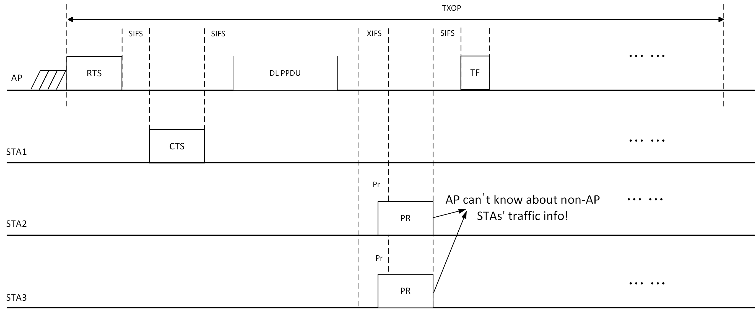
Issue
When an AP granted a preemption period to non-AP STAs, the AP cannot know how urgent the STAs’ traffics are.

Slide 4
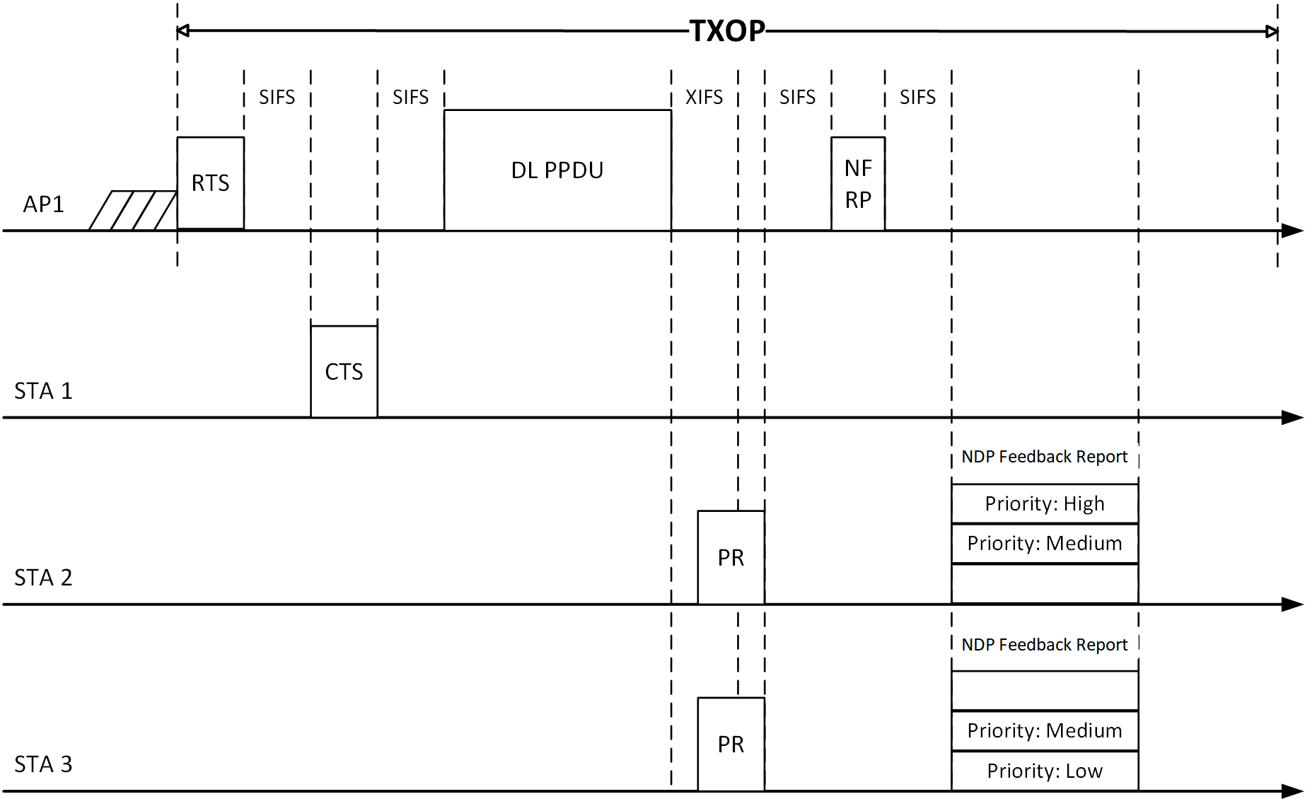
Priority based preemption
Non-AP STAs which are doing preemption can transmit NDP feedback with specific tones
The specific tones are mapped to the priority of traffics
Example:
Tones 0~9: High priority (or urgency)
10~19: Medium priority (or urgency)
20~29: Low priority (or urgency)
… …

Slide 5
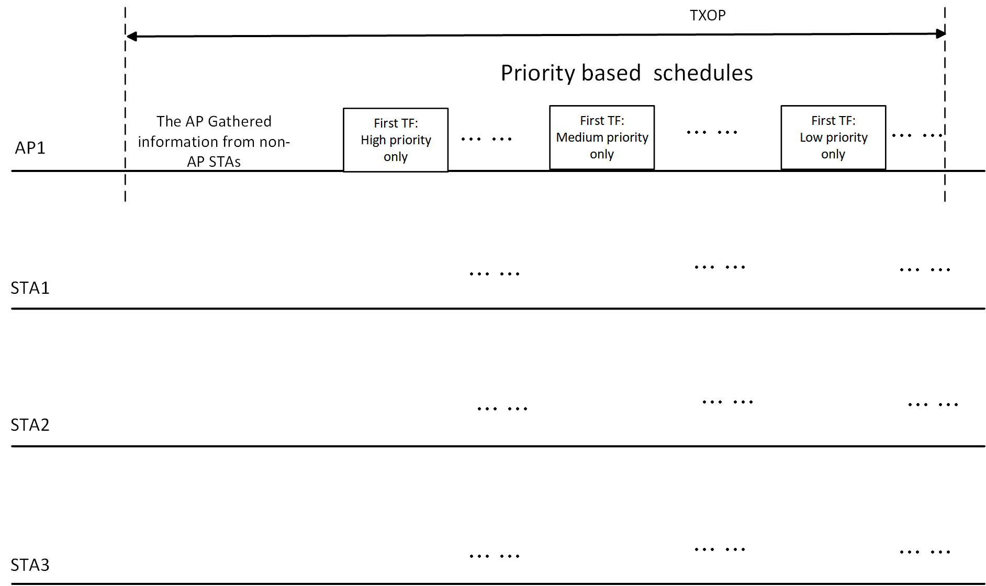
Priority based preemption (cont’d)
The AP can schedule preemption periods (trigger frame transmission) based on the priority information
Example:
The AP firstly schedules high priority only trigger frame
Only the non-AP STAs which transmitted in high priority tones can transmit its data frames to the AP.

Slide 6
Summary
In this submission, priority based preemption method for 11bn is discussed
The non-AP STAs transmit NDP feedback to specific tones based on the urgency or priority of its traffics
The AP can schedule preemption periods (e.g., trigger frames) based on the priority information of non-AP STAs

Slide 7
References
[1] 11-23/1229r1: Preemption for low latency application (Follow up), https://mentor.ieee.org/802.11/dcn/23/11-23-1229-01-0uhr-preemption-for-low-latency-application-follow-up.pptx
[2] 11-23/1174r0: TXOP preemption follow up, https://mentor.ieee.org/802.11/dcn/23/11-23-1174-00-0uhr-txop-preemption-follow-up.pptx

