Slide 1
Update of the Spatial Modulation
Date: 2023-11-06
Authors:
Name | Affiliation | Address | Phone | Email
Junghoon Suh | Huawei |  |  | junghoon.suh@huawei.com
Yan Xin |  |  |  | Yan.Xin@huawei.com
Osama AboulMagd |  |  |  | Osama.AboulMagd@huawei.com
Edward Au |  |  |  | edward.ks.au@huawei.com

Slide 2
Summary of Feedback for the UHR contribution, 23/1328r0 Spatial Modulation
Performance comparison between Spatial Modulation (SM) and Beamformed SU-MIMO is requested
SNR operation region is too high, not practical
Throughput gain (16 dB) is too high and not clear how this is achieved
Thank you for the interest in the proposal

Slide 3
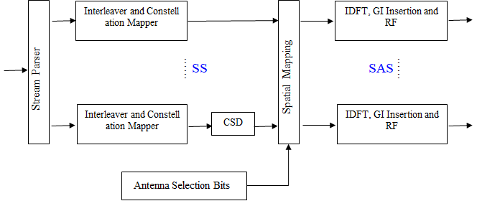
How to implement the SM on the TX side
Scrambler
Bit Parser
FEC Encoder
The SS stands for the Spatial Stream and the SAS stands for the Spatial-Antenna Stream
The number of SAS is aligned with the number of TX RF chains

Slide 4
Spatial Modulation Implementation Example:
4 TX (= 4 TX RF chains), 2 RX antennas with Rank 2 (= Nss 2) transmission
Rather than applying a 4X2 Q-matrix to map 2 Spatial-Streams to 4 TX antennas, 2 TX antennas are randomly selected out of 4 TX antennas based on the Antenna Selection bits. The following Table shows an example.
Since the Nss is 2 in this case, let’s denote two stream data as s0 and s1 at each subcarrier
  s0 or s1 is a QAM symbol according to the MCS of data
If the selected TX are TX0 and TX1, then, the s0 is transmitted from TX0 and s1 is transmitted from TX1, while TX2 and TX3 transmit the Null data with no energy
If the selected TX are TX0 and TX3, then, the s0 is transmitted from TX0 and s1 is transmitted from TX3, while TX1 and TX2 transmit the Null data with no energy
The Antenna Selection bits are not encoded or interleaved, so this information effectively corresponds to the MCS 3 transmission of the data information in terms of the total information bits
AS Bits |  | Selected TX Antennas Pair
b0 | b1 | 1st TX | 2nd TX
0 | 0 | TX0 | TX1
0 | 1 | TX2 | TX3
1 | 0 | TX0 | TX3
1 | 1 | TX1 | TX2
Table 1. Two Antennas Selection (AS) bits for the selection of the 2 TX Antennas out of 4 Available TX

Slide 5
High-level description of SM operation
: based on the Bit-parsing of coded bits
Data stream: MCS 1 (2 coded bits per tone)
AS Stream: Same data rate as MCS 3 (2 information (used for the AS) bits per tone)
TX0
TX1
…..s_{k0}…..s₁₀s₀₀
…..d_{n}…..d₁d₀
d_{n} : data bit
s_{kl} : QAM symbol (QPSK)
b_{m} : Antenna Selection bit
a_{k} : Antenna Selection index
k : Sub-carrier index
FEC
AS
TX2
…..s_{k1}…..s₁₁s₀₁
TX3
…..a_{k}…..a₁a₀
…..b_{m}…..b₁b₀
b₀b₁ ➔ a₀ mapped
according to the Table
in the previous slide
The “d” streams and “b” streams above are the information streams passed from the upper layer
As seen above, for the MCS-1 two stream data transmission, the same amount of information bits are
transmitted through the Antennas Selection

Slide 6
RX design flow
Constellation Demapper and Bit Deinterleaver
…..
GI Removal, FFT and Channel
Estimation with Full TX antennas
Stream Deparser
……
RX
FEC Decoder
MIMO Detection
LLR Calculation for
Antenna Selection (AS) bits
Descrambler
Bit Deparser
Constellation Demapper and Bit Deinterleaver
Hard Decision of
Antenna Selection

Slide 7

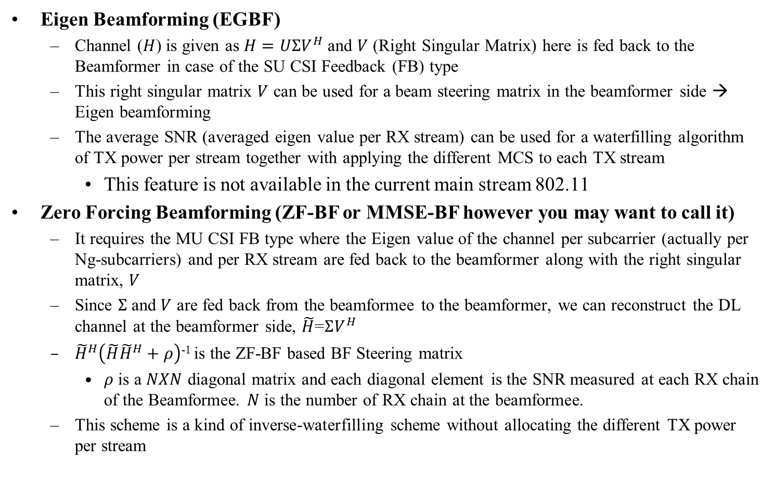



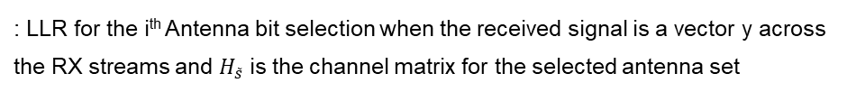
Detection of Spatial Modulation
The Antenna Selection (AS) bits are detected at the RX side using an Maximum-Likelihood (ML) detection
  LLR Calculation for Antennas Selection bits is obtained as follows, [2]
If we take the table on slide 4 as an example, for the first AS bit “1” case, the Selected TX Antennas pair would be either (TX0, TX3) or (TX1, TX2). The Selected TX Antennas pair for the first AS bit “0” case would be either (TX0, TX1) or (TX2, TX3).
Compute the Euclidean distance between the received signal and all possible the QAM symbols multiplied with the estimated channels for the corresponding TX Antennas pair, and choose the minimum Euclidean distance
  The minimum Euclidean distance for AS bit “0” minus the minimum Euclidean distance for AS bit “1” is the LLR for the corresponding AS bit position
  We can run a hard decision once we obtain this LLR for each AS bit position, that is, the LLR less than “0” may indicate the bit “0” for the corresponding AS bit position
Once the AS bits are detected, the remaining MIMO detection is a routine detection as each vendor has implemented, that is, if a vendor implemented a MIMO detection algorithm with an MMSE detection, then, it may continue to use the same MIMO detection
$L\left(s^{i}|y,H_{\tilde{s}}\right)≈−\min_{\tilde{s} ∈ s_{1 }^{i}, \tilde{x}∈ℵ}\left\{\frac{1}{2σ^{2}}{\left\|y−H_{\tilde{s}}\tilde{x}\right\|}^{2}\right\}$ +$\min_{\tilde{s} ∈ s_{0 }^{i}, \tilde{x}∈ℵ}\left\{\frac{1}{2σ^{2}}{\left\|y−H_{\tilde{s}}\tilde{x}\right\|}^{2}\right\}$
$$L\left(s^{i}|y,H_{\tilde{s}}\right)$$
: LLR for the i^{th} Antenna bit selection when the received signal is a vector y across
the RX streams and $H_{\tilde{s}}$ is the channel matrix for the selected antenna set
$$\tilde{s}$$
: Selected Antennas bit selection
$$s_{1 }^{i}$$
: antenna configuration set when the i^{th} Antenna bit selection is 1
$$\tilde{x}$$
: QAM constellation set
$$ℵ$$
: Entire QAM constellation set

Slide 8
Simulation
4TX-2SS-2RX SM vs Close-Loop (CL) SU-MIMO (4TX-2SS-2RX)
  N_c = 2, N_A = 2, 2 streams selection out of 4 SAS
  Eigen BF (EGBF: Right singular vectors of the channel) applied to the CL SU-MIMO
As for the Spatial Modulation, the TX Power is split by Num_SAS to be applied to each stream of the LTF portion and split by Num_SS to be applied to each stream of the Data portion
IEEE Chan D
The average receiver SNR where the channel gain is included in the signal power calculation
Packet Length (500 bytes for MCS 1), BCC Encoding for FEC, 20 MHz, MMSE MIMO Detection

Slide 9
Goodput calculation
Spatial Modulation
  Goodput (bps/Hz) = (1 – PER) (N_BPSC * Coderate * N_c + N_A) * N_{sc} / OFDM Symbol Length (/wo GI) / BW
    N_BPSC: Number of Bits Per Subcarrier, N_c: Rank of the Transmission
    N_A: Number of Antenna Selection Bits, N_{sc}: Total Number of Data Subcarriers
    OFDM Symbol Length (/wo GI): 12.8 usec
CL SU-MIMO
  Goodput (bps/Hz) = (1 – PER) (N_BPSC * Coderate * N_c) * N_{sc} * (N_{SYMB} - N_{LTF}) * N_{PPDU} /
  ( (N_{SYMB} - N_{LTF}) * N_{PPDU} * OFDM Symbol Length (/wo GI) + T_{NDPA} + T_{SIFS} + T_{NDP} + T_{SIFS} + T_{CSIFB} ) / BW
    N_{SYMB} : Number of symbols per PPDU (20), N_{LTF} : Number of EHT-LTFs per PPDU (4)
    N_{PPDU} : Number of PPDUs per Sounding (100, 10, 5 or 1), T_{NDPA} : NDPA Packet length in time (28 usec)
    T_{NDP} : NDP Packet length in time (112 usec), T_{SIFS} : SIFS in time (16 usec)
    T_{CSIFB} : CSI FB Packet length in time (about 500 bytes using MCS0 in 20 MHz) (592 usec)

Slide 10
Gootput comparison between SM and EGBF SU-MIMO

Slide 11
PER comparison between SM and EGBF SU-MIMO

Slide 12
PER comparison of EGBF SU-MIMO with TX-SNR vs RX-SNR

Slide 13
Why the throughput gain is different from the reference paper
TX-SNR: Average signal power of QAM constellations and Precoder is normalized to one, and the signal power is assumed to be one in TX-SNR
Average Receiver SNR: Average signal power is computed real time after passing through the IEEE channel model, right before the AWGN being added to the Received signal, which reflects more practical situation
Sampling rate of IEEE Channel model is 100 MHz
  20 MHz packet needs to be up-sampled by 5 to apply the right IEEE channel model, which needs to be decimated by 5 before the baseband detection is processed in the RX side
The number of LTF symbols and streams needs to be aligned with N_SAS (which is 4 in the simulation example), but the N_SS is aligned with the rank of the transmission which is 2 in the simulation example. The Precoder size is 4X2 in the simulation example, and the same Precoder cannot be applied to the LTFs, because the number of streams of LTFs is different from the number of data streams, which makes the Beamforming difficult to be applied to the Spatial Modulation

Slide 14
Summary
We considered the Spatial Modulation to WLAN
  The data stream of Antenna Selection bits correspond to the effective additional MCS-3 data stream which contributes to the throughput gain of Spatial Modulation
The highest Goodput of SM is always better than CL SU-MIMO for each MCS
  The CL SU-MIMO reaches the certain Goodput (3 bps/Hz) 2~4 dB earlier than SM when the multiple PPDUs are transmitted each sounding period, in MCS 7 case
  However, the upper bound in Goodput of SM is much higher than the CL SU-MIMO, that is, the maximum throughput each MCS can achieve is limited by the Sounding overhead in case of CL SU-MIMO
  The SM is especially good for those sporadic packets exchanged between the AP and a STA
The higher SNR operation region can be explained by the Average receiver SNR

Slide 15
Appendix
Background to the Spatial Modulation
Goodput comparison between SM and Open-Loop (OL) SU-MIMO

Slide 16
Introduction
  It is a common use case to see a single client associated with an AP in WLAN
  We have less focused on the improvement of SU-MIMO in the previous several amendments
  We can generalize the Extension in the Number of LTFs
  The Limited Singular Value feedback in the SU-Type CSI Report
  Spatial Modulation can transmit the extra antenna selection bits along with the data bits
  Multi-Layer Transmission with the different MCS in each TX stream [1]

Slide 17
Background to the Spatial Modulation
SU-MIMO scenario is a common use case in WLAN
An AP may typically have the TX antennas up to 8, but the client device is limited by the number of RX antennas
  It is not common to see more than two RX antennas in a Smart Phone device
The throughput of the SU-MIMO between a single AP and a single STA is limited by the number of RX antennas
Spatial Modulation (SM) can transmit the extra antenna selection bits along with the data bits
  Enhanced throughput
  Number of TX antennas more than the Number of RX is necessary which is appropriate for a single AP and a Single STA use case

Slide 18
Spatial Modulation (SM)
For an SU-MIMO transmission, the Rank of the transmission is limited by the number of RF chains in the RX, that is, the number of available TX RF chains is greater than or equal to the number of RX RF chains
When the number of TX RF chains is greater than the Rank of the transmission, we randomly select the TX RF chains based on the Rank of the transmission among the available total TX RF chains
  The random selection of the TX RF chains is determined by the selection bits which are also a part of the source data
  The random selection of the TX RF chains takes place every subcarrier

Slide 19
We can introduce a Spatial-Antenna Stream (SAS) to the WLAN to implement the SM
On the TX side, Spatial Streams (SS) are mapped to the Spatial-Antenna Streams which are then being mapped to the TX antennas
  The Spatial Stream (SS) is aligned with the Rank of the transmission and is less than or equal to the number of RX
  The Spatial Streams are mapped to the Spatial-Antenna Streams (SAS) through the Spatial Modulation introduced in this contribution
  The SAS can be mapped to the TX antennas with a proprietary solution, and the number of TX antennas is greater than or equal to the SAS
The Antenna Selection bits are not encoded or interleaved, so this information effectively corresponds to the MCS 3 of the data information in terms of the total information bits
CSD can be applied to the SS
The Number of LTFs follow the Number of Available SAS not the SS
  LTF extension can be applied according to the P-matrix extension (ex. For 4 SAS case, 4X4 or 4X8 P-matrix can be applied)
Linear Operating Range of the TX Power Amplifier needs to be flexible enough to support the case of the max TX Power being split across the streams between SS and SAS

Slide 20
We need to add the 1 bit subfield in a SIG field to indicate that the frame is an SM frame
The Number of SAS need to be indicated in a SIG field as well
The following frame shows an expected UHR frame format (An exact format may be different as the TGbn progresses)
  The SM frame Indication can be carried in either U-SIG or UHR-SIG
  Number of SAS can be indicated in either U-SIG or UHR-SIG
RL-
SIG
UHR
-STF
UHR
-LTF1
..
UHR
-LTFN
…..
L-STF
L-LTF
L-SIG
U-SIG
UHR-SIG
Data
Data
FCS

Slide 21
Simulation
4TX-2SS-2RX SM vs Open Loop (OL) SU-MIMO
  N_c = 2, N_A = 2, 2 streams selection out of 4SAS
As for the Spatial Modulation, the Max TX Power is split by Num_SAS to be applied to each stream of the LTF portion and split by Num_SS to be applied to each stream of the Data portion
IEEE Chan D
The average receiver SNR where the channel gain is included in the signal power calculation
Packet Length (500 bytes for MCS 1), BCC Encoding for FEC, 20 MHz, MMSE MIMO Detection
Goodput (bps/Hz) =
  (1 – PER) (N_BPSC * Coderate * N_c + N_A) * N_{sc} / OFDM Symbol Length (/wo GI) / BW
  N_BPSC: Number of Bits Per Subcarrier
  N_c: Rank of the Transmission
  N_A: Number of Antenna Selection Bits
  N_{sc}: Total Number of Data Subcarriers

Slide 22
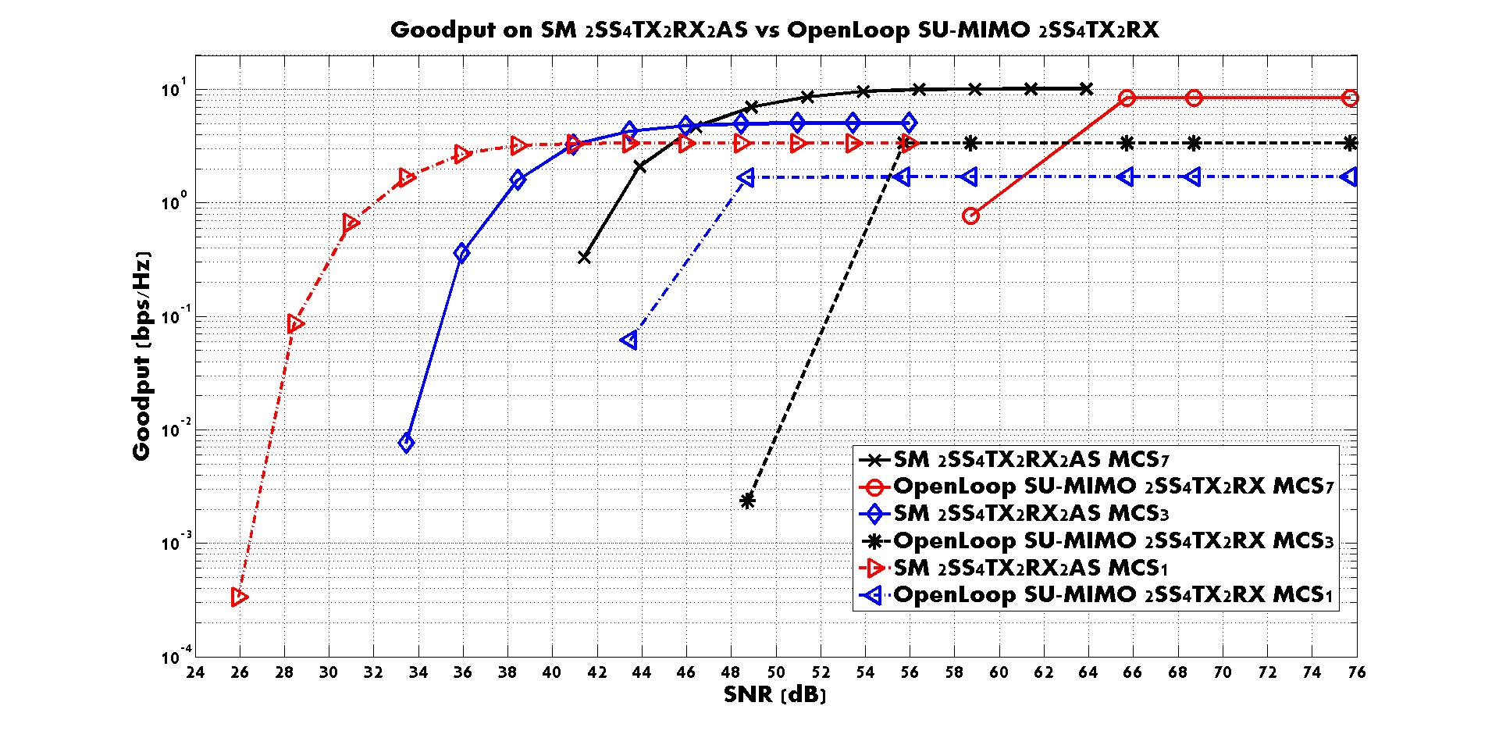
4TX-2SS-2RX SM vs OL SU-MIMO

Slide 23
References
[1] 11-22/1930r0, Layered QoS and multi-layer transmission follow-up, Ross Jian Yu et.al.
[2] A. Helmy, et. al., “Spatial Modulation for Improved Performance of Next-Generation WLAN”, WCNC 2017, San Francisco, CA USA

Slide 24
SP
Would you like to explore the Spatial Modulation technology as one of the feature to improve the SU-MIMO performance in the UHR?
  Yes
  No
  Abs

