Slide 1
R-TWT Coordination in Multi-BSS
Date: 2023-11-12
Authors:
Name | Affiliation | Address | Phone | Email
SunHee Baek | LG Electronics | 19, Yangjae-daero 11gil, Seocho-gu, Seoul 137-130, Korea |  | sunhee.baek@lge.com
Jinsoo Choi |  |  |  | js.choi@lge.com
Insun Jang |  |  |  | insun.jang@lge.com
Yelin Yoon |  |  |  | yl.yoon@lge.com
Geonhwan Kim |  |  |  | geonhwan.kim@lge.com
DongJu Cha |  |  |  | dongju.cha@lge.com
Eunsung Park |  |  |  | esung.park@lge.com
Dongguk Lim |  |  |  | dongguk.lim@lge.com
Jinyoung Chun |  |  |  | jiny.chun@lge.com
Insik Jung |  |  |  | insik0618.jung@lge.com
HanGyu Cho |  |  |  | hg.cho@lge.com
Sanggook Kim |  | 10225 Willow Creek Rd, San Diego, CA, USA |  | sanggook.kim@lge.com

Slide 2
Introduction
In 11be, the R-TWT is defined in the perspective of transmission for latency sensitive traffic in a single BSS.
  It may be a problem when STAs exchange the latency sensitive traffic in actual use environments (e.g. several adjacent BSSs are overlapping).
  Some STAs have relatively few opportunities to obtain TXOP since the operations of other BSSs.
EHT STAs(APs) cannot handle the schedule information of R-TWT in Multi-BSS.
  To distinguish between R-TWT SP scheduled by the associated AP and R-TWT SP scheduled by the neighboring APs, the latter R-TWT SP named OBSS R-TWT SP in this contribution.
  Some contributions, [1] ~ [11], were presented about that UHR(11bn) requires to consider OBSS R-TWT schedules.
In this contribution, we suggest how to negotiate and operate R-TWT schedule(s) between BSSs.

Slide 3
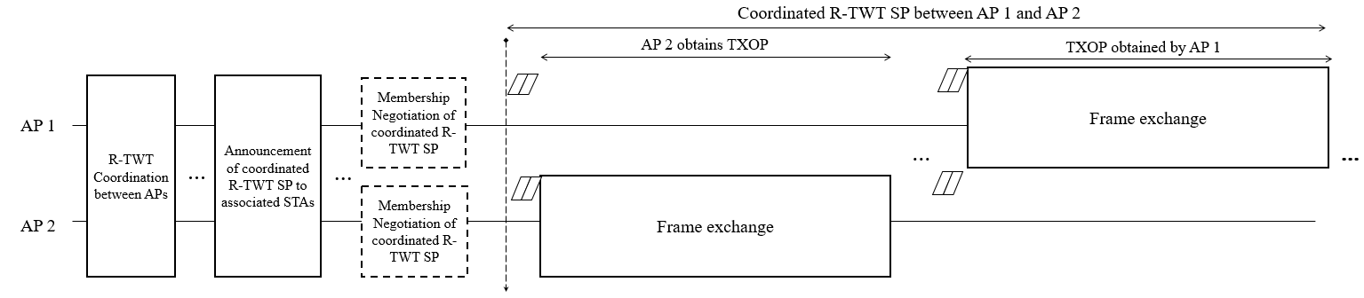
Overview
The coordination for R-TWT schedule(s) between APs is to prevent conflicting each schedules in Multi-BSS.
  During the R-TWT coordination, APs negotiate schedule information for R-TWT to coordinate.
  As the result of the R-TWT coordination, APs obtain coordinated R-TWT schedule(s).
  After the R-TWT coordination, APs announce the coordinated R-TWT schedule(s) to associated STAs.
During the coordinated R-TWT schedule, APs should obtain its TXOP to transmit/receive their latency sensitive traffic.
  An AP can obtain its TXOP based on random backoff during the coordinated R-TWT schedule(s).
  The AP will transmits/receives low latency traffic to the associated STA during its TXOP.
*Example for the case of an overlapped R-TWT SP between AP 1’s R-TWT SP and AP 2’s R-TWT SP.

Slide 4
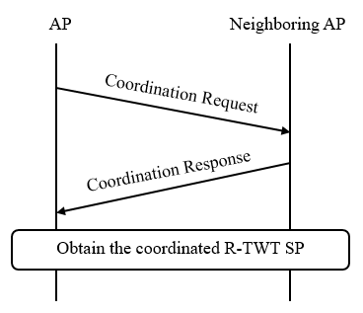
R-TWT Schedule Coordination
The coordination for R-TWT schedule between APs is carried out through coordination request and coordination response.
  The coordination request and coordination response can be organized based on TWT request frame and TWT response frame defined in baseline.
    The TWT request/response frames include the schedule information of the R-TWT.
      However, there is needed to review whether all (sub)fields in TWT request/response frames are necessary for R-TWT schedule coordination between APs.
    The additional information in coordination request should include channel access parameter(EDCA parameter set of AP and STAs) and AP coordination scheme types(C-TDMA, C-SR, etc).
  The coordination request can be initialized from an AP to the other AP
  located within the range of transmitting/receiving Beacon frame.

Slide 5
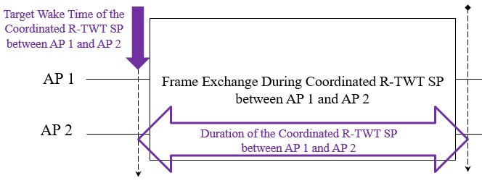
Overlapped Coordinated R-TWT schedule
After the R-TWT schedule coordination between APs, they can obtain overlapped coordinated R-TWT schedule.
  The overlapped coordinated R-TWT schedule is the result of negotiation to transmit/receive latency sensitive traffic for same R-TWT schedule within each other’s BSS.
    For example, the AP1(AP2) and the STA(s) associated with AP1(AP2) supporting R-TWT can transmit/receive the latency sensitive traffic during the coordinated R-TWT SP scheduled by AP 1 and AP2.
  The overlapped coordinated R-TWT schedule is considered to have same values of TWT interval, TWT SP duration, and target wake time(TWT) based on the different TSFs of APs.
    If the AP coordination scheme is used, APs will operate the schedule(s) based on same AP coordination scheme(C-TDMA, C-SR etc.).

Slide 6
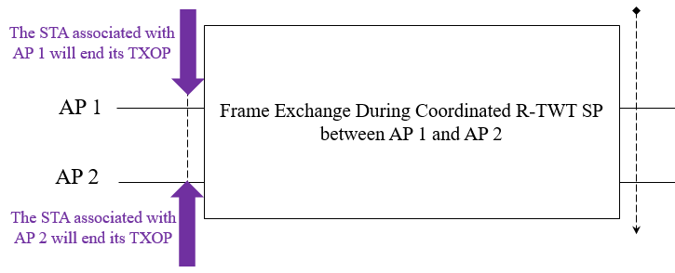
Overlapped Coordinated R-TWT schedule
It is expected that each AP would announce the overlapped coordinated BSS’s schedule(s) as the schedule(s) in its BSS, not OBSS.
The STAs associated with APs can protect the overlapped coordinated R-TWT schedule(s) as follows;
  The associated EHT/UHR STAs supporting R-TWT will follow the protection rules and participate in the schedule to transmit/receive UL/DL low latency traffic.
  The STAs not supporting R-TWT apply the rules defined in 11be.

Slide 7
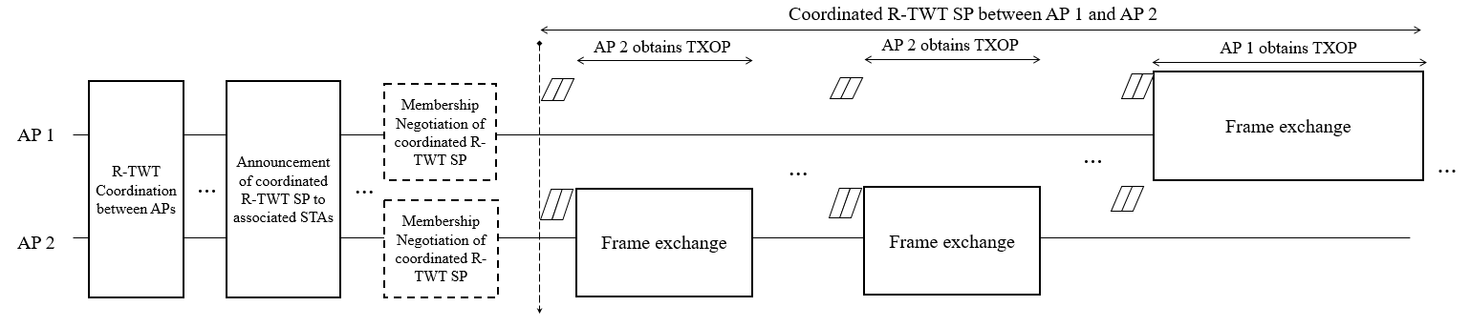
Access Rules within
Overlapped Coordinated R-TWT Schedule
During the overlapped coordinated R-TWT schedule, APs operate random backoff mechanism to obtain TXOP following baseline.
  There is possible unfairness circumstance, for example, AP/STA often obtains more frequent channel access opportunities based on the values of parameter set that are much better than other AP/STAs.
  Based on the random backoff mechanism, several rules should be required to prevent a AP from obtain TXOP unilaterally.
    For example, APs negotiate a coordinated EDCA parameter set (e.g., TXOP Limit) of AP(STAs) used within the overlapped coordinated R-TWT schedule(s) during R-TWT schedule coordination.

Slide 8
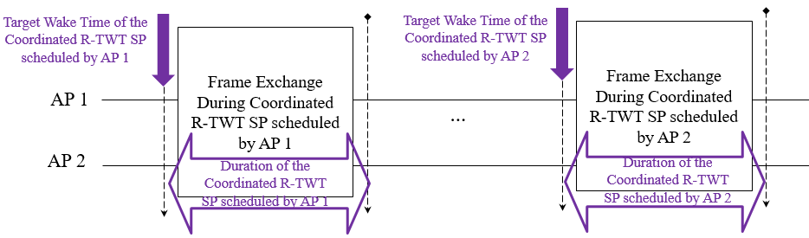
Non-overlapped
Coordinated R-TWT Schedules
After the R-TWT schedule coordination between APs, they can obtain non-overlapped coordinated R-TWT schedules.
  The non-overlapped coordinated R-TWT schedules are the result of negotiation to protect each other’s R-TWT schedules within each other’s BSS.
    For example, the AP1 and the STA(s) associated with AP1 supporting R-TWT can transmit/receive latency sensitive traffic during the coordinated R-TWT SPs scheduled by AP1, but they cannot during coordinated R-TWT SPs scheduled by AP2.
    (It is vice versa for the case of the AP2 and the STA(s) associated with AP2.)
  The non-overlapped coordinated R-TWT schedules are considered to have different values of TWT interval and target wake time(TWT) based on the different TSFs of APs.
    This type of coordinated R-TWT schedule must not overlap each other’s coordinated R-TWT schedules.

Slide 9
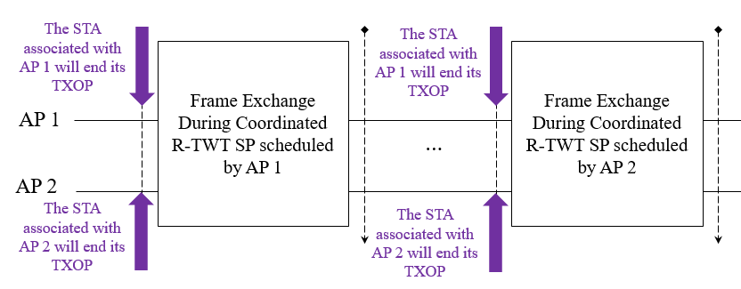
Non-Overlapped
Coordinated R-TWT Schedules
The AP announces the schedule information of the non-overlapped coordinated OBSS R-TWT schedule(s).
  Also, AP can indicate whether the associated STAs follow the protection rule of R-TWT schedule for OBSS as mandatory or conditionally mandatory based on additional information about the OBSS R-TWT schedule(s).
  We can discuss the additional information which expects to enable to exchange frames in a BSS without the impact on OBSS, i.e., enable to ignore the protection rule (e.g., power level).
The STA associated with APs can protect the non-overlapped coordinated R-TWT schedules as follows;
  The associated STAs will end their TXOP before the start time of non-overlapped coordinated R-TWT schedule(s), and may end their TXOP before the start time of non-overlapped OBSS coordinated R-TWT schedule(s).
    The EHT/UHR STAs supporting R-TWT may end their TXOP before the start time of non-overlapped OBSS coordinated R-TWT schedule(s) depending on how the associated AP consists of the announcement about the schedule(s).
  The STAs not supporting R-TWT apply
  the rules defined in 11be.

Slide 10
Non-Coordinated R-TWT Schedules
The non-coordinated R-TWT schedules aren’t the shared/agreed between APs.
  For example, it can be the schedule information of OBSS R-TWT schedules in an overhearing Beacon frame.
The APs may announce the non-coordinated R-TWT schedules to associated STAs.
  We assume that the announcement of non-coordinated R-TWT schedules doesn’t give any advantage to the associated STAs because they should protect the OBSS R-TWT schedules whenever receiving it.
  When an AP announces the non-coordinated OBSS R-TWT schedules but the neighboring AP doesn’t announce, the only associated STAs with the AP could not do anything during the OBSS schedules.
APs may use the schedule information of non-coordinated R-TWT without announcing the OBSS R-TWT schedules to the associated STAs.
  For example, an AP uses the OBSS R-TWT schedules for R-TWT schedules not to overlap with the OBSS R-TWT schedules to protect BSS’s SP(s).
  When the associated STAs overhear Beacon frame announced by neighboring AP(s), the STAs can request R-TWT not to overlap with the OBSS R-TWT schedule(s).
    Also, the STAs can share whether the requested R-TWT schedule(s) doesn’t overlap with the OBSS R-TWT schedule(s) to the associated AP.

Slide 11
Further Issues
Several issues to support R-TWT in Multi-BSS are necessary to be more considered as follows;
  Detail negotiation process during R-TWT coordination between APs.
  Detail methods for coordinated R-TWT schedule(s).
    When AP announces the schedule information of coordinated R-TWT to associated STA(s), how to organize the schedule information.
    Whether APs and the associated STA(s) can follow the baseline or need additional rules before the start time of the coordinated R-TWT schedule(s).
    Whether APs and the associated STA(s) can follow the baseline or need additional rules during the coordinated R-TWT schedule(s).

Slide 12
Conclusion
In this contribution, we propose R-TWT schedule(s) coordination between an AP and neighboring AP.
  Coordinated R-TWT schedule(s)
    Non-overlapped coordinated R-TWT schedule
    Overlapped coordinated R-TWT schedule
Therefore, we prefer to coordinate/negotiate R-TWT schedule(s) between APs to protect data transmissions within each BSSs.

Slide 13
Straw Poll 1
Do you agree to define mechanism(s) where an AP coordinates R-TWT schedule(s) with neighboring AP(s).
  R-TWT schedule that is coordinated and agreed between the APs is the coordinated R-TWT schedule
    Name is TBD.

Slide 14
Straw Poll 2
Do you agree to support that an AP announces the coordinated R-TWT schedule(s).
  The detail signaling is TBD.

Slide 15
Straw Poll 3
Do you agree that APs coordinate an EDCA parameter set using the APs for R-TWT schedule(s).
  The detail signaling is TBD.

Slide 16
Straw Poll 4
Do you agree that APs shall use an coordinated EDCA parameter set to access channel within the coordinated R-TWT schedule(s).
  The detail is TBD.

Slide 17
Straw Poll 5
Do you agree that STA supporting R-TWT as a TXOP holder shall ensure the TXOP ends before the start time of any active R-TWT schedules that are advertised by its associated AP.

Slide 18
Straw Poll 6
Do you agree that AP supporting R-TWT as a TXOP holder shall ensure the TXOP ends before the start time of any active R-TWT schedules that are advertised by itself.

Slide 19
References
[1] 23/771 Coordinated of R-TWT Protection in Multi-BSS
  [2] 23/226 Coordination of R-TWT for Multi-AP Deployment
  [3] 23/250 AP coordination with R-TWT
[4] 23/291 R-TWT Multi-AP Coordination
[5] 23/293 Follow-up on TWT-based Multi-AP Coordination
[6] 23/297 rTWT for Multi-AP
[7] 23/355 Enhanced R-TWT and M-AP operation
[8] 23/771 Coordinated R-TWT Protection in Multi-BSS
[9] 23/860 Further thoughts on coordinated TWT
[10] 23/1087 Announcement for R-TWT Coordination
[11] 23/1424 Follow-up on peer-to-peer(P2P) communication for UHR

