Slide 1
Enhanced Security for Control frame in 11bn
Date: 2023-11-12
Authors:
Name | Affiliation | Address | Phone | Email
SunHee Baek | LG Electronics | 19, Yangjae-daero 11gil, Seocho-gu, Seoul 137-130, Korea |  | sunhee.baek@lge.com
Insun Jang |  |  |  | insun.jang@lge.com
Jinsoo Choi
 |  |  |  | js.choi@lge.com
Yelin Yoon |  |  |  | yl.yoon@lge.com
Geonhwan Kim |  |  |  | geonhwan.kim@lge.com
Dongju Cha |  |  |  | dongju.cha@lge.com
Eunsung Park |  |  |  | esung.park@lge.com
Dongguk Lim |  |  |  | dongguk.lim@lge.com
Jinyoung Chun |  |  |  | jiny.chun@lge.com
Insik Jung |  |  |  | insik0618.jung@lge.com
HanGyu Cho |  |  |  | hg.cho@lge.com
Sanggook Kim |  | 10225 Willow Creek Rd, San Diego, CA, USA |  | sanggook.kim@lge.com

Slide 2
Introduction
Current security definition is applied only to the data frame and management frame. So, the control frame doesn’t support security method by setting reserved on the Protected Frame subfield in the Frame Control field.
However, the particular types of control frame, Trigger frame and (Multi-)BlockAck, are needed to support security protocol, [1] ~ [3], because of the importance of contained information.
Control frames are vulnerable to a number of different attacks.
STA must wake up and can waste its power/medium because of the Trigger frame transmitted by an attacker [1].
If the control frame is sent by an attacker, QoS Data delivery status and BA scoreboards are misaligned between STAs [2][3].
In the case of Trigger frame, the RU assignment can be interrupted by an attacker. As the result, the data transmission between STAs will not be done properly.
In this contribution, we suggest enhanced security methods for control frame in 11bn.

Slide 3
Background
In the current baseline, RSNA security protocol has following types;
Only Integrity Check method (e.g., BIP)
Encryption/Decryption method (e.g., CCMP, GCMP)
The Integrity Check method(BIP) is used for management frame including Beacon frame through IGTK or BIGTK.
In the result of BIP, values of Key ID, IPN/BIPN, and MIC within MME(Management MIC element) are included at the end of management frame body without encryption/decryption.
The Encryption/Decryption method(CCMP/GCMP) is used for data frame through PTK or GTK.
In the result of CCMP/GCMP, values of Key ID and PN are located within CCMP/GCMP header and the value of MIC is located before FCS.
There are two possible methods to protect the control frame based on the current security methods of the baseline.

Slide 4
Integrity Check for Control frame
The Integrity Check method can detect attacks such as data value changes from a 3rd STA.
When applying the Integrity Check method, the ways of constructing the control frame can be differed depending on the individually or group addressed RA.
For example, when a Trigger frame is applied to the integrity check method(BIP), it can be constructed below.
About individually addressed Trigger frame only for UHR STAs
The UHR STA will receive a Trigger frame applied to the integrity check method(BIP), so check the integrity of the Trigger frame through (new) PTK.
For example, the Trigger frame for UHR STA can include information for integrity check(e.g., Key ID, IPN, MIC) as a new field before padding field, and the MIC value can be calculated based on the Common Info field and User Info List field.
But, current BIP doesn’t support to use PTK to check the integrity of the transmitted/received frame.
In 11bn, the definition of BIP can be extended to use PTK, or encryption/decryption methods can be used for individually addressed RA of Trigger frame.
Maybe the calculation range of MIC subfield is set to Common Info field or User Info List field.
Maybe the length of Protection Info field, Key ID subfield, IPN/BIPN subfield, and MIC subfield can be changed.

Slide 5
Integrity Check for Control frame
About group addressed Trigger frame,
When a STA receives group addressed Trigger frame applied to the Integrity Check method(BIP), there are two possible case depending on the combination of User Info fields in a User Info List field, whether received STAs are either only UHR STAs(Case 1) or pre-UHR STA and UHR STA(Case 2).
⇨ [Case 1] If User Info fields for only UHR STA are included in the User Info List field,
The information for integrity check(e.g., Key ID, IPN, MIC) can be located after the User Info List field as a new field. And the MIC value can be calculated based on the Common Info field and User Info List field.
Likewise the format of individually addressed Trigger frame in the previous slide.
For calculate the value of MIC, Key ID will be set GTK for Trigger frame.
Maybe the calculation range of MIC subfield is set to Common Info field or User Info List field.
Maybe the length of Protection Info field, Key ID subfield, IPN/BIPN subfield, and MIC subfield can be changed.

Slide 6
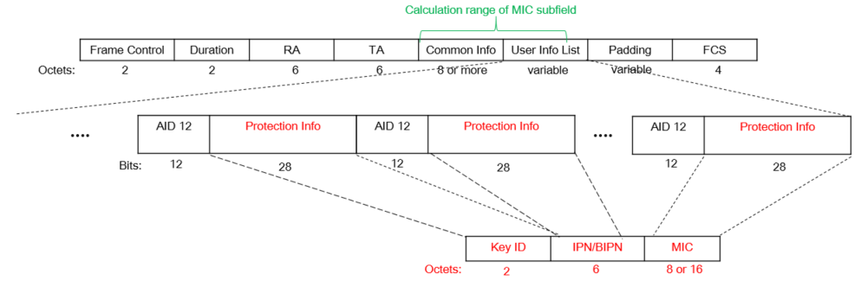
Integrity Check for Control frame
About group addressed Trigger frame,
⇨ [Case 2] If User Info fields for pre-UHR STAs and UHR STAs are included in the User Info List field,
When User Info field(s) for pre-UHR STA(s) is located in the User Info List field, the format of Trigger frame contained the information for integrity check shall be designed to decode the Common Info field and User Info List field for all recipient STAs including pre-UHR STAs and UHR STAs.
In one way, the information for integrity check can be included in User Info List field for following the existing baseline. For example, the Special User Info subfield of 11be can be one of options to include the information for integrity check with a particular AID.
The particular AID indicates only to UHR STA that the Special User Info subfield includes the information for integrity check. Pre-UHR STA will ignore the Special User Info subfields containing the Protection info subfield.
UHR STA concatenates the parts of Protection info subfield except AID 12 subfield until before Padding field.
Maybe the calculation range of MIC subfield is set to Common Info field or User Info List field.
Maybe the length of Protection Info subfield, Key ID subfield, IPN/BIPN subfield, and MIC subfield can be changed.

Slide 7
Integrity Check mode indication for Control frame
About group addressed Trigger frame, two types of format for Trigger frame are possible depending on combination of recipient STAs.
The format for pre-UHR STA and UHR STA(Case 2) can support that pre-UHR STAs can receive its Common Info and User Info from the Trigger frame without decoding error as well as UHR STAs.
But when only UHR STAs receive it(Case 1), the format for pre-UHR STA and UHR STA(Case 2) can be unnecessary to use AID 12 subfield and divide the information for integrity check into different User Info fields.
So, the two types of format for Trigger frame are needed to guarantee that UHR STA check integrity of received Trigger frame under any circumstances.
If the format of Trigger frame is different depending recipient STA(s), an indication needs which type of format for Trigger frame is used.
The mode indication distinguishes how the information for integrity check is included in the transmitted/received Trigger frame.
For example, if the recipient STA(s) is only UHR STA(s), the information is located after the User Info List field and before Padding field. Or if the recipient STAs are pre-UHR STA and UHR STA, the information is located within the User Info List field.
The reserved bit in Common Info field can be used to indicate the location of the information in the Trigger frame and set by transmitter STA.

Slide 8
Encryption/Decryption for Control frame
Encryption/Decryption method is a method of shielding and protecting messages.
For example, if Trigger frame is applied to CCMP or GCMP, Common Info field and User Info List field will be encrypted.
The value of MIC is calculated based on Common Info field and User Info List field following to CCMP or GCMP.
Maybe the calculation range of MIC subfield is set to Common Info field or User Info List field.
In the case of the individually addressed RA, the encryption/decryption is performed based on PTK with recipient STA. And in the case of the group addressed RA, the encryption/decryption is performed based on GTK with recipient STAs.
The keys(PTK and GTK) can be for encryption/decryption method of Control frame(e.g., Trigger frame).
If the control frame encrypts Common Info field and User Info List field of the Trigger frame, the Protected Frame subfield in Frame Control field will be set to 1.
The STA supporting encryption/decryption on Trigger frame should announce its capabilities during an association.
For example, whether encryption/decryption of Trigger frame is supported and keys/cipher suites for encryption/decryption of Trigger frame, etc.

Slide 9
Encryption/Decryption for Control frame
Encryption/Decryption method is the most powerful protection method than the integrity check method of the baseline.
Encryption/Decryption method can prevent from attacks to change/damage data values from a 3rd STA.
If STA can decrypt cipher message based on value of Key ID subfield in CCMP/GCMP header, it can access/decode the plain message and check integrity of the received frame based on PN and MIC.
If a STA doesn’t recognize the key info based on the value of Key ID subfield, the STA cannot access/decode cipher message.
So, the 3rd STA doesn’t have an opportunity to change/damage the cipher message at all.
This method applies only to (beyond-)UHR STA supporting encryption/decryption for Trigger frame.
If pre-UHR STAs receive the encrypted Trigger frame, they cannot decode Common Info field and User Info List field.
Also, unassociated STAs cannot decode the encrypted Trigger frame.
Encryption/Decryption method can guarantee the confidentiality and integrity of Control frame between UHR STAs.

Slide 10
Further Issues
There are several topics to address to support the frames designed in this contribution.
How to announce whether the control frame supports to apply security method.
Which cipher suites for control frame are used.
Which keys for control frame are used depending on individually and group addressed control frame.
How to set/define the information related to check integrity/confidentiality of the control frame.
Like the Trigger frame, it is necessary to review whether protection is required for other types of control frames.
E.g, BlockAck frame(compressed/Multi-STA), etc.

Slide 11
Conclusion
In this contribution, we propose several protection methods for control frame (e.g., Trigger frame).
Only Integrity Check based on BIP,
Individually addressed RA
group addressed RA
Encryption/Decryption based on CCMP/GCMP
To support that legacy STAs can receive/decode the control frame applied security mechanism, the integrity check method for control frame is preferred.

Slide 12
Straw Poll 1
Do you agree to define mechanism(s) for checking integrity of Trigger frame.
The detailed method is TBD.

Slide 13
Straw Poll 2
Do you agree to use Broadcast Integrity Protocol (BIP) for checking integrity of Trigger frame.
The detailed method is TBD.
Notes:
BIP(Broadcast Integrity Protocol)

Slide 14
Straw Poll 3
Do you agree that Trigger frame carries the information for checking integrity of Trigger frame.
The detailed information is TBD.

Slide 15
Straw Poll 4
Do you agree that Trigger frame carries the Key ID, PN, and MIC for checking integrity of Trigger frame.

Slide 16
Straw Poll 5
Do you agree to define mechanism(s) for confidentiality and integrity protocol of Trigger frame.
The detailed method is TBD.

Slide 17
References
[1] 23/0286 Trigger frame protection
[2] 23/0312 Thoughts on Secure control frames
[3] 23/0352 Enhanced Security Discussion

Slide 18
Appendix A. Integrity Check method for BlockAck frame
When applying the Integrity Check method, the ways of constructing the control frame can be differed depending on the individually or group addressed RA
The new field for the information for checking integrity can be defined about individually address BlockAck frame only for UHR STA and group addressed BlockAck frame only for UHR STAs.
Maybe the length of Protection Info subfield, Key ID subfield, IPN/BIPN subfield, and MIC subfield can be changed.

Slide 19
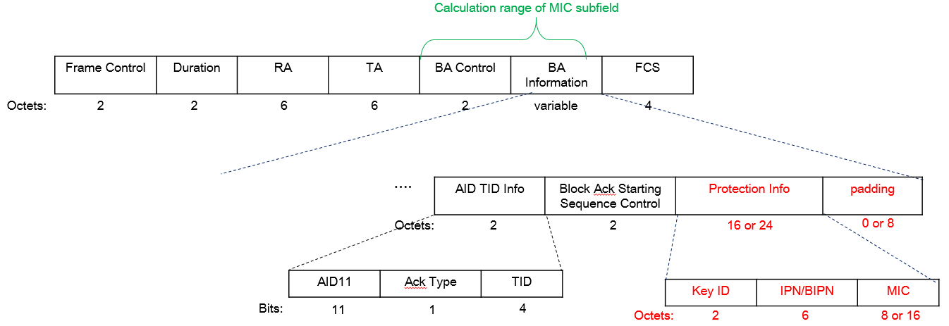
Appendix A. Integrity Check method for BlockAck frame
The information for checking integrity can be included in BA Information field about group addressed BlockAck frame when recipients are pre-UHR STAs and UHR STAs.
Maybe the length of Protection Info subfield, Key ID subfield, IPN/BIPN subfield, and MIC subfield can be changed.

Slide 20
Appendix B. Encryption/Decryption method for BlockAck frame
Encryption/Decryption method is a method of shielding and protecting messages.
For example, if BlockAck frame is applied to CCMP or GCMP, BA Control field and BA Information field will be encrypted.

