Slide 1
Secondary Channel Access Operation
Date: 2023-11-12
Authors:
Name | Affiliation | Address | Phone | Email
Dongju Cha | LG Electronics | 19, Yangjae-daero 11gil, Seocho-gu, Seoul 137-130, Korea |  | dongju.cha@lge.com
Insun Jang
 |  |  |  | insun.jang@lge.com
Jinsoo Choi
 |  |  |  | js.choi@lge.com
Sunhee Baek |  |  |  | sunhee.baek@lge.com
Geonhwan Kim |  |  |  | geonhwan.kim@lge.com
Yelin Yoon |  |  |  | yl.yoon@lge.com
Eunsung Park |  |  |  | esung.park@lge.com
Dongguk Lim |  |  |  | dongguk.lim@lge.com
Jinyoung Chun |  |  |  | jiny.chun@lge.com
Insik Jung |  |  |  | insik0618.jung@lge.com
HanGyu Cho |  |  |  | hg.cho@lge.com
Sanggook Kim |  | 10225 Willow Creek Rd, San Diego, CA, USA |  | sanggook.kim@lge.com

Slide 2
Introduction
According to the current spec, primary channel (PCH) is the only channel that can perform Back-off procedure and frame exchange is allowed only when primary channel is IDlE even when the remaining secondary channels are available
This limits medium efficiency in wide bandwidth, so new mechanism, secondary channel access (SCA) or non-primary channel access (NPCA) that allows frame exchange even when PCH is BUSY needs to be defined in 802.11bn [1][2]
In UHR SG and 11bn TG, many contributions discussed high level views for SCA and technical issues that need to be considered
Most of the contributions have aligned views with slight different details [3]-[9]
In this contribution, we discuss the operation of secondary channel access and some technical issues and solutions to achieve successful frame exchange when performing secondary channel access mechanism

Slide 3
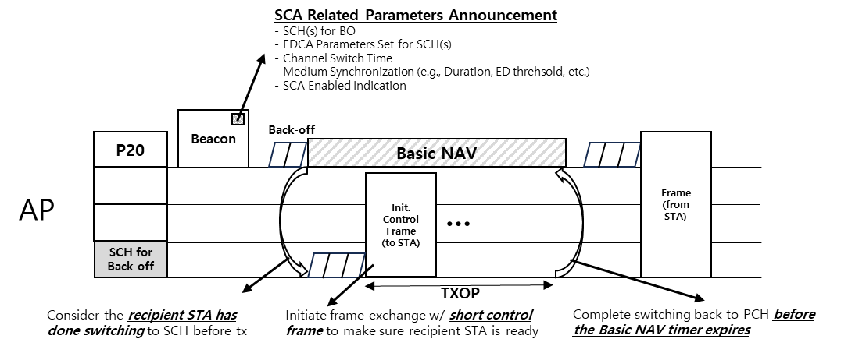
Overview: Secondary Channel Access Operation
To perform Secondary Channel Access (SCA), AP needs to announce SCA related parameters [see next slide]
When Basic NAV is set on a PCH due to OBSS PPDU, STA may switch to a SCH announced by AP to perform Back-off and frame transmission can be done without including a PCH
In this contribution, we discuss the following things that should be considered when performing secondary channel access operation
Timing issue / Medium Synchronization
Different Channel Switch Delay / TXOP end condition
Multiple SCH(s) for Back-off

Slide 4
AP announcement for SCA
SCA related parameters shall be announced by an AP
One or more SCH(s) for Back-off
To perform SCA, at least one SCH for Back-off shall be announced
When having multiple SCHs for Back-off, STA may get more gain in terms of channel access delay or channel access opportunity
EDCA Parameter Set for SCH(s)
E.g. EDCA Parameter Set for PCH can be shared with SCH while updating its own CW parameter
Or, New EDCA Parameter for SCH(s) may be defined reusing the format of existing EDCA Parameter Set
Secondary Channel Access (SCA) Mode (Enable/Disable)
Used for indicating whether AP or STA supporting SCA enables SCA or not when the Basic NAV is set on the PCH
Medium Synchronization (E.g., ED threshold, Max. num. of TXOPs, Duration)
Channel Switch Delay
Channel switch delay from PCH to SCH (vice versa)

Slide 5
Considerations for Performing SCA
Before performing SCA, AP and STA(s) having capability for SCA need to signal their SCA Mode whether it enables SCA or not to guarantee that a recipient STA is performing SCA when a Basic NAV is set on a primary channel
Because some STA(s) may set an SCA Mode to be disabled for the purpose of power saving
When the Basic NAV is set on the PCH,
Both of an AP (tx side) and a STA(s) (rx side) may switch to SCH
However, due to the different channel switch delay and starting point of channel switching, frame exchange may not be done successfully
AP and STA(s) need to indicate their channel switch delay to make sure AP transmits frame(s) after STA(s) has done switching

Slide 6
Considerations for Performing SCA (cont’d)
After channel switching to SCH,
One of AP or STA may not switch to an SCH due to different view on a PCH
To make sure whether the Back-off channel of a recipient STA is aligned with transmitter,
Frame exchange need to be initiated with a short control frame (e.g., RTS)
STA(s) may loss medium synchronization on a SCH
Medium access recovery procedure that performs EDCA w/ some restrictions may be needed [2]
TXOP end condition on SCH
TXOP on SCH shall be done before the Basic NAV timer expires on the PCH not to lose the medium synchronization on PCH
Otherwise, STA(s) shall not obtain TXOP on SCH
Also, STA(s) performing EDCA on SCH should complete switching to PCH considering the channel switch delay from SCH to PCH before the Basic NAV timer expires on the PCH
After switching back to PCH,
STA(s) may loss medium synchronization
This might happen due to CF-end frame sent from OBSS while STA(s) and AP are performing SCA (TXOP truncation on PCH)

Slide 7
Multiple SCHs for BO
When PCH is simultaneously performing PD/CCA w/ SCH, medium synchronization procedure is not needed
Also, when having multiple SCH(s) for BO, STA(s) may get performance improvement in terms of channel access delay and channel access opportunity
Because among multiple SCH(s) for BO, STA can transmit frame(s) through including one of SCH that Back-off counter value reaches to 0 first
This can be good to meet the requirement for the latency sensitve traffic
However, implementation complexity and power consumption for concurrent PD/CCA need to be considered
Also, memory overhead is increased due to EDCA Parameter Sets and Back-off counter when having multiple SCH(s) for BO

Slide 8
Conclusion
In this contribution, we’ve shared some thoughts to achieve secondary channel access in 11bn in terms of
AP Announcement for SCA
Techical Issues and Solutions
Secondary Channel Access Mode
Different Channel Switch Delay
Medium Synchronization/Timing issue
TXOP end condition on SCH
Multiple SCH(s) for Back-off

Slide 9
Reference
[1] 23/1112r0, Thoughts on Secondary Channel Access
[2] 23/1911r0, Secondary Channel Access and Frame Transmission
[3] 23/034r1, Non-primary Channel Utilization
[4] 23/1444r1, Non-primary channel access evaluations_followup
[5] 23/1419r0, Nonprimary channel access discussions
[6] 23/1365r0, Discussions on Non-primary Channel Access
[7] 23/797r0, Non-primary channel access
[8] 23/1288r0, Non-primary Channel Utilization Follw-up
[9] 23/1414r0, secondary channel usage follow up

Slide 10
Straw Poll 1
Do you support to define a Secondary Channel Access (SCA) which allows STA to perform EDCA on a secondary channel when a Basic NAV is set on a primary channel due to OBSS PPDU and additional TBD conditions?

Slide 11
Straw Poll 2
Do you agree that an AP supporting Secondary Channel Access announces one secondary channel that performs EDCA
The secondary channel is one of 20MHz channel in its BSS Operating Channel Width
Detailed signaling is TBD

Slide 12
Straw Poll 3
Do you agree that a STA supporting Secondary Channel Access indicates its channel switch delay that is required when a STA switches the channel that performs EDCA from a primary channel to a secondary channel
How to indicate is TBD

Slide 13
Straw Poll 4
Do you agree that a STA supporting Secondary Channel Access initiates frame exchange with control frame when it performs EDCA on secondary channel
Subtype of control frame is TBD

Slide 14
Straw Poll 5
Do you agree a TXOP that a STA obtains on a secondary channel shall end before the Basic NAV timer on a primary channel expires

Slide 15
Straw Poll 6
Do you agree that a STA which performs EDCA on a secondary channel shall complete switching to a primary channel before the Basic NAV timer on the primary channel expires

