Slide 1
Secondary Channel Access Operation
Date: 2023-11-12
Authors:
Name | Affiliation | Address | Phone | Email
Dongju Cha | LG Electronics | 19, Yangjae-daero 11gil, Seocho-gu, Seoul 137-130, Korea |  | dongju.cha@lge.com
Insun Jang
 |  |  |  | insun.jang@lge.com
Jinsoo Choi
 |  |  |  | js.choi@lge.com
Sunhee Baek |  |  |  | sunhee.baek@lge.com
Geonhwan Kim |  |  |  | geonhwan.kim@lge.com
Yelin Yoon |  |  |  | yl.yoon@lge.com
Eunsung Park |  |  |  | esung.park@lge.com
Dongguk Lim |  |  |  | dongguk.lim@lge.com
Jinyoung Chun |  |  |  | jiny.chun@lge.com
Insik Jung |  |  |  | insik0618.jung@lge.com
HanGyu Cho |  |  |  | hg.cho@lge.com
Sanggook Kim |  | 10225 Willow Creek Rd, San Diego, CA, USA |  | sanggook.kim@lge.com

Slide 2
Introduction
In 802.11, many contributions have been discussed to improve the use of the medium
  E.g., DL/UL MU based on MU-MIMO/OFDMA with preamble puncturing
However, frame exchange is allowed only when primary channel is IDlE even when the remaining secondary channels are available which limits the efficient use of the medium
  So, in previous UHR SG, we have discussed secondary channel access (or, non-primary channel access) that allows frame exchange even when primary channel is BUSY [1][2]
In this contribution, we discuss the operation of secondary channel access and some technical issues and solutions to achieve successful frame exchange when performing secondary channel access mechanism

Slide 3
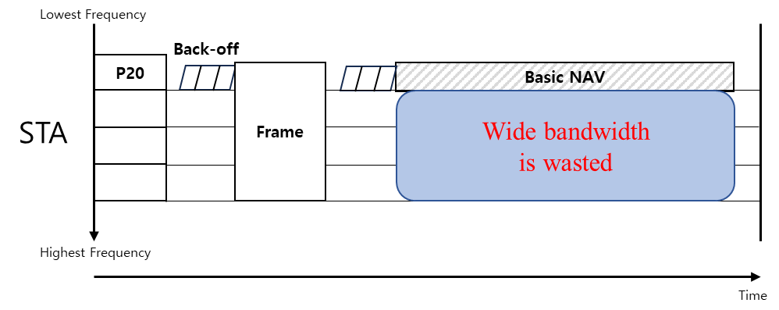
Recap: Wide Bandwidth Channel Access
According to the current spec, primary channel (PCH) is the only channel that can perform Back-off procedure and frame exchange cannot be happened when PCH is BUSY even though the remaining secondary channel(s) (SCH(s)) is IDLE
  This limits the efficient use of the medium in wide bandwidth operation
New mechanism that allows frame exchange even when PCH is BUSY needs to be defined in 802.11bn for the medium efficiency

Slide 4
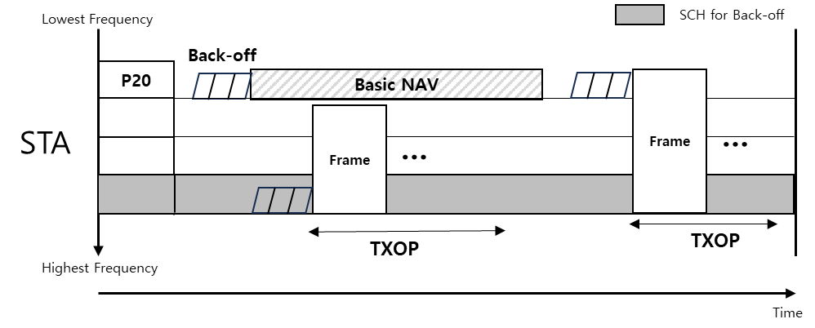
Overview: Secondary Channel Access Operation
When PCH cannot be used due to a Basic NAV, STA may switch to SCH to perform Back-off procedure
  Switching to SCH is allowed only when PCH is BUSY due to the Basic NAV
    Switching to SCH when intra-BSS NAV is set on PCH is not proper since AP and STA are currently exchanging frames
When BC on an SCH for BO reaches to 0, a PPDU including Frame(s) can be transmitted on other IDLE SCH(s) including SCH for BO
After frame exchange is done through Secondary Channel Access (SCA), STA switches to PCH

Slide 5
Prerequisites for Secondary Channel Access Operation
SCA Capabilities
  STAs can have several capabilities for performing SCA
    Capability for supporting SCA
    Capability for Sequential PD/CCA vs. Concurrent PD/CCA
SCA related parameters shall be announced by an AP
  One or more SCH(s) for Back-off
    To perform SCA, at least one SCH for Back-off shall be announced
    Each SCH(s) for Back-off is one of 20MHz channel in its BSS Operating Channel Width
    When having multiple SCHs for Back-off, STA may get more gain in terms of channel access delay or channel access opportunity
  EDCA Parameter Set for SCH(s)
    E.g. EDCA Parameter Set for PCH can be shared with SCH while updating its own CW parameter
    Or, New EDCA Parameter for SCH(s) may be defined reusing the format of existing EDCA Parameter Set
  Medium Synchronization (e.g., Duration, ED threhsold, Maximum number of TXOPs)

Slide 6
SCA Enabled Indication
STA(s) supporting SCA shall perform SCA when Basic NAV is set on PCH may not be appropriate in some cases as follows,
  When all STA(s) associated with AP supporting SCA do not support SCA, AP should not perform SCA
  Some STA(s) supporting SCA may not want to switch to SCH for purpose of power saving
SCA enabled/disabled indication
  AP and STA(s) supporting SCA indicate whether it enables SCA or not
    With this, STA and AP get more chance to align SCH for Back-off
  When AP indicates SCA indication to be disabled,
    STA(s) does not switch to SCH for performing SCA
  When AP indicates SCA indication to be enabled,
    STA(s) may indicate to be enabled or disabled according to STA(s) intention
      In case of all associated STA(s) indicates SCA indication to be disabled or does not support SCA, AP should not switch to SCH

Slide 7
Synchronization Issues
Synchronization issues should be considered
  Medium synchronization: When AP or STA switches to SCH for Back-off, it would lose the medium synchronization
  Timing issue: AP and STA may have different view on PCH
    E.g., AP is performing Back-off on the SCH(s) due to Basic NAV set on PCH while STA is still on PCH
Solution
  To deal with issues above, we can design similar to medium access recovery procedure in 11be [3]
    Timer countdown starts after STA switches to SCH
    While the timer is running, STA can perform EDCA using baseline with some restrictions
    Considering PCH of OBSS may be overlapped with SCH for Back-off, AP needs to carefully consider the ED threshold
    Frame exchange shall be initiated with short control frame (e.g., RTS frame)
      To check whether the recepient STA is ready for frame exchage
      Subtype of control frame is TBD
    Maximum number of TXOPs that STA is allowed to attempt to initiate frame exchange can be announced by AP

Slide 8
Different Channel Switch Time / TXOP on SCH
Different channel switch time between AP and STA(s) should be considered
  When AP or STA switches to SCH to perform SCA, frame exchange may not be successful due to different channel switch time between AP and STA(s)
    E.g., STA that has done switching transmits frame to the STA has not switched yet
  To address the issue above, AP and STA need to indicate their channel switch time
    Channel switch time from PCH to SCH, vice versa
  TX STA need to consider channel switch time of RX STA when transmitting frame
TXOP on SCH should be end before the Basic NAV timer expires
  When Basic NAV timer expires, legacy STA(s) may get chance to transmit frame through PCH
  If frame exchange through SCA cannot be done before the Basic NAV timer expires, STA should not perform SCA
  When considering channel switch time, TXOP on SCH should be end before Basic NAV end time – channel switch time (From SCH to PCH)

Slide 9
Conclusion
In this contribution, we’ve shared some thoughts to achieve secondary channel access in 11bn in terms of
  Prerequisites for Secondary Channel Access Operation
    SCA Capability
    AP Announcement for SCA Related Parameters
  Technical Issues and Solutions
    Medium Synchronization/Timing issue
    Different Channel Switch Time
    TXOP on SCH

Slide 10
Reference
[1] 23/1112r0, Thoughts on Secondary Channel Access
[2] 23/034r1, Non-primary Channel Utilization
[3] 20/1009r10, Blindness issue for non-STR operations-followup

Slide 11
Straw Poll 1
Do you support to define a Secondary Channel Access (SCA) which allows transmission without including primary channel in 11bn?

Slide 12
Straw Poll 2
Do you agree that an AP supporting Secondary Channel Access announces at least one secondary channel that performs EDCA
  The secondary channel is one of 20MHz channel in its BSS Operating Channel Width
  More than one secondary channel that performs EDCA is TBD
  Detailed signaling is TBD

Slide 13
Straw Poll 3
Do you agree that STA(s) supporting Secondary Channel Access indicates its channel switch time that is required when STA(s) switches from primary channel to secondary channel
  How to indicate is TBD

Slide 14
Straw Poll 4
Do you agree that STA(s) supporting Secondary Channel Access indicates its channel switch time that is required when STA(s) switches from secondary channel to primary channel
  How to indicate is TBD

Slide 15
Straw Poll 5
Do you agree that TXOP on secondary channel shall end before the Basic NAV timer on primary channel expires

Slide 16
Straw Poll 6
Do you agree that a STA which performs EDCA on secondary channel shall complete switching to primary channel before the Basic NAV timer on primary channel expires

Slide 17
Straw Poll 7
Do you agree that STA(s) supporting Secondary Channel Access initiates frame exchange with control frame when it performs EDCA on secondary channel
  Subtype of control frame is TBD

Slide 18
Straw Poll 8
Which options do you prefer for EDCA Parameter Set on secondary channel in 11bn?
  Option 1: MU EDCA Parameter Set
  Option 2: Same EDCA Parameter Set used in primary channel
  Option 3: New EDCA Parameter Set
  Option 4: Abstain
  Option 5: None of above
  This is for information gathering

Slide 19
Straw Poll 9
Do you agree that STA(s) supporting Secondary Channel Access shall switch to secondary channel when Basic NAV is set on primary channel under TBD condition(s)

