Slide 1
Seamless Roaming in 11bn
Date: 2024-01-17
Authors:
Name | Affiliation | Address | Phone | Email
Yelin Yoon | LG Electronics | 19, Yangjae-daero 11gil, Seocho-gu, Seoul 137-130, Korea |  | yl.yoon@lge.com
Insun Jang
 |  |  |  | insun.jang@lge.com
Jinsoo Choi
 |  |  |  | js.choi@lge.com
Sunhee Baek |  |  |  | sunhee.baek@lge.com
Geonhwan Kim |  |  |  | geonhwan.kim@lge.com
Dongju Cha |  |  |  | dongju.cha@lge.com
Eunsung Park |  |  |  | esung.park@lge.com
Dongguk Lim |  |  |  | dongguk.lim@lge.com
Jinyoung Chun |  |  |  | jiny.chun@lge.com
Insik Jung |  |  |  | insik0618.jung@lge.com
HanGyu Cho |  |  |  | hg.cho@lge.com
Sanggook Kim |  | 10225 Willow Creek Rd, San Diego, CA, USA |  | sanggook.kim@lge.com

Slide 2
Abstract
Seamless mobility, a feature outlined in UHR PAR, requires a mechanism that ensures reliable connectivity and quality of experience for mobile users [1]
In this presentation, we introduce a seamless roaming framework to address these requirements

Slide 3
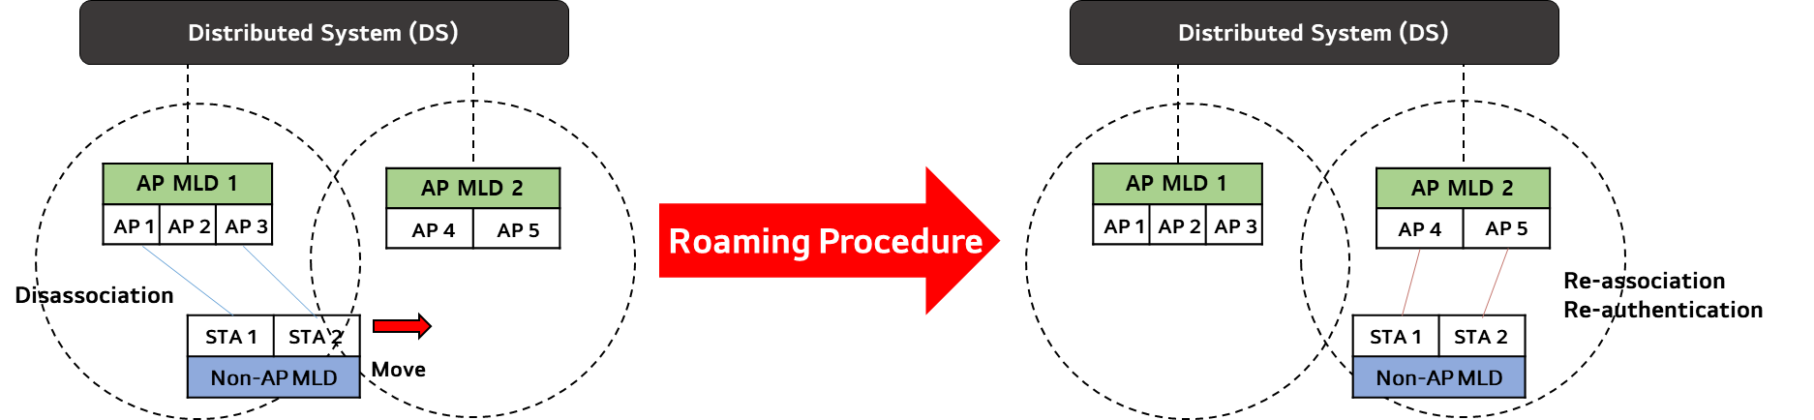
Motivation (1/2)
Current roaming mechanisms, including Fast BSS Transition, fall short in providing seamless roaming
  Despite its attempts to expedite the process, re-authentication and re-association process lead to significant time delays.
  Additionally, the data discontinuity experienced during disassociation and re-association with the target AP further aggravates these delays.

Slide 4
Motivation (2/2)
We need a new framework to achieve “Ultra High Reliability (UHR)” which allows the non-AP STAs to roam without re-association, re-authentication, and data discontinuity.
This framework should address the challenges posed by current methods by implementing key features:
  Data Continuity: Ensuring Seamless data transfer and facilitating the exchange of data between the serving AP MLD and the target AP MLD
  Efficient Frame Exchanges: Minimizing the delays caused by frame exchanges during re-authentication and re-association processes
  Preserving the Multi-Link Setup
  Context Agreement Maintenance: Sharing necessary information, such as contexts and agreements, between the AP MLDs
  Legacy support: Ensuring compatibility with legacy systems and devices

Slide 5
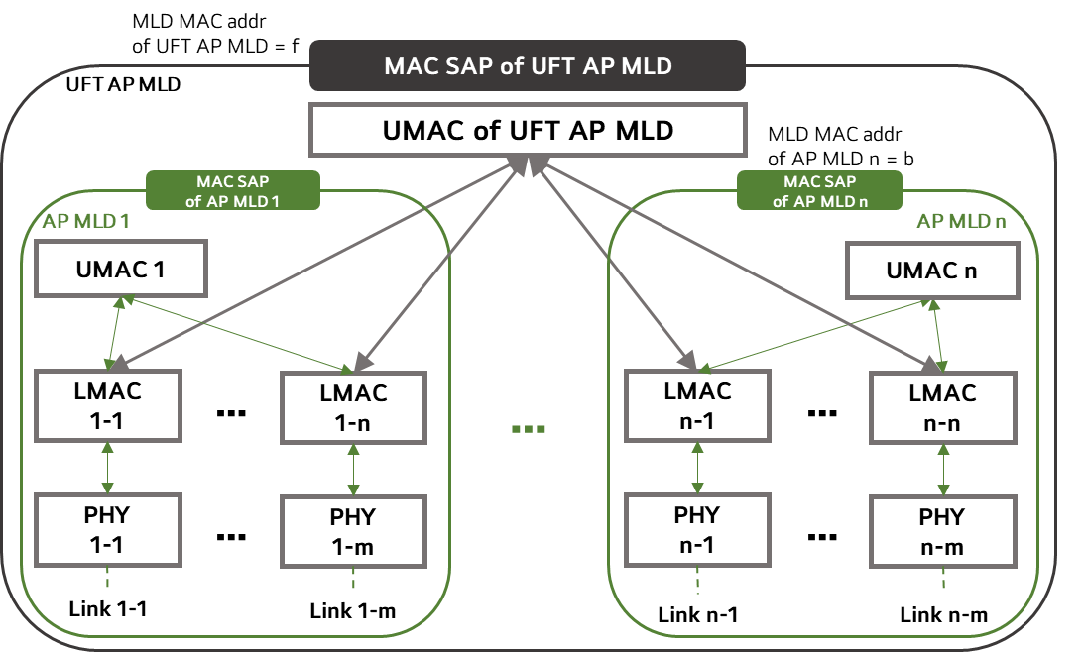
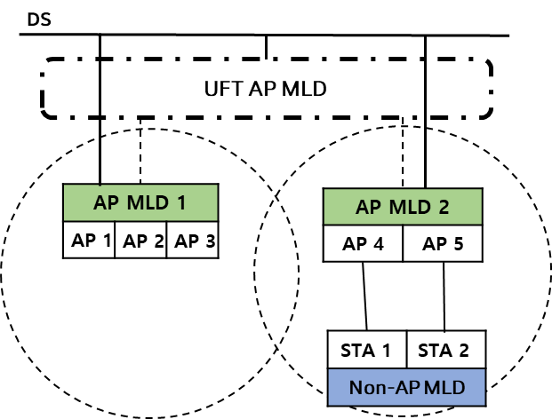
Roaming Architecture
We want to use the MLD based architecture to enable roaming
  The APs that support seamless roaming are affiliated with the Ultra Fast BSS Transition (UFT) AP MLD
    The UFT AP MLD has its own MAC SAP
    The UFT AP MLD has its unique MLD MAC address and it shall be announced in management frames
    ( e.g. beacon as in 11be)
  The UMAC of the UFT AP MLD manages the UMAC functions of the AP MLDs, including:
    multi-link – setup, authentication, reconfiguration, Block Ack agreement, Security Key, SN, PN, etc.
  There are no architectural changes in the AP MLDs for a legacy support
  An UHR non-AP MLD, designed to enable seamless roaming, can identify the UFT AP MLD
Notes:
Green box 가 있어야 하는 이유에 대해 답안 정리
이 architecture 안에서는 어떻게 할 수 있고 그게 아니라면 어떻게 하는지에 대한 overview 가 필요할 듯

Slide 6
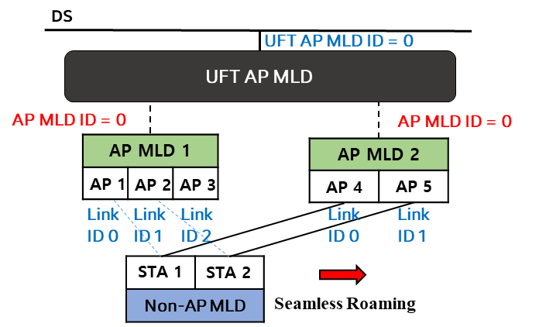
Identification
When a non-AP STA is roaming to other APs, we need a method to identify the APs
  IDs will be used to identify the APs and will be announced before roaming
Through IDs, a non-AP STA can check whether a specific AP is affiliated with the same UFT AP MLD with which the current AP is affiliated.
  We can assign an UFT AP MLD ID to the UFT AP MLD.
    The UFT AP MLD ID needs to be announced by affiliated APs (e.g. Through RNR)
  Instead of assigning the UFT AP MLD ID, we may just indicate whether the announced APs are affiliated with the same UFT AP MLD
Within the same UFT AP MLD, the non-AP STA should be able to identify the AP MLD as well. However, the current AP MLD ID cannot be used in the roaming due to the following reasons
  Assigning an AP MLD ID to another AP MLD necessitates co-location. It cannot assign the AP MLD ID to the non-collocated AP MLD.
  The AP MLD ID of the current AP is always set to 0. This
  might lead to confusion, especially when a non-AP MLD
  is connected to multiple APs affiliated with different
  AP MLDs

Slide 7
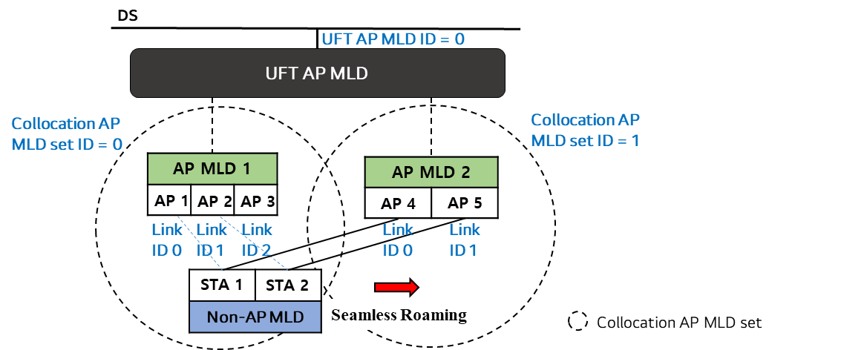
Identification - Collocated AP MLD Set
Our goal is to guarantee seamless roaming while moving from one AP to another AP that is physically far apart
We group the AP MLDs that are co-located into a Collocation AP MLD set, and the UFT AP MLD assigns an ID to each set.
  The Collocation AP MLD set contains one ore more AP MLDs
  The non-AP STA only roams to the AP that is affiliated with the AP MLD that is in the different Collocation AP MLD Set.
  The Collocation AP MLD set ID and the link ID are used to identify the AP for roaming

Slide 8
Roaming Procedure Overview
An MLD based architecture allows the non-AP STA to roam between the APs using reconfiguration frames
  It streamlines the roaming steps
  It reduces the roaming time
  It ensures the data continuity
Before a non-AP MLD roams to another AP MLD, the UFT AP MLD can provide some information.
  The UFT AP MLD announces the information of the affiliated APs to the non-AP STA (e.g. via Beacon or Probe Request/Response frames)
    Whether the AP supports Seamless Roaming
    Whether the AP is in a different Collocation AP MLD Set
  The UFT AP MLD may provide a list of recommended APs
    The non-AP STA can request for the recommendation (e.g. Reconfiguration Notify frame, BTM) based on the information of APs obtained during announcement
    The UFT AP MLD may send without any request from the non-AP STA (e.g. Reconfiguration frame, BTM)
  How these information will be signaled is TBD

Slide 9
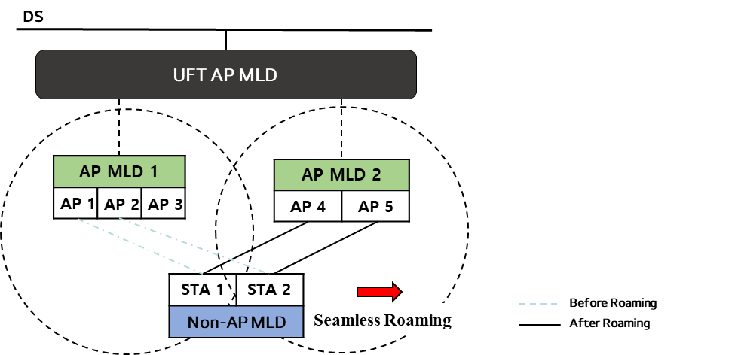
Roaming Procedure – During Roaming (1/2)
During roaming, both AP MLD and non-AP MLD maintain the Multi-Link Setup using a Reconfiguration process
The roaming triggering procedure involves:
  The non-AP MLD or UFT AP MLD selects the target AP MLD for roaming and sends a Reconfiguration Request frame
  Upon accepting the roaming request, the UFT AP MLD or the non-AP MLD responds with a Reconfiguration Response frame

Slide 10
Roaming Procedure – During Roaming (2/2)
*New link: the link between the target AP MLD and the non-AP MLD
*Old link: The link between the serving AP MLD and the non-AP MLD
The Reconfiguration frame includes two methods of link transition[4]:
    Link add then delete (preferred) - A *new link is added, and subsequently, the *old link is deleted
    The non-AP MLD establishes a new link with the target AP MLD first
    Once the new data path is operational, data from the DS is transferred to the target AP MLD
    The link connected to the serving AP MLD is then deleted
    During roaming, at least one link must be maintained between the UFT AP MLD and non-AP MLD
    Requirement: This method requires non-AP MLD support for dual connectivity.
    Link switch - Delete then add at once: The old link and the new link are deleted and added simultaneously
    The UFT AP MLD/non-AP MLD announces the link it intends to delete and add in a single frame
    A timer is set for link deletion while data is shared via the newly added link
    Upon the timer expiration, roaming concludes
    Requirement: If the new link operates on a different channel, the AP MLD may need to notify the remaining time for the channel switch.
    NOTE - Data continuity cannot be guaranteed in single STA operation.

Slide 11
Ultra Fast BSS Transition (UFT) AP MLD
  An AP MLD that meets the following requirements:
    AP MLDs that are in the same ESS are affiliated with the UFT AP MLD
    Both AP MLDs that are part of the same collocated AP MLD set, as well as those in different collocated AP MLD sets, are affiliated with the UFT AP MLD
    The UFT AP MLD supports a seamless transition between AP MLDs that are not in the same collocated AP MLD set

Slide 12
Conclusion
In this contribution, we introduce the UFT AP MLD, a novel solution enabling seamless roaming among its affiliated APs.
  Our proposal includes an analysis of the UFT AP MLD’s architecture and the configuration of AP MLD IDs
  We have also introduced terminology associated with the UFT AP MLD
Additionally, we have outlined a roaming process utilizing the Reconfiguration.
  This process includes the establishment of a recommended AP list and two methods of link transition, ensuring efficient and seamless connectivity during roaming

Slide 13
Straw Poll #1
Do you agree with the definition of the collocated AP MLD set:
  The set containing one or more AP MLDs that are co-located
    NOTE - The collocated set is in the same ESS
    NOTE - The method to identify the set is TBD

Slide 14
Straw Poll #2
Do you agree with the definition of an Ultra Fast BSS Transition (UFT) AP MLD:
  An AP MLD with which APs that are co-located or not are affiliated
  APs that are not collocated are affiliated with EHT AP MLDs included in different collocated AP MLD sets
  NOTE – The exact name can be changed

Slide 15
Straw Poll #3
Do you support the following:
  An UFT AP MLD has its own singly identifying MLD MAC Address

Slide 16
Straw Poll #4
Do you support the following:
  AP affiliated with the UFT AP MLD shall announce the UFT AP MLD‘s MLD MAC Address via Beacon and Probe Response frames
  Signaling is TBD

Slide 17
Straw Poll #5
Do you support to define a method for identifying an UFT AP MLD
  NOTE – Using the method, a non-AP STA affiliated with a non-AP MLD can be aware that the associated AP and a reported AP are affiliated with the same UFT AP MLD

Slide 18
Straw Poll #6
Do you support the following:
  The UFT AP MLD assigns an unique ID to each collocated AP MLD set

Slide 19
Straw Poll #7
Do you support that:
  A non-AP MLD which can identify an UFT AP MLD may initiate a multi-link setup with the UFT AP MLD

Slide 20
Straw Poll #8
Do you support the following:
  Seamless Roaming Multi-Link reconfiguration refers to a set of procedures through which a non-AP STA can add and delete one or more links connected with AP MLDs

Slide 21
References
[1] 11-23/480r3 UHR draft proposed PAR
[2] 11-23/279r0 Considerations on Seamless Roaming
[3] 11-23/1090r0 Seamless Roaming Follow-up
[4] 11-23/1908r0 Seamless Roaming Procedure

Slide 22
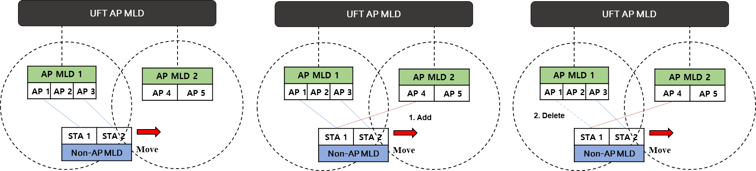
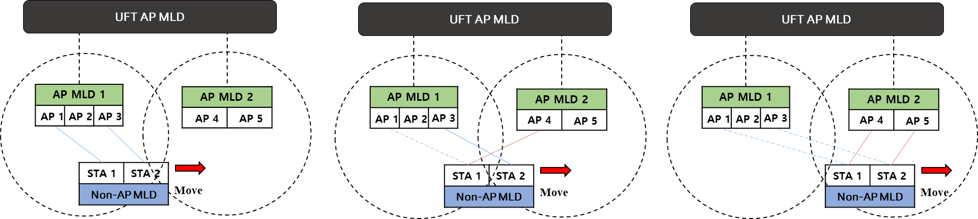
Appendix
Link Add then Delete
Link Switch

Slide 23
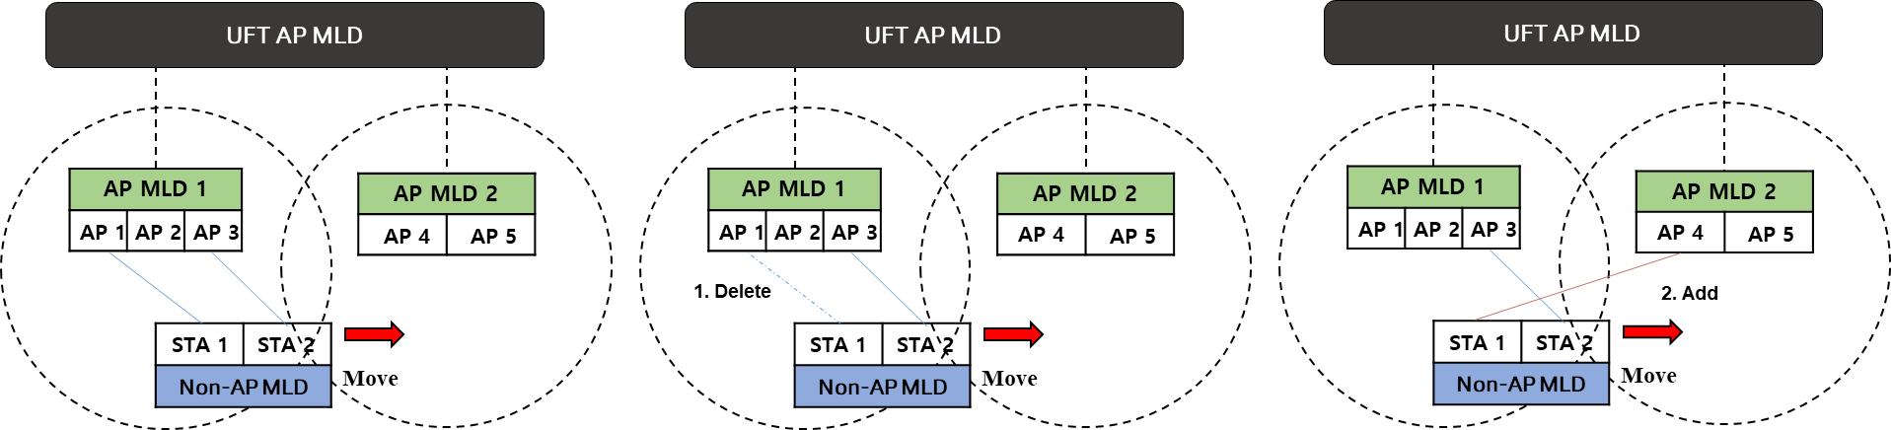
Appendix
Link Delete then Add

