Slide 1
Seamless Roaming in 11bn
Date: 2023-11-13
Authors:
Name | Affiliation | Address | Phone | Email
Yelin Yoon | LG Electronics | 19, Yangjae-daero 11gil, Seocho-gu, Seoul 137-130, Korea |  | insun.jang@lge.com
Insun Jang
 |  |  |  | js.choi@lge.com
Jinsoo Choi
 |  |  |  | sunhee.baek@lge.com
Sunhee Baek |  |  |  | yl.yoon@lge.com
Geonhwan Kim |  |  |  | geonhwan.kim@lge.com
Dongju Cha |  |  |  | dongju.cha@lge.com
Eunsung Park |  |  |  | esung.park@lge.com
Dongguk Lim |  |  |  | dongguk.lim@lge.com
Jinyoung Chun |  |  |  | jiny.chun@lge.com
Insik Jung |  |  |  | insik0618.jung@lge.com
HanGyu Cho |  |  |  | hg.cho@lge.com
Sanggook Kim |  | 10225 Willow Creek Rd, San Diego, CA, USA |  | sanggook.kim@lge.com

Slide 2
Abstract
Seamless mobility, a feature outlined in UHR PAR [5], requires a mechanism that ensures reliable connectivity and quality of experience for mobile users [5]
In this presentation, we introduce a seamless roaming framework to address these requirements

Slide 3
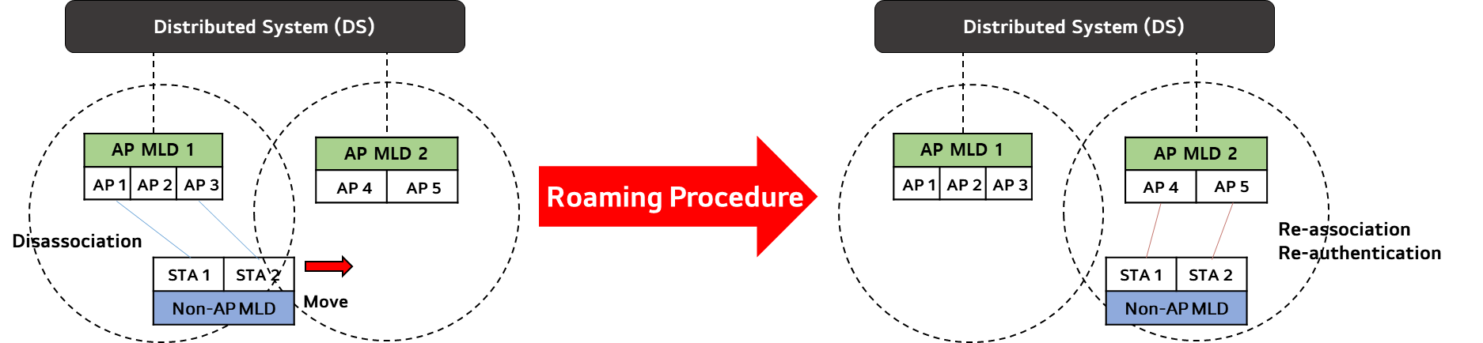
Motivation
Current roaming mechanisms, including Fast BSS Transition, fall short in providing seamless roaming
  Despite its attempts to expedite the process, re-authentication and re-association process lead to significant time delays which is taking too much time.
  Additionally, the data discontinuity experienced during disassociation and re-association with the target AP further aggravates these delays

Slide 4
Motivation
We need a new framework to achieve “Ultra High Reliability (UHR)”. This framework should address the challenges posed by current methods by implementing key features:
  Data Continuity: Ensuring Seamless data transfer and facilitating the exchange of data between the serving AP MLD and the target AP MLD
  Efficient Frame Exchanges: Minimizing the delays caused by frame exchanges during re-authentication and re-association processes
  Preserving the Multi-Link Setup
  Context Agreement Maintenance: Sharing necessary information, such as contexts and agreements, between the AP MLDs
  Legacy support: Ensuring compatibility with legacy systems and devices

Slide 5
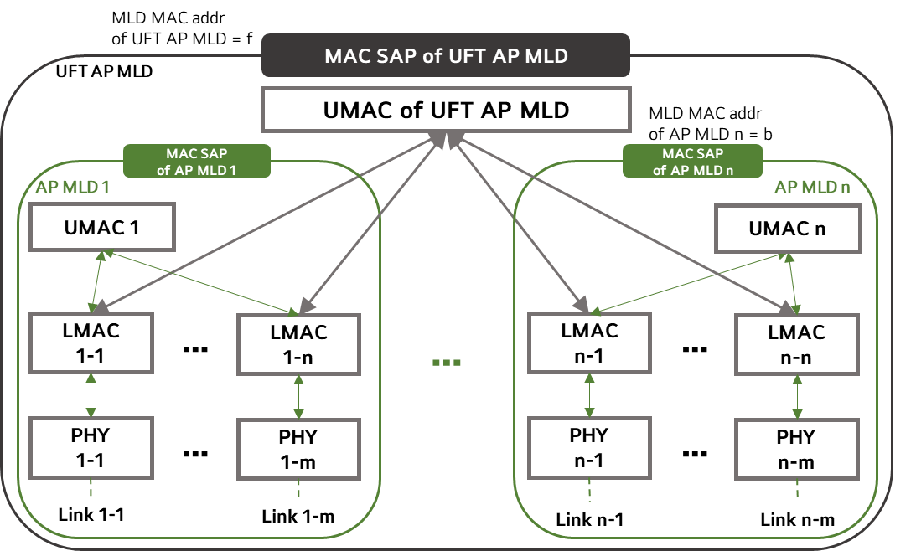
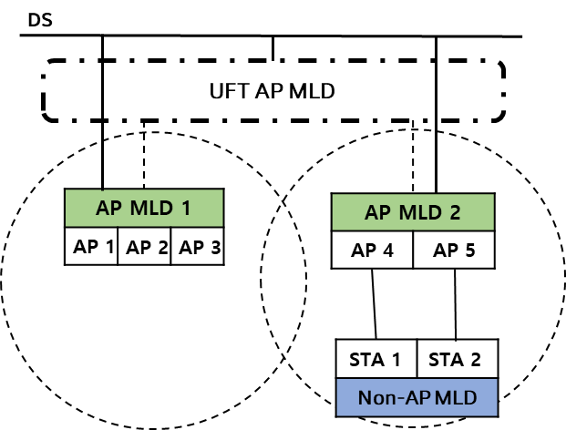
Roaming Architecture
Utilizing MLD may meet all the previously discussed requirements
  The UFT (Ultra Fast BSS Transition) AP MLD affiliates the APs that support seamless roaming between AP MLDs which are not co-located
    The UFT AP MLD has its own MAC SAP
    The UFT AP MLD has its unique MLD MAC address
  The UMAC of the UFT AP MLD manages the UMAC functions of the AP MLDs, including:
    multi-link – setup, authentication, reconfiguration, Block Ack agreement, Security Key, SN, PN, etc.
  There are no architectural changes in the AP MLDs for a legacy support
  An UHR non-AP MLD, designed to enable seamless roaming, can identify the UFT AP MLD
The UHR non-AP MLD can seamless roam between the APs affiliated with the same UFT AP MLD
  If the UHR non-AP MLD is roaming between the AP MLDs affiliated with the different UFT AP MLDs, it needs to use the Fast BSS Transition

Slide 6
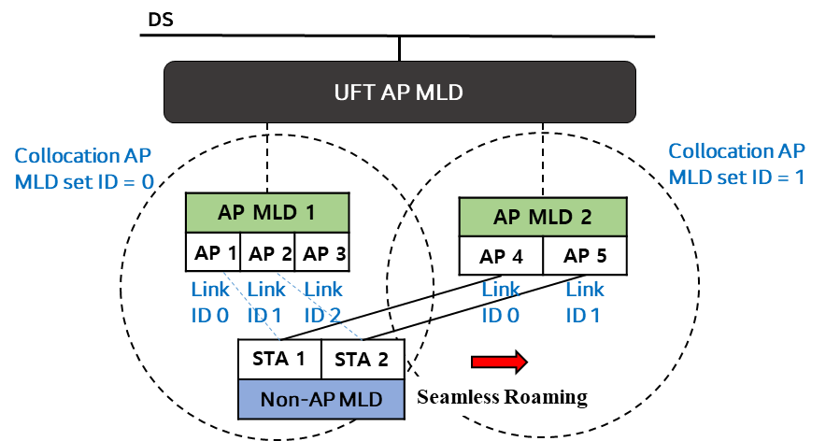
Roaming Architecture - Identification
As roaming is done between the APs affiliated with the same UFT AP MLD, we need to establish a method for identifying whether a specific AP belongs to the same UFT AP MLD
We also need a new approach to assigning AP MLD IDs
  According to the 11be specification, assigning an AP MLD ID to another AP MLD necessitates co-location. It cannot assign the AP MLD ID to the non-collocated AP MLD. We want a roaming between non-collocated APs.
  The current method of setting AP MLD IDs relative to other AP MLDs might lead to confusion, especially when a non-AP MLD is connected to multiple AP MLDs, especially when a non-AP MLD is connected to multiple AP MLDs
  => To address these challenges, the UFT AP MLD can assign absolute AP MLD IDs to the affiliated AP MLDs, ensuring clear identification

Slide 7
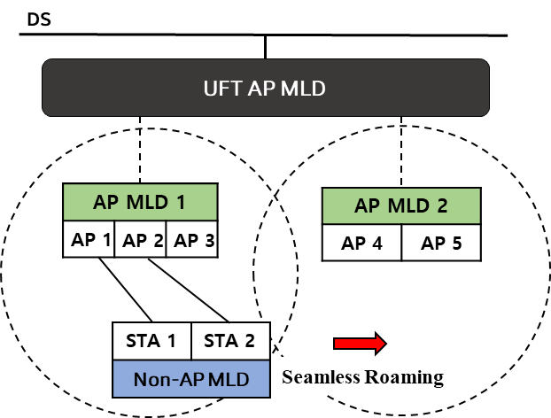
Roaming Procedure – Before Roaming
Before a non-AP MLD roams to another AP MLD, the UFT AP MLD needs to announce all its affiliated APs, and specific information exchange is necessary, including:
  Seamless Roaming Support
    Verification of seamless roaming support by both AP MLD and non-AP MLD
  AP MLD recommendation list
    The non-AP MLD can ask for the recommended list of APs to the UFT AP MLD via ML Probe Request frame. The list is then obtained from the UFT AP MLD using an ML Probe Response frame
    An AP has the flexibility to send a Reconfiguration Notify frame without any preceding requesting frame. Alternatively, it can initiate the process by sending a Reconfiguration Notify Request frame to solicit the Reconfiguration Notify frame from the corresponding entities.
      This list may also specify the order of the links based on preference or priority

Slide 8
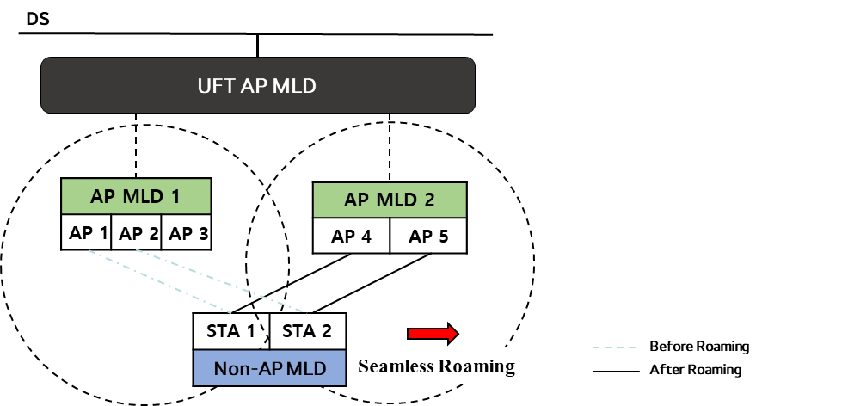
Roaming Procedure – During Roaming (1/3)
During roaming, both AP MLD and non-AP MLD maintain the Multi-Link Setup using a Reconfiguration process
The roaming triggering procedure involves:
  The non-AP MLD or UFT AP MLD selects the target AP MLD for roaming and sends a Reconfiguration Request frame
  Upon accepting the roaming request, the UFT AP MLD or the non-AP MLD response with a Reconfiguration Response frame

Slide 9
Roaming Procedure – During Roaming (2/3)
The Reconfiguration frame includes three methods of link transition:
  Add then Delete: A *new link is added, and subsequently, the *old link is deleted
  Link Switch: The old link and the new link are deleted and added simultaneously
  Delete then Add: The old link is deleted first, followed by the addition of the new link
Link add then delete
  The non-AP MLD establishes a new link with the target AP MLD first
  Once the new data path is operational, data from the DS is transferred to the target AP MLD
  The link connected to the serving AP MLD is then deleted
  During roaming, at least one link must be maintained between the UFT AP MLD and non-AP MLD
  Requirement: This method requires non-AP MLD support for dual connectivity.
*New link: the link between the target AP MLD and the non-AP MLD
*Old link: The link between the serving AP MLD and the non-AP MLD

Slide 10
Roaming Procedure – During Roaming (3/3)
Link switch (Delete then add at once)
  The UFT AP MLD/non-AP MLD announces the link it intends to delete and add in a single frame
  A timer is set for link deletion while data is shared via the newly added link
  Upon timer expiration, roaming concludes
  Requirement: If the new link operates on a different channel, the AP MLD may need to notify the remaining time for the channel switch.
  NOTE - Data continuity cannot be guaranteed in single STA operation.
Link delete then add
  The link connected to the AP affiliated with the serving AP MLD is deleted
  Data is shared either by the remaining link or the previously added link
  A new link is added to the target AP MLD
  Requirement: To maintain data continuity, at least one link must remain connected to the AP affiliated with the serving AP MLD.
  NOTE - Data continuity cannot be guaranteed in single STA operation.

Slide 11
Roaming Procedure – After Roaming
After the non-AP MLD has successfully roamed to the target AP MLD, several considerations come into play:
  Ensure that the Multi-Link Setup is preserved with the link that is newly added, ensuring network stability and reliability
  Following roaming, reset all links to the TID default mode. Each link should undergo TID negotiation process
  Once the link is added, enable immediate frame exchange between the non-AP MLD and the AP MLD, ensuring seamless data transmission and connectivity

Slide 12
Terminology
Ultra Fast BSS Transition (UFT) AP MLD
  An AP MLD that meets the following requirements:
    AP MLDs that are in the same ESS are affiliated with the UFT AP MLD
    Both AP MLDs that are part of the same collocated AP MLD set, as well as those in different collocated AP MLD sets, are affiliated with the UFT AP MLD
    The UFT AP MLD supports a seamless transition between AP MLDs that are not in the same collocated AP MLD set

Slide 13
Conclusion
In this contribution, we introduce the UFT AP MLD, a novel solution enabling seamless roaming among its affiliated APs.
  Our proposal includes an analysis of the UFT AP MLD’s architecture and the configuration of AP MLD IDs
  We have also introduced terminology associated with the UFT AP MLD
Additionally, We have outlined a roaming process utilizing the Reconfiguration. This process includes the establishment of a recommended AP list and three methods of link transition, ensuring efficient and seamless connectivity during roaming

Slide 14
Straw Poll #1
Do you support a transition mechanism of the non-AP MLD between AP MLDs that are within the same Extended Service Set (ESS) without re-authentication and re-association?

Slide 15
Straw Poll #2
Do you agree with the definition of the collocated AP MLD set:
  The set containing one or more AP MLDs that are co-located
  The collocated set is in the same ESS
  The method to identify the set is TBD
  The AP MLDs that are in different collocated AP MLD set are not collocated

Slide 16
Straw Poll #3
Do you agree with the definition of Ultra Fast BSS Transition (UFT) AP MLD:
  An AP MLD with which APs, affiliated with non-UFT AP MLDs and can be grouped into two or more collocated sets, are affiliated
  NOTE – The exact name can be changed

Slide 17
Straw Poll #4
Do you support the following:
  A UFT AP MLD has its own singly identifying MLD MAC Address

Slide 18
Straw Poll #5
Do you support the following:
  The UFT AP MLD assigns an absolute ID value to the collocated AP MLD set

Slide 19
Straw Poll #6
Do you support that:
  A non-AP MLD which can detect the UFT AP MLD is able to perform a multi-link setup with the UFT AP MLD

Slide 20
Straw Poll #7
Do you agree with:
  The UFT AP MLD shall announce the information of all the affiliated APs affiliated with the UFT AP MLD
    Specific Information TBD

Slide 21
Straw Poll #8
Do you support the following:
  An UFT AP MLD and an non-AP MLD use the Multi-Link reconfiguration to change the link from the serving AP MLD to the target AP MLD

Slide 22
References
[1] 11-23/480r3 UHR draft proposed PAR
[2] 11-23/279r0 Considerations on Seamless Roaming
[3] 11-23/1090r0 Seamless Roaming Follow-up

Slide 23
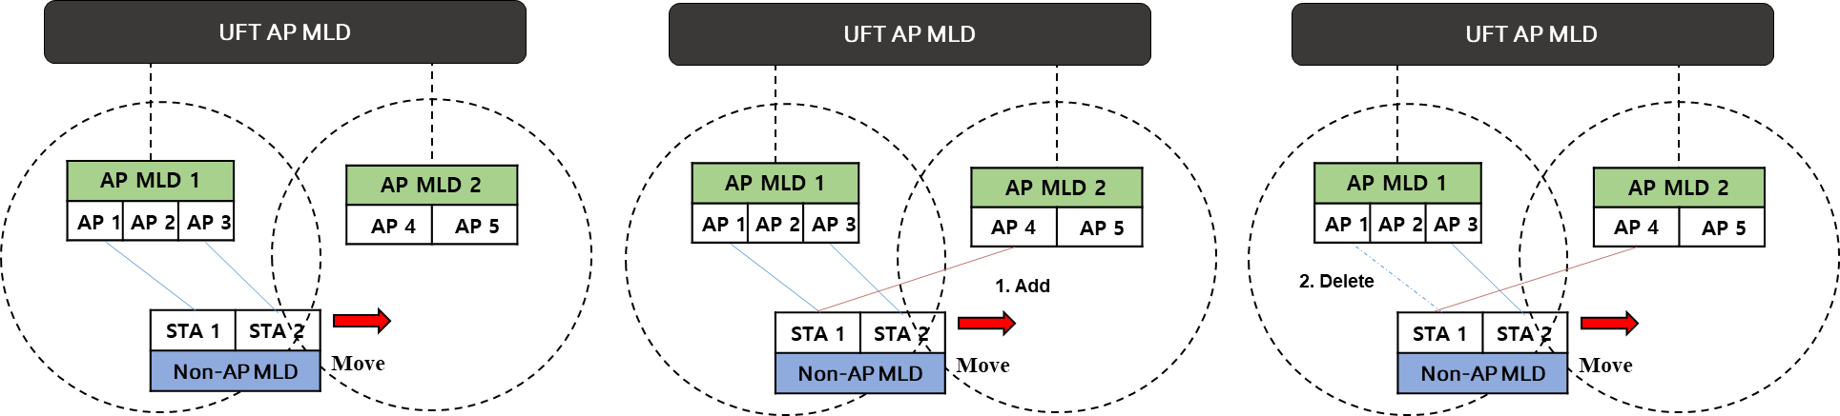
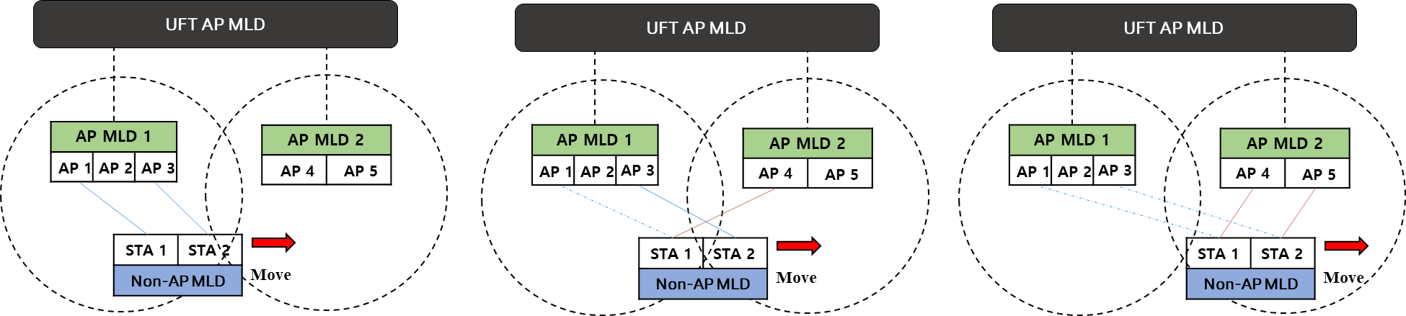
Appendix
Link Add then Delete
Link Switch

Slide 24
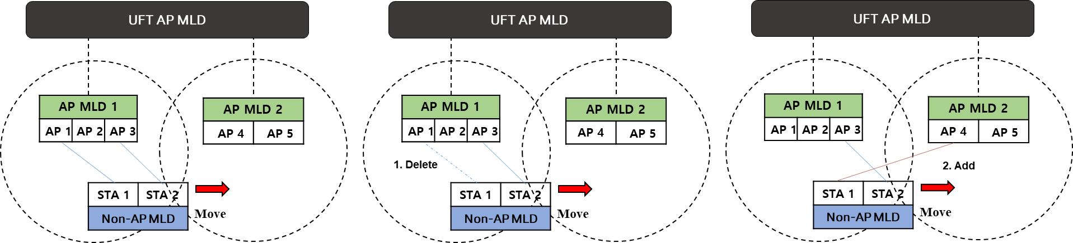
Appendix
Link Delete then Add

