Slide 1
Relay Operation for 11bn
Date: 2023-10-20
Authors:

Slide 2
Introduction
In the document [1], relay is proposed to enhance Rate-vs-Range (RvR) performance for UHR.
Some potential solutions/operations to implement a relay protocol in UHR are discussed in [2-4]
In this presentation, we share some thoughts on the potential relay architecture and related operations.

Slide 3
Recap UHR Relay Design Principle [2]
UHR needs to define relay solutions to
  Improve multi-hop channel access delay
    E.g. TXOP sharing enhancement
  Enhance end-to-end QoS
    E.g. end-to-end BA/ACK protocol
  Simplify relaying protocol
    Reduce relay processing complexity
      E.g. single user relay, simpler relay signaling, no encryption/decryption, reduced relay packet processing delay
    Enable cost-effective designs: non-AP STA/uAP can support relaying
      Much simpler than multi-AP protocol
    BF support: AP → Relay, Relay → STA
rSTA
tSTA
dSTA

Slide 4
Recap Potential Solution:
Lower MAC Relay (Architecture) [2]
Lower MAC Relay provides
  Hop-by-hop block acknowledgement via relay link and the end-to-end security/SN processing
A relay device (rSTA) involves only
  Lower MAC functions
    A-MPDU processing
    Optional Relay BlockAck Scoreboarding, etc.
  Note: It is similar to per-link functions in the EHT ML framework.
End devices (transmitter STA: tSTA, and destination STA: dSTA) involve both
  Upper MAC functions
    security process
    SN generation/reordering
    E2E Block Ack Scoreboarding, etc.
  Lower MAC functions
    A-MPDU processing
    Optional Relay BlockAck Scoreboarding, etc.
  Note: It is similar to MLD functions with upper MAC functions and lower MAC functions in the EHT ML framework.

Slide 5
Relay Architecture (1/2)
If the relay device equips with more than one radio, a possible way is to regard the relay as a non-colocated AP affiliated with the AP MLD, as shown in below figure, referred as rAP (i.e. AP 13).
The rAP communicates with the AP MLD through AP12 and relay STA (referred as rSTA ).
rSTA and rAP are implemented on different channels/bands.
Relay MLD with multiple radios
Relay function
6GHz
rSTA
5GHz
rAP (AP13)@ 6GHz
Wireless backhaul
STA13
MLD common MAC
Non-AP MLD
AP MLD
AP12@5 GHz
STA12
AP11@2.4 GHz
STA11

Slide 6
Relay Architecture (2/2)
If the relay device equips with only one radio, then the sole radio behaviors as both rSTA and rAP. In this case, AP12, rSTA and rAP are implemented on the same channel.
Relay MLD with single radio
Relay function
rSTA
rAP
Wireless backhaul
Relay link@ 5 GHz
Direct link@ 5 GHz
AP12@5 GHz
MLD common MAC
AP MLD
STA12
Non-AP MLD
AP11@2.4 GHz
STA11

Slide 7
Discovery of rAP
The relay MLD indicates it supports the relay operation and other transmission capabilities when initiating the association with the AP MLD.
Once the association is established, the AP MLD can follow the current Multi-link operation to advertise the existence of a rAP as an affiliated AP through the RNR element and the Basic Multi-link element.
Considering the rAP may not transmit the Beacon /Probe Response frame, it should be invisible for the EHT non-AP MLD. Hence,
  Use a new TBTT Info Field Type to advertise the info on the rAP in the RNR element.
  Define a Relay Profile subelement for the Basic Multi-link element to carry the info on the rAP.
To distinguish the rAP from other affiliated AP, a Relay Flag bit may be introduced.

Slide 8
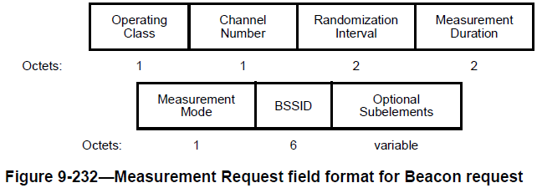
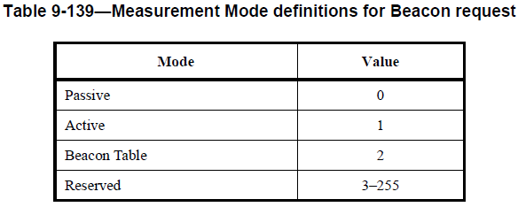
Selection of non-AP MLD
If a non-AP MLD has a good link quality with the rAP, the AP MLD can recommend the UHR non-AP MLD to add a relay link with the rAP by sending Link Reconfiguration Notify frame. Then the UHR non-AP MLD can request to add a relay link with the rAP by exchanging Link Reconfiguration Request/Response frame.
In order to identify whether the UHR non-AP MLD is located near the rAP, the AP MLD can request the non-AP MLD to do the Beacon Request measurement. Since the rAP doesn’t transmit the Beacon/Probe Response frame, we need to define a new Measurement Mode.
  E.g. NDP Request + NDPA + NDP.

Slide 9
Summary
In this contribution, a potential architecture for the relay operation in UHR is discussed.
  Reuse the current Multi-link operation by viewing the relay as a reduced affiliated AP
We also discussed
  The channel measurement between the rAP and the non-AP MLD
    Define a new measurement mode for the Beacon Request measurement.

Slide 10
References
[1] IEEE 802.11-22/1908r1 UHR rate-vs-range enhancement with relay
[2] IEEE 802.11-23/1175r0 UHR Relay Follow-up
[3] IEEE 802.11-23/1138r1 Features to consider for efficient Relay operation
[4] IEEE 802.11-23/1139r0 Relay transmission in UHR

